Slide 2
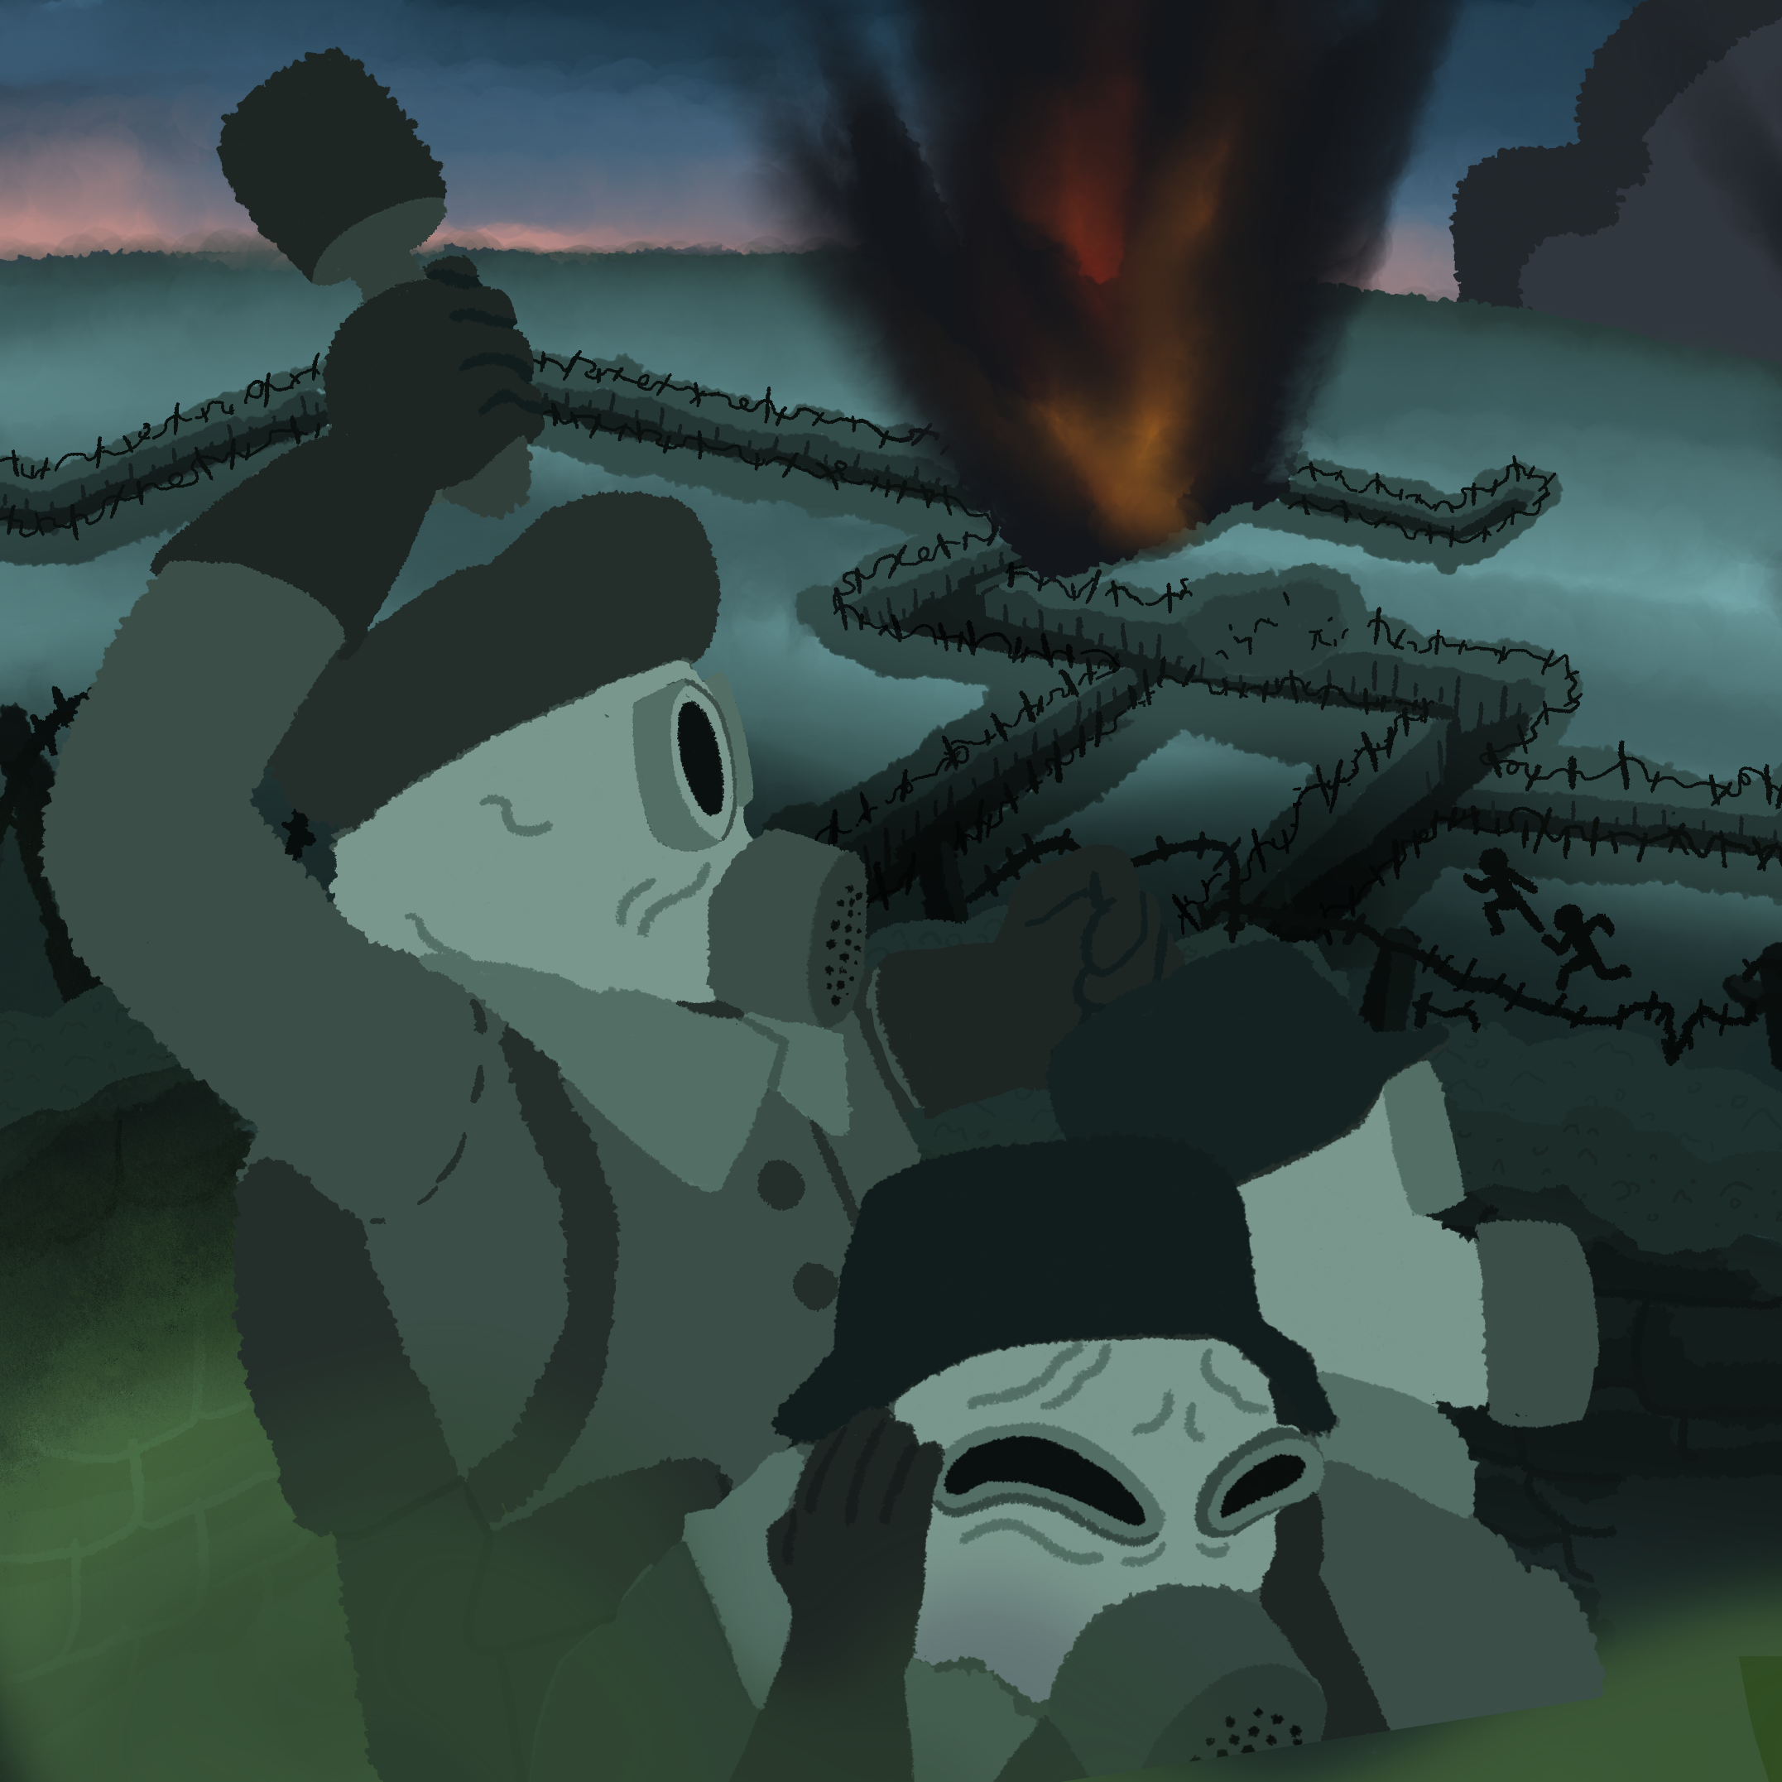
In the Trenches
Trench Warfare in World War I

Slide 3

Inside Out
In the smallest circle, write down everything you can think of about trench warfare.
Notes:
K20 Center. (n.d.) Inside out. Strategies. https://learn.k20center.ou.edu/strategy/93

Slide 4
Essential Question
How was World War I fought?

Slide 5
Learning Objective
Explain how trench warfare affected soldiers in World War I.

Slide 6
Virtual Exhibit
Visit the online exhibit presented by The National WWI Museum and Memorial: https://k20.ou.edu/of
Navigate through the exhibit and listen to the information provided.
Notes:
Google. (n.d.). Trenches of World War I: An Immersive Tour [Interactive activity]. Google Arts & Culture. Retrieved December 17, 2021, from https://artsandculture.google.com/exhibit/IQLS5svcf515Iw

Slide 7
Inside Out
In the middle circle, write down everything you learned about trench warfare from visiting the virtual exhibit.
Notes:
K20 Center. (n.d.) Inside out. Strategies. https://learn.k20center.ou.edu/strategy/93

Slide 8

Why Life of a WWI Soldier in the Trenches SUCKED
Notes:
The Infographics Show. (2020, April 12). Why Life of a WWI Soldier in the Trenches SUCKED [Video]. YouTube. https://youtu.be/iDUqUpNWtl4

Slide 9
Life in the Trenches
How did trench warfare prolong World War I?
How would you describe life in the trenches?

Slide 10
Inside Out
In the last circle, write down everything you learned about trench warfare from the video.
Notes:
K20 Center. (n.d.) Inside out. Strategies. https://learn.k20center.ou.edu/strategy/93

Slide 11
Tic Tac Tell
Trench Food | Mustard Gas | Machine Gun
No Man’s Land | Knife | Gas Mask
Trench | Soldier | Rifle
Notes:
K20 Center. (n.d.b.). Tic tac tell. Strategies. https://learn.k20center.ou.edu/strategy/1920

Slide 12

Exit Ticket
How did trench warfare affect soldiers in World War I?
Notes:
K20 Center. (n.d.). Bell ringers and exit tickets. Strategies. https://learn.k20center.ou.edu/strategy/125

