Slide 2
LBJ Voting Rights
US History or US Government class
Milton Bowens

Slide 3
Essential Question
In the past, how have voting rights been threatened?
Are voting rights threatened today?

Slide 4
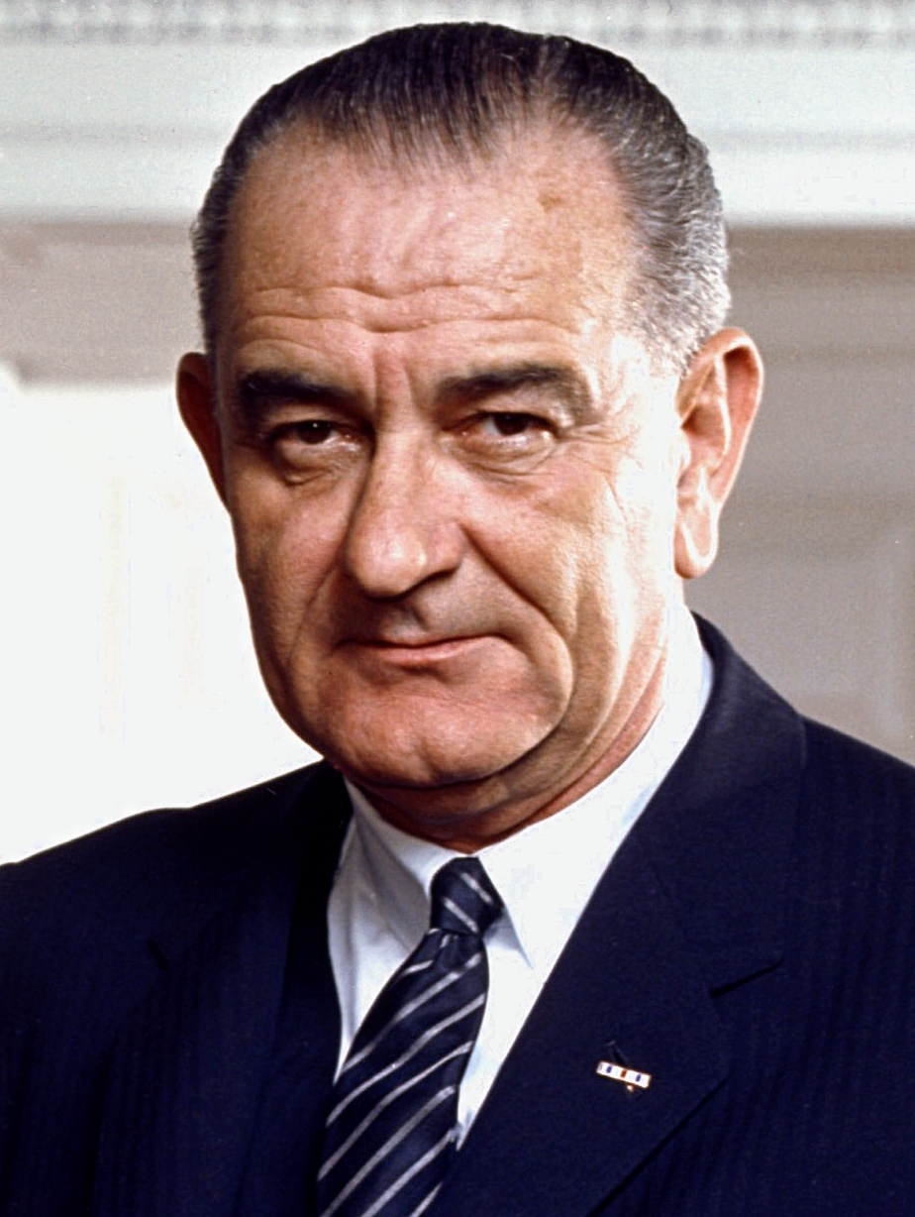
Video
Think about this question during the video:
What illegal barriers to voting was
President Johnson referring to in his speech?
The American Promise speech of 1965 by Pres. Lyndon Johnson
This Photo by Unknown Author is licensed under CC BY-SA

Slide 5
What illegal barriers to voting was President Johnson referring to in his speech?
Write down your answer. Share your
answer with a partner. Discuss with your partner
what President Johnson believes about voting rights.

Slide 6
Jigsaw Reading
Find class members who were assigned a different number and form a group with a one, two, and three.
Number ones- read only first page of speech
Number twos- read second page
Number threes- read third page

Slide 7
CUS and Discuss
Star the main ideas.
Underline supporting details.
Once everyone has read, the group is to look through the document and find any words or phrases they do not understand. They should make a list of these.

Slide 8
3-2-1 Activity
On your notebook paper, write:
3 things I learned from the speech that I did not know
2 questions regarding Johnson’s speech
1 belief about the right to vote

Slide 9
What about now?
Are we still limiting the right to vote for certain individuals?
Are voting rights threatened today?

Slide 10
