Slide 2
A Solidifying Pattern
Surface Area of Prisms and Pyramids

Slide 3
Essential Question
Why would it be useful to find the surface area?

Slide 4
Lesson Objectives
Measure and calculate the surface area of a geometric solid.
Solve real-world and mathematical problems using surface area.
Explain the process of finding the surface area and the meaning of the result.

Slide 5
Painting My Room
What would you need to know if you wanted to paint your room?
Go to Menti.com.
Enter code: <insert code>
Quickly enter as many things as you can.
Notes:
K20 Center. (n.d.). Mentimeter. Tech tools. https://learn.k20center.ou.edu/tech-tool/645
K20 Center. (n.d.). Quick Write. Retrieved from https://learn.k20center.ou.edu/strategy/1127

Slide 6
Scratching the Surface
Work with your group to complete the following:
Measure your chosen solid using centimeters.
Find the surface area of your solid.
Red Groups
Cylinder | Triangular Pyramid
Triangular Prism | Square Pyramid
Blue Groups
Pentagonal Prism | Pentagonal Pyramid
Hexagonal Prism | Hexagonal Pyramid

Slide 7
Check Your Work
Find another person who had the same solid.
Compare results and work. Are your results the same?
If not, work together to get the same result.
Red Groups
Cylinder | Triangular Pyramid
Triangular Prism | Square Pyramid
Blue Groups
Pentagonal Prism | Pentagonal Pyramid
Hexagonal Prism | Hexagonal Pyramid

Slide 8
Prisms vs. Pyramids
Divide into 2 groups:
Those who measured prisms
Those who measured pyramids
Prisms
Cylinder | Pentagonal Prism
Triangular Prism | Hexagonal Prism
Pyramids
Triangular Pyramid | Pentagonal Pyramid
Square Pyramid | Hexagonal Pyramid

Slide 9
Prisms vs. Pyramids
Work in your new group to see if you can generalize and write the formula for the surface area of your type of solid.
When finding the surface area, is there something that all prisms or all pyramids have in common?
Use words to write your formula for the surface area of your solid.
Does your formula hold true for everyone in your group?
Record your thinking at the bottom of your Scratching the Surface handout.

Slide 10
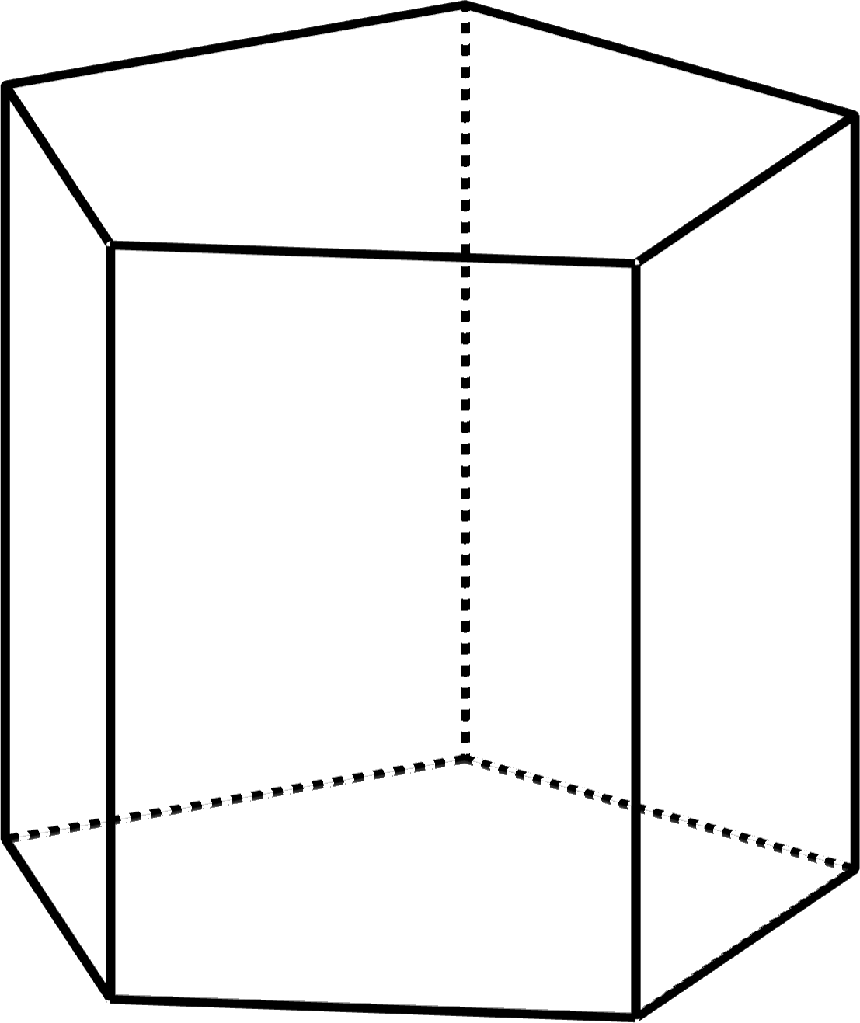
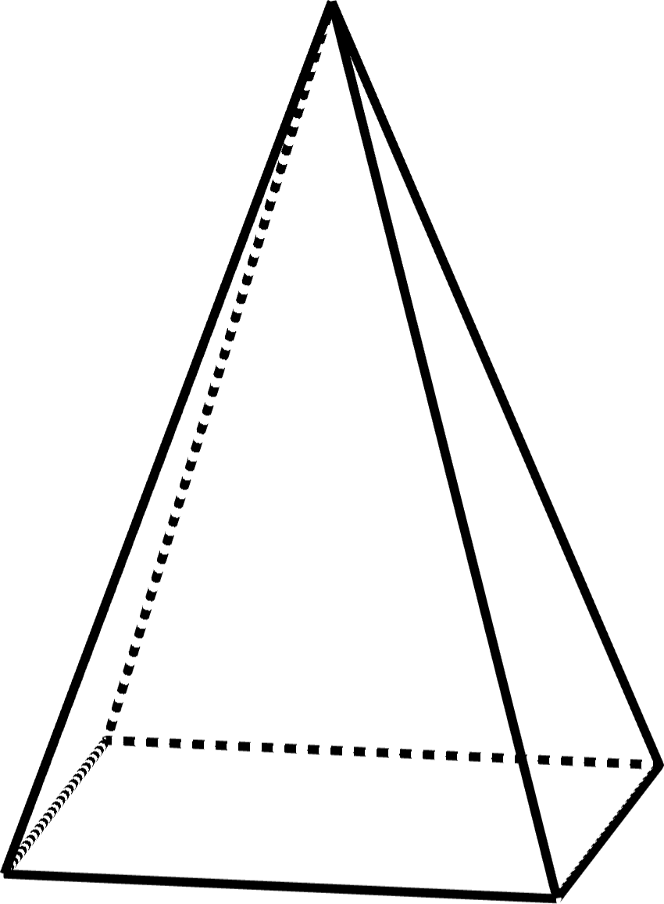
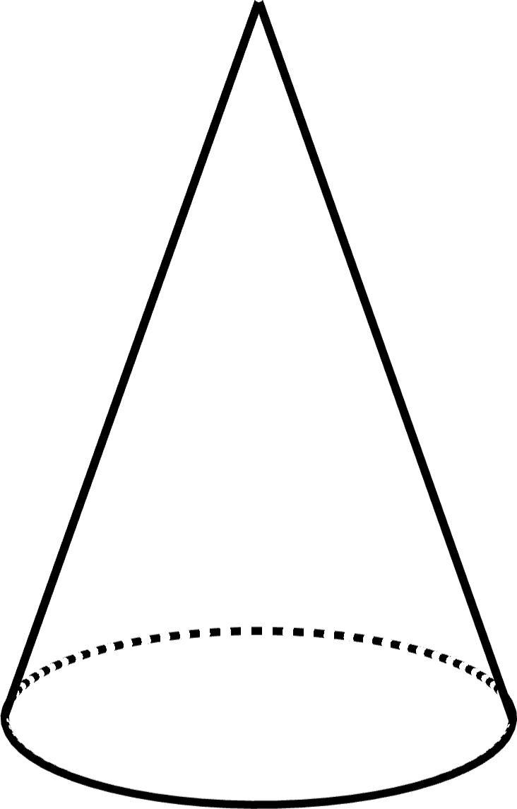
Surface Area of Prisms and Pyramids
Surface Area of a Prism:
Surface Area of a Regular Pyramid:

Slide 11
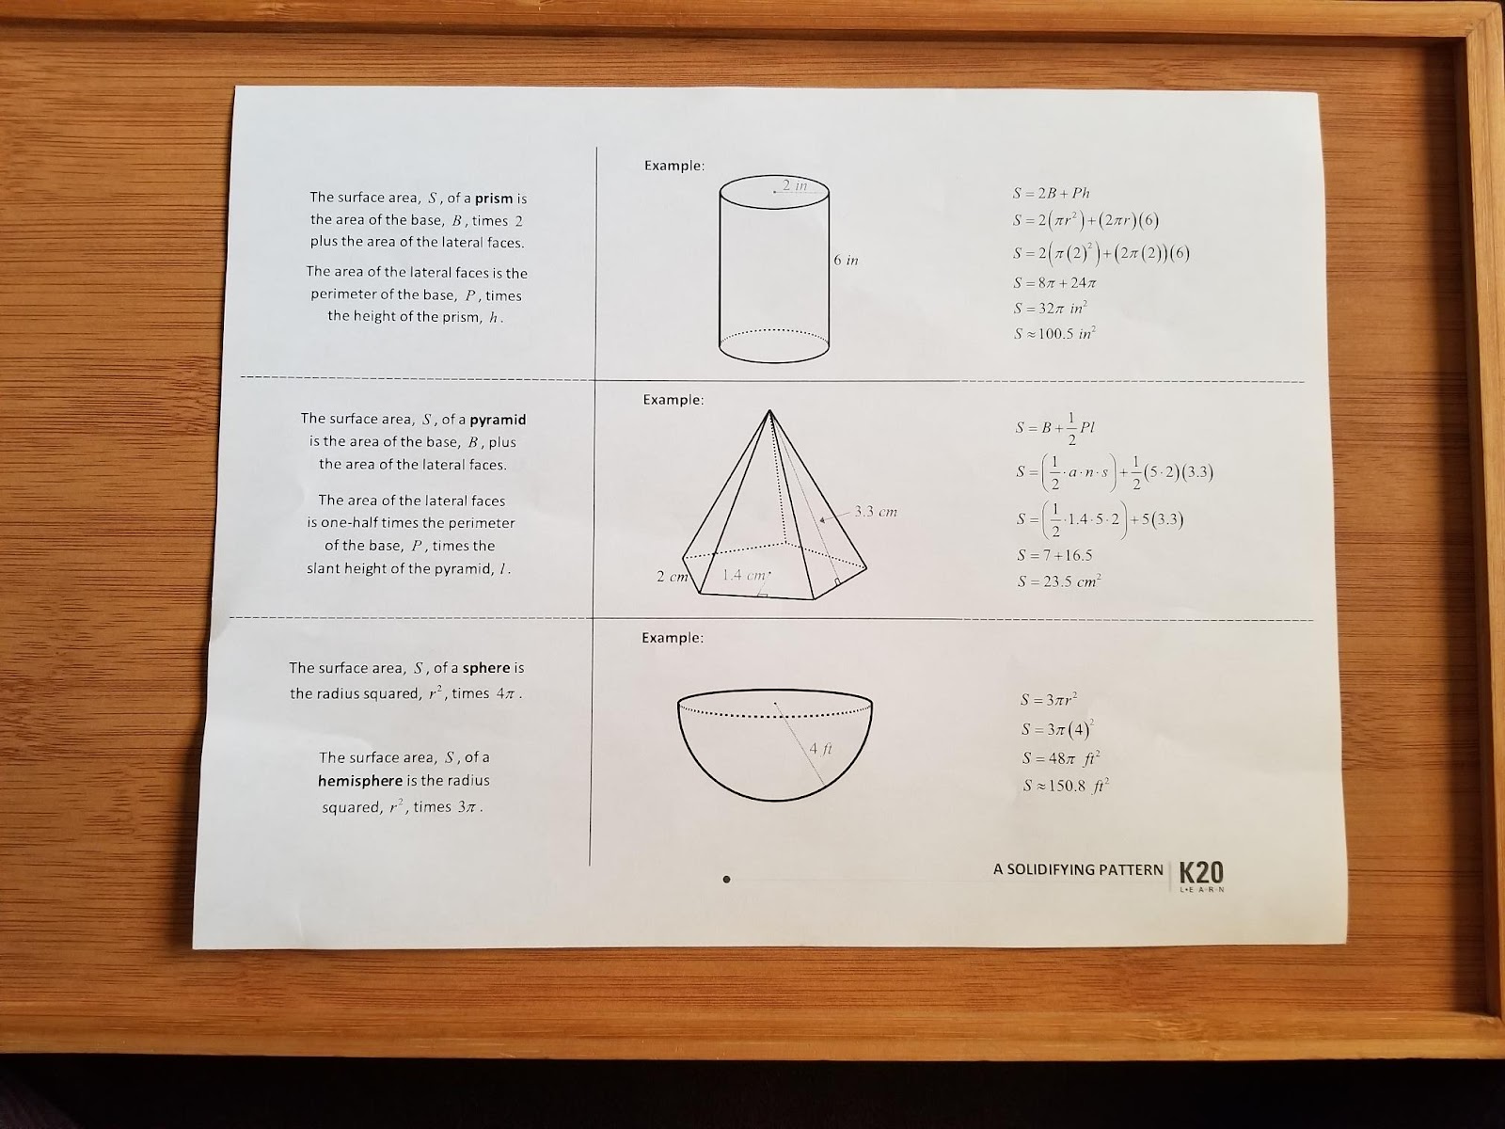
Foldable
Step 1
Place the paper such that the K20 LEARN logo (in the bottom-right corner) is facing you.

Slide 12
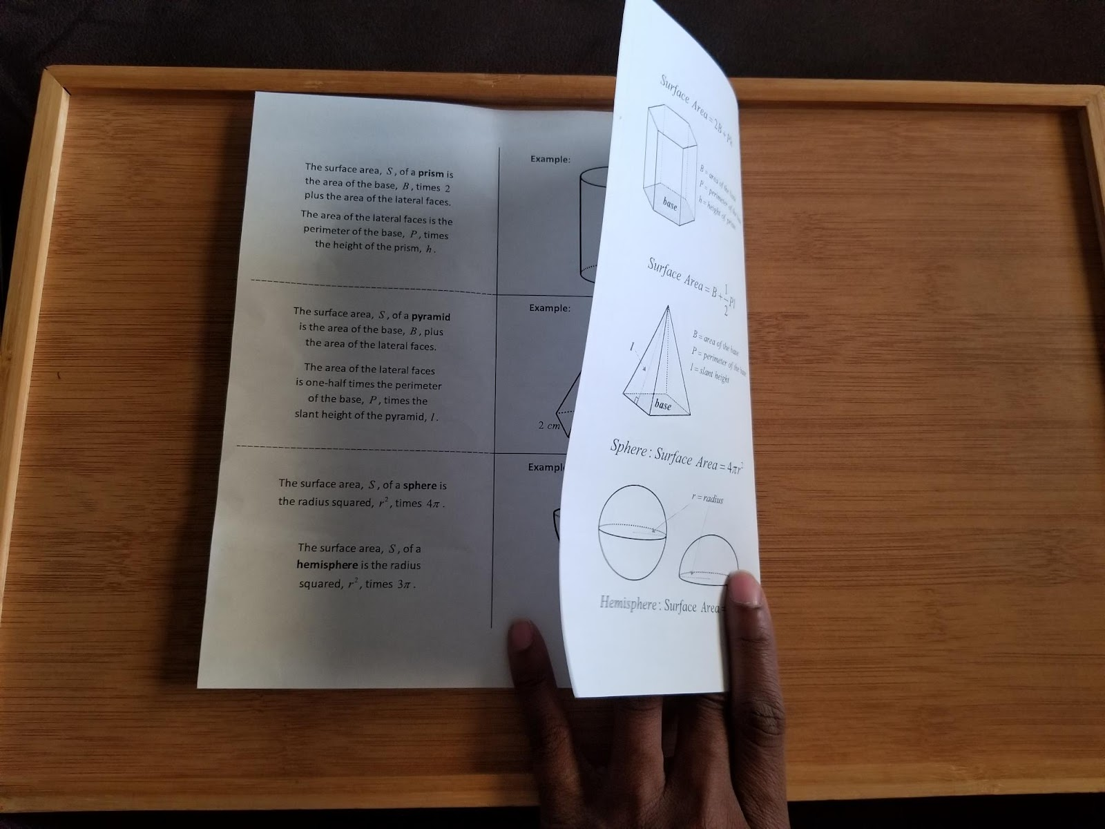
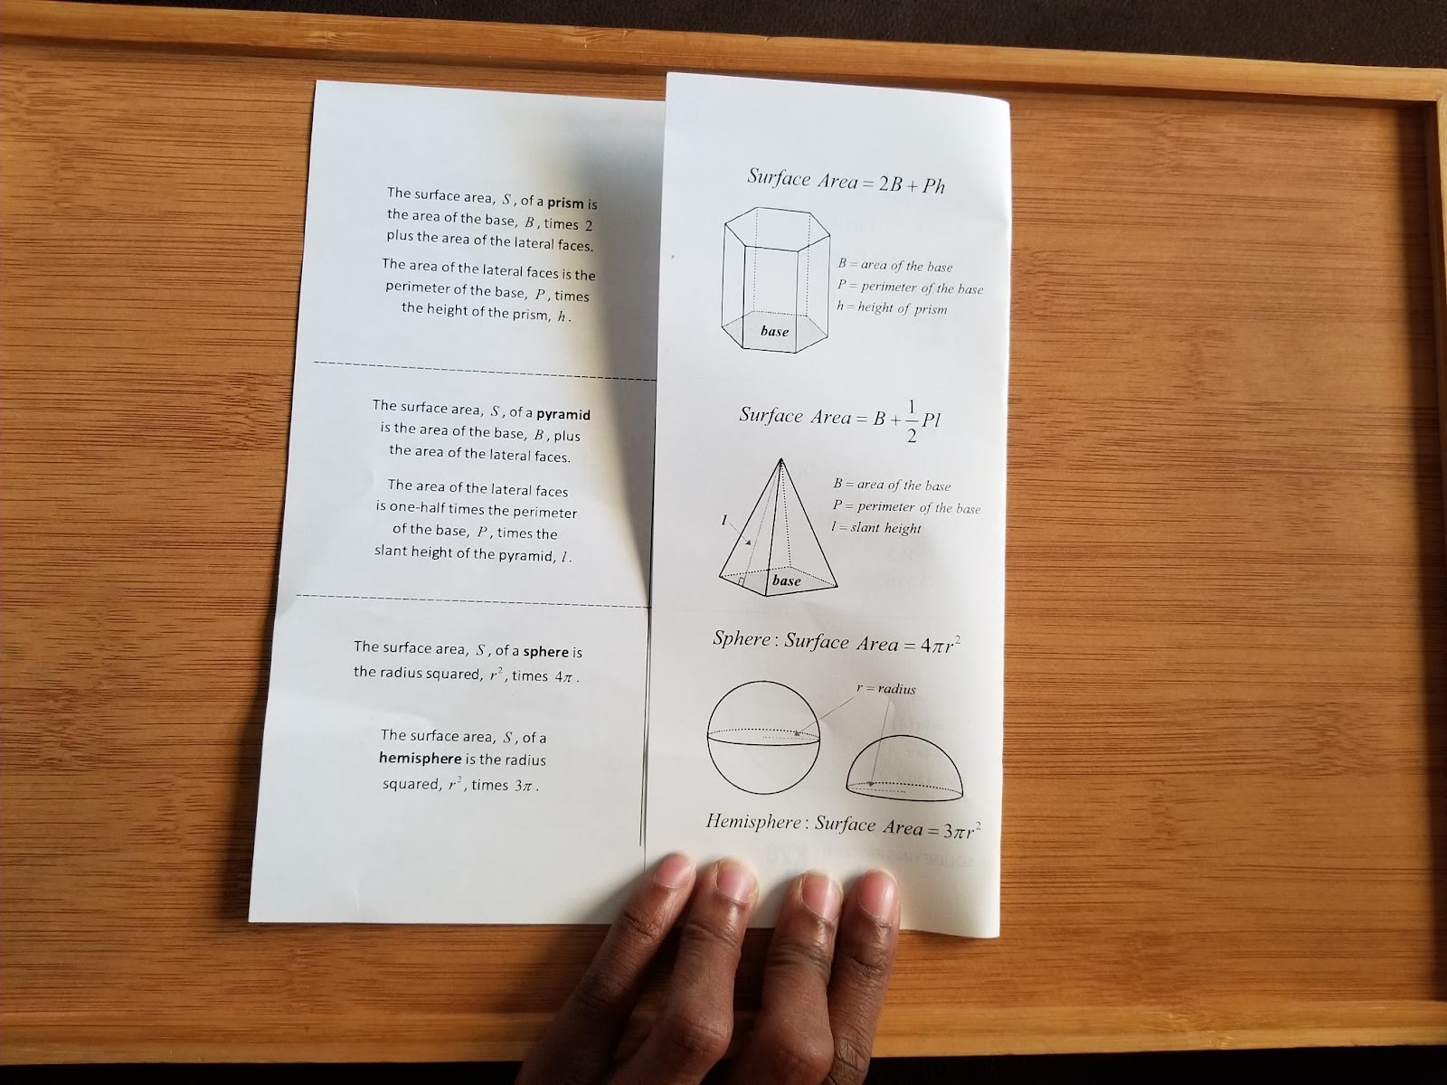
Foldable
Take the right edge of the paper and match it up with the vertical line. Fold the paper.
Step 2
Step 3

Slide 13
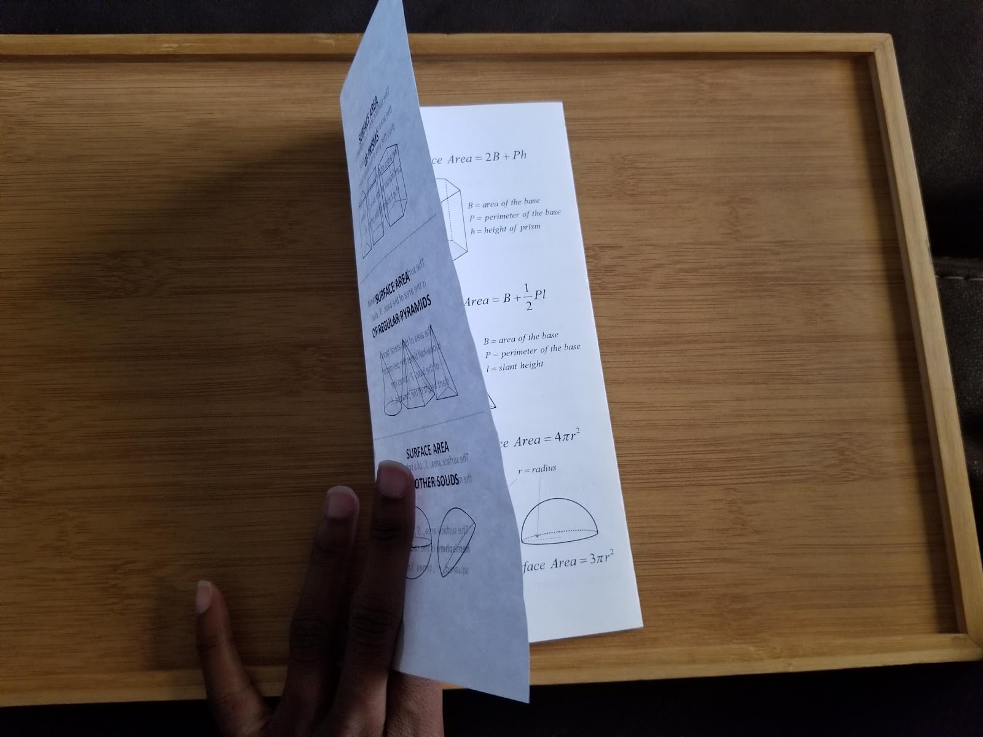
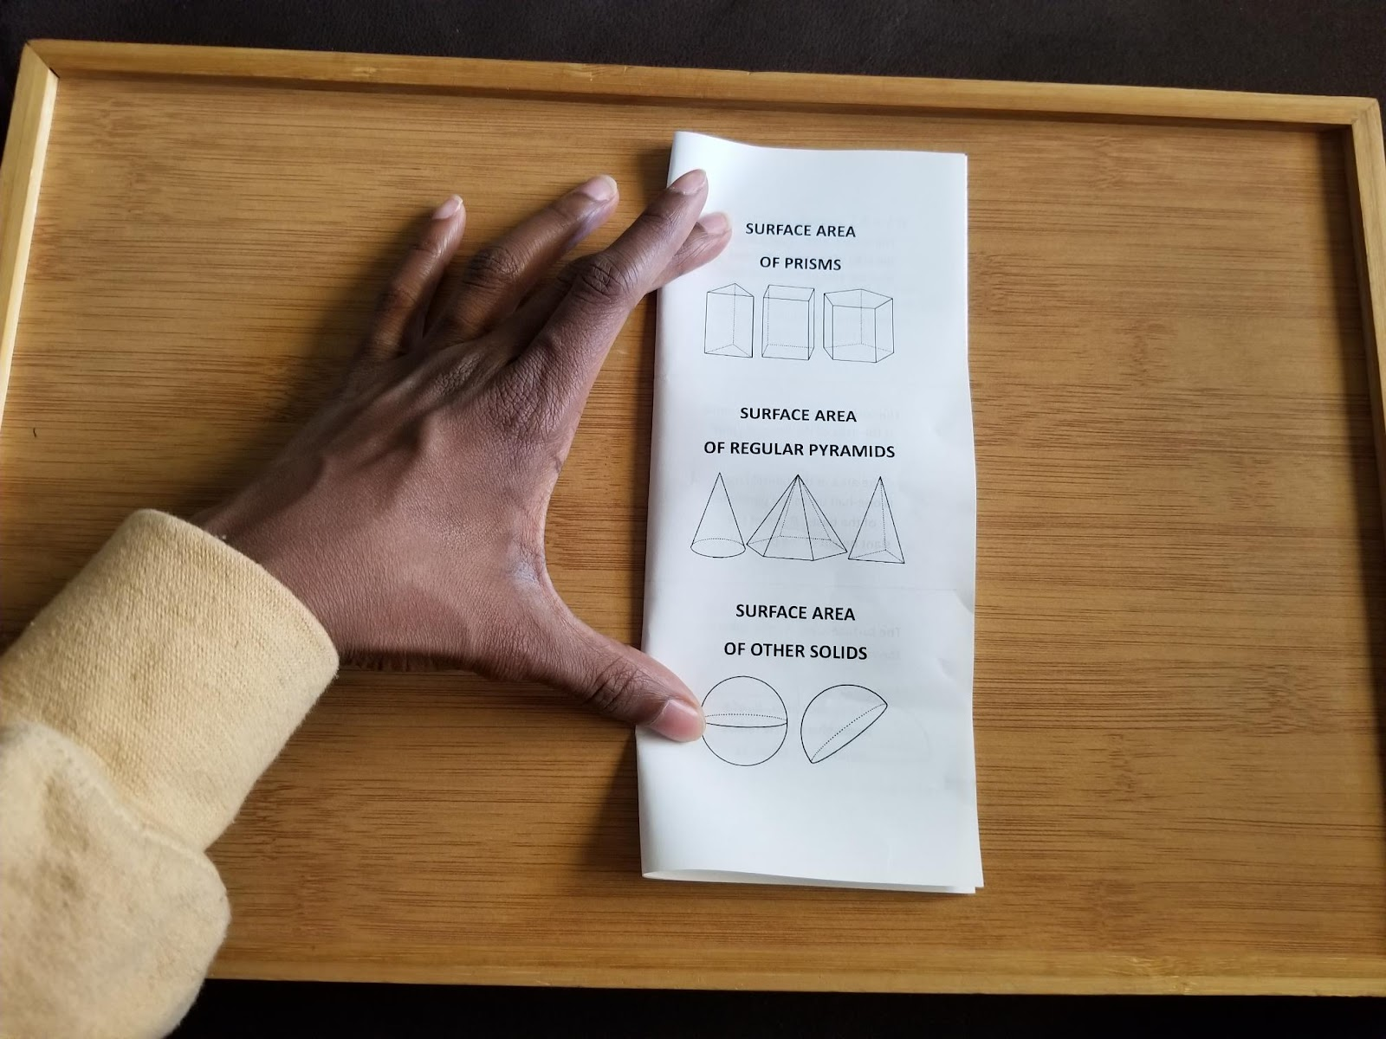
Foldable
Take the left edge of the paper and match it up with the previous fold. Fold.
Step 4
Step 5

Slide 14
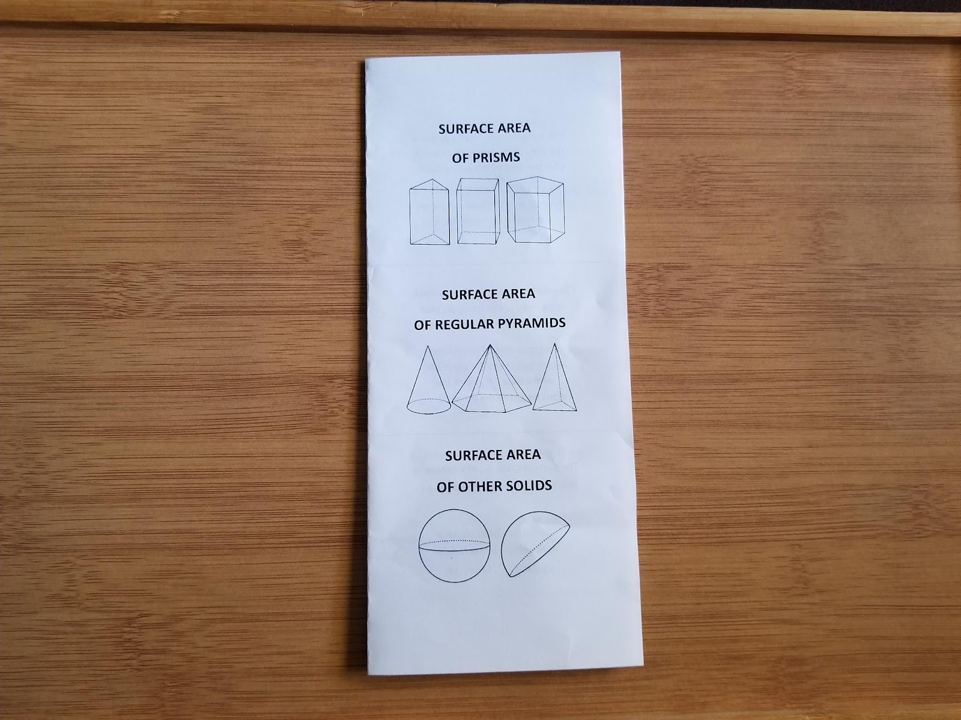
Foldable
Check Point
You should now have your paper folded into thirds, like a brochure.

Slide 15
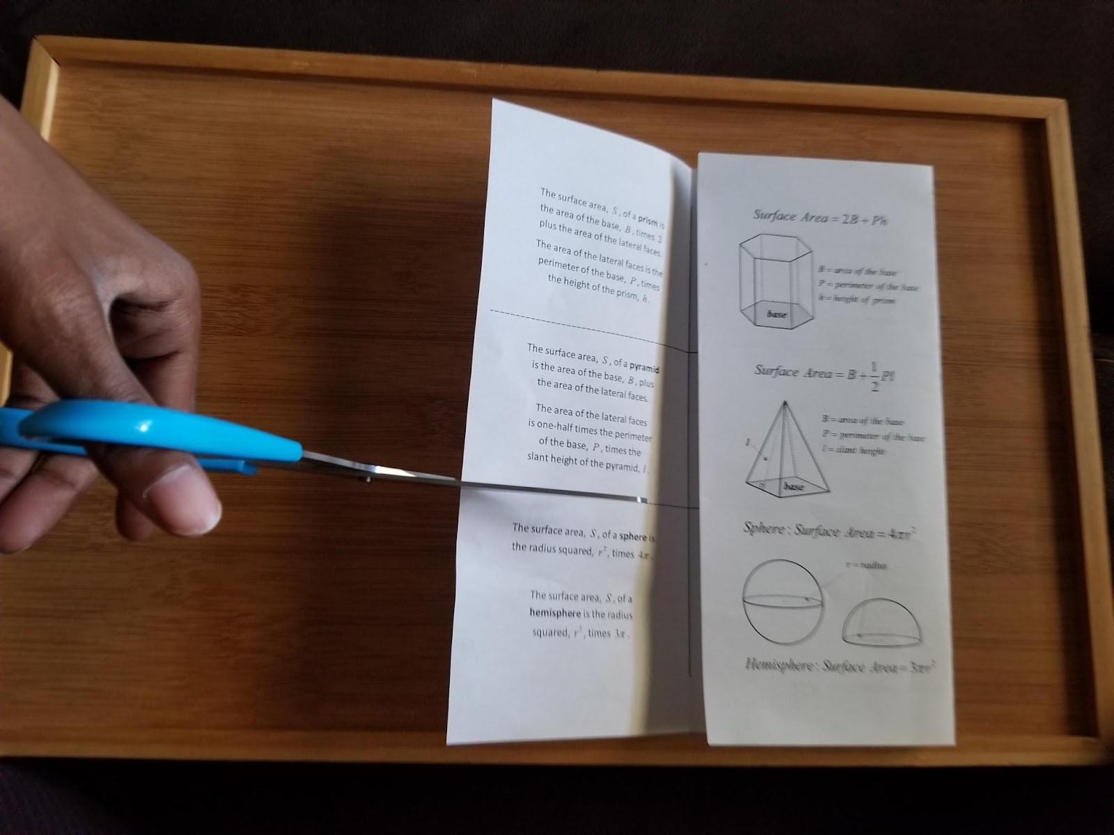
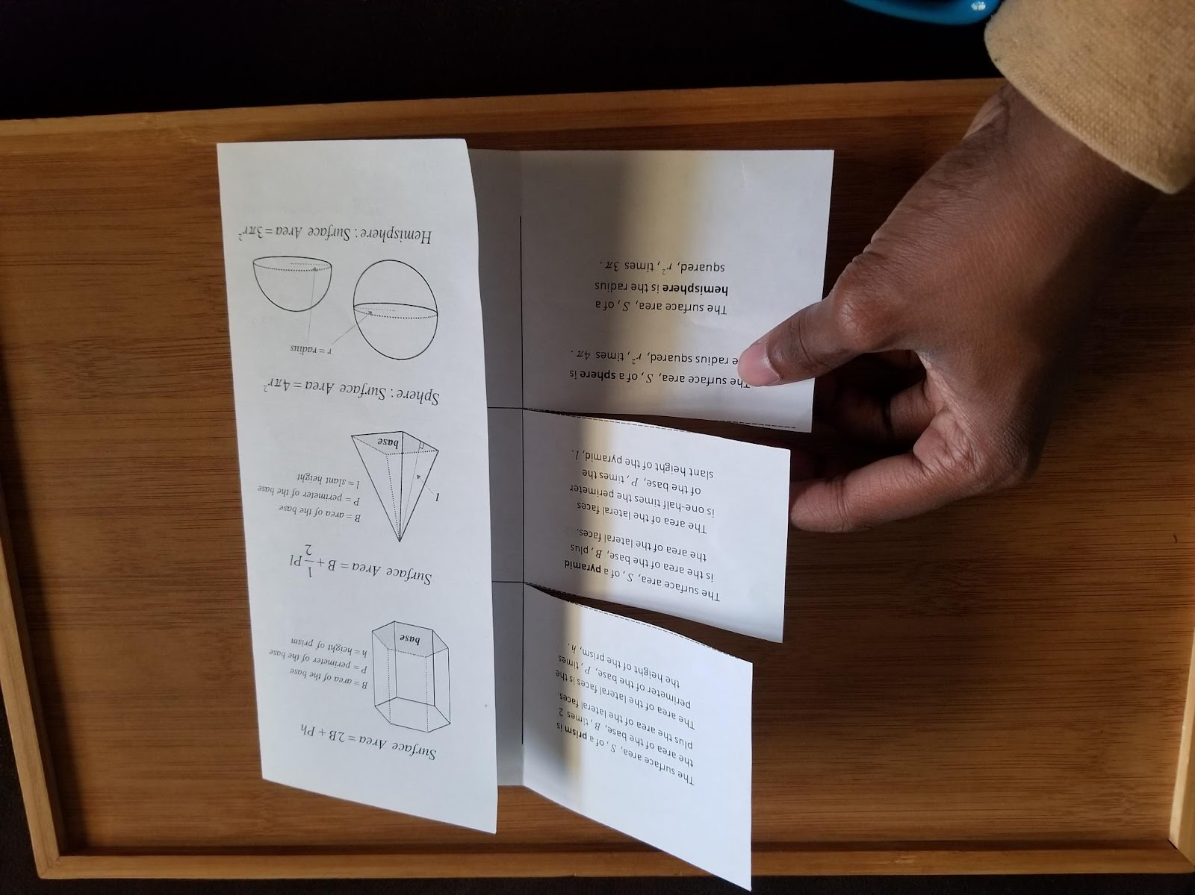
Foldable
Open the first third and cut along the 2 dashed lines. Stop cutting when you get to the fold.
Step 6
Step 7

Slide 16
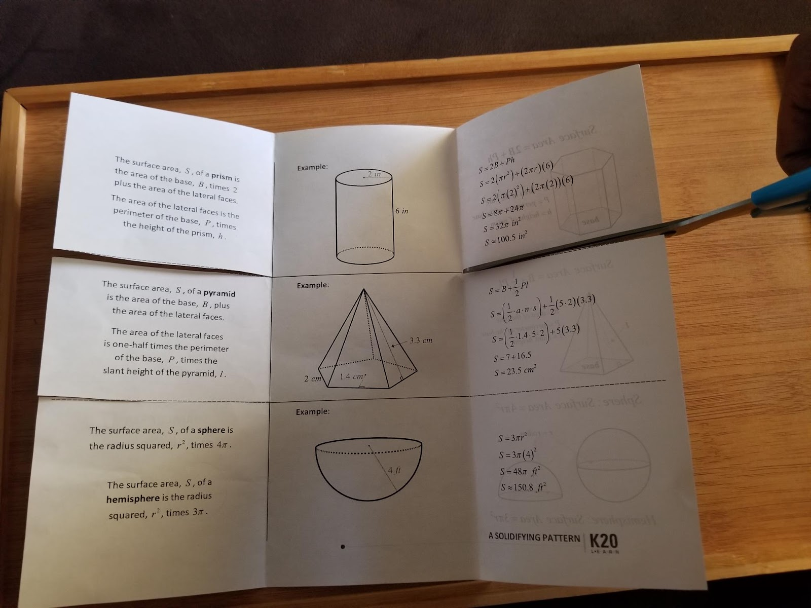
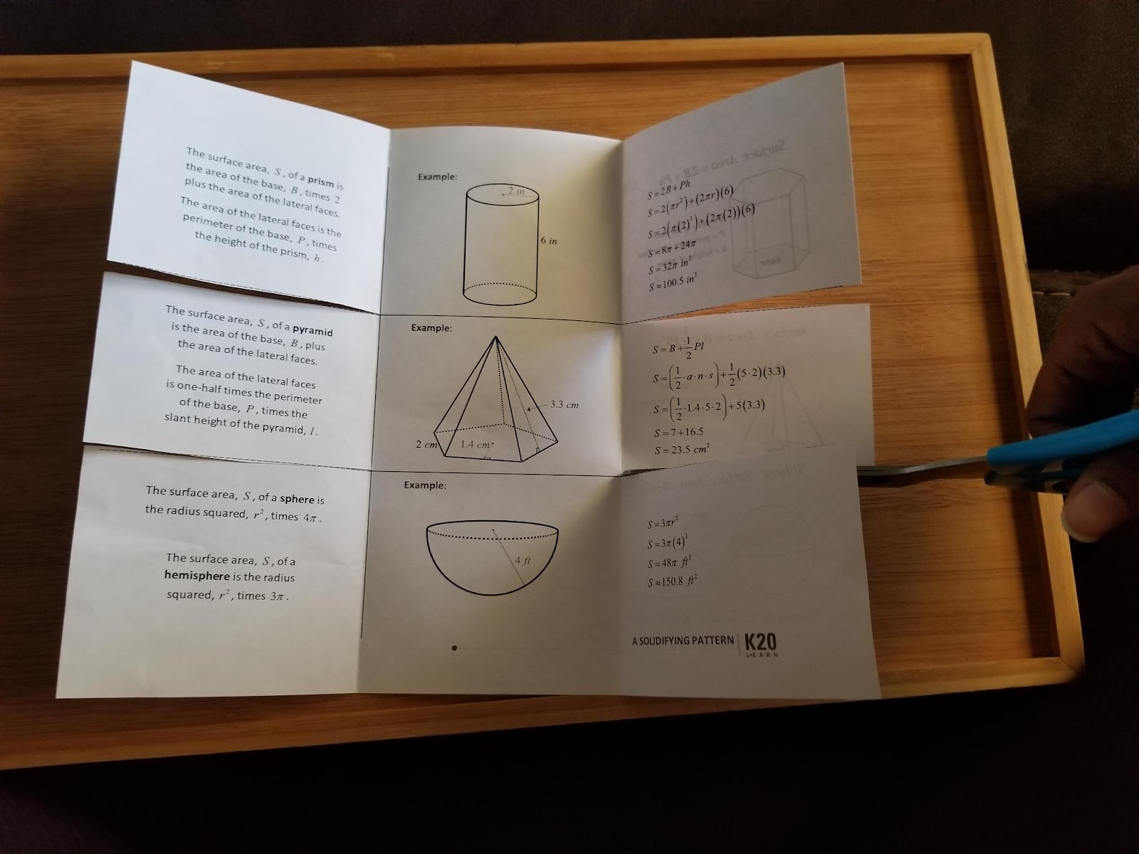
Foldable
Open the right third and cut along the 2 dashed lines. Stop cutting when you get to the fold.
Step 8
Step 9

Slide 17
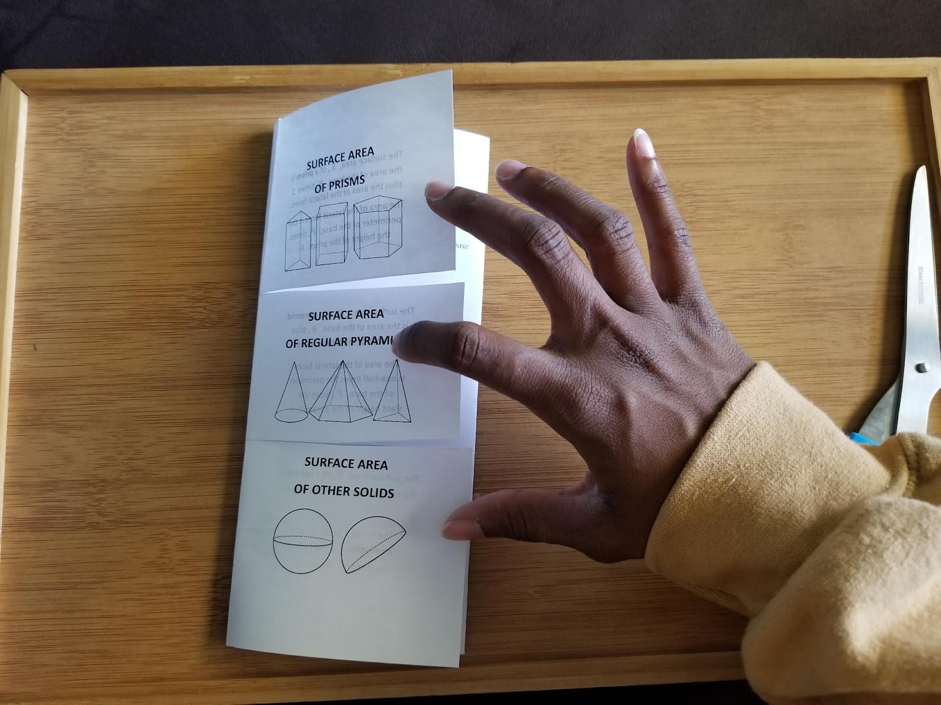
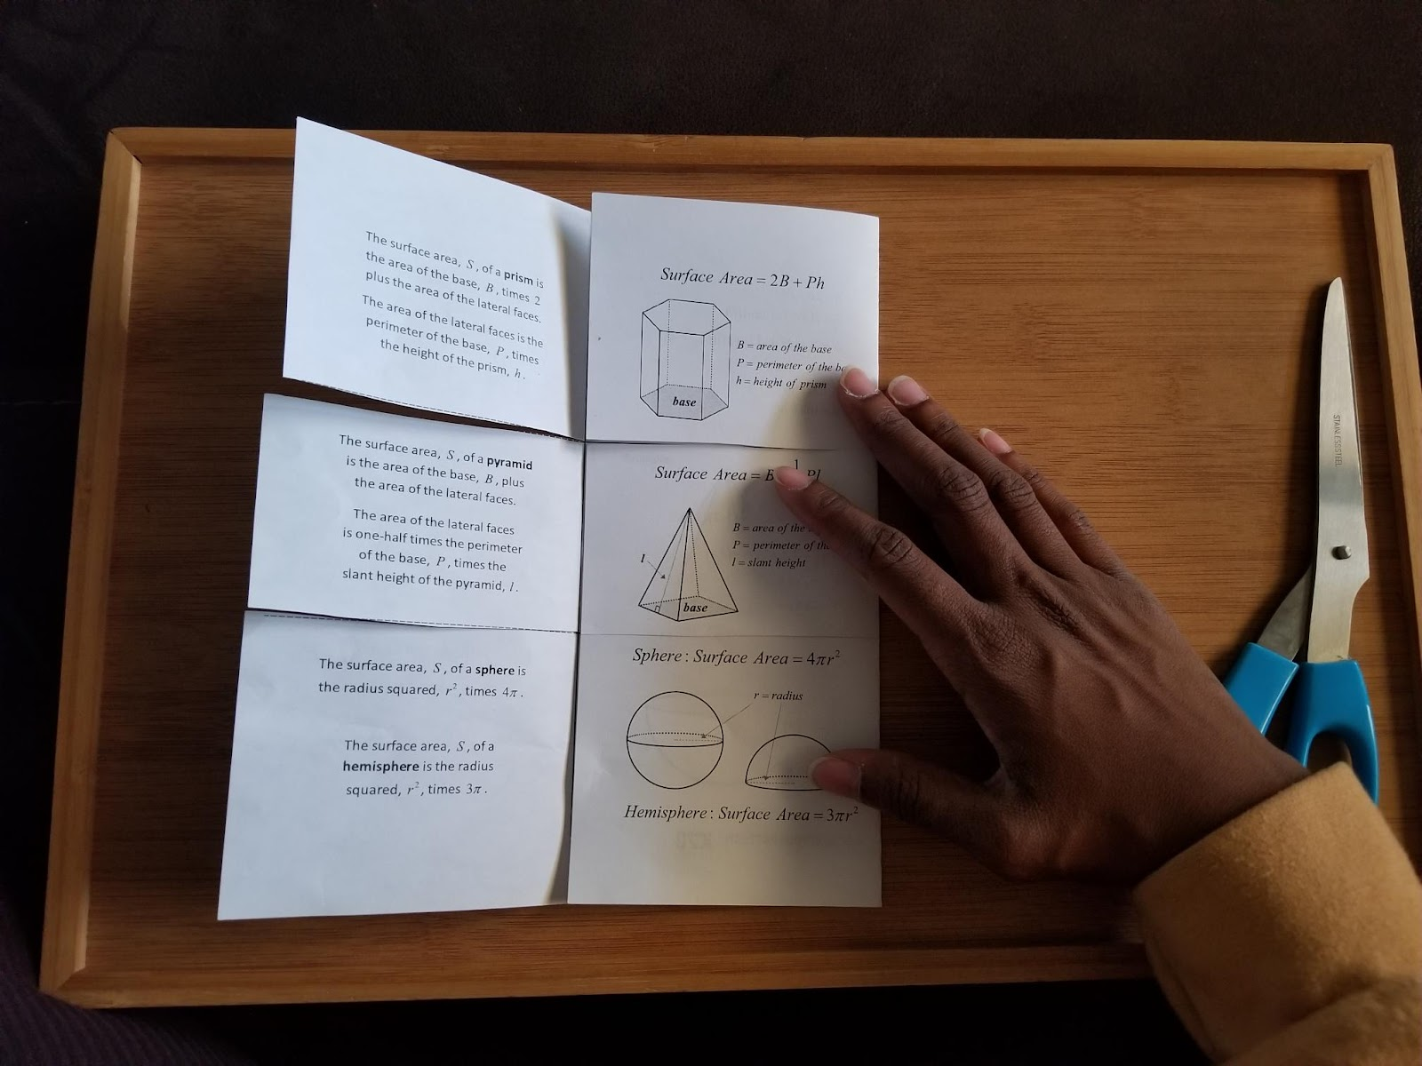
Foldable
Close the right, then left sides into the center.
Step 10
Step 11

Slide 18
Surface Area of Prisms
Notice that Ph represents the area of the lateral faces.
Notes:
K20 Center. (n.d.). Elbow Partners. Retrieved from https://learn.k20center.ou.edu/strategy/116

Slide 19
Surface Area of Pyramids
Notes:
K20 Center. (n.d.). Elbow Partners. Retrieved from https://learn.k20center.ou.edu/strategy/116

Slide 20
Surface Area of Spheres and Hemispheres
Surface Area of a Sphere:
Surface Area of a Hemisphere:
Notes:
K20 Center. (n.d.). Elbow Partners. Retrieved from https://learn.k20center.ou.edu/strategy/116

Slide 21
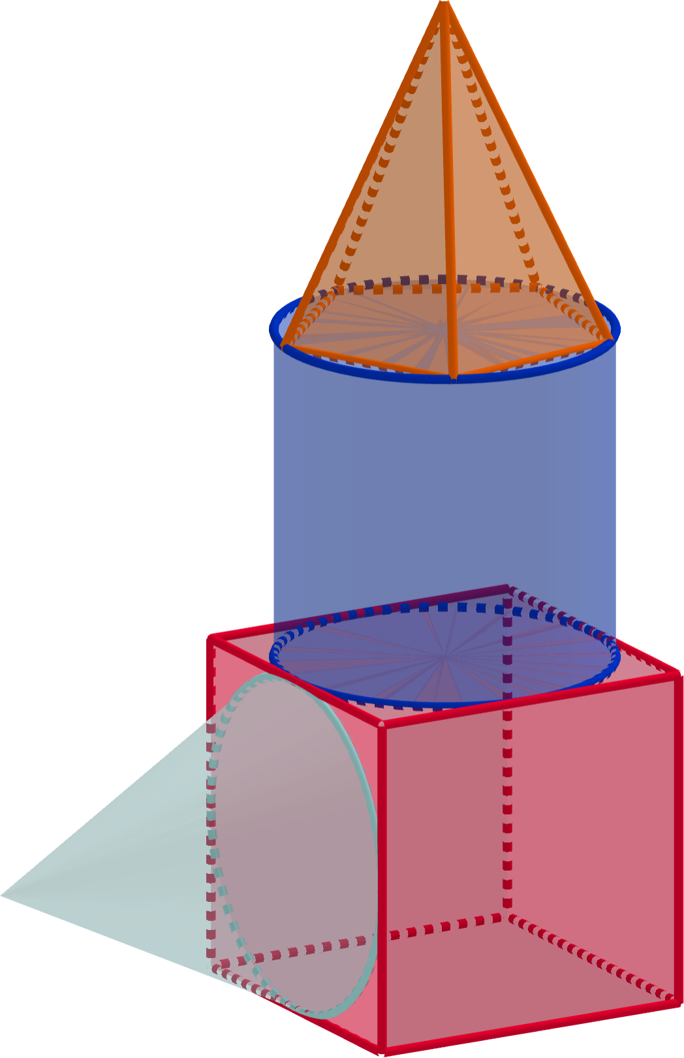
Composite Solids
Work in groups of 3 on the Creating Composites handout.
Select and circle one solid per column (columns 1–4).
Create a model using your selected solids.

Slide 22
Composite Solids
Sketch your model on a piece of blank paper.
Find the surface area of your model on the back of your Creating Composites handout.
Show your work.
Label your answer with units.

Slide 23
Exit Ticket
Work independently on the Exit Ticket.
Show your work.
Label your answer with the appropriate units.
Notes:
K20 Center. (n.d.). Bell Ringers and Exit Tickets. Retrieved from https://learn.k20center.ou.edu/strategy/125

Slide 24
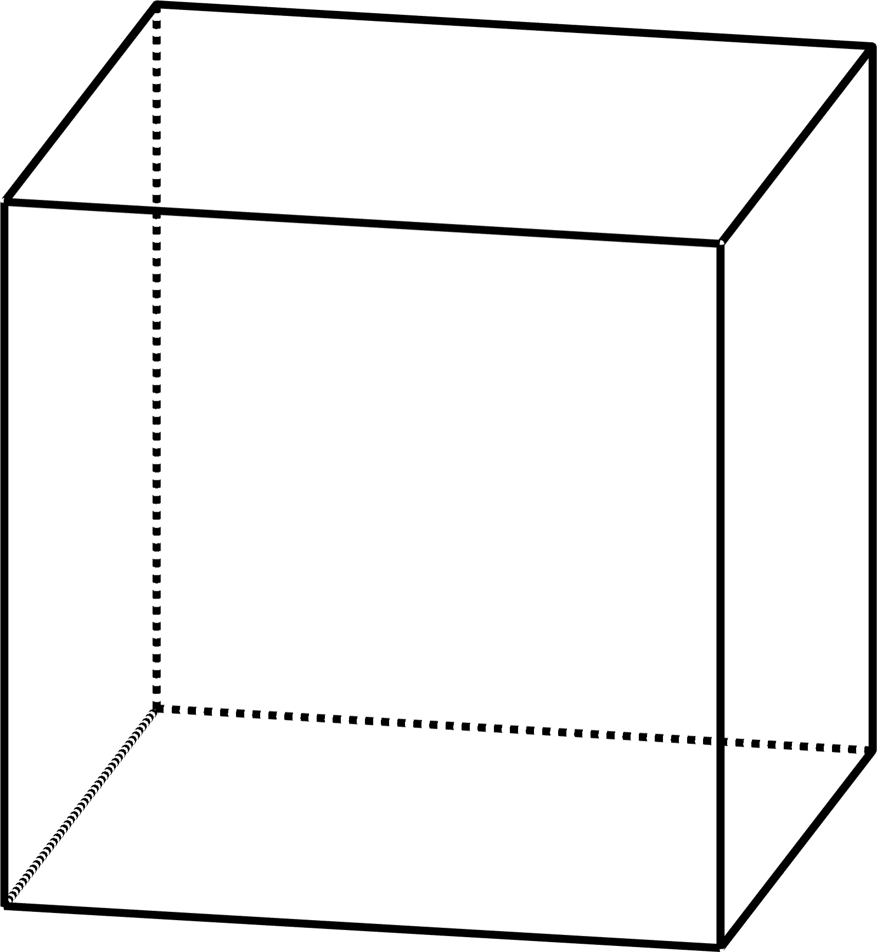
Exit Ticket (Solution)
Notes:
K20 Center. (n.d.). Bell Ringers and Exit Tickets. Retrieved from https://learn.k20center.ou.edu/strategy/125

