Slide 2
Law of Cosines
Triangulation and Mapping

Slide 3
Essential Question
How can indirect measurements help calculate unknown distances?

Slide 4
Lesson Objectives
Explain why and how the Law of Cosines works.
Apply the Law of Sines and Law of Cosines to solve a real-world problem.

Slide 5

Trig Pillars
Notes:
Scott, T. [Tom Scott] (2014, December 8). The concrete pillars on top of British hills: Trig points. [Video]. YouTube. https://www.youtube.com/watch?v=VxBlyZAl5MQ

Slide 6
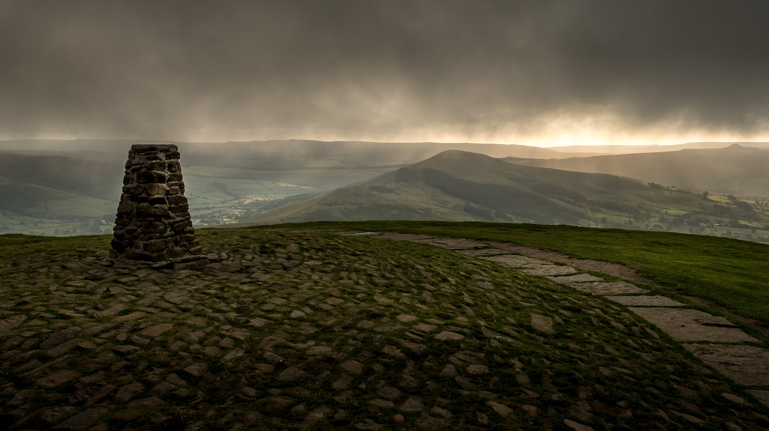
Trig Pillars
There are over 6,000 Trig Pillars across the UK that were built between the late 1930s and early 1960s.
Visiting these pillars is known as “trig bagging,” and some make it a hobby.
Notes:
Hill, T. (2020, July 11). Trig Point Peak [Photograph]. Pixabay. https://pixabay.com/photos/mam-tor-trig-point-peak-district-5393677/

Slide 7
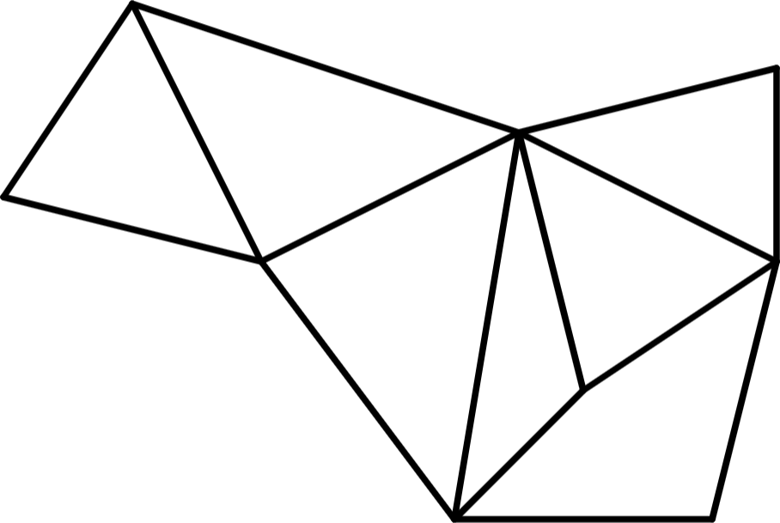
Triangulation
If you have a network of
triangles, then you only need
to know the length of one side
and the angle measures to find
the lengths of the other sides, using trigonometry.
Cartographers used this technique, called triangulation, to draw accurate maps, as it is easier
to measure angles than long, linear distances.

Slide 8
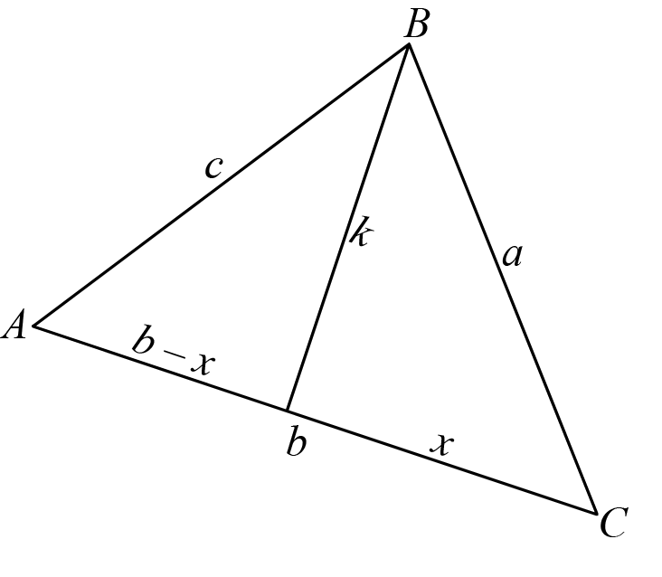
Proof Process
Work through the Proof Process handout individually.
  Complete what you can.

Slide 9
Proof Process
Find a partner.
Compare your responses.
  If you disagree, discuss and come to a consensus.

Slide 10
Proof Process (Solutions)
2)
3b)
4b)
5)
6)

Slide 11
Proof Process (Solutions)
7a)
8)
9)

Slide 12
Proof Process: Law of Cosines
How did you do?

Slide 13
Law of Cosines

Slide 14

Calculating Distance
N
You need:
  School Map handout
  Calculating Distance handout
  protractor
  straightedge
Use Law of Cosines and Law of Sines to find each distance.
Remember to use the center of the rooms unless the directions state otherwise.

Slide 15
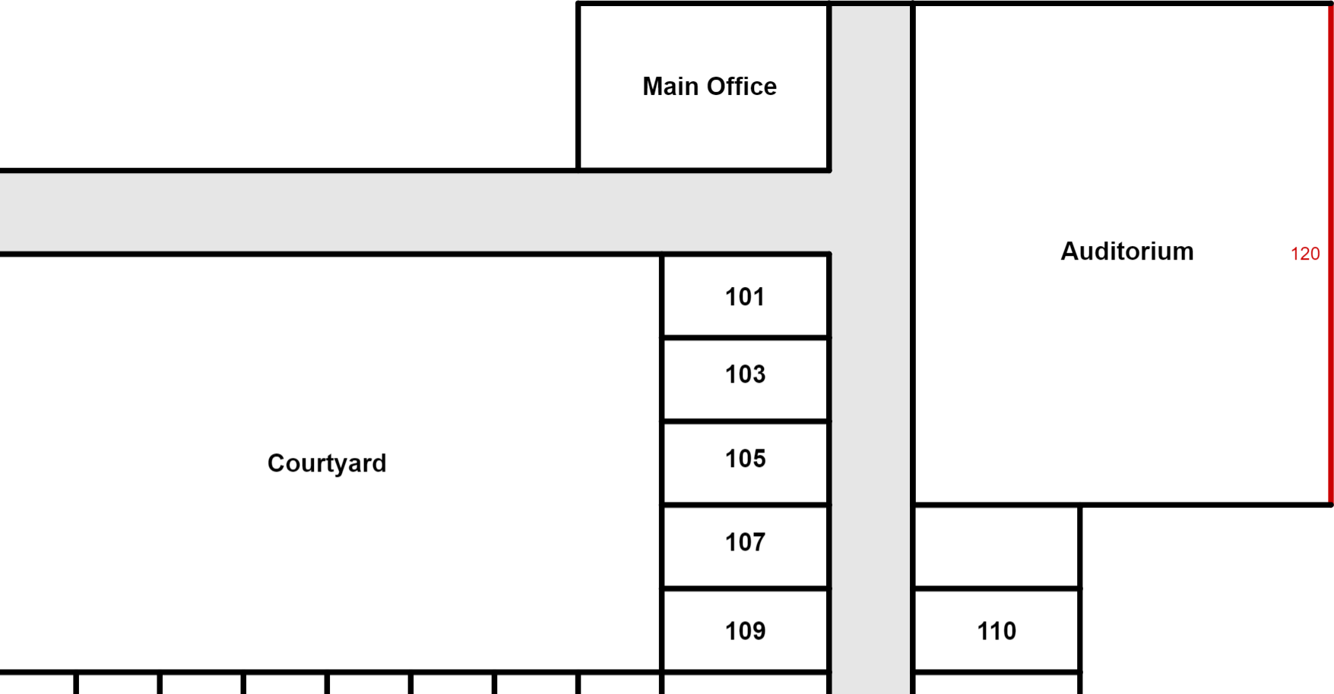
Calculating Distance
Draw a line against the far east wall of the auditorium.
That distance is defined
as 120 feet.
120 ft.

Slide 16
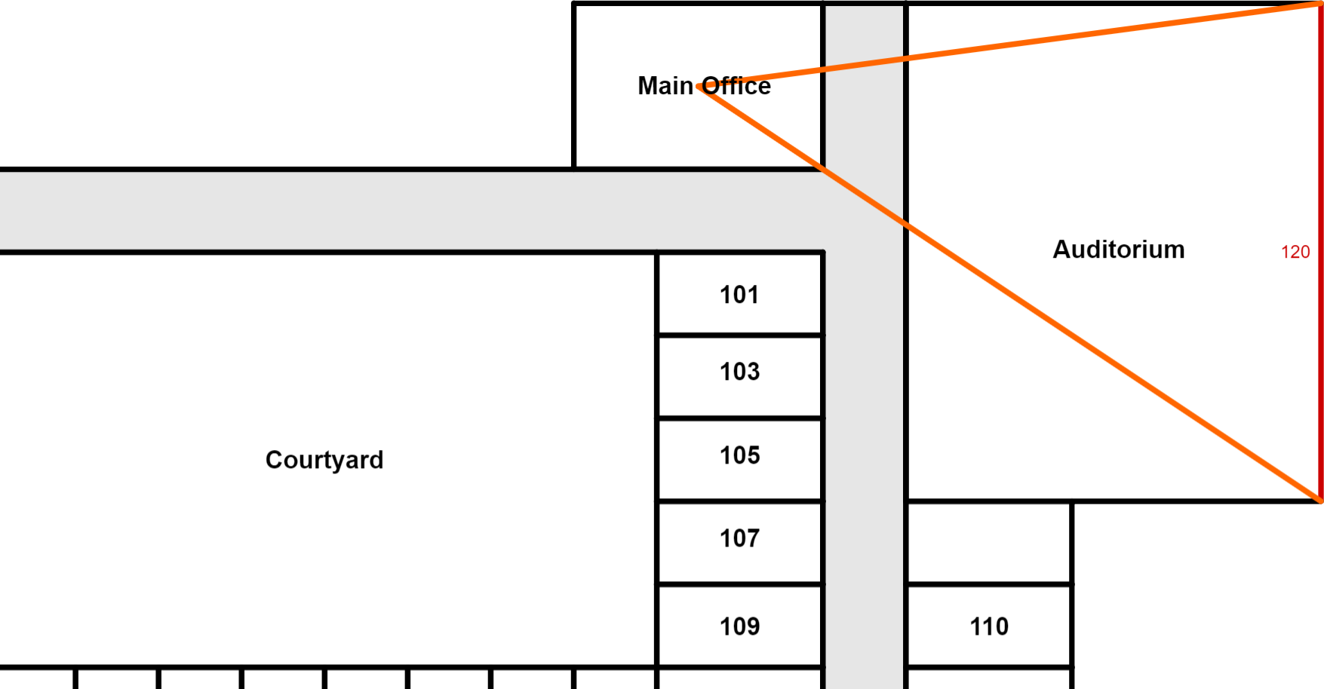
Calculating Distance
Construct a triangle connecting both end points of the far east wall segment of the
auditorium
to the center
of the main
office.
120 ft.

Slide 17
Calculating Distance (Solutions)
SE corner of auditorium to the main office: 180 ft.
SE corner of auditorium to room 201: 180 ft.
main office to room 201: 161 ft.
room 201 to the gym: 113 ft.
gym to the main office: 247 ft.
gym to the library: 279 ft.
library to the main office: 244 ft.

Slide 18
Reflection
On the back of your Calculating Distance handout, number and answer the following questions:
In which situation(s) did you use the Law of Sines?
In which situation(s) did you use the Law of Cosines?
In which situation(s) could you have used the Law of Cosines? In which situation(s) could you have not? Justify your answers.
What information could be used to determine if the Law of
Sines or Law of Cosines is most appropriate for the situation?

