Slide 2
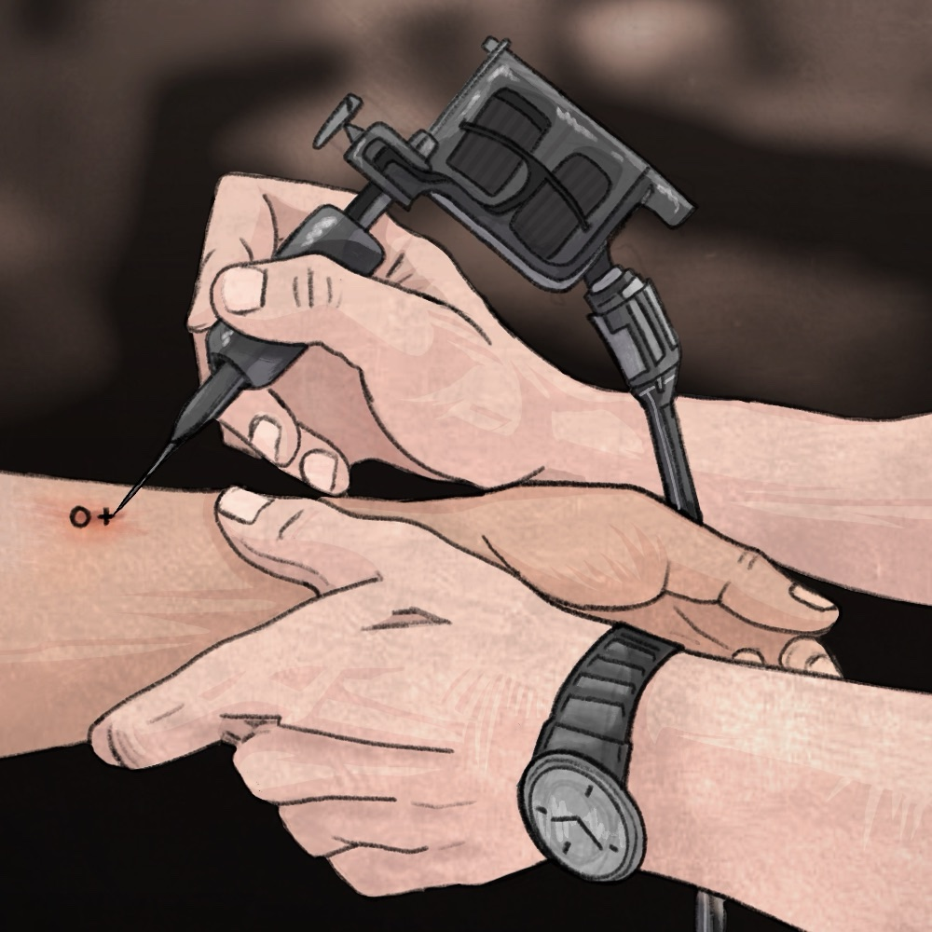
On Pins and Needles
Effects of the Cold War

Slide 3
Essential Question
How did the Cold War affect citizens of the United States?

Slide 4
Learning Objective
Students will evaluate the effects of the Cold War on citizens in the United States.

Slide 5

I Used to Think…
In the left-hand column of your handout “I Used to Think,” write down what you know about how the Cold War affected people in the United States.
You will fill in the right-hand column of your handout later.
Notes:
K20 Center. (2020, September 16). I used to think… But now I know. Strategies. https://learn.k20center.ou.edu/strategy/137

Slide 6

Surprising, Interesting, Troubling
As you read, look for the following:
  One Surprising fact or idea.
  One Interesting fact or idea.
  One Troubling fact or idea.
Once you have completed your S-I-T handout, discuss with an elbow partner what you have discovered.
Notes:
K20 Center. (2021, February 12). S-I-T (Surprising, Interesting, Troubling). Strategies. https://learn.k20center.ou.edu/strategy/926

Slide 7
Video Notes
On the top of your pyramid, include the most important information. In 25–45 words, address the 5 Ws and make a bold statement based on your opinion.
In the middle of your pyramid, add the essential information (i.e., story details, background info, evidence supporting your statement).
At the bottom of your pyramid, list the extras (i.e., interesting facts, ways in which the event in the video relates to the article or events in your life, a concluding statement).

Slide 8
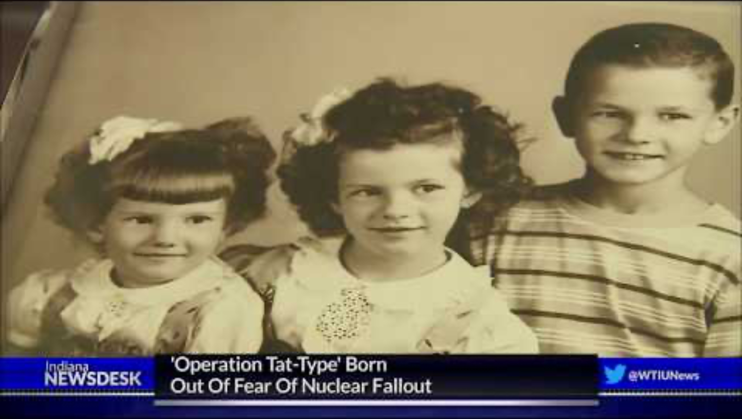
Some Hoosiers Carry Permanent Reminder Of 'Operation Tat-Type’
Notes:
WTIU. (2019, July 5). Some Hoosiers carry permanent reminder of ‘Operation Tat-Type’ [Video]. YouTube. https://www.youtube.com/watch?v=DjitM34Fr1w

Slide 9

Jigsaw
In your group of four, divide the four sections:
Summarize in the left-hand column the events that happened in your assigned location.
In the right-hand column, summarize how the event is similar to or different from what happened in the Cold War.
Notes:
K20 Center. (2020, September 16). Jigsaw. Strategies. https://learn.k20center.ou.edu/strategy/179

Slide 10
Jigsaw
As you connect with your group, discuss and complete your Jigsaw handout.
Items to discuss:
  Takeaways from the article
  Questions you still have
  Things you wondered about
Notes:
K20 Center. (2020, September 16). Jigsaw. Strategies. https://learn.k20center.ou.edu/strategy/179

Slide 11
But Now I Know
In the right-hand column of your handout “But Now I Know,” write down what you now know about how the Cold War affected citizens in the United States.
Notes:
K20 Center. (2020, September 16). I used to think… But now I know. Strategies. https://learn.k20center.ou.edu/strategy/137

