Slide 2
Globalization since 1945
A World History Lesson

Slide 3
Essential Questions
How does globalization affect people’s lives?
What are some of the pros and cons of globalization?

Slide 4

Think-Pair-Share
Write down the two essential questions on a piece of paper.
Think and write a response for each question.
Once you have your responses, Pair with an assigned partner.
Share your ideas with your partner.
Notes:
K20 Center. (n.d.). Think-pair-share. Strategies. https://learn.k20center.ou.edu/strategy/139

Slide 5
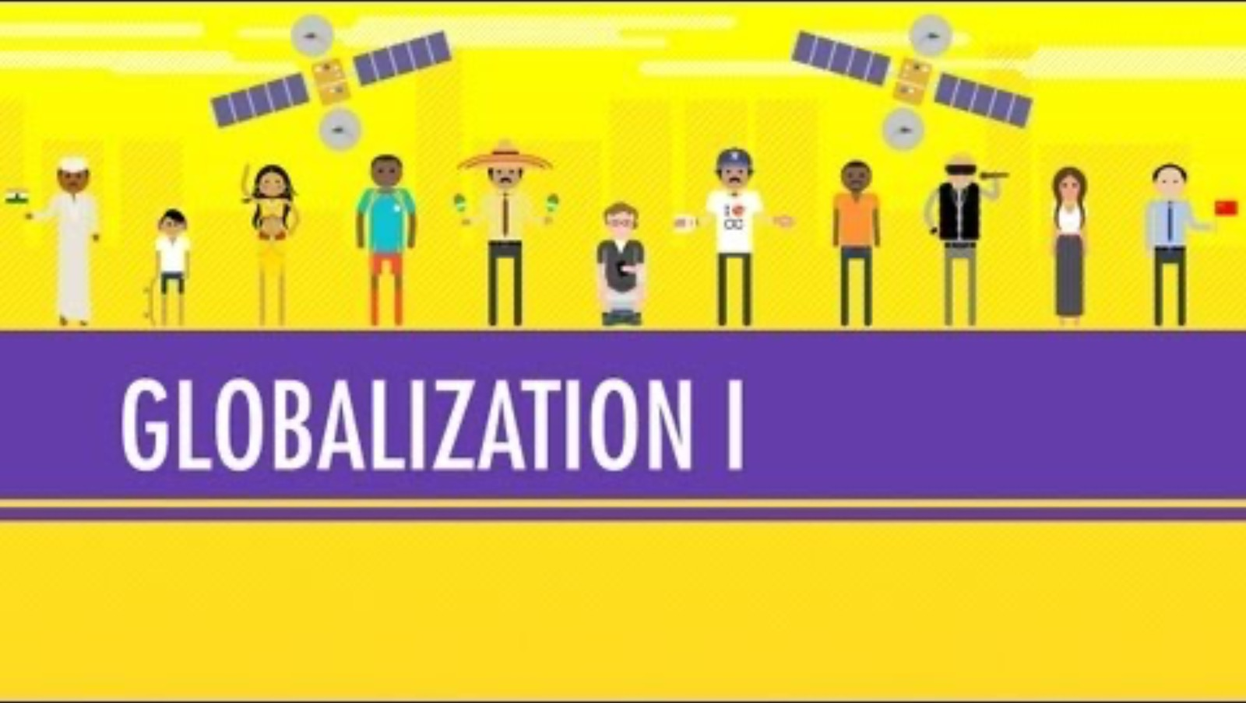
Globalization 1 – The Upside
Notes:
CrashCourse. (2012, November 2). Globalization I - the upside: Crash course world history #41 [Video]. YouTube. https://www.youtube.com/watch?v=5SnR-e0S6Ic&t=312s

Slide 6

Globalization Definition
The act or process of globalizing (to make worldwide in scope or application): the state of being globalized; especially the development of an increasingly integrated global economy marked especially by free trade, free flow of capital, and the tapping of cheaper foreign labor markets.
Notes:
Merriam-Webster. (2017). Globalization. Merriam-Webster. https://www.merriam-webster.com/dictionary/globalization

Slide 7
Globalization Pros and Cons
Fold your notebook paper hot-dog style and create the following table:
Globalization
Pros: | Cons:

Slide 8

Jigsaw Group Assignment
Each member in your group should read one article.
Write the pros and cons of globalization that you read onto the table you just made.
When everyone in your group has finished their readings, take turns sharing your findings with your group.
Notes:
K20 Center. (n.d.). Jigsaw. Strategies.https://learn.k20center.ou.edu/strategy/179

Slide 9
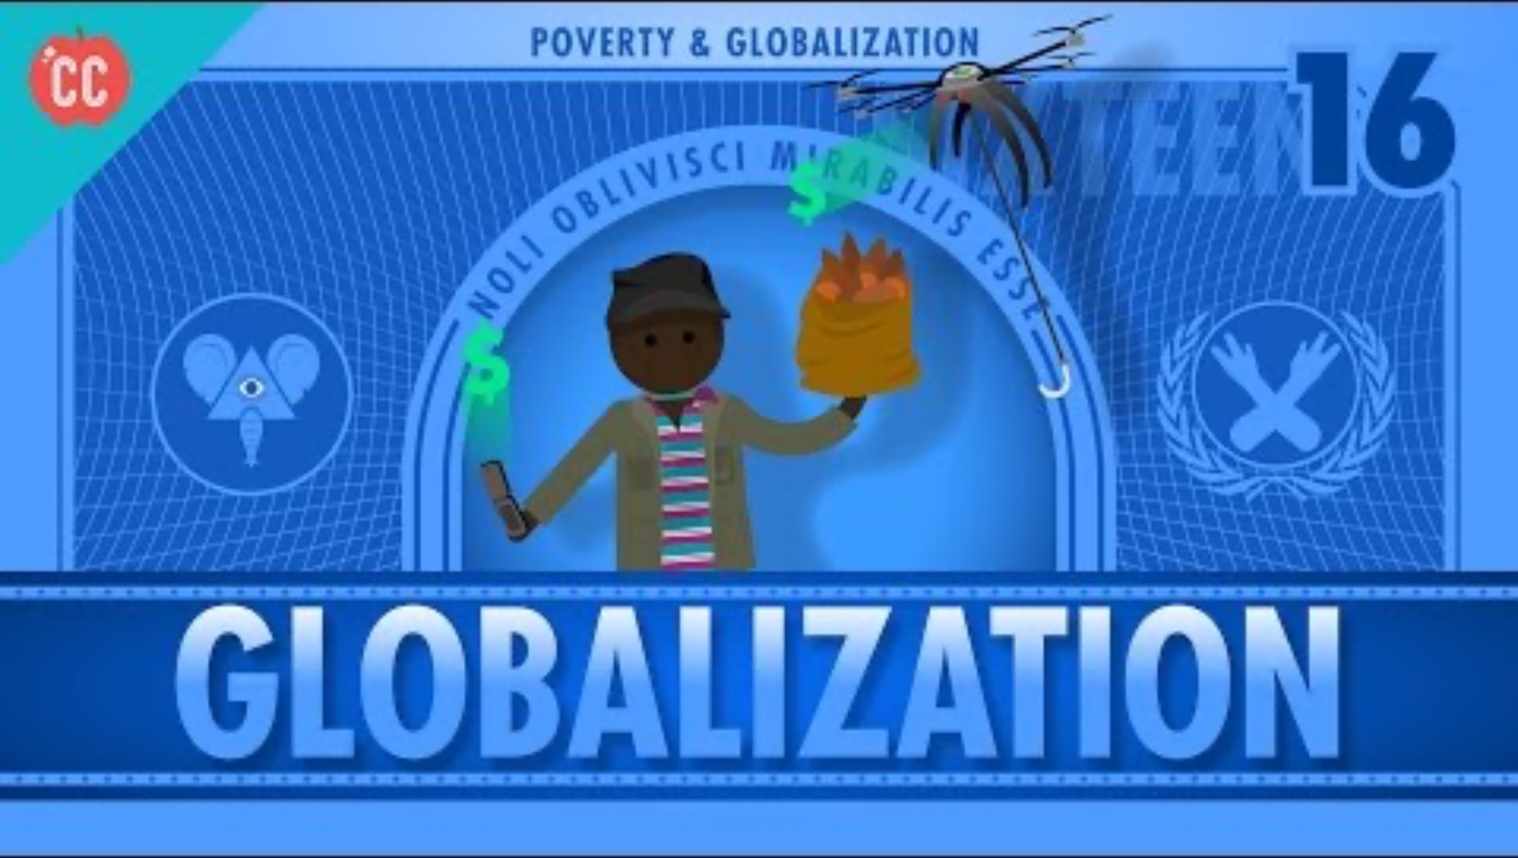
Globalization and Trade and Poverty
Notes:
CrashCourse. (2015, November 27). Globalization and trade and poverty: Crash course economics #16 [Video]. YouTube.
https://www.youtube.com/watch?v=9MpVjxxpExM&t=2s

Slide 10
Take a Stand!
After watching the video and with your group notes about globalization, what do you think?
Do the pros outweigh the cons for globalization for developing countries like Bangladesh? Explain your reasoning.

