Slide 2
Matrix Operations
Matrices in Computer Graphics

Slide 3
Essential Question
How do we use matrices?

Slide 4
Lesson Objectives
Organize and represent data with matrices.
Perform operations with matrices, including scalar multiplication, addition, subtraction, and multiplication.

Slide 5

Matrices in Computer Graphics
Notes:
K20 Center. (2022, July 21). Matrices in computer graphics [Video]. YouTube. https://youtu.be/g8sMoZ2fgZw

Slide 6
Missing Information
Match each matrix with the data it represents.
Use your matches to answer the questions at the bottom of the Missing Information handout.

Slide 7
Missing Information Solutions
B
C
D
A

Slide 8
Guided Notes
Let’s complete the Guided Notes together.

Slide 9
Problem Solved
Apply what you have learned about matrix operations to answer the questions on the Problem Solved handout.

Slide 10
Problem Solved Solutions

Slide 11
Problem Solved Solutions

Slide 12

How Graphics Work
Notes:
McLaughlin, A. [TheHappieCat]. (2015, July 22). How rendering graphics works in games. [Video]. YouTube. https://youtu.be/cvcAjgMUPUA

Slide 13
Guided Notes
Let’s complete the Guided Notes together.

Slide 14
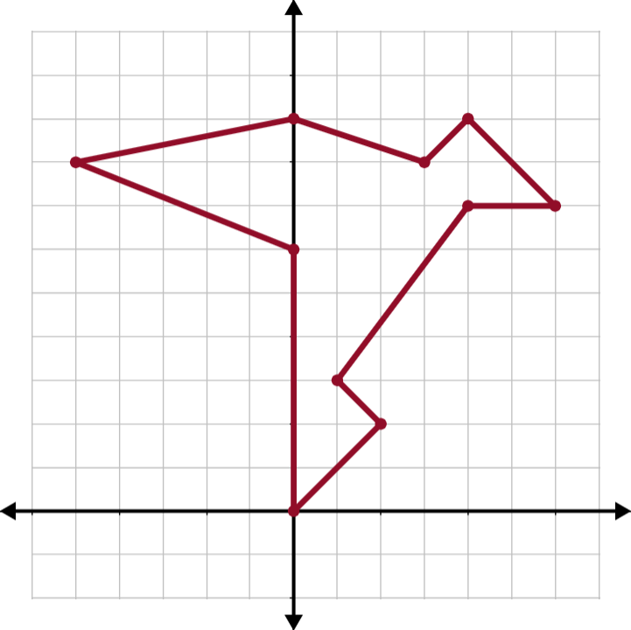
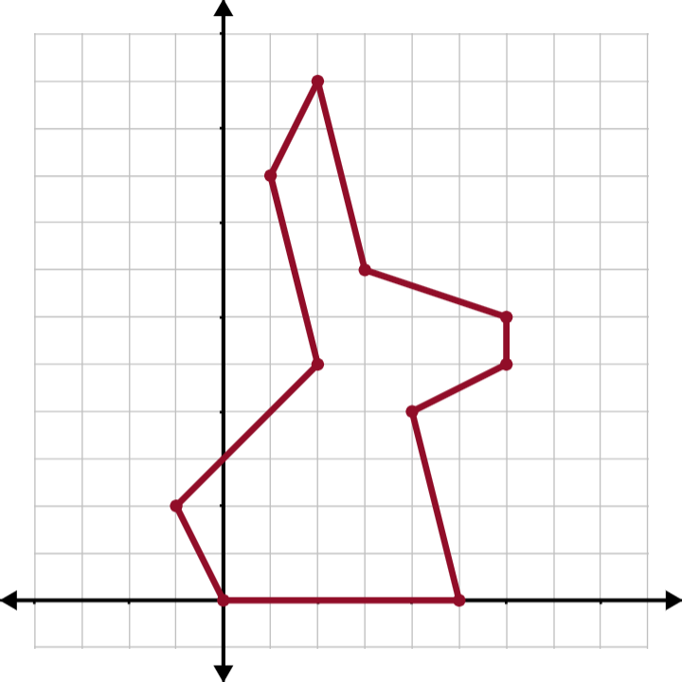
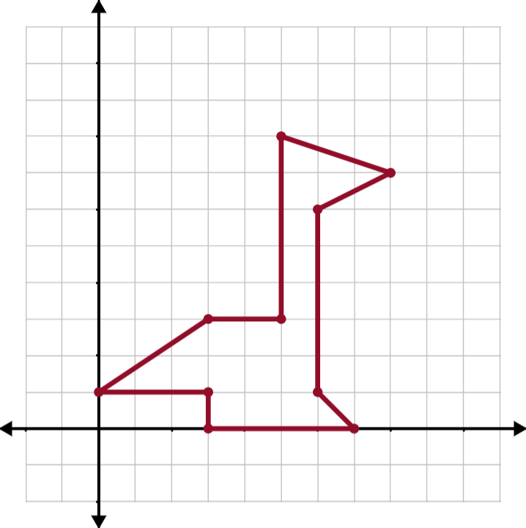
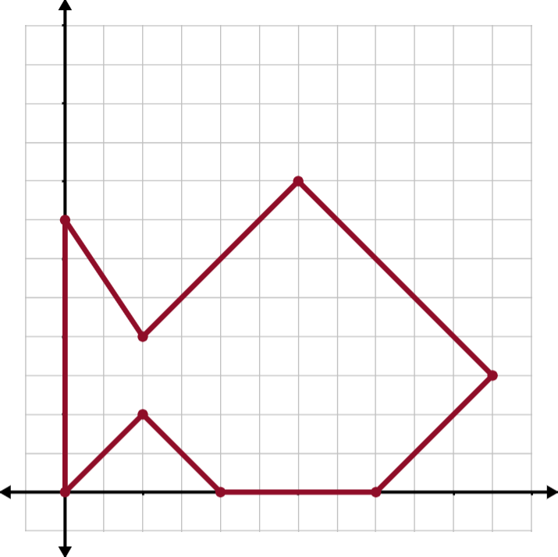
Transformation Matrices
Work with your group to pick a figure and transform it using the information provided on the Transformation Matrices handout.

Slide 15
Transformation Matrices
Write your vertices as 3x1 matrices.
Apply your transformation matrix, T, to each
of the vertices. Each result is the new, transformed vertex.

Slide 16

Transformation Matrices: GeoGebra
Go to geogebra.org/m/re5ajfet to check
your work.
Find your selected figure on the page.
Click the transformation buttons in the
order in which you want them applied (opposite
of the order in which you multiplied them).
Did your final result match?

Slide 17

Exit Ticket
Apply what you have learned
about matrices to answer the
questions on the Exit Ticket handout.
Remember to identify the dimensions of each matrix before attempting the matrix operation.
Notes:
K20 Center. (n.d.). Bell ringers and exit tickets. Strategies. https://learn.k20center.ou.edu/strategy/125

Slide 18
Exit Ticket Solutions

Slide 19
Exit Ticket Solutions

