Slide 2

Native American Education: Past, Present, and Future
Assimilation

Slide 3

S-I-T
As you view the video, think about something you find:
  Surprising
  Interesting
  Troubling
Be prepared to discuss.

Slide 4
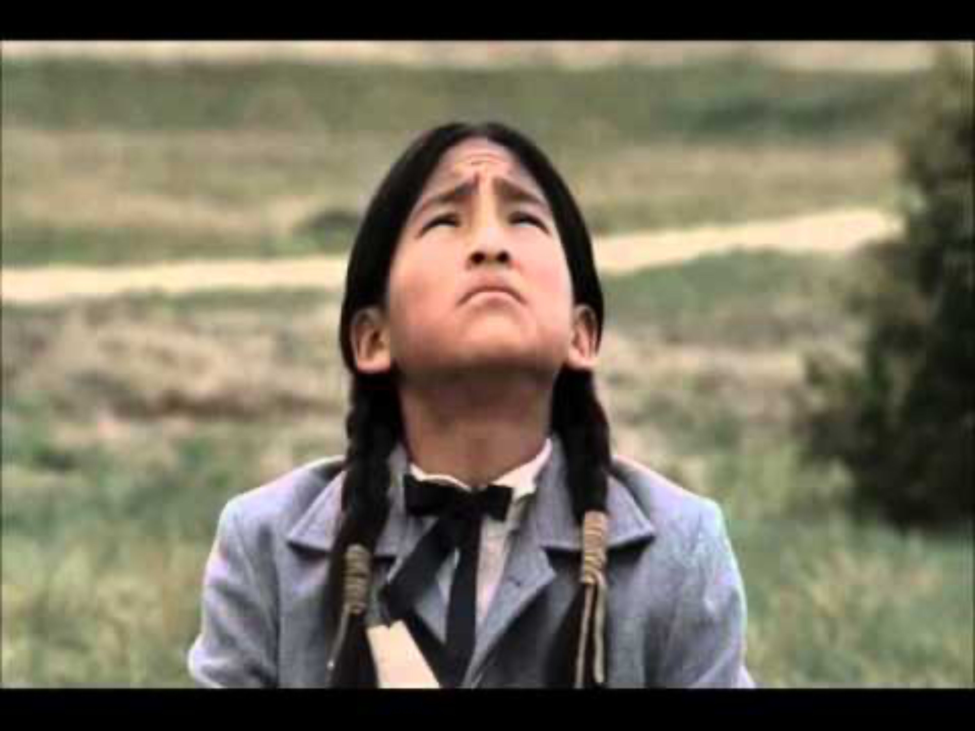
Into the West-Carlisle Indian School
Notes:
TNT. (2011, Sept 11). Into the West-Carlisle Indian School. [Video]. YouTube. https://www.youtube.com/watch?v=yfRHqWCz3Zw&t

Slide 5
Essential Questions
Why did the U.S. government use assimilation to educate Native children?
How did assimilation in education affect Native people?

Slide 6
Learning Objectives
Examine primary sources from students who attended Carlisle Indian Industrial School.
Analyze the many ways schools assimilated Native children.
Participate in a collaborative discussion about the history of boarding schools, their existence today, and the future of Native education.

Slide 7
Native American Education
Explore primary source documents from the Carlisle Indian School Digital Resource Center about students who attended the school around 100 years ago.
Take notes about the two students on your handout.
Notes:
Dickinson College. (n.d.). Carlisle Indian School Digital Resource Center. https://carlisleindian.dickinson.edu

Slide 8

Why-Lighting
Read the short summary of the “History of Native Education: A Snapshot.”
Highlight key vocabulary you might not know.

Slide 9

Honeycomb Harvest
Review each topic on the hexagons.
Arrange the hexagons so the sides of related topics touch.
Be ready to discuss the choices you have made.

Slide 10
Choice Board
Choose one link from each column to explore and answer the question:
  “How does the type of education described in the document affect Native students of that time?”
https://k20.ou.edu/mg

Slide 11
Reflection Questions
How has assimilation affected education in today’s Native communities?
What does the future of Native education look like?

