Slide 2
Native American Education
Past, Present, and Future

Slide 3
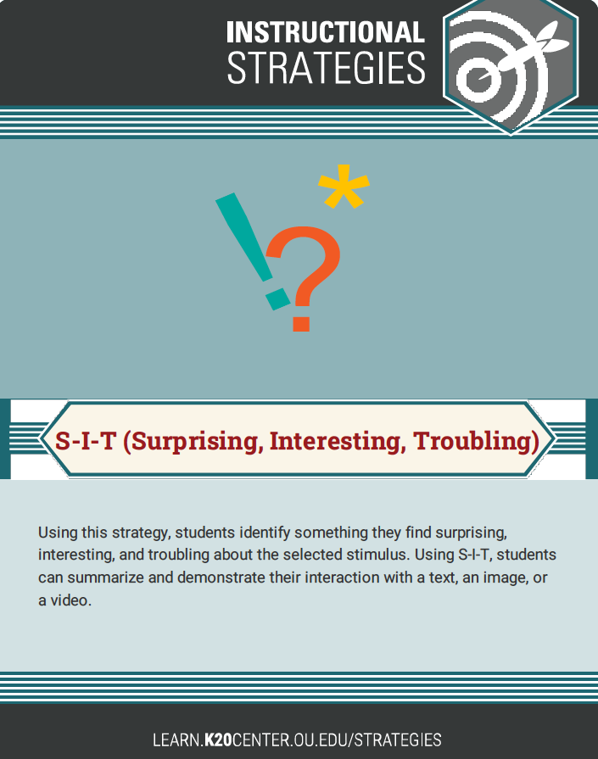
Engage: S-I-T
Using this strategy, identify something you find surprising, interesting, and troubling about the video.
Summarize and demonstrate your interaction with the film.
S=Surprising
I=Interesting
T=Troubling
Notes:
K20 Center. (n.d.). S-I-T (Surprising, Interesting, Troubling). Strategies. https://learn.k20center.ou.edu/strategy/926

Slide 4
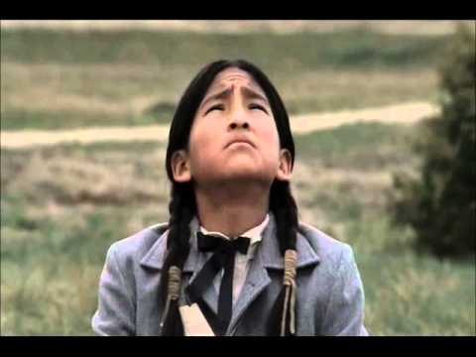
S-I-T
Keep in mind the S-I-T strategy as we watch the clip from TNT’s Into the West series where Native American students arrive at the Carlisle Indian Industrial School for the very first time.
Be prepared to discuss what you find surprising, interesting, and troubling.
Notes:
TNT. (2011, Sept 11). Into the West-Carlisle Indian School. [Video]. YouTube]. https://www.youtube.com/watch?v=yfRHqWCz3Zw&t=3s

Slide 5
Essential Questions
Why did the US government use assimilation to educate native children?
How did assimilation in education affect native people?

Slide 6
Learning Objectives
Examine primary sources of students attending the Carlisle Indian Industrial School.
Analyze the many ways schools assimilated native children.
Participate in collaborative discussion about the history of boarding schools, their existence today, and the future of assimilation techniques in education.
Explore a variety of instructional strategies that foster critical thinking.

Slide 7
Explore: Primary Sources Worksheet
Using the website, Carlisle Indian School Resource Center, explore primary source documents about students who attended the school around 100 years ago.
Use the attached “Native American Education Note Catcher” to record your work.
Take guided notes on 2 of the students listed.
Notes:
Carlisle Indian School Digital Resource Center. (n.d.). https://carlisleindian.dickinson.edu/

Slide 8
Explain: Why-Lighting
Highlight sentences or passages from the Carlisle Indian School Resource Center materials that seem important to your understanding.
Reflect on the thinking process that led to your choice of highlights.
Read the short summary of the “History of Native Education -- A Snapshot.”
Highlight key vocabulary you might not know.
Notes:
K20 Center. (n.d.). Why-Lighting. Strategies. https://learn.k20center.ou.edu/strategy/128
Due to time constraints, you may want to JIGSAW this reading. 3 paragraphs, 2 paragraphs, 3 paragraphs.

Slide 9
Honeycomb Harvest
This strategy is designed to help you understand logical relationships among words and concepts.
Use a set of hexagons containing different concepts related to the content.
Work individually or in groups to arrange them so the sides of related hexagons touch.
Be ready to discuss the choices you have made.
Notes:
K20 Center. (n.d.). Honeycomb Harvest. Strategies. https://learn.k20center.ou.edu/strategy/61

Slide 10
Choice Board: The Past, the Present, & Future
Choose 1 link from each column – the Past, the Present, and the Future – to explore.
While you are viewing/reading, keep in mind the following question:
How does the type of education described in the document affect native students of the time?
https://bit.ly/3qxPbIz
Notes:
K20 Center. (n.d.). Choice Boards. Strategies. https://learn.k20center.ou.edu/strategy/73
Choice Board: https://bit.ly/3qxPbIz

Slide 11
Evaluate: Reflection Questions
How has assimilation affected education in today’s Native communities?
What does the future of Native education look like?

