Slide 2


Slide 3
Essential Questions
Why does citing sources matter?
What does citing sources offer to readers?
How should correctly cited sources look?

Slide 4
Learning Objectives
Students will be able to perform the following:
Create citations in MLA format for books, journals, and websites
Apply MLA formatting to a short paper

Slide 5


Slide 6
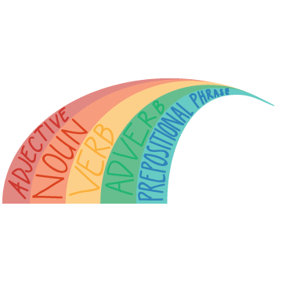
Rainbow Write - Book Citation
Take a few minutes to look at the cards in front of you for citing a book as a resource.
What do you notice about the different cards?
Notes:
K20 Center. (n.d.). Rainbow Writer. Strategy. https://learn.k20center.ou.edu/strategy/80

Slide 7
Rainbow Write - Book Citation
New York, Simon & Schuster Paperbacks, 1951.
Bradbury, Ray.
Fahrenheit 451.
Citation Format:
Last Name, First Name. Title of Book. City of Publication, Publisher, Publication Date.

Slide 8
Rainbow Write - Journal Citation
Take a few minutes to look at the cards in front of you for citing a journal as a resource.
What do you notice about the different cards?

Slide 9
Rainbow Write - Journal Citation
American Noir: Underground Writers and Filmmakers of the Postwar Era, Washington, Smithsonian Institution Press, 2000, pp. 55-72.
“‘I’m Being Ironic’: Imperialism, Mass Culture, and the Fantastic World of Ray Bradbury.”
Cochran, David.
Citation Format:
Author(s). "Title of Article." Title of Periodical, (Day,) (Month,) Year, pages.

Slide 10
Rainbow Write - Website Citation
Take a few minutes to look at the cards in front of you for citing a website as a resource.
What do you notice about the different cards?

Slide 11
Rainbow Write - Website Citation
“Pride of Oklahoma Members ‘Implore’ Peers to Communicate Concerns with Leadership, Band Reaches 40 Covid-19 Cases.”
OU Daily, 5 Jan. 2022, https://www.oudaily.com/news/pride-of-oklahoma-members-implore-peers-to-communicate-concerns-with-leadership-band-reaches-40-covid/article_97bff36a-6e7f-11ec-8af1-3f8cf4c418b1.html
Blake Douglas, editor-in-chief.
Citation Format:
Author or Editor. "Title." Title of container (self contained if book), Other contributors (translators or editors), Version (edition), Number (vol. and/or no.), Publisher, Publication Date, Location (pages, paragraphs and/or URL, DOI or permalink). 2nd container’s title, Other contributors, Version, Number, Publisher, Publication date, Location, Date of Access (if applicable).

Slide 12


Storyline
Making Sense of MLA (ou.edu)
In this activity, you will learn more about the different guidelines for writing an essay in MLA format.
As you work through this, click the highlighted text portions to learn more.
You will not be able to advance to the next slide until you have clicked on and read all of the information.

Slide 13

Examples and Non-Examples
Review the Examples and Non Examples citation cards.
If they are written correctly, do nothing.
If they are written incorrectly, or have an error, make the necessary revisions using a red pen.

Slide 14



Your Turn
The task:
Write a one (1) page paper on a book you are currently reading.
Be sure to include the following:
  What makes it a good book?
  Why should your peers read this book?
  Examples from the text
  Support from reviews, quotes, or even research
  Citations in MLA format for each source you use

