Slide 2
The Curtain Falls
End of the Cold War

Slide 3
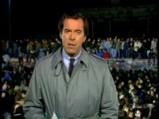
I Notice, I Wonder
Notes:
ABCNews. (2009, November 4). Nov. 10, 1989: Celebration at the Berlin Wall. YouTube. https://www.youtube.com/watch?v=snsdDb7KDkg

Slide 4
Essential Question
Why do governments collapse?

Slide 5
Lesson Objective
Explain why the Cold War ended.

Slide 6
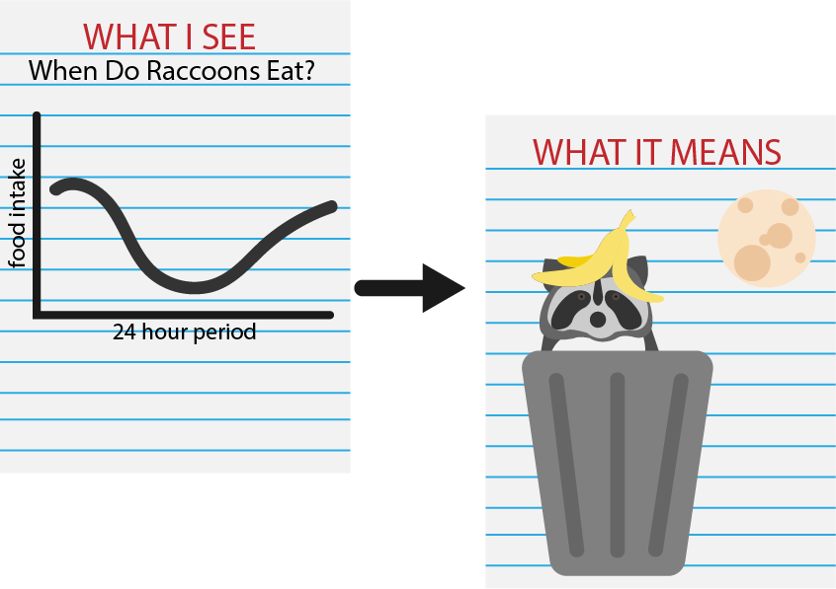
WIS-WIM
Look at the table.
Write notes around the table about what data you see.
Add notes about what this data means.
Under the table, summarize what you see and what it means in a paragraph.
Notes:
https://learn.k20center.ou.edu/strategy/1201

Slide 7

Why-Lighting
Read the End of the Cold War handout with your partner.
Highlight passages that led to the end of the Cold War.
Write why you highlighted certain passages in the margin.
Notes:
https://learn.k20center.ou.edu/strategy/128

Slide 8

Dividing The Pie
Create a pie chart illustrating reasons for the end of the Cold War.
Next to each part of the pie, explain why your group gave it a certain percentage.
Use color and add a title to your pie chart.
Some categories to consider include:
  High cost of goods
  Low wages
  Low gross domestic product
  The war in Afghanistan
  Policies such as glasnost and perestroika
  Political movements in Poland and Hungary
Notes:
https://learn.k20center.ou.edu/strategy/1867

Slide 9

Six-Word Memoir
Think about what you have learned about the end of the Cold War.
Create a six-word memoir by summarizing why the Cold War ended in six words.
Example: Economic woes led to USSR collapse.

