Slide 2
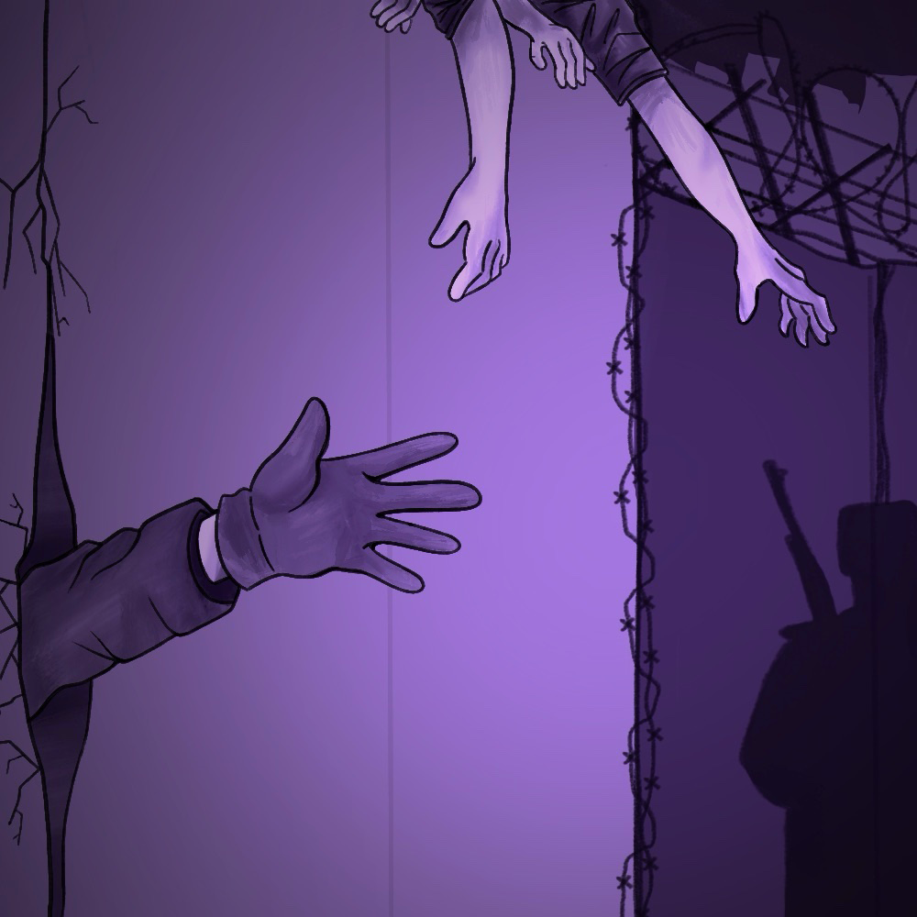
The Curtain Falls
End of the Cold War

Slide 3
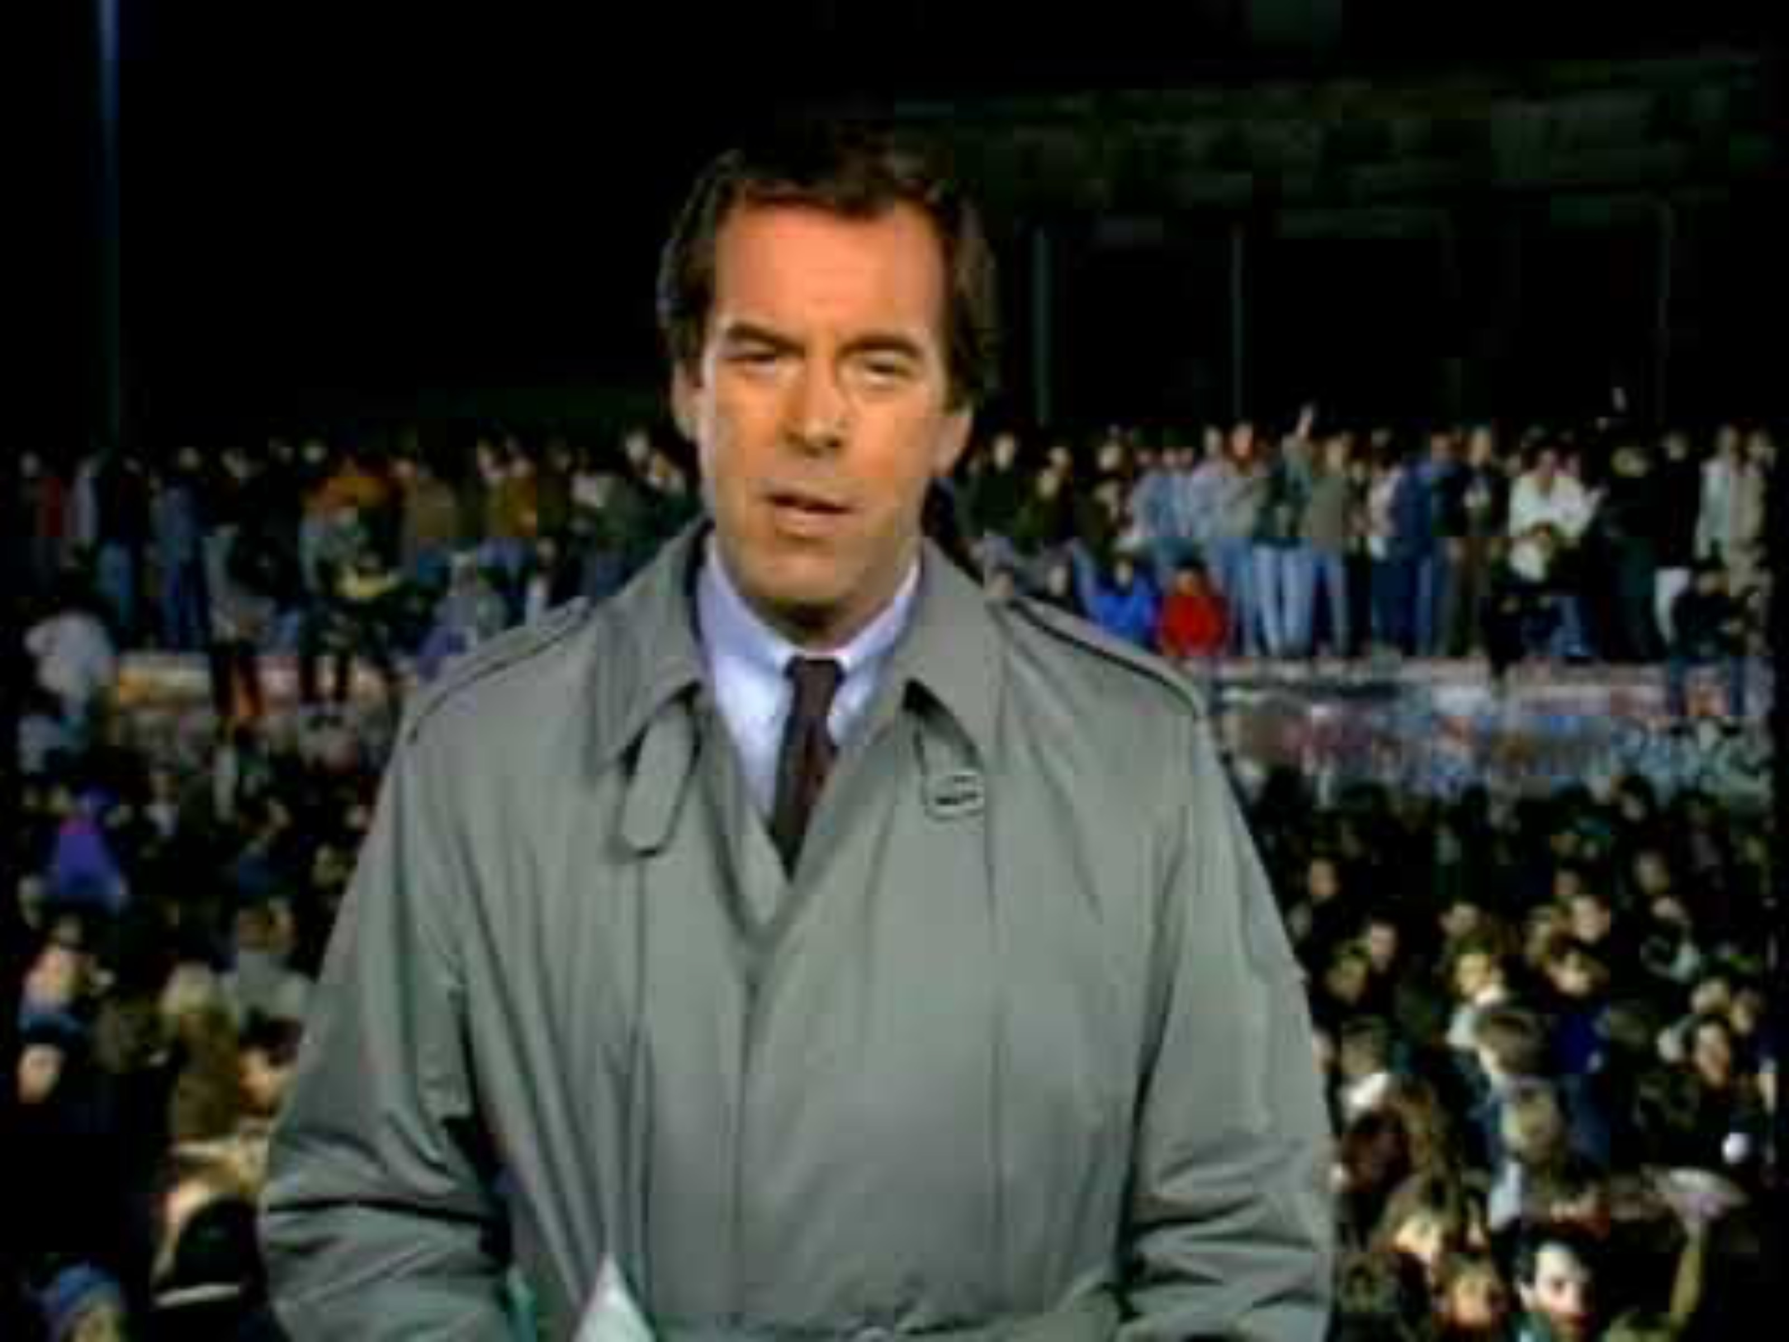
Celebration at the Berlin Wall
Notes:
ABC News. (2009, November 4). Nov. 10, 1989: Celebration at the Berlin Wall [Video]. YouTube. https://www.youtube.com/watch?v=snsdDb7KDkg
K20 Center. (n.d.). I notice, I wonder. Strategies. https://learn.k20center.ou.edu/strategy/180

Slide 4
Essential Question
Why do governments collapse?

Slide 5
Learning Objective
Explain why the Cold War ended.

Slide 6
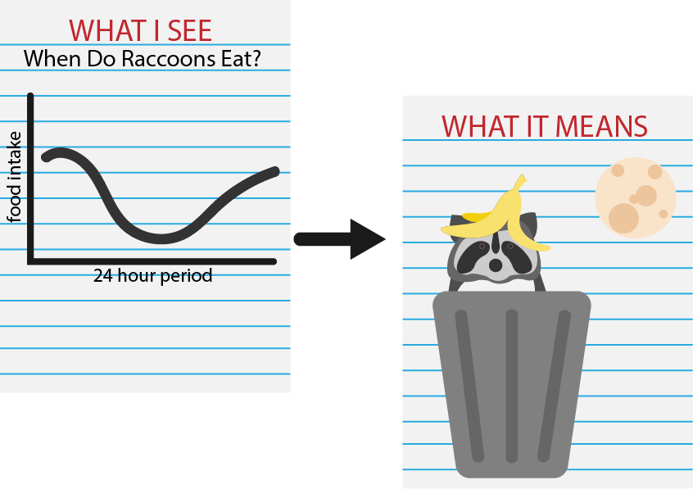
WIS-WIM
Look at the table.
Write notes in the margins about the data you see.
Add notes about what this data means.
Under the table, summarize what you see and what it means in a paragraph.
Notes:
K20 Center. (n.d.). WIS-WIM. Strategies. https://learn.k20center.ou.edu/strategy/1201

Slide 7

Why-Lighting
Read the article “The End of the Cold War” with your partner.
Highlight passages that describe what led to the end of the Cold War.
Next to each passage you highlight, explain why you chose to highlight it.
Notes:
K20 Center. (n.d.). Why-lighting. Strategies. https://learn.k20center.ou.edu/strategy/128

Slide 8

Dividing the Pie
Create a pie chart that illustrates reasons for the end of the Cold War.
Next to each part of the pie, explain why your group gave it that percentage of the pie.
Add color to your pie chart and give it a title.
Consider including the following categories:
  High cost of goods
  Low wages
  Low gross domestic product
  The war in Afghanistan
  Policies such as glasnost and perestroika
  Political movements in Poland and Hungary
Notes:
K20 Center. (n.d.). Dividing the pie. Strategies. https://learn.k20center.ou.edu/strategy/1867

Slide 9

Six-Word Memoirs
Reflect on everything you learned about the end of the Cold War.
Create a six-word memoir that summarizes why the Cold War ended in six words.
  Example: “Economic woes led to USSR collapse.”
Notes:
K20 Center. (n.d.). Six-word memoirs. Strategies. https://learn.k20center.ou.edu/strategy/75

