Slide 2
The K20 Chronicle, Lesson 1
What Makes a Good Article?

Slide 3
Essential Questions
What are the components of a journalistic article?
What makes a good article?
How do you create an engaging story?

Slide 4
Lesson Objectives
Evaluate how authors who write about the same issue approach their writing in different ways.
Analyze how the text structures used in different articles support each author’s purpose.
Evaluate an article for its effectiveness in writing.

Slide 5
Looks Like, Sounds Like, Feels Like
Think about the best newspaper or magazine articles you’ve read before, either in print or online.
What does a good article look like?
What does a good article sound like?
How does a good article make you feel?
Notes:
K20 Center. (n.d.). Looks like, feels like, sounds like. Strategies. https://learn.k20center.ou.edu/strategy/88

Slide 6
Who Is Enes Kanter Freedom?
What do you already know about him?
What information might you want to know about him?
Is there anything interesting or surprising about him?
Notes:
Drost, E. (2021, November 15). Enes Kanter [Image]. Wikimedia Commons. Retrieved January 31, 2022, from https://commons.wikimedia.org/wiki/File:Enes_Kanter_(51687645921)_(cropped).jpg

Slide 7
Categorical Highlighting
As you read through your article, if you come across anything from your list, highlight it.
Looks Like: Pink
Sounds Like: Blue
Feels Like: Yellow
Notes:
K20 Center. (n.d.). Categorical highlighting. Strategies. https://learn.k20center.ou.edu/strategy/192

Slide 8
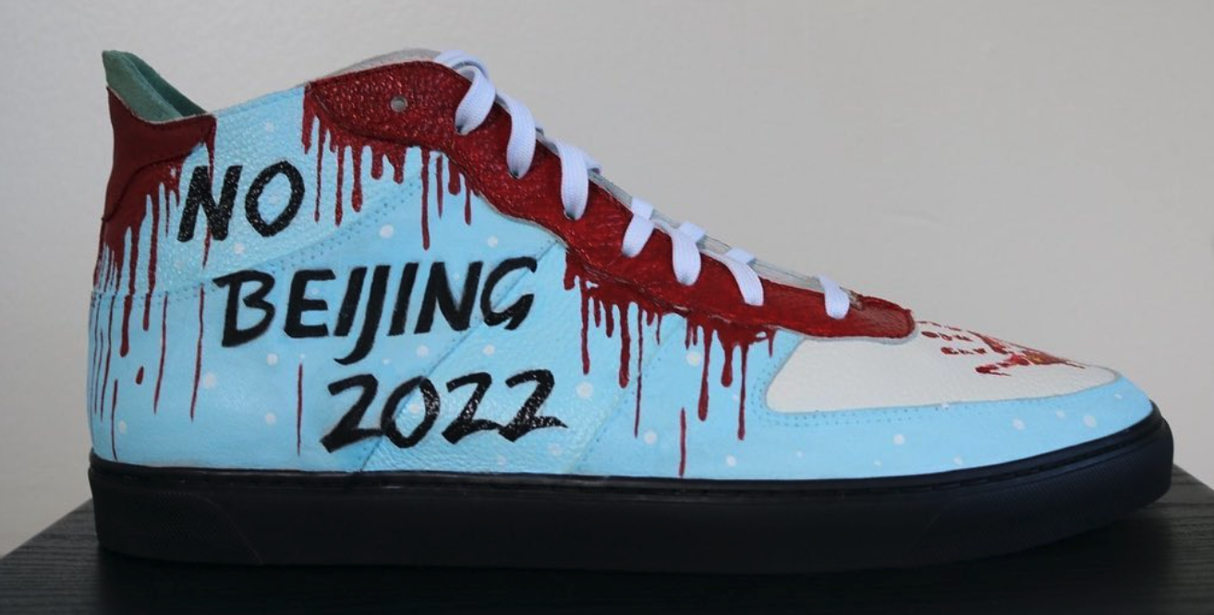
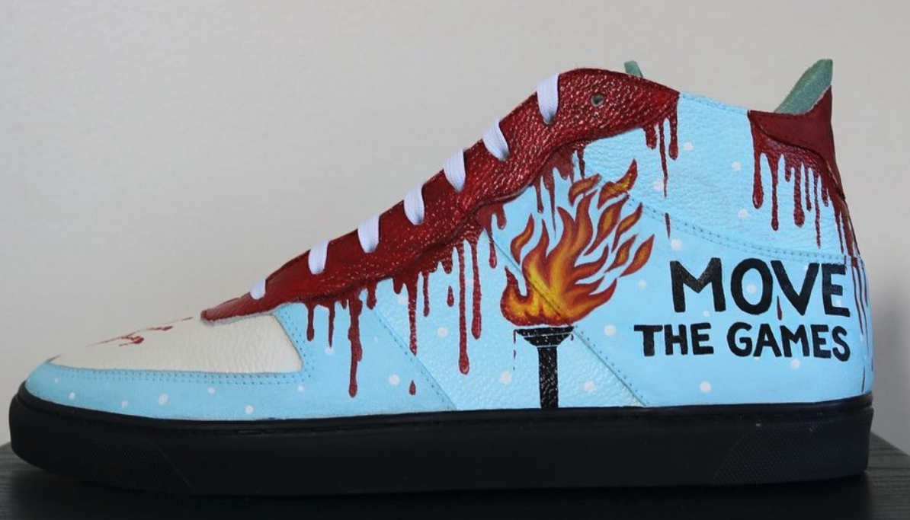
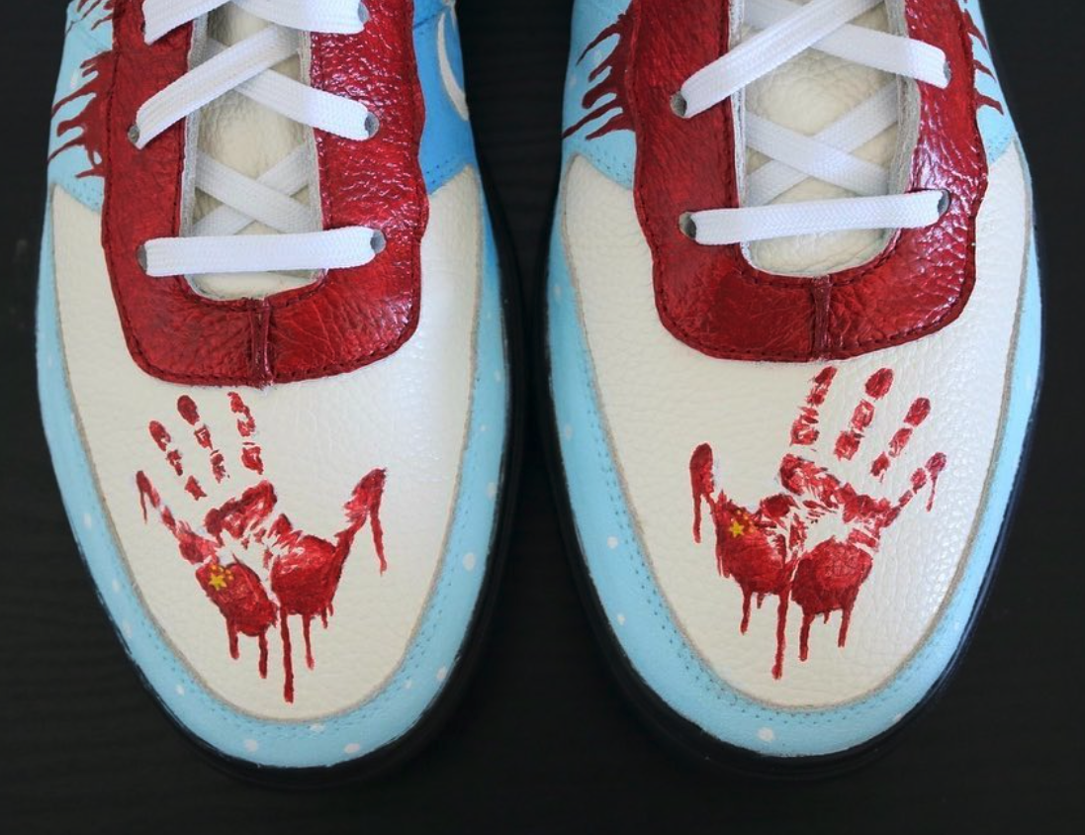
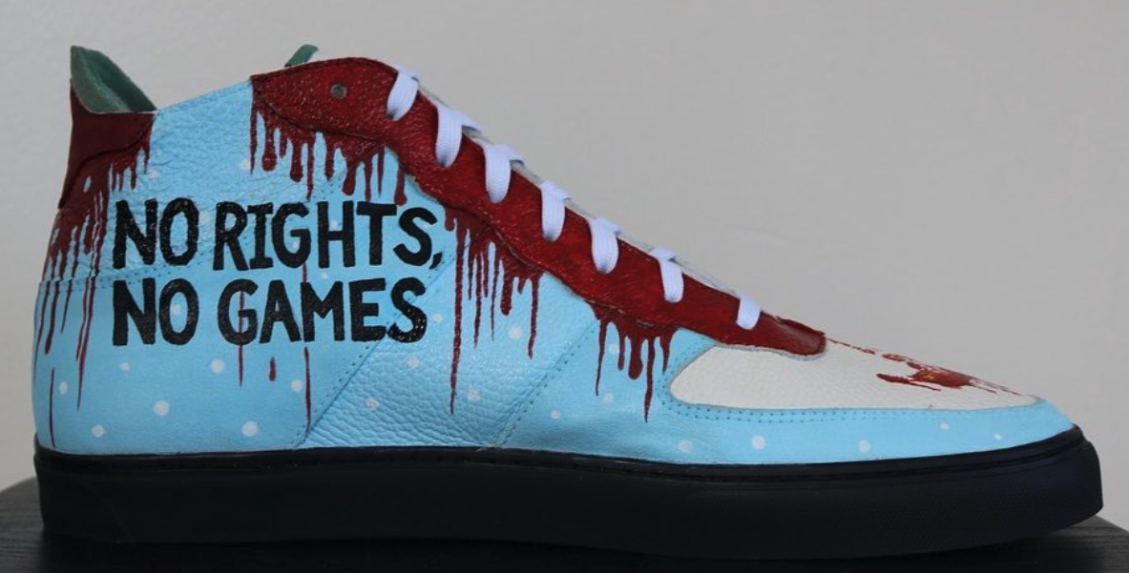
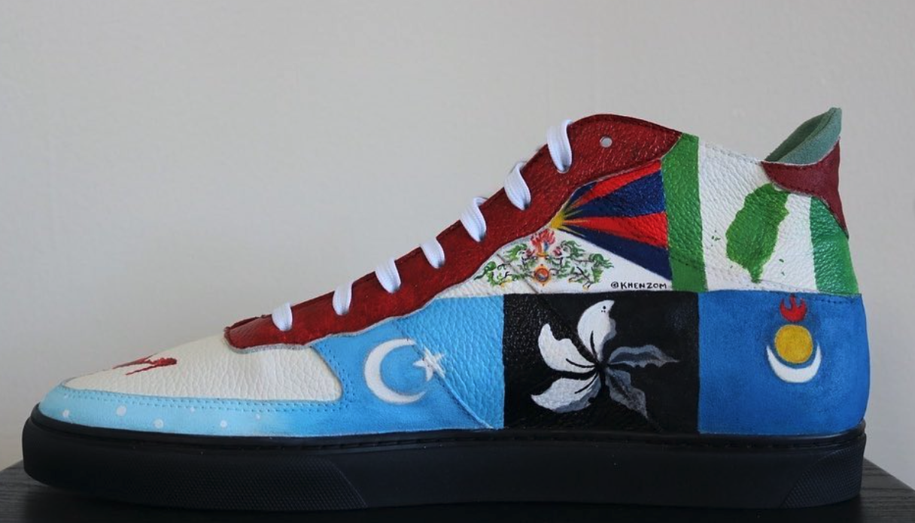
#NoBeijing2022
#FreedomShoes
Notes:
Freedom, E. K. (2021, October 30). No Beijing 2022 shoes [Image]. Instagram. Retrieved January 31, 2022, from https://www.instagram.com/p/CVqJr5gFtYI/

Slide 9
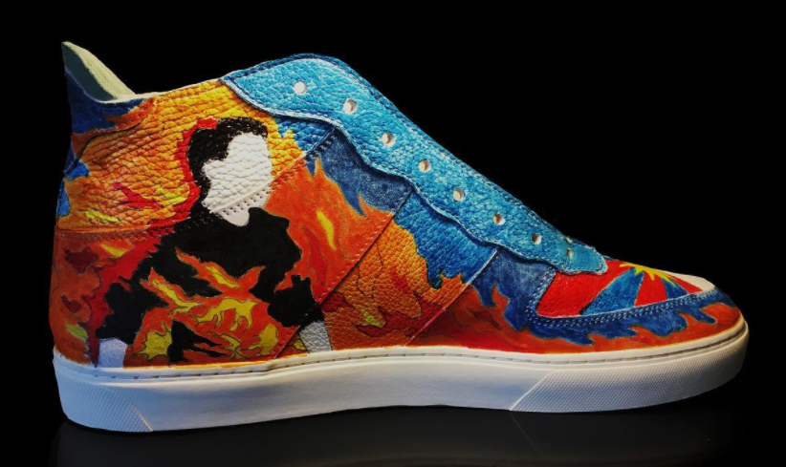
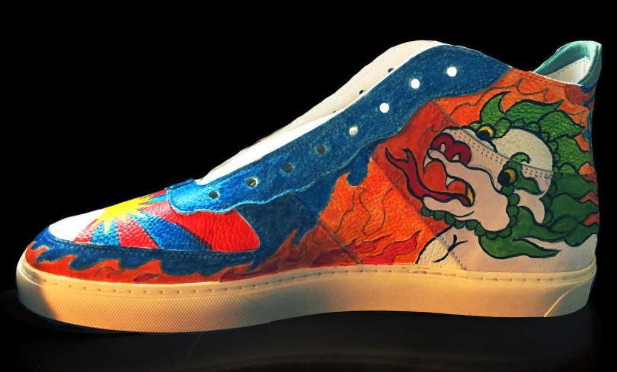
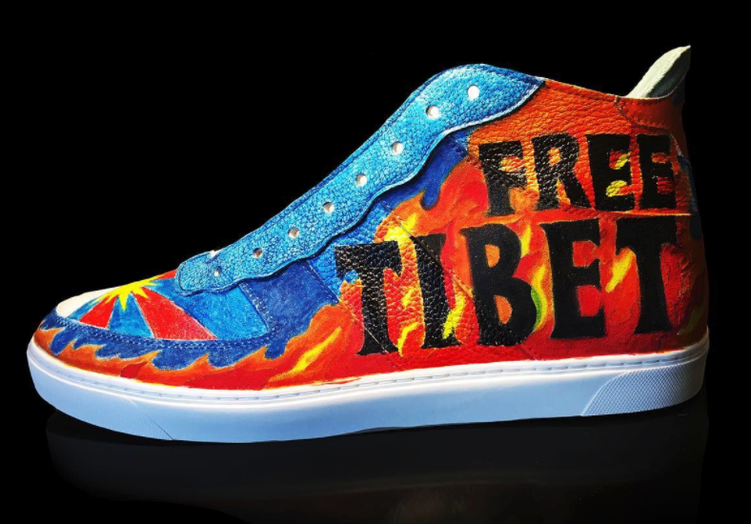
#FreedomShoes
#FreeTibet
Notes:
Freedom, E. K. (2021, October 20). Free Tibet shoes [Image]. Instagram. Retrieved January 31, 2022, from https://www.instagram.com/p/CVRLubYsCA2/

Slide 10
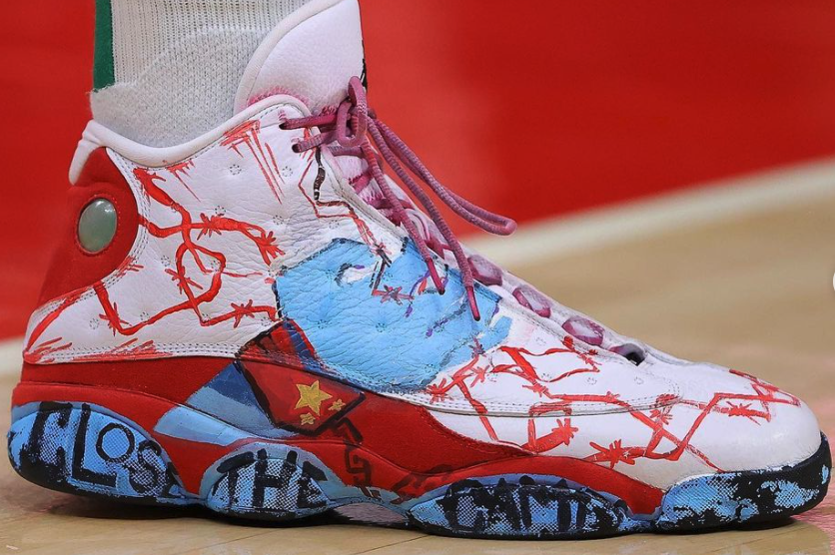
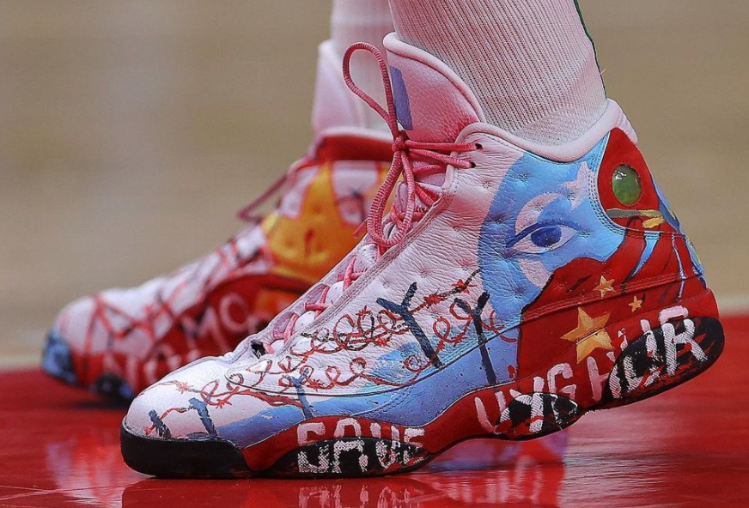
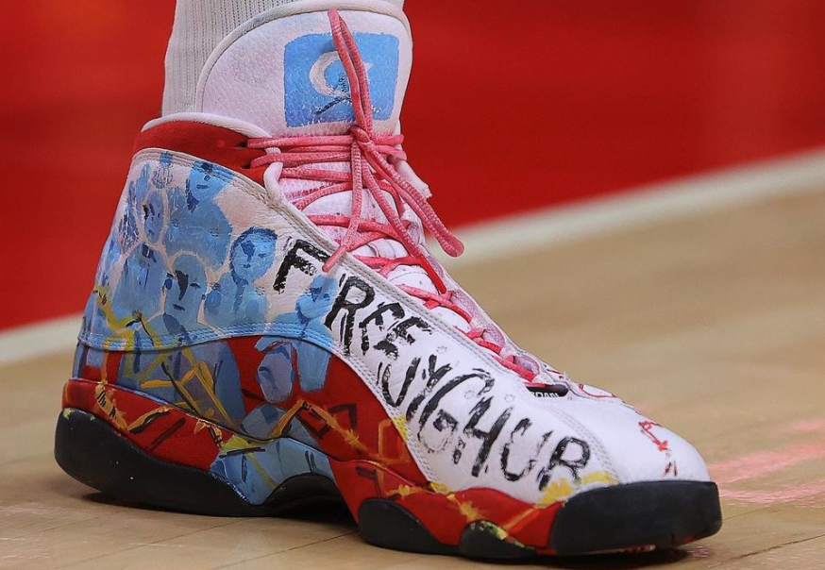
#FreeUyghurs
Notes:
Freedom, E. K. (2021, November 28). Save Uyghur shoes [Image]. Instagram. Retrieved January 31, 2022, from https://www.instagram.com/p/CW1GVNtlSos/

Slide 11
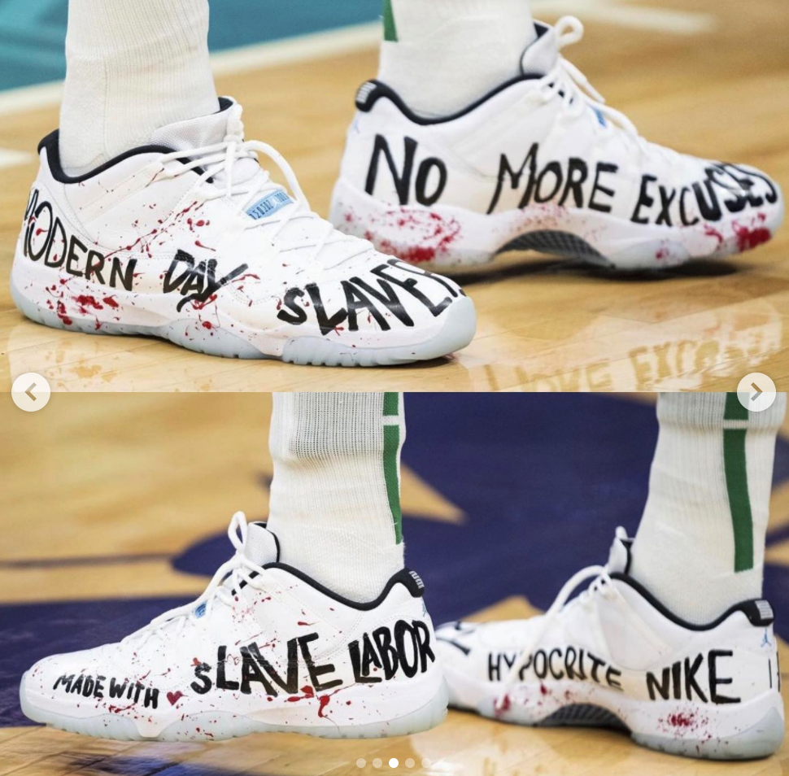
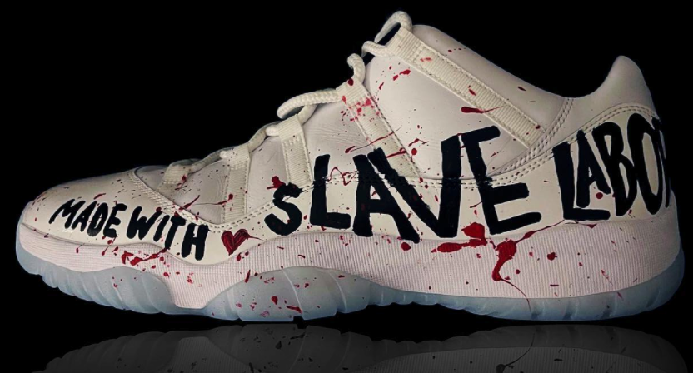
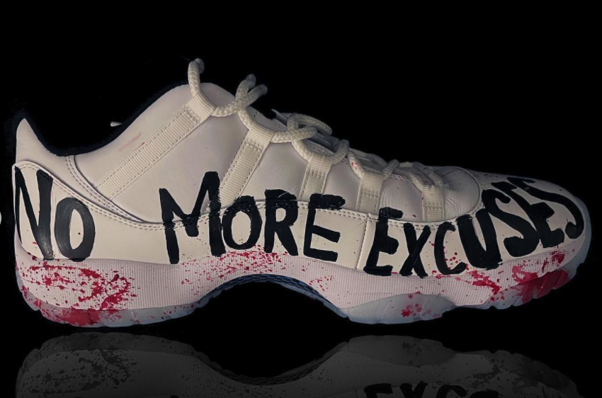
#EndUyghurForcecdLabor
Notes:
Freedom, E. K. (2021, October 26). Hypocrite Nike shoes [Image]. Instagram. Retrieved January 31, 2022, from https://www.instagram.com/p/CVgEle_l18s/

Slide 12
Always, Sometimes, or Never True
Read each of the statements on the following slides and decide how often it is true:
Always
Sometimes
Never
Make sure to justify your answer.
Notes:
K20 Center. (n.d.). Always, sometimes, or never true. Strategies. https://learn.k20center.ou.edu/strategy/145

Slide 13
Always, Sometimes, or Never True
The title of a journalistic article is called a headline.
Always True

Slide 14
Always, Sometimes, or Never True
An image of the author is included.
Sometimes True

Slide 15
Always, Sometimes, or Never True
Images should have captions to tell the audience key information.
Always True

Slide 16
Always, Sometimes, or Never True
An article includes the name of the newspaper in the body text.
Sometimes True

Slide 17
Always, Sometimes, or Never True
A drophead (or deck) is a secondary headline that provides additional information about a story.
Always True

Slide 18
Always, Sometimes, or Never True
The byline should be included only at the end of an article.
Never True

Slide 19
Always, Sometimes, or Never True
Every article should begin with a lead (or lede) that tells readers what the most important information is.
Always True

Slide 20
Always, Sometimes, or Never True
Images are an important way to capture the audience's attention.
Always True

Slide 21
Always, Sometimes, or Never True
The author of an article should cite who/where their facts and information come from.
Always True

Slide 22
Always, Sometimes, or Never True
Quotations should be direct, with nothing omitted from what the source said.
Sometimes True

Slide 23
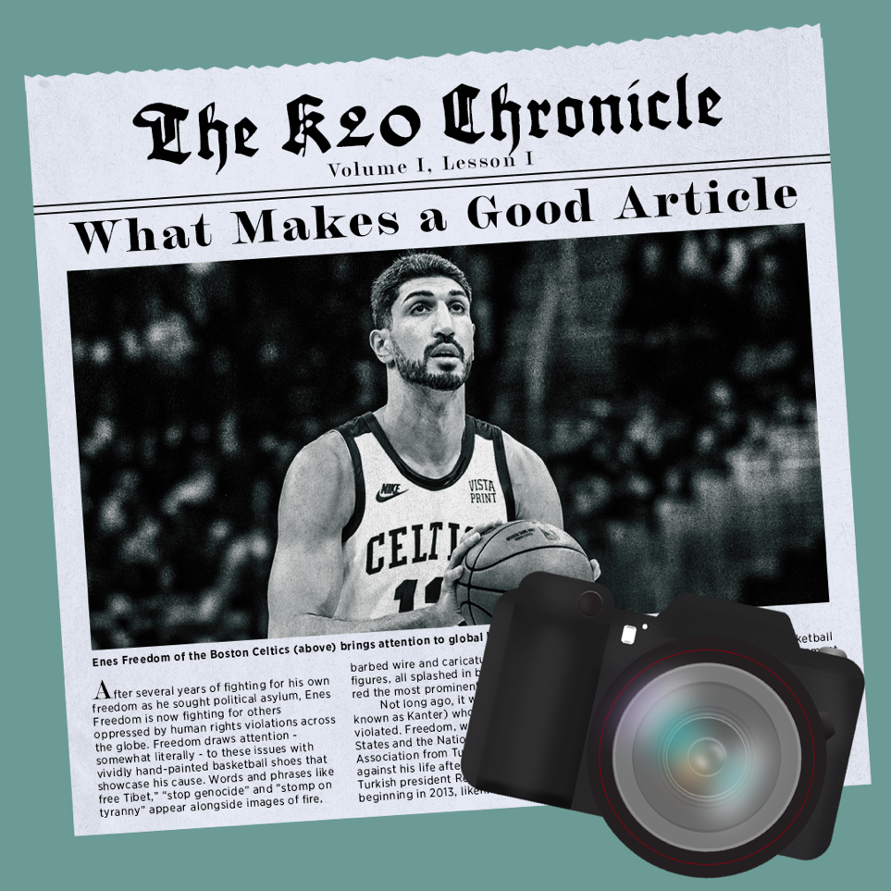
Your Turn!
Choose one of the articles you read earlier. Based on what you’ve learned, create your own start to the article. Be sure to include the following:
Headline
Byline
Image with caption
Don’t forget to credit the photographer!

Slide 24
What Makes a Good Article?
Using the rubric, read through your assigned story and score it to determine whether it is a “good” article!

