Slide 2
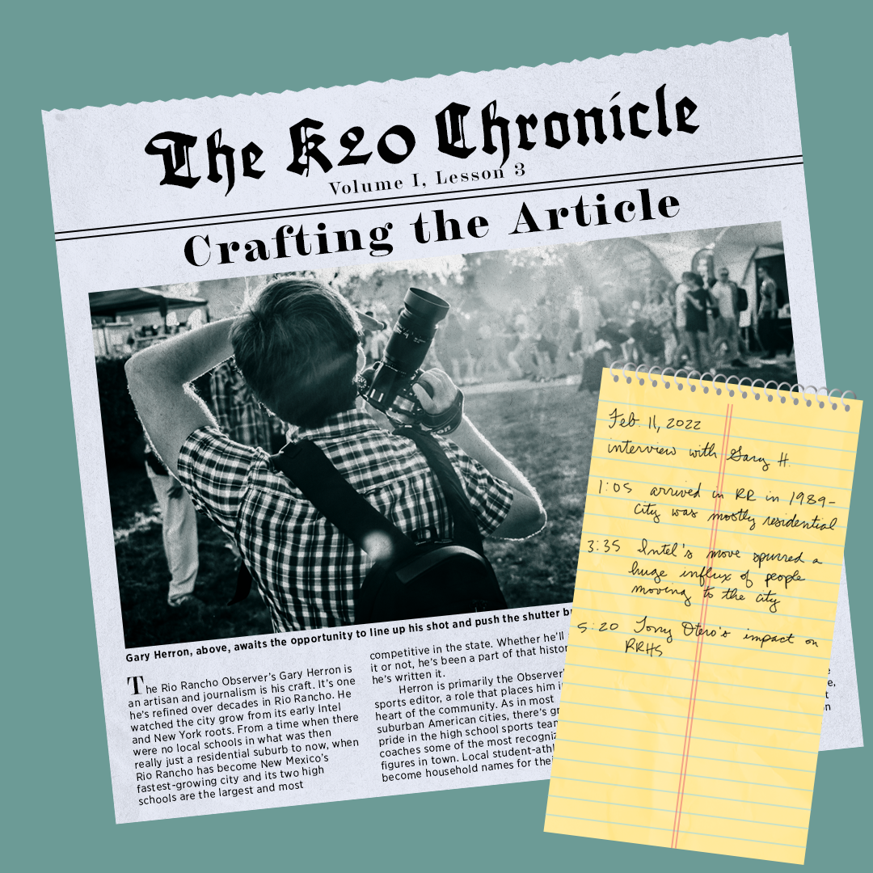
K20 Chronicle
Crafting the Article

Slide 3
Essential Questions
What are the components of a journalistic article?
What makes a good article?
How do you create an engaging story?

Slide 4
Lesson Objectives
Examine articles for historical context, audience, and intended purpose.
Explore a theme and capture images to represent it.
Use interview transcripts to craft an article about a senior student for the school newspaper.

Slide 5
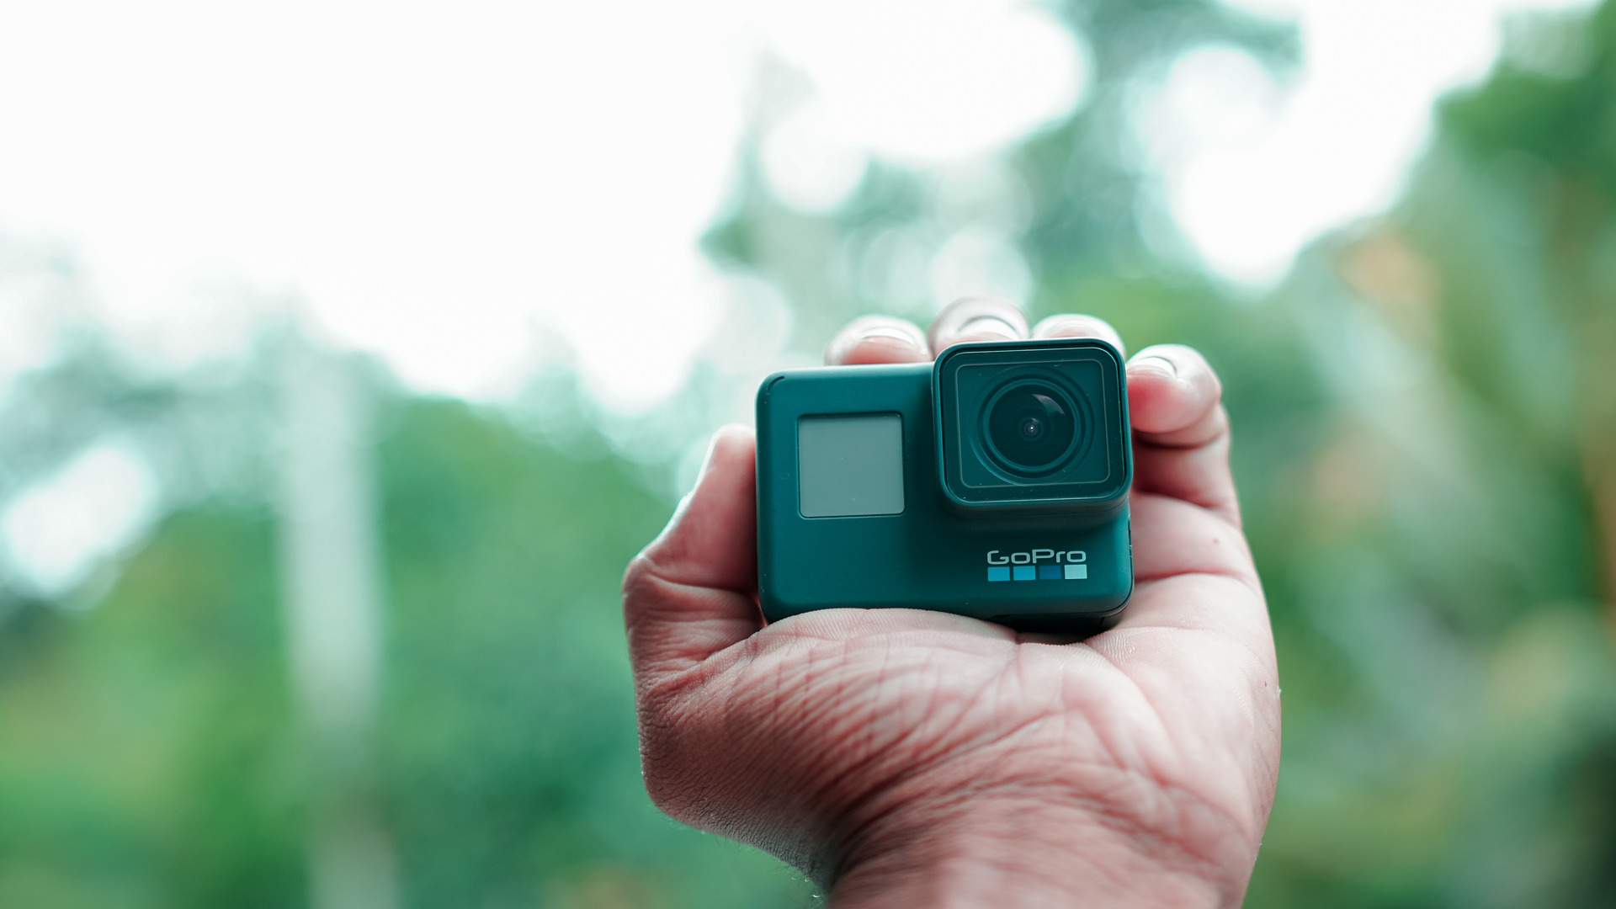
Caption This
Select 2-3 photos that you took of your senior to share with the class.
Notes:
Linojacob. (2021). Gopro, camera, device, gopro hero 6, action camera, technology, photos [Clip art]. Pixabay. https://pixabay.com/photos/gopro-camera-device-gopro-hero-6-6325014/.

Slide 6

Caption This
Walk around the room and take some time looking at the images that your peers selected.
Provide a suggested caption for at least one photo per person.
If someone already wrote a caption that you like, put a check mark next to it!

Slide 7
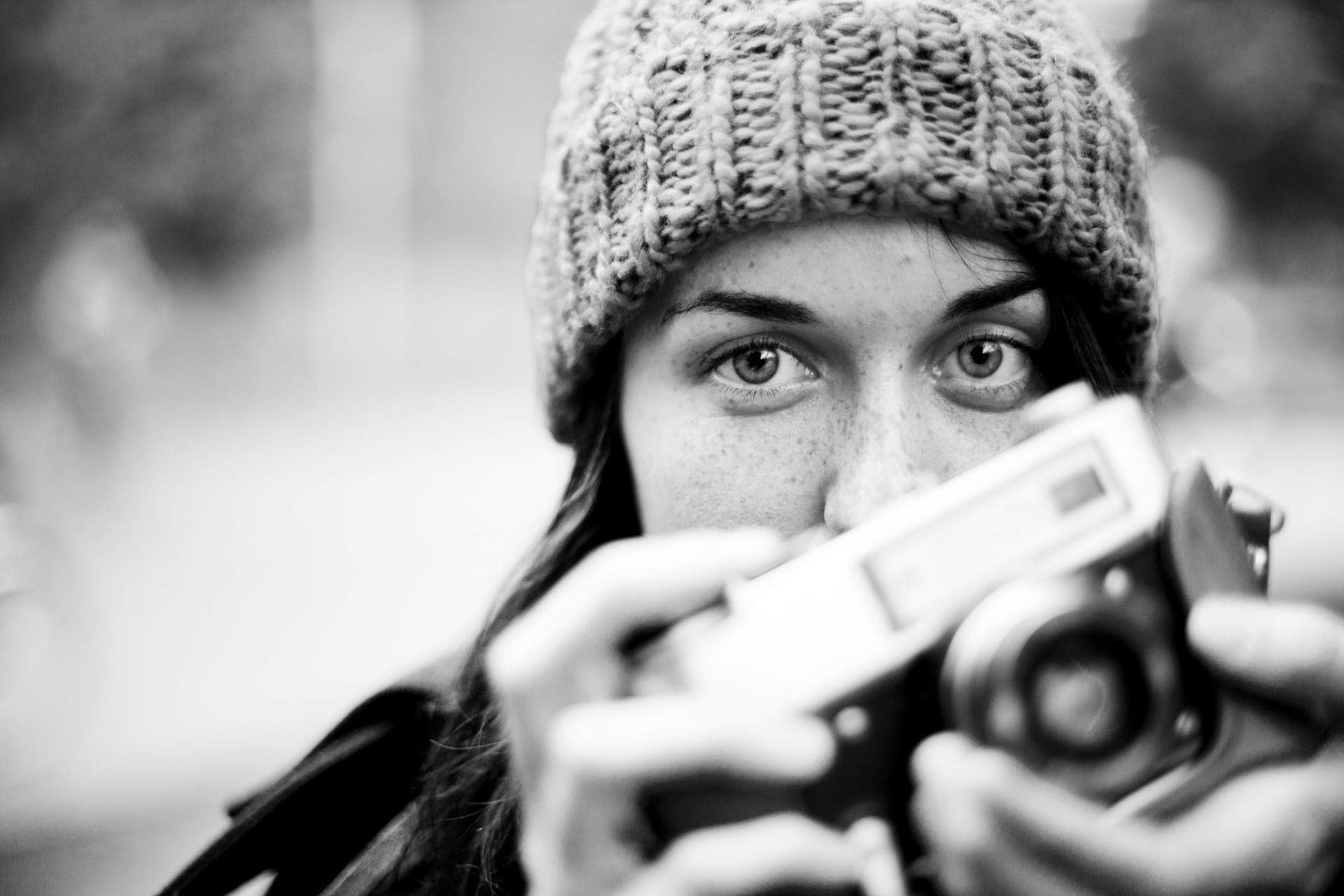
ICAP: Photojournalism
As you are watching the video, listen for key words and themes that stand out to you.
Enter them into this Mentimeter
[paste Mentimeter link here]
Notes:
Link to ICAP video: https://www.youtube.com/watch?v=v3P0zmR4hZI
To generate the Mentimeter link: visit this link [https://www.mentimeter.com/app/presentation/186012398af4d15ec8a0a6432035ddd0/48f1e47119b4] and copy the presentation to your own account, then click “share,” and copy the new link to paste it into this slide.
AlexLoban. (2016). Photographer, photography, camera, old, retro, hobby, shoot, person, photographing, creative, young, girl, autumn, lifestyle, hands, objective, black and white, bw, gray camera, gray photography, gray retro, gray creative, gray old, photos [Clip art]. Pixabay. https://pixabay.com/photos/photographer-photography-camera-old-1773331/.

Slide 8
Choose one word or theme from the word cloud
Notes:
Paste the newly-created word cloud from Mentimeter onto this slide.

Slide 9

Photojournalism
Take photos around the school that represent your chosen word or theme
Create a visual collage using the photos you take

Slide 10

H.I.P.P.
Select three articles to read from this Wakelet.
As you read, consider the techniques you see the interviewers using and use the H.I.P.P. acronym to help you answer the questions on your handout.
  H is for historical context
  I is for intended audience
  P is for point of view
  P is for purpose
Notes:
Provide students with this link to the Wakelet: https://wke.lt/w/s/LS3ee1

Slide 11
Outlining Your Article
Lead Sentence
  Grab and hook your reader right away.
Introduction
  Which image will you share with your reader?
  How will this introduce your senior?
Opening Quotation
  What will give your reader a sense of what your senior wants to share?
Main Body
  What is the heart of your story?
Closing Quotation
  What will sum up the article in a few words or sentences?
Conclusion

