Slide 2
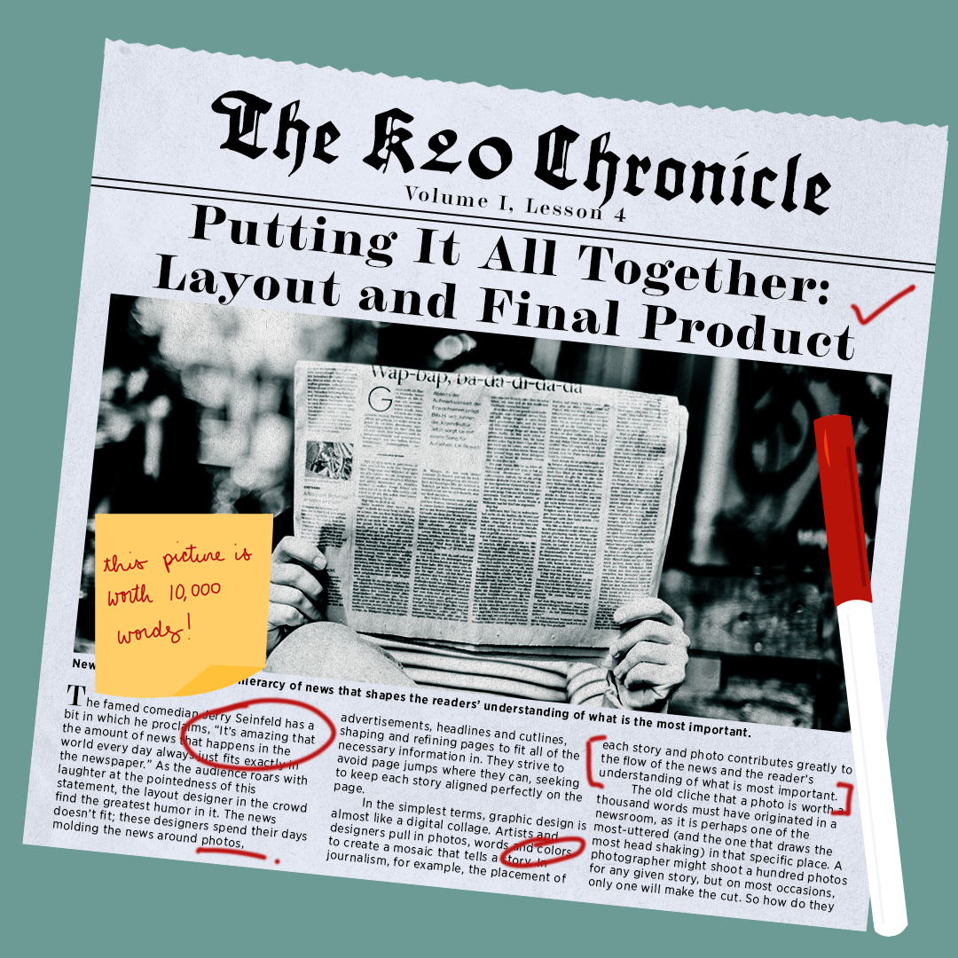
K20 Chronicle
Putting It All Together

Slide 3
Essential Questions
What are the components of a journalistic article?
What makes a good article?
How do you create an engaging story?

Slide 4
Learning Objectives
Cultivate articles to create a newsletter.
Design the layout of articles and related images.

Slide 5
Surprising, Interesting, Troubling
As you watch the video about how the New York Times is made, write down the following:
One thing that surprised you
One thing that is interesting to you
One thing that is troubling you
Notes:
Link to “How It’s Made” video: https://youtu.be/MrWP2z8I0Qk

Slide 6
Looks Like, Sounds Like, Feels Like
Think back to the newspaper, journal, and online articles you have read throughout this unit.
In Lesson 1, we created a class list of what a good article:
Looks like
Sounds like
Feels like

Slide 7
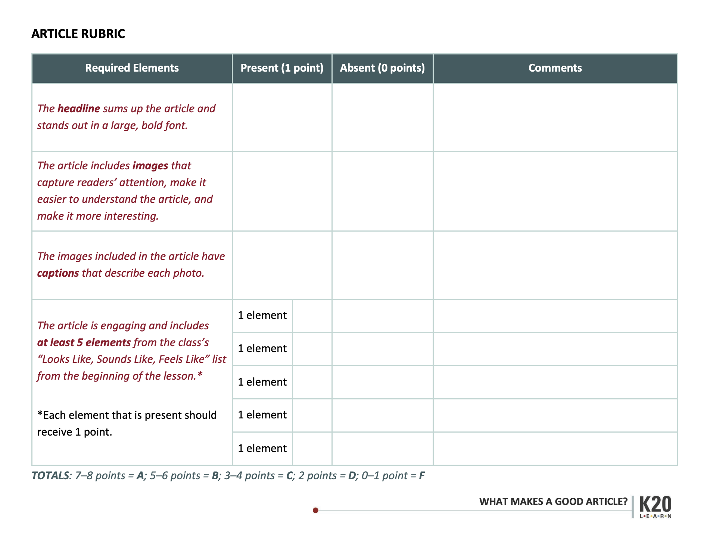
How Did You Do?
Revisit the rubric and “Looks Like,” “Sounds Like,” and “Feels Like,” chart from Lesson 1.
Read through your partner’s article.
Provide them with helpful feedback on how they could improve.

Slide 8
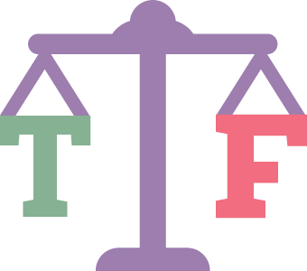
ICAP Online and Print Media Specialists
Review the list of statements on your handout.
As you are watching the video, listen for key words that help you determine whether those statements are true or false.
Notes:
Link to ICAP video: https://youtu.be/ujon29P_eZ0

Slide 9
Examples and Non-Examples
With your group, find the following:
2-3 examples of articles with good layouts
2-3 examples of articles with poor layouts

Slide 10
Your Turn!
As you are laying out your final product, don’t forget to include the following:
Headline
Images
Captions
Complete Article

Slide 11
I Used to Think, But Now I Know
Reflect on some ideas you had about what it meant to write an article prior to this journalism unit.
How has your thinking changed? What do you now know about this topic that you didn’t before?

