Slide 2
Set the Stage
Media Production, Lesson 2:
Setting Up Audio for Live Productions

Slide 3
Bell Ringer
Make a list of all the necessary audio equipment you think is needed to host a live band or speaker at an event.
Notes:
To play the 3-minute timer video, click the image on the slide or paste the following link into your web browser: https://www.youtube.com/watch?v=iISP02KPau0
Source: K20 Center. (n.d.). 3-minute timer [Video]. YouTube. https://www.youtube.com/watch?v=iISP02KPau0

Slide 4
Essential Question
How does one use audio equipment in live production?

Slide 5
Lesson Objective
Learn how to set up for a live audio production using audio mixer, speakers, and microphones.

Slide 6
I Notice, I Wonder
Using the handout, take notes about what you observe and questions you have about each of the following pieces of equipment:
Speaker
Subwoofer
Microphone
Audio Mixer
Notes:
K20 Center. (n.d.). I Notice, I Wonder. Strategies. https://learn.k20center.ou.edu/strategy/180

Slide 7
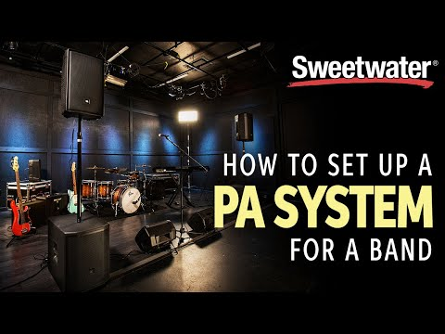
Video
Notes:
To play the video, click the image on the slide or paste the following link into your web browser: https://www.youtube.com/watch?v=Shtwr8-P0zs
Source: SweetwaterSound. (2020, March 13). How to set up a PA system for a band [Video]. YouTube. Retrieved February 11, 2022, from https://www.youtube.com/watch?v=Shtwr8-P0zs

Slide 8
Create a Stage Diagram
Using the handout with the equipment images, create a stage and place the equipment in the proper places.
Cut out each piece of equipment.
Glue the equipment pieces on copy paper as they would be on stage.
Label all pieces of equipment.
Using colored pencils or markers, draw lines representing where cables should connect each piece of equipment.

Slide 9
Set the Stage
Using your diagram as a reference, set the equipment up in the way that you would for a show.
Make sure the connections are in the correct places.

Slide 10
3-2-1 Strategy
3 - What are three things you learned?
2 - What are two questions you still have?
1 - What is one thing you found interesting?
Notes:
K20 Center. (n.d.). 3-2-1. Strategies. https://learn.k20center.ou.edu/strategy/117

