Slide 2
Exploring Conflict and Theme
Engaging with “The Necklace”

Slide 3
Essential Question
How do types of conflict contribute to theme and author’s purpose?

Slide 4
Lesson Objective
Students will be able to analyze how an author uses conflict in a story to develop the theme.

Slide 5
Notes:
https://www.youtube.com/watch?v=07d2dXHYb94

Slide 6
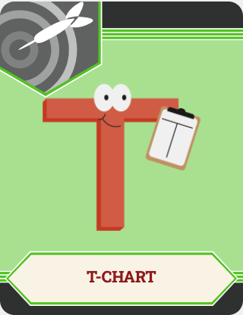
Sorting Conflicts and Problems
With your partner, determine whether each conflict/problem is an Internal or External Conflict.
Sort these into the appropriate column on your paper.

Slide 7
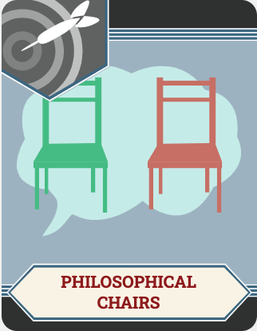
Philosophical Chairs
A debate style activity that centers on listening to understand versus listening to respond.

Slide 8
Philosophical Chairs
Make sure you fully understand the statement before beginning the activity
You MUST summarize what the previous person said before you can voice your own opinion
Three people must state their opinions before you can go again
Address the ideas and NOT the person
Refrain from side conversations

Slide 9
Money can buy happiness.

Slide 10
Envy: Have you ever seen or felt its negative effects?

Slide 11
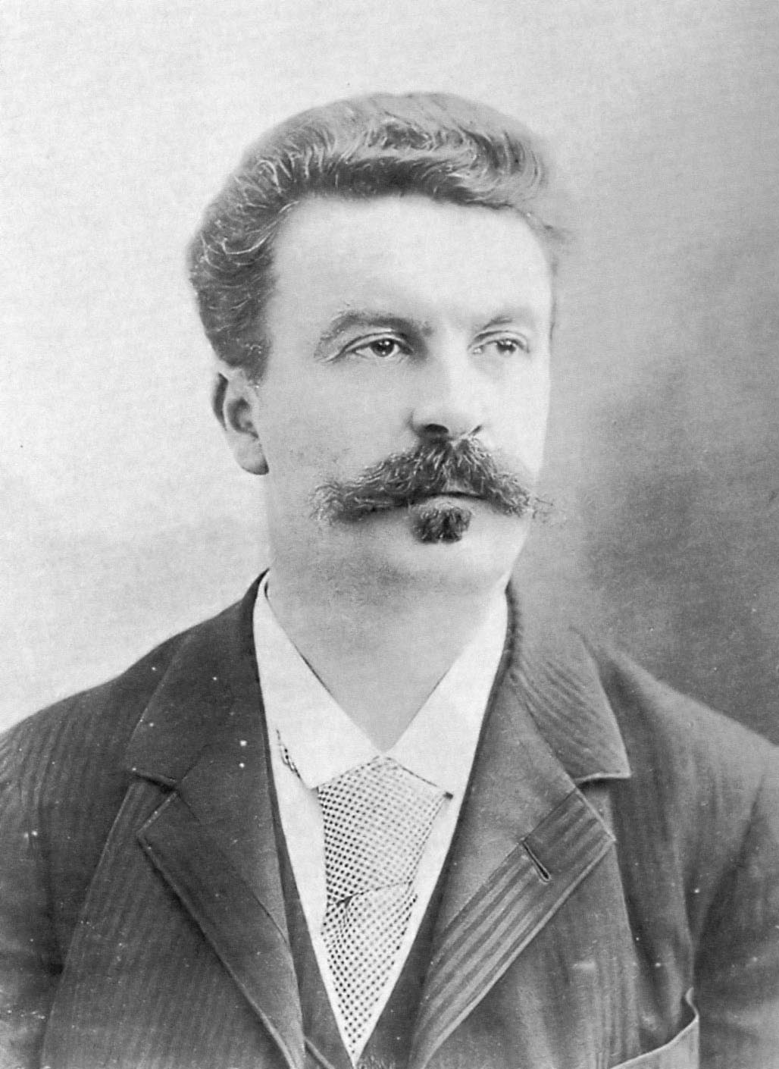
Guy de Maupassant
19th Century French Author
Wrote many short stories, including “The Necklace”
Notes:
https://commons.wikimedia.org/wiki/File:Maupassant_2.jpg

Slide 12
External Conflict
Situations outside of the character’s control.
Man v. Man
Man v. Nature
Man v. Society
Man v. Fate

Slide 13
Internal Conflict
Conflicts inside a character’s mind.
Emotional Conflict
Insecurity
Moral Dilemma

Slide 14
Dialectical Journal
Conflict: What is the problem? Include the type of conflict.
Textual Evidence: Include the evidence from the text to support your answer. (Include page numbers!)
Plan of Action: What is the plan of action to solve the conflict in the story?

Slide 15
What is the theme of a story?

Slide 16
Theme
The theme, or lesson learned, in the story makes up the author’s purpose on what they want us, the reader, to understand about life.

Slide 17
“The Necklace”
What are some themes?
Choose one theme from “The Necklace” and turn it into a theme statement, or advice for life
What are some real-world scenarios where people experience the results/consequences of that statement?

Slide 18
One-Pager
Theme
One graphic that represents the theme
Three examples of textual evidence to support your theme
Border to describe how the theme built meaning and the author’s purpose in the story

Slide 19
One Pager
Write your chosen theme word or statement on the page
Draw one graphic that represents your theme
Include three pieces of textual evidence directly from the text that supports your theme
In the border around your page, include your words on how the theme built meaning and the author’s purpose in the story

