Slide 2
I’m No Lazybones
Movement and the Musculoskeletal System

Slide 3
Essential Question
How do the muscular and skeletal systems interact to produce movement?

Slide 4
Lesson Objectives
Observe tissues and relate their structure and function.
Create and use a model to illustrate how the parts of the musculoskeletal system work together to produce movement.

Slide 5
Stoat Hypnotizes Rabbit
Notes:
To play the video, click on the image on the slide OR paste the following link into your web browser: https://www.youtube.com/watch?v=ODEUK5sB5vE
NatGeoWild. (2012, October 1). Stoat hypnotizes Rabbit | World's deadliest [Video]. YouTube. https://www.youtube.com/watch?v=ODEUK5sB5vE

Slide 6
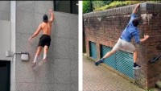
Parkour and Freerunning
Notes:
To play the video, click on the image on the slide OR paste the following link into your web browser: https://web.archive.org/web/20220317043404/https://www.youtube.com/watch?v=PqeBGJXH-uQ
PKFR TV. (February 2, 2022). The World's Best Parkour and Freerunning [Video]. YouTube. https://web.archive.org/web/20220317043404/https://www.youtube.com/watch?v=PqeBGJXH-uQ

Slide 7
Examining Tissues
View the different tissues under the microscopes at each station.
As you view the tissue, sketch what you see and describe in words what you see under the microscope.

Slide 8
Musculoskeletal System
Muscular System
+
Skeletal System
=
Musculoskeletal System

Slide 9
Musculoskeletal System
Muscular System
Skeletal muscle
Smooth muscle
Cardiac muscle
Skeletal System
Bones
Connective tissue (cartilage, ligaments, tendons)

Slide 10
Musculoskeletal System: Muscle
Skeletal muscle
Attached to bones
Voluntary movement
Smooth muscle
Found inside organs (e.g., stomach), vessels (e.g., arteries), and tracts (e.g., urinary, respiratory)
Involuntary movement
Cardiac muscle
Found only in the heart
Involuntary movement

Slide 11
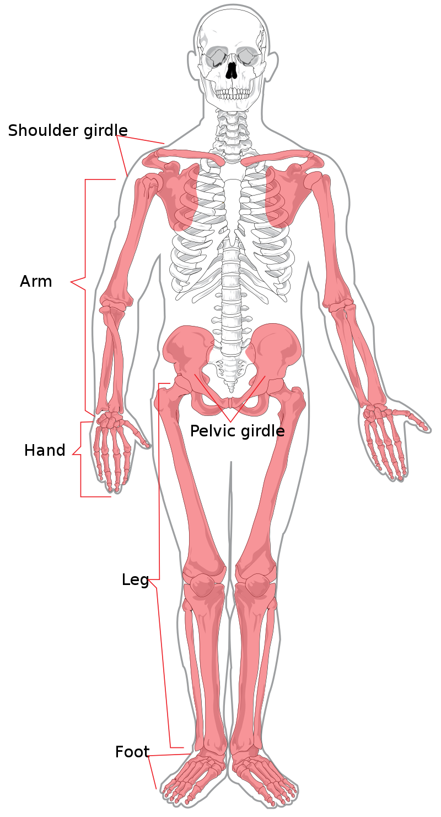
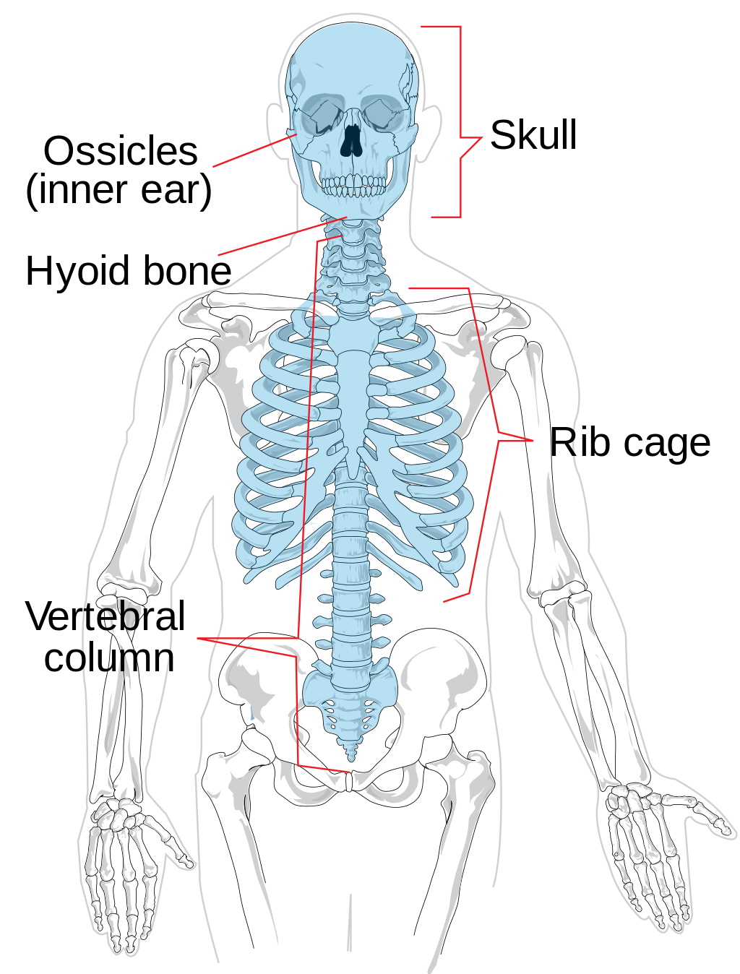
Musculoskeletal System: Bones
Axial skeleton
Appendicular skeleton
Bones at the center of the body
Support and protect organs
Limb bones
Bones that connect limbs to the axial skeleton
Notes:
Wikimedia Foundation. (2022, April 9). Axial Skeleton. Wikipedia. Retrieved April 13, 2022, from https://en.wikipedia.org/wiki/Axial_skeleton#/media/File:Axial_skeleton_diagram.svg
Wikimedia Foundation. (2021, November 14). Appendicular skeleton. Wikipedia. Retrieved April 13, 2022, from https://en.wikipedia.org/wiki/Appendicular_skeleton#/media/File:Appendicular_skeleton_diagram.svg

Slide 12
Musculoskeletal System: Connective Tissue
Cartilage
Several kinds with different functions, both protective and structural; can be found:
In our nose and ears
Between bones at joints and vertebrae
As part of the structure of specific bones (e.g., ends of ribs)
In bronchial tubes and airways
Notes:
Cartilage: protects the ends of bones and keeps bones from rubbing together directly; found as a structural component of the rib cage, ears, nose, bronchial tubes, etc.

Slide 13
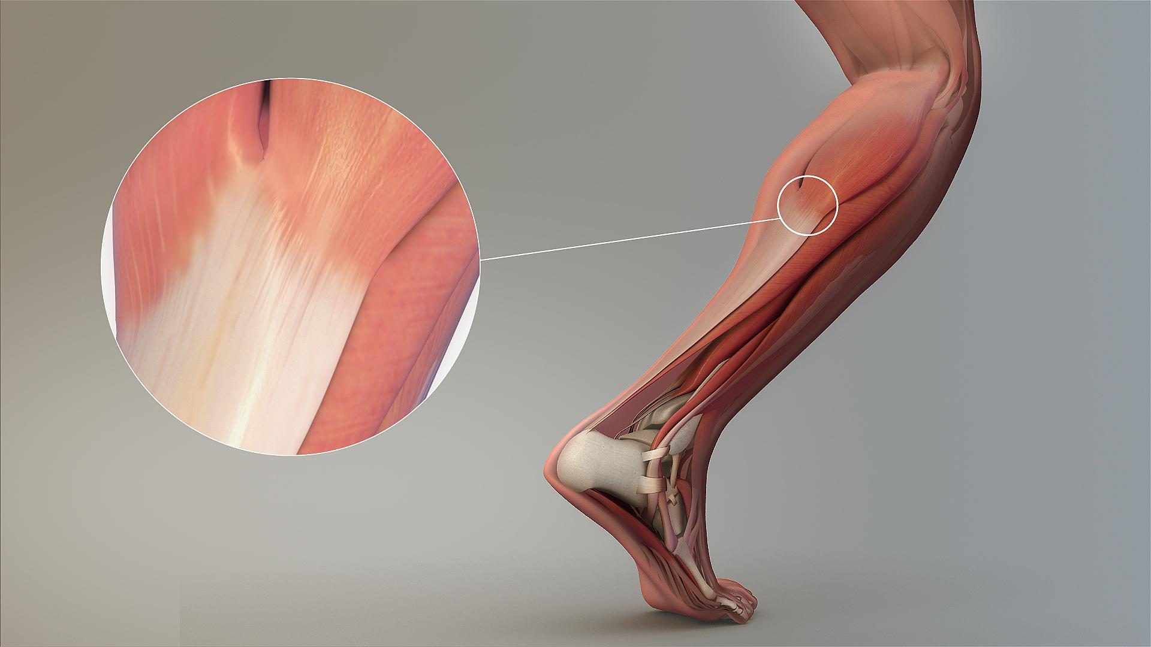
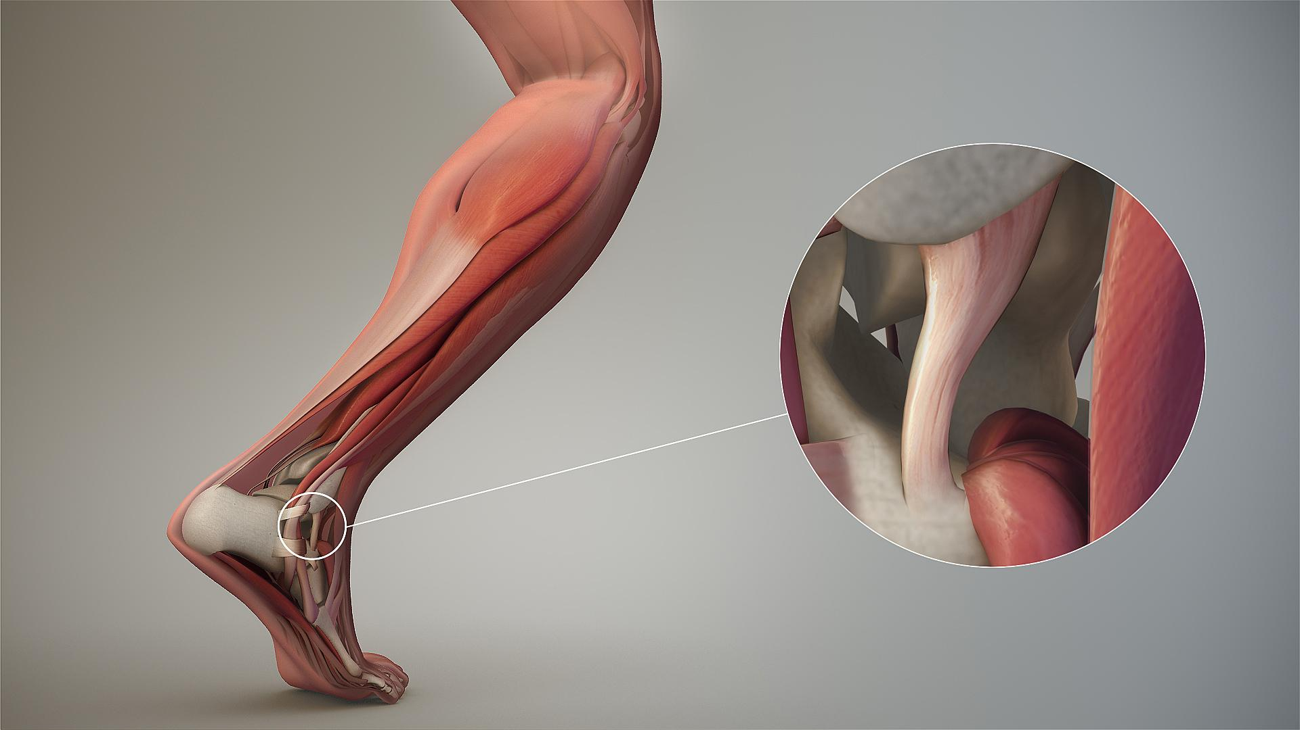
Musculoskeletal System: Connective Tissue
Tendons
Ligaments
Connect muscle to bones
Connect bones to other bones
Notes:
Wikimedia Foundation. (2022, February 22). Ligament. Wikipedia. Retrieved April 13, 2022, from https://en.wikipedia.org/wiki/Ligament#/media/File:Ligament.jpg
Wikimedia Foundation. (2022, March 16). Tendon. Wikipedia. Retrieved April 13, 2022, from https://en.wikipedia.org/wiki/Tendon#/media/File:Magnified_view_of_a_Tendon.jpg

Slide 14
Musculoskeletal System Movement
Body movement happens at joints.
If each muscle is only able to pull in a single direction, how is movement possible?

Slide 15
Create a Flipbook
Use sticky notes to create a flipbook that demonstrates how the musculoskeletal system components interact to create movement.
Options include:
Flexion/extension – bending and extending your forearm at the elbow
Abduction/adduction – arm motion during jumping jacks

