Slide 2
(Not) Sorry to Burst Your Bubble
Passive Transport, Homeostasis, and Antibiotics

Slide 3
Essential Question
How does the cell membrane help cells maintain homeostasis?
How does vancomycin work to destroy MRSA bacteria?

Slide 4
Lesson Objectives
Conduct an investigation of the cell membrane and passive transport.
Explain how the antibiotic vancomycin kills MRSA bacteria.

Slide 5
3-Way Venn Diagram
animal cell
plant cell
bacteria cell

Slide 6
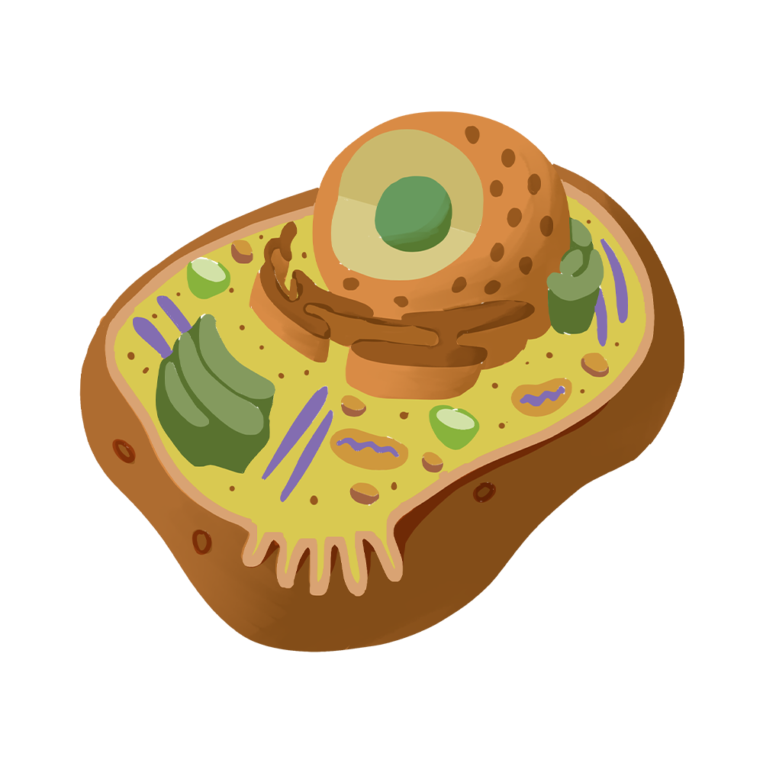
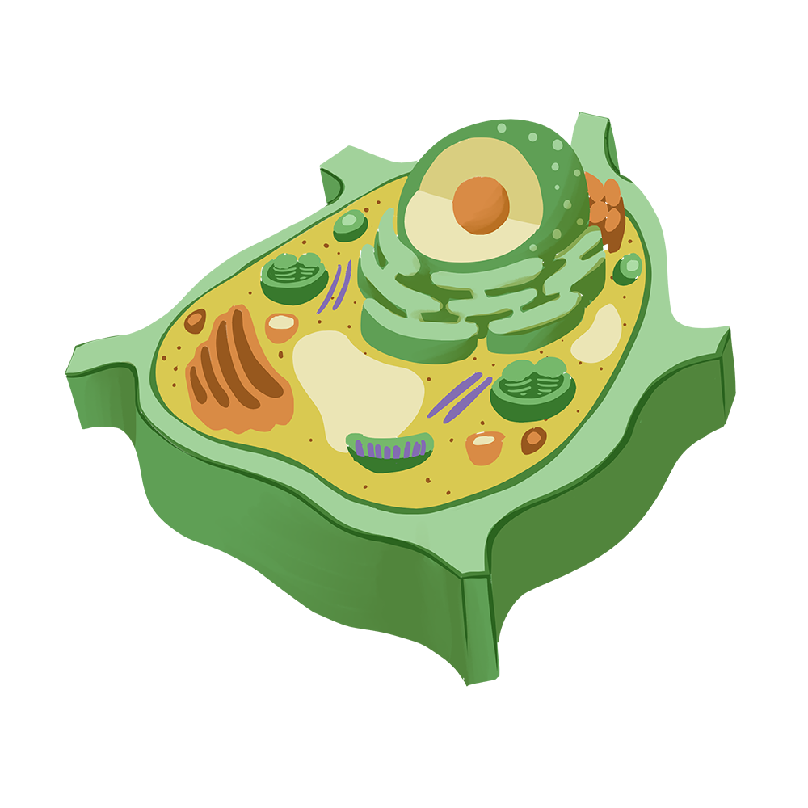
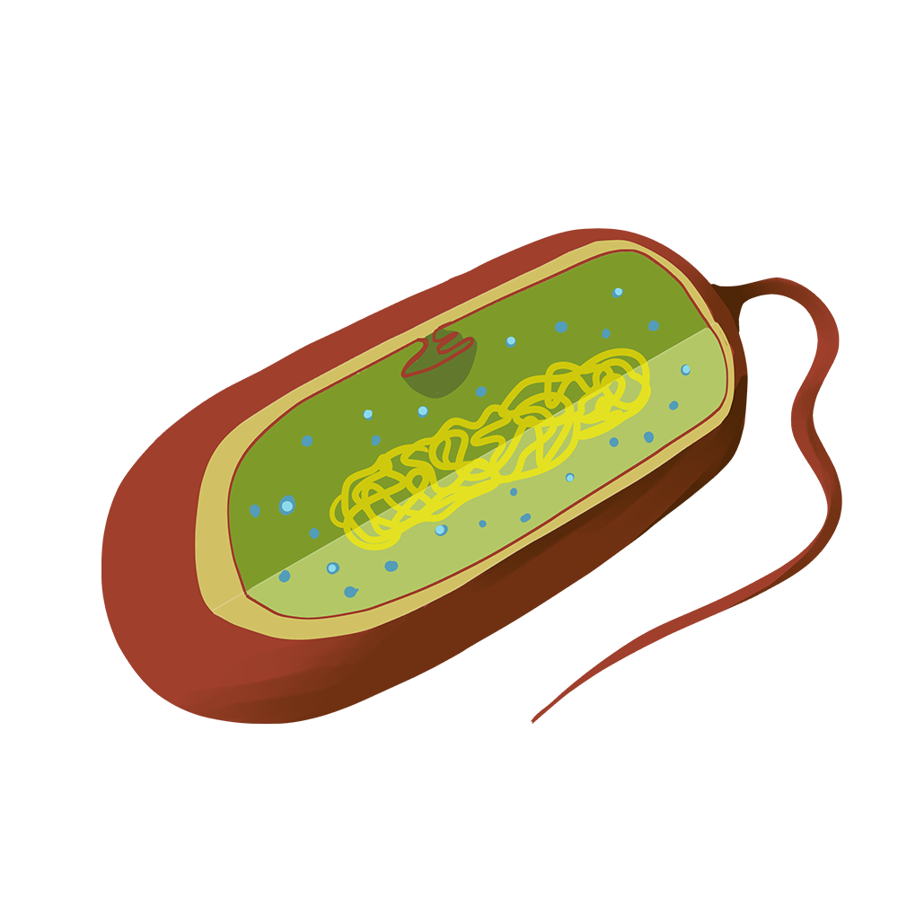
Animal, Plant, and Bacteria Cells
Compare the three cells using your Venn Diagram.
Animal Cell
Plant Cell
Bacteria Cell

Slide 7
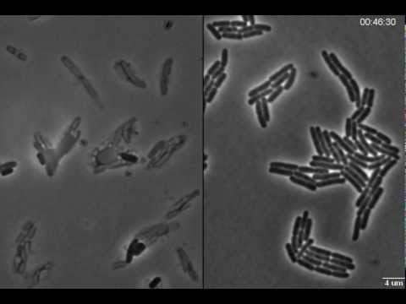
E. coli
Effects of Penicillin
no-antibiotic
Notes:
icambncl. (2013, March 11). Exploding bacteria with penicillin. YouTube. Retrieved August 1, 2022, from https://www.youtube.com/watch?v=UjLmf-cVcMw

Slide 8
Think About it
How could antibiotics like penicillin be used to kill bacteria without harming the cells of the infected organism?
Notes:
Ask students what possible consequences could occur if a cell wall is damaged.
Draw their attention to the plasma membrane (also called the cell membrane) which surrounds all of the cells, and ask them to recall what the plasma membrane does.
Encourage them to consider why plant and bacteria cells need this membrane if they already have a cell wall.
It is fine if they do not have a correct answer, but they should offer some ideas.

Slide 9
Diffusion/Osmosis Investigation
Gather the following materials for your lab group:
insert materials for lab
insert materials for lab

Slide 10
Diffusion/Osmosis Investigation
Insert direction for the investigation here

Slide 11
After Investigation
Work with your lab group to answer the question at the bottom of your Diffusion/Osmosis Investigation Handout.

Slide 12
Share What You Learned
 | Before | After
Mass of cell
Color of cell
Color of solution
Presence of starch
Presence of glucose
Presence of iodine
What substances moved into the dialysis tube? How do you know?
What substances moved out of the dialysis tube? How do you know?

Slide 13
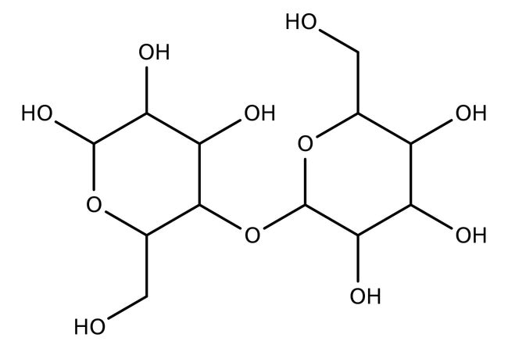
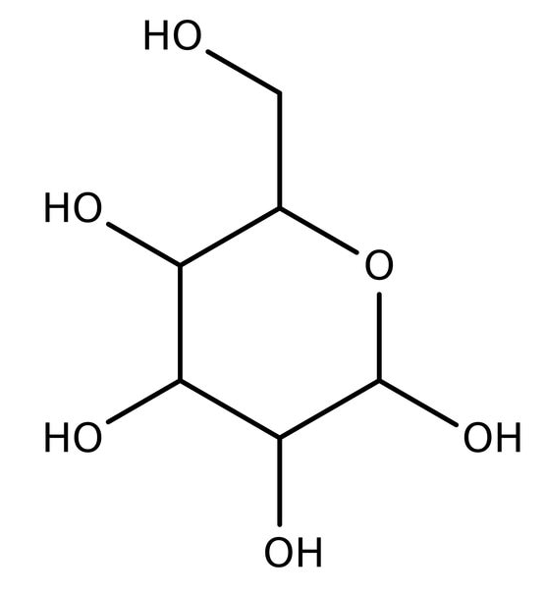
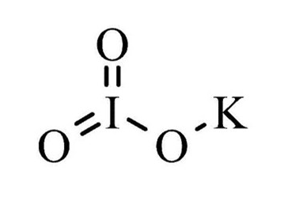
Chemical Structure
Potassium iodide
Glucose
Cornstarch
Notes:
Was the starch able to pass through the membrane? How do you know? (No, the contents of the tube turned blue/black.)
If it had made it through the membrane, how would you know/what would you expect to see? (The solution outside the tube would have turned blue/black.)
Was the iodine able to pass through the membrane? How can you tell? (Yes, because the contents of the tube turned blue/black. Starch can't leave, so the only way it could react is if iodine moved inside.)
Why could glucose and iodine pass through but starch could not? (They are smaller molecules than starch and can fit through the pores in the membrane.)

Slide 14

Cornell Notes: Passive Transport
As we go over the next few slides, take notes over passive transport.
On the right side of your paper, write down the big ideas as notes.
On the left side of your paper, write down key concepts, ask questions, and add your own ideas about the notes.
Be prepared to summarize your ideas into a sentence or two at the bottom of the paper.
Notes:
K20 Center. (n.d.). Cornell Notes System. Strategies.https://learn.k20center.ou.edu/strategy/56

Slide 15

STAR
Title your paper Passive Transport.
As we go over the next few slides, take notes.
Include facts, details, definitions, drawings, symbols.
Remember these are your notes, so write them in a way that makes the most sense to you.
Highlight or underline important information.
Add any questions.
Notes:
K20 Center. (n.d.). Star Notes. Strategies. https://learn.k20center.ou.edu/strategy/69

Slide 16
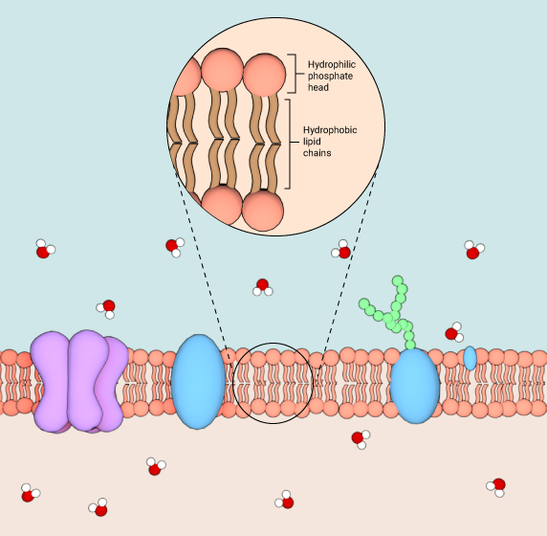
Plasma Membrane: Lipid Bi-layer
Hydrophilic end of protein
  “Water-loving”
  The “head” is attracted to water which makes it orient out, facing water.
Hydrophobic end of protein
  “Water-fearing”
  The “tail” end repels water, which makes it orient in, avoiding water.
Notes:
It is okay if students can’t remember hydrophilic and hydrophobic as long as they understand that the lipid bilayer separates the water inside from the water outside of the cell. Additionally, if students have the prior knowledge, you can also add polar and non-polar to the concepts outlined here.
© The National University of Singapore, 2009 – 2018.
Unless stated otherwise all text, animations, video, illustrations, sounds, communications, and other data, herein referred to as “Material” is licensed under the Creative Commons Attribution-NonCommercial-ShareAlike 4.0 International License. This means all Material provided by and to MBInfo is available for non-commercial use when accompanied with adequate attribution. This content remains subject to the same license as that proposed by MBInfo.

Slide 17
Plasma Membrane: Lipid Bi-layer
Called a bi-layer because there are two layers:
  Outer: In contact with the environment outside of the cell;
  Inner: In contact with the inside of the cell.
Membrane proteins and other molecules are embedded within the bi-layer.

Slide 18
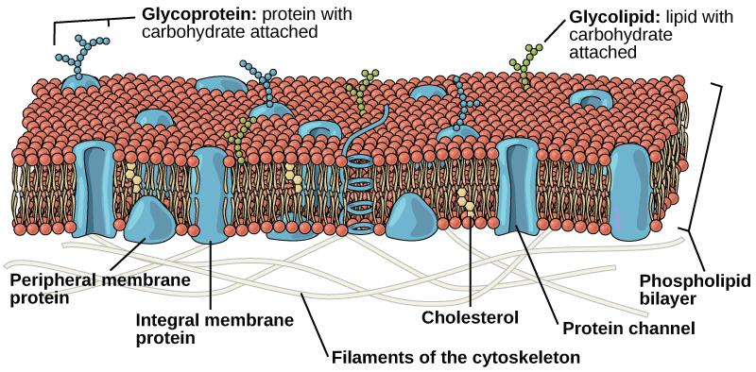
Plasma Membrane: Fluid Mosaic Model
Notes:
Remind students that the fluid mosaic model describes the cell membrane because it moves (fluidly) because its components “float,”and its phospholipid bilayer has a variety of biomolecules embedded in and through it.
Concepts of Biology - 1st Canadian Edition (https://opentextbc.ca/biology/) by Charles Molnar and Jane Gair is licensed under a Creative Commons Attribution 4.0 International License (https://creativecommons.org/licenses/by/4.0/), except where otherwise noted.

Slide 19
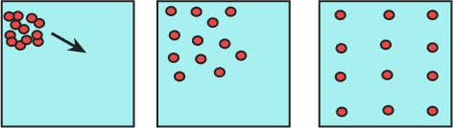
Passive Transport
Simple Diffusion
Osmosis
Movement of solutes from an area of high concentration to low concentration;
Results in the a more homogenous solution.
Movement of solvent (primarily water) across a semi-permeable membrane;
Occurs when solutes cannot cross the membrane;
Solvent moves from areas of high solvent concentration to low solvent concentration.
Notes:
(https://www.biologycorner.com/bio1/notes_diffusion.html) This work is licensed under a Creative Commons Attribution-NonCommercial-ShareAlike 4.0 International License.

Slide 20
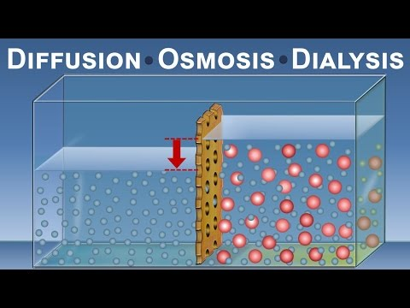
Passive Transport
Notes:
Play until 0:57
CanalDivulgacion. (2017, March 26). Diffusion, osmosis and Dialysis (IQOG-CSIC). YouTube. Retrieved August 1, 2022, from https://www.youtube.com/watch?v=tHzkRtzVmUM

Slide 21
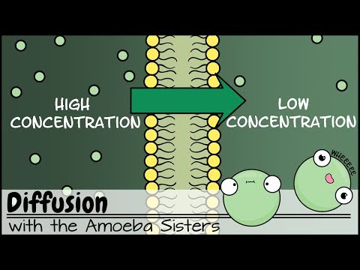
Passive Transport
Notes:
1:46-3:27 (diffusion and passive transport); 3:45-4:18 (facilitated diffusion)
AmoebaSisters. (2019, September 5). Diffusion. YouTube. Retrieved August 1, 2022, from https://www.youtube.com/watch?v=jhszFBtBPoI

Slide 22
Facilitated Diffusion
Involves molecules that cannot pass through the lipid
bi-layer of the cell membrane directly;
Move into or out of the cell through protein channels instead;
Still passive transport because it requires no energy.

Slide 23
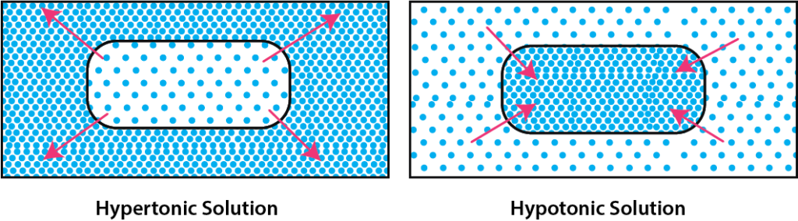
Osmosis: Tonicity
Hypertonic Solution
Isotonic Solution
Hypotonic Solution
Solute concentration is higher inside the cell;
H₂O flows into the cell;
Cells swell; may burst.
Solute concentration is higher outside cell;
H₂O flows out of the cell;
Cell shrink; may collapse.
Solute concentration is the same inside & outside the cell;
H₂O flows in & out of cell in “dynamic equilibrium.”
Notes:
Ask students under what conditions passive transport occurs.
Have students add the tonicity diagrams in addition to their written notes, taking care to include labels and draw arrows in the correct directions.

Slide 24
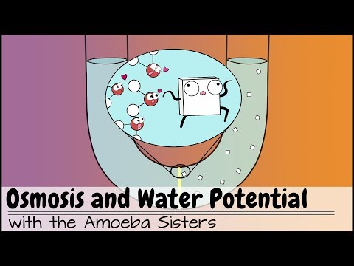
Osmosis and Water Potential
Notes:
0:59-4:09 (osmosis and tonicity); 4:10-5:34 (medical example of tonicity and cells)
AmoebaSisters. (2018, June 27). Osmosis and water potential (updated). YouTube. Retrieved August 1, 2022, from https://www.youtube.com/watch?v=L-osEc07vMs

Slide 25
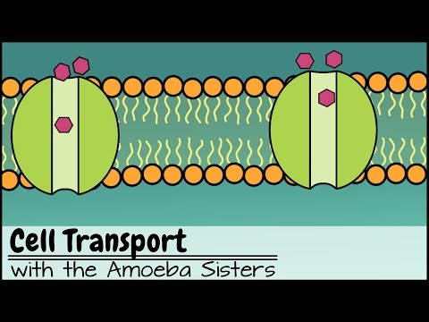
Cell Transport
Notes:
0:41-1:06 (homeostasis); 1:07-1:37 (membrane structure); 1:39-5:34 (simple and facilitated diffusion)
AmoebaSisters. (2016, June 24). Cell transport. YouTube. Retrieved August 1, 2022, from https://www.youtube.com/watch?v=Ptmlvtei8hw

Slide 26
Essential Question
How does the cell membrane help cells maintain homeostasis?

Slide 27
E. coli
Effects of Penicillin
no-antibiotic
Notes:
Ask your students how passive diffusion through the plasma membrane could be related to what happened to the E. coli in the video.

Slide 28
MRSA
Methicillin Resistant Staphylococcus Aureus are strains of S. aureus that have developed resistance to the antibiotic methicillin.
Methicillin is an antibiotic similar to penicillin, which is used to treat E. coli infections.
Due to the resistance of S. aureus, doctors have to prescribe vancomycin, a stronger antibiotic with more serious side effects, to get rid of a MRSA infection.

Slide 29

Vancomycin Card Sort
Pick a set of cards.
Sort the cards to map out the major steps of vancomycin’s mechanism of action.
Hint: There is a missing step.
Find where the missing step goes in the process.
Notes:
K20 Center. (n.d.). Card Sort. Strategies.https://learn.k20center.ou.edu/strategy/147

Slide 30
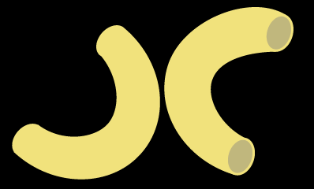
Elbow Partners
With a partner, discuss what role passive transport plays in the process.

Slide 31
Essential Question
How does vancomycin work to destroy MRSA bacteria?

Slide 32

Cognitive Comics
How does vancomycin work to destroy MRSA bacteria?
Work independently to create a comic to illustrate how passive diffusion works as part of vancomycin’s mechanism.
Use your cards from the card sort.
Include drawings of your own to fill in the gaps.
Add captions to support your conclusion.
Notes:
K20 Center. (n.d.). Cognitive Comics. Strategies. https://learn.k20center.ou.edu/strategy/69

