Slide 2
Function Operations, Part 1
Basic Operations and Domain Restrictions

Slide 3
Essential Question
How do we perform function operations and how do they cause domain restrictions?

Slide 4
Lesson Objectives
Perform basic operations on functions while using function notation.
Determine the domain restrictions of functions.

Slide 5
Function Notation
With your partner, complete the Evaluating Functions portion of your handout.
Use the given information about f (x), g(x), and h(x) to answer questions 1–4.

Slide 6
Evaluating Functions (Solutions)

Slide 7
Function Notation
With your partner, complete the Performing Operations portion of your handout.
Use the given information about f (x), g(x), and h(x) to answer questions 5–8.

Slide 8
Performing Operations (Solutions)
*

Slide 9

Let’s Take a Closer Look
Simplifying means to reduce and
keep equivalent.
Let’s graph the first step and final answer
of question 8 and compare the results.

Slide 10
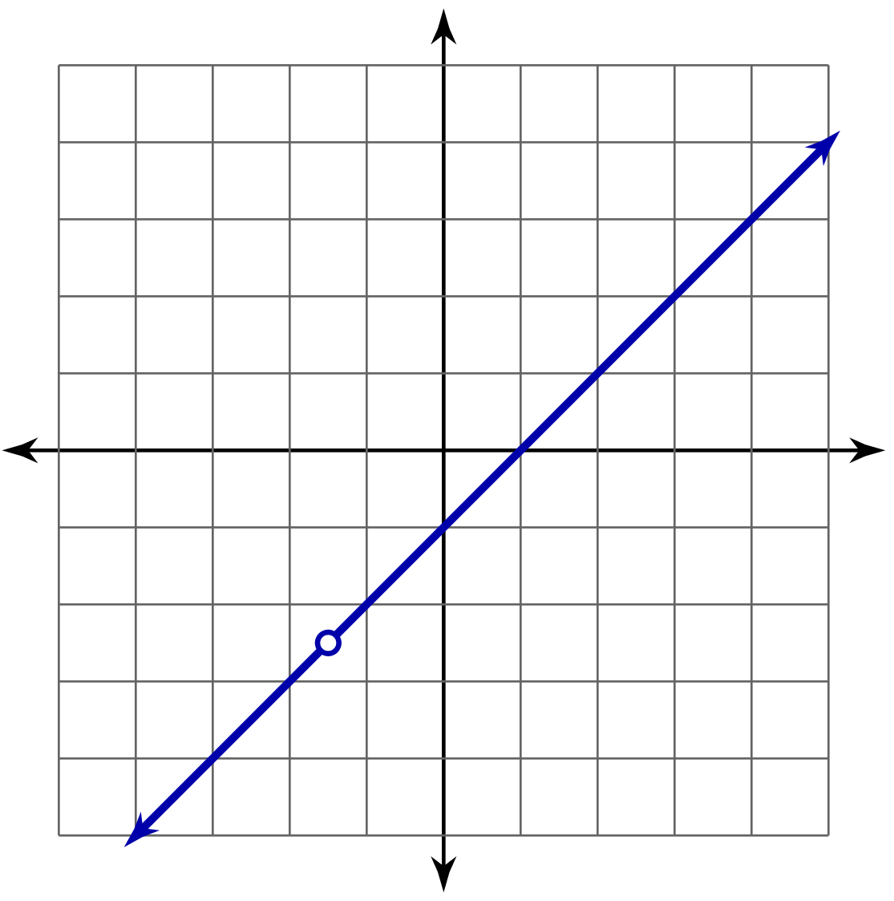
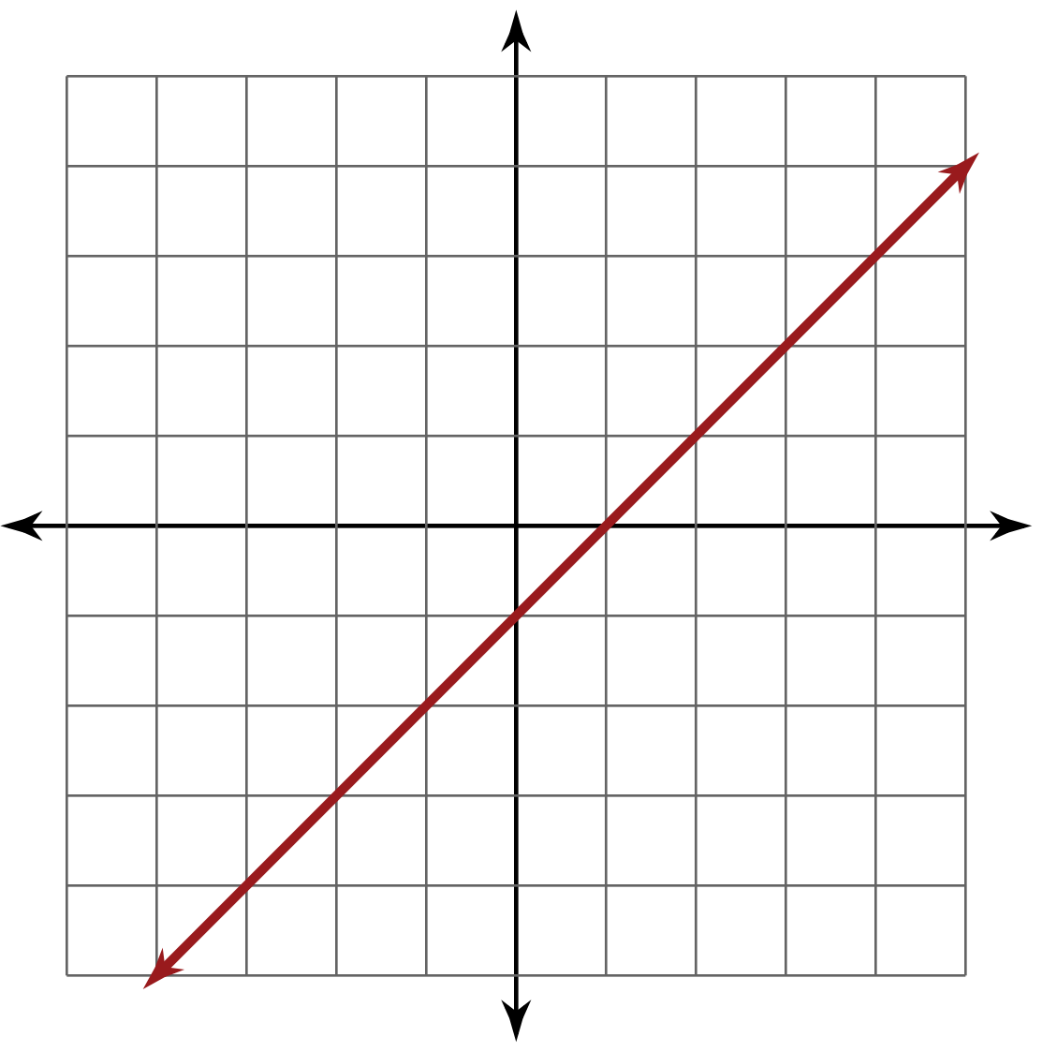
What is the Same? What is Different?

Slide 11
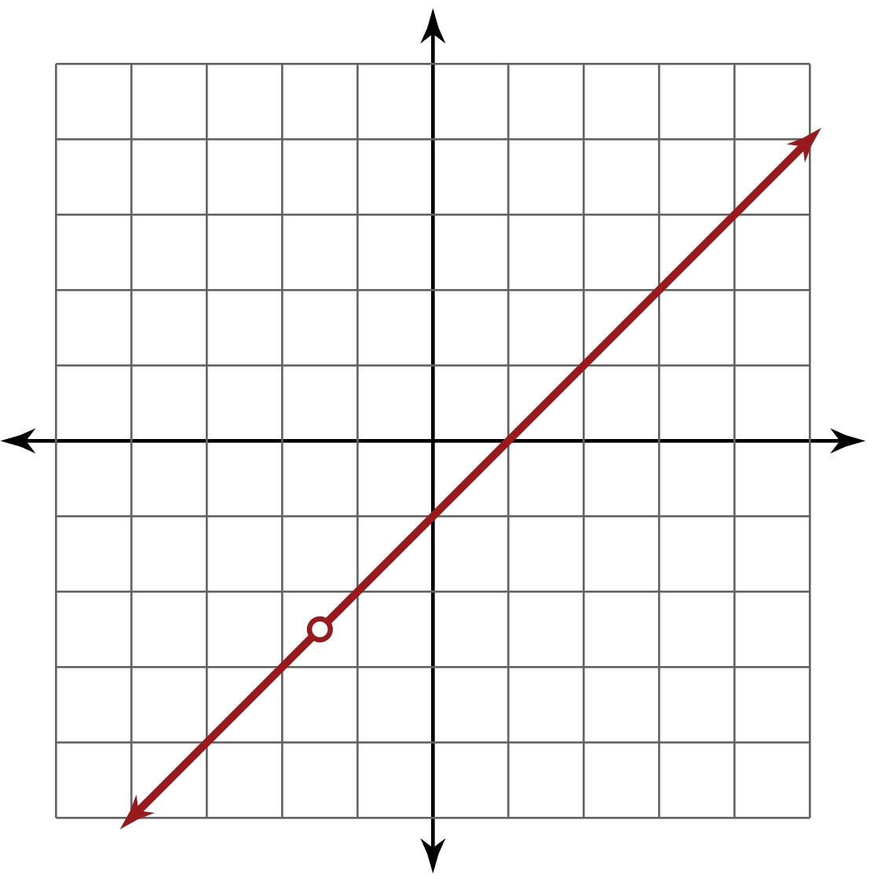
Adding Domain Restriction(s)

Slide 12

Where to Find Domain Restrictions
Discuss the following with your elbow partner:
Why should we look for variable(s)
in the denominator?
Why should we look for even root(s)?
Notes:
K20 Center. (n.d.). Elbow Partner. Strategies. https://learn.k20center.ou.edu/strategy/116

Slide 13
Notation
Operation | Definition | Shorthand
Addition
Subtraction
Multiplication
Division

Slide 14
Finishing the Guided Notes
Let’s complete the example problems from the
Guided Notes together.

Slide 15
Applying Operations
Find a new partner and work together to complete the Focusing on Notation portion of your handout.
Use the given information about v(t), d(t), and r(t) to answer questions 1–4.

Slide 16
Focusing on Notation (Solutions 1–2)

Slide 17
Focusing on Notation (Solutions 3–4)

Slide 18
Applying Operations
Find a new partner and work together to complete the Finding Domain Restrictions portion of your handout.
Multiply and divide each pair of functions, f (x) and g(x), to answer questions 5–7.
  Don’t forget your domain restrictions!
  Write “none” if there are no domain restrictions.

Slide 19
Finding Domain Restrictions (Solution 5)

Slide 20
Finding Domain Restrictions (Solution 6)

Slide 21
Finding Domain Restrictions (Solution 7)

Slide 22

Stoplight Stickies
How confident are you in your ability to perform function operations?
  On a sticky note, write a question or comment that represents your response.
How confident are you in your ability to find domain restrictions?
  On a separate sticky note, write a question or comment that represents your response.
Notes:
K20 Center. (n.d.). Stoplight Stickies. Strategies. https://learn.k20center.ou.edu/strategy/92

