Slide 2
Get in Line
Exploring Linear (and Nonlinear) Situations

Slide 3
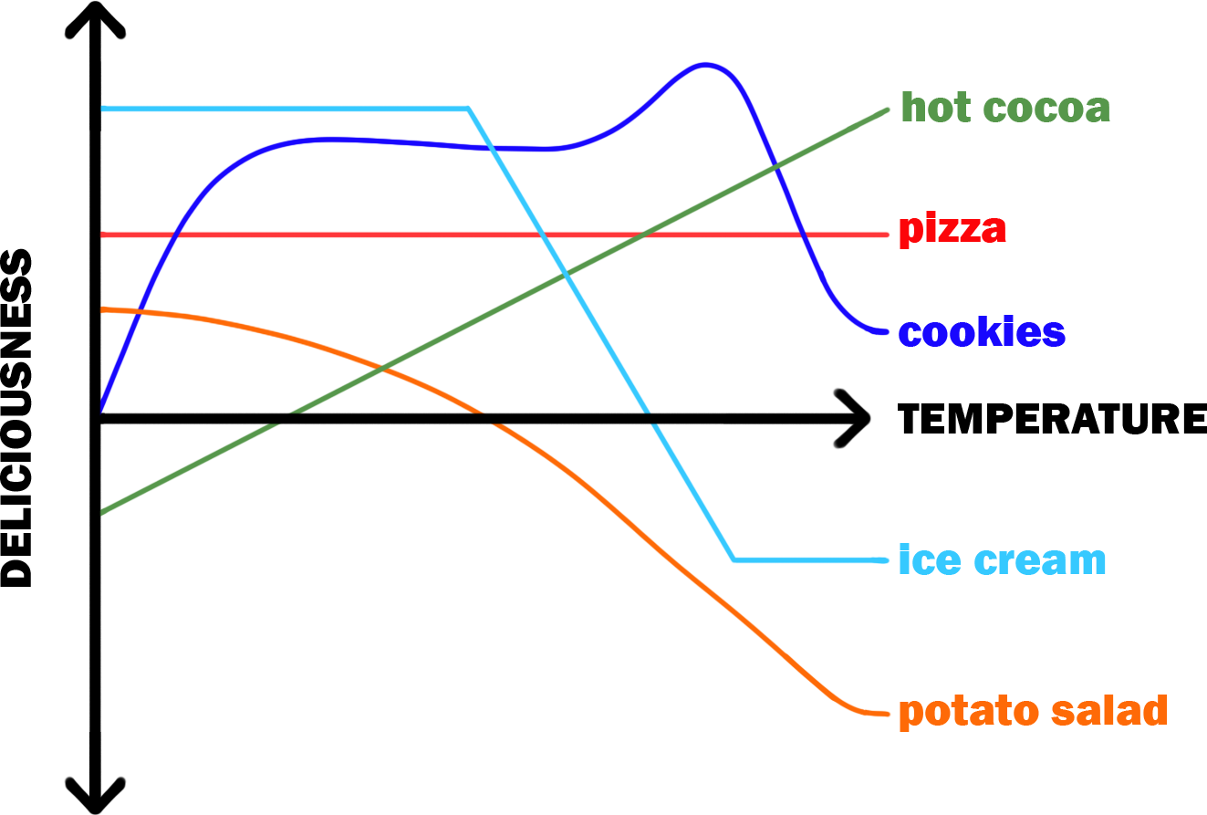
What Does This Graph Tell Us?

Slide 4
What Does This Graph Tell Us?
The deliciousness of which food(s) was represented by a line?
What does that mean about the deliciousness of those foods?
Notes:
K20 Center. (n.d.) Think-pair-share. Strategies. https://learn.k20center.ou.edu/strategy/139

Slide 5
Essential Question
How do we know when a relation is linear?

Slide 6
Lesson Objectives
Determine when a function is linear or nonlinear.
Write linear equations in slope-intercept form.

Slide 7
Reading the Situation
Read Situation 1.
Create a graph for the situation.
Describe the graph.
Is the graph a line or not?
Explain your reasoning.
Identify the y-intercept.
Write it as an ordered pair.

Slide 8
Reading the Situation: Discussion
How did you know how to graph the situation?
Was the graph of the situation a straight line or not?
Did your graph match your prediction?

Slide 9
Vocabulary
Linear relationship: when the relationship between two variables makes a straight line when graphed
Nonlinear relationship: when the relationship between two variables does not make a straight line when graphed

Slide 10
Vocabulary
Rate: the mathematical comparison between two variables (often written as this per that)
Slope: the mathematical steepness of a line; also known as the rate of change
When the rate of change is constant, the relationship is linear
y-intercept: where the line crosses the y-axis

Slide 11
Slope-Intercept Form

Slide 12
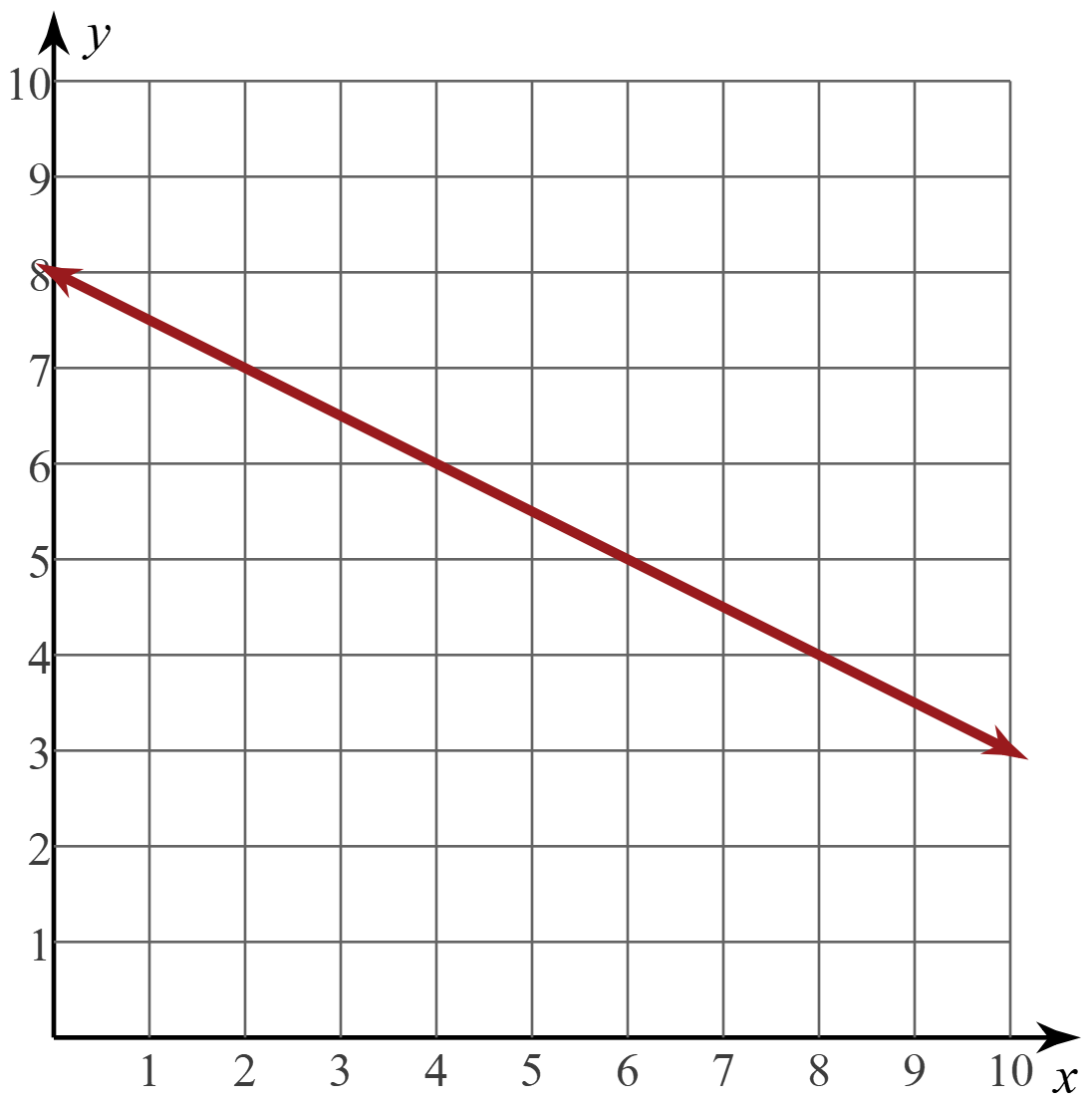
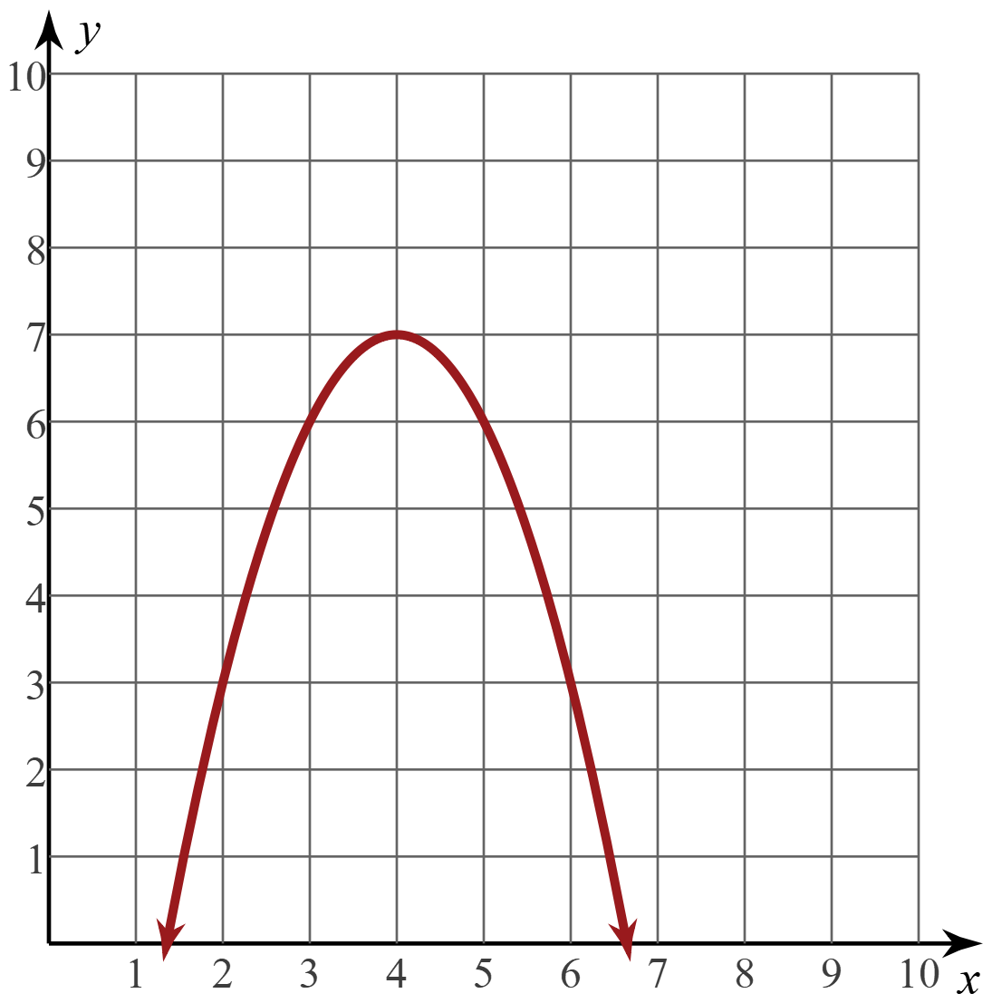
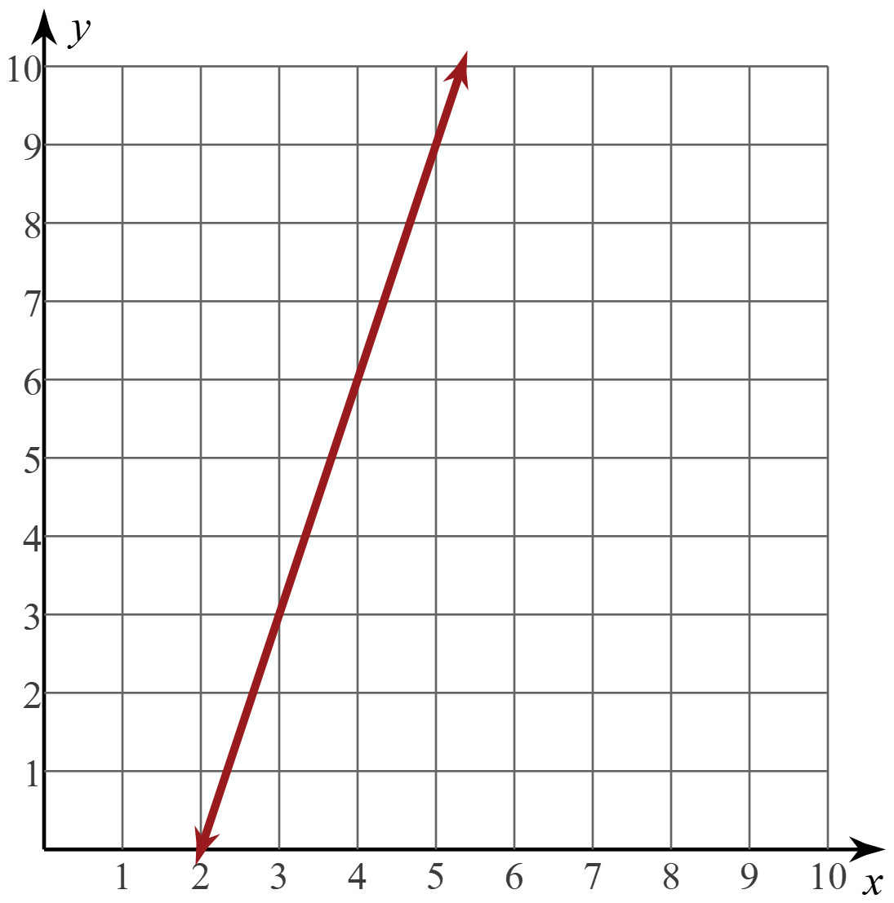
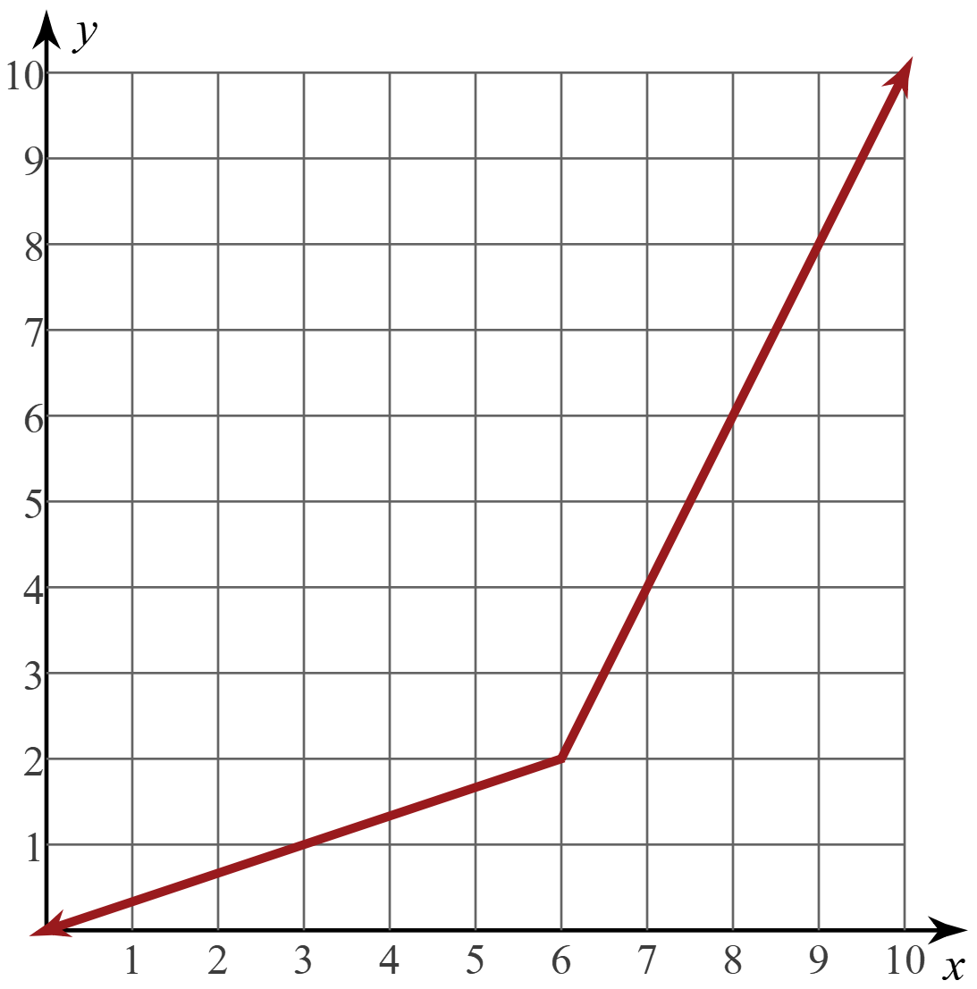
Linear vs. Nonlinear
Linear | Nonlinear

Slide 13
Create Your Own
Think of a situation in your life that has a constant rate of change.
Complete your handout in any order you want.
Be careful to make sure your situation is linear.

Slide 14
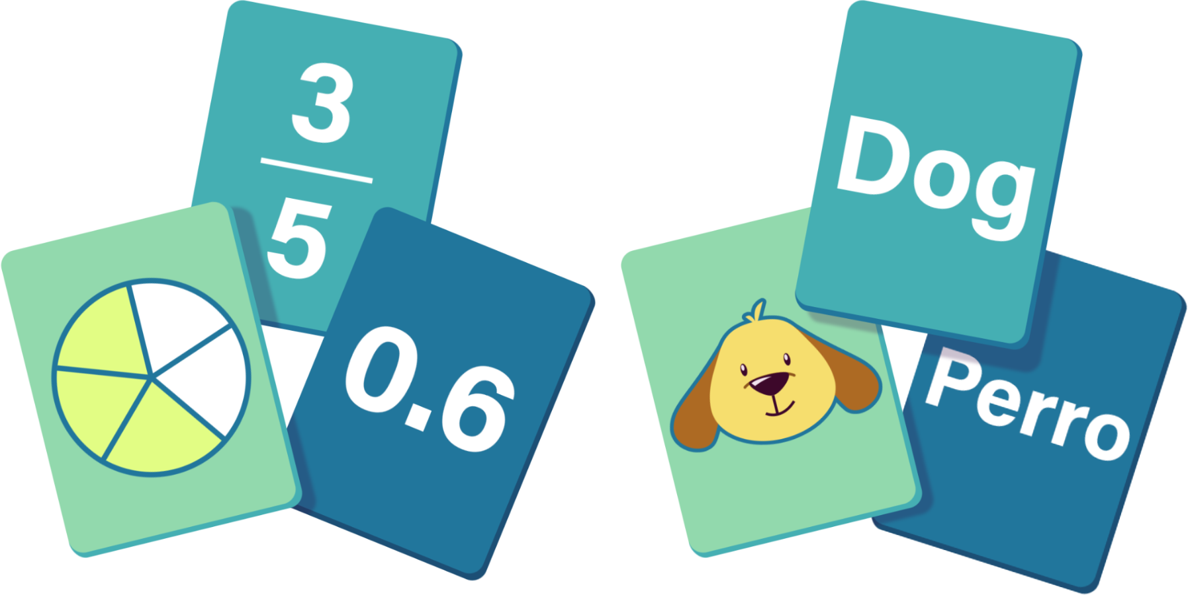
Card Matching
Cut your handout along the dashed lines to create 4 cards.
Notes:
K20 Center. (n.d.) Card matching. Strategies. https://learn.k20center.ou.edu/strategy/1837

Slide 15
Card Matching
In your group, gently shuffle the cards.
Trade card decks with another group.
Match the cards to create sets of 4 cards.
Take time to really read the cards and match the mathematics, not the handwriting.
Notes:
K20 Center. (n.d.) Card matching. Strategies. https://learn.k20center.ou.edu/strategy/1837

