Slide 1
Keep on Moving, It’s About the Climb
Linear Proportions

Slide 3
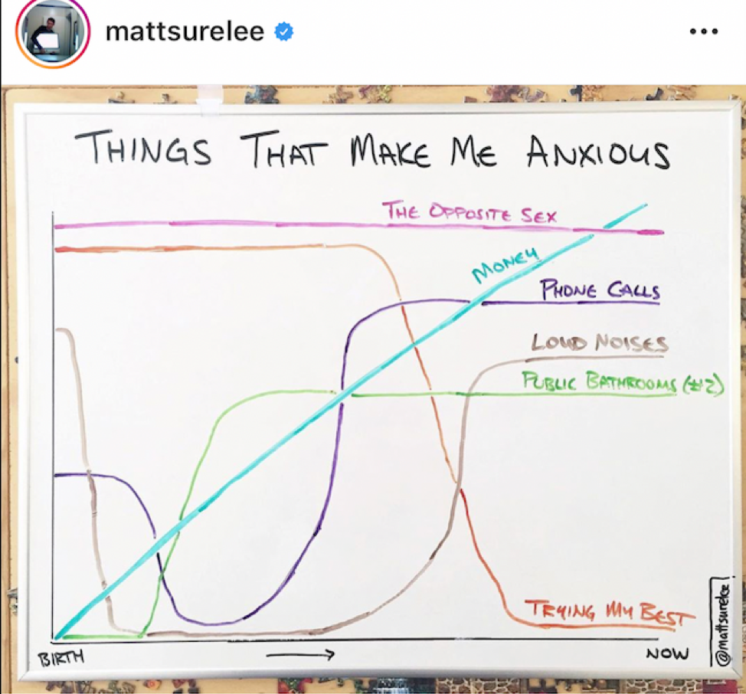
What is the graph telling you? Write down in your notebook EVERYTHING you think the graph is telling you.
What does the straight line mean compared to the curved lines? Write down your thoughts in your notebook.

Slide 4
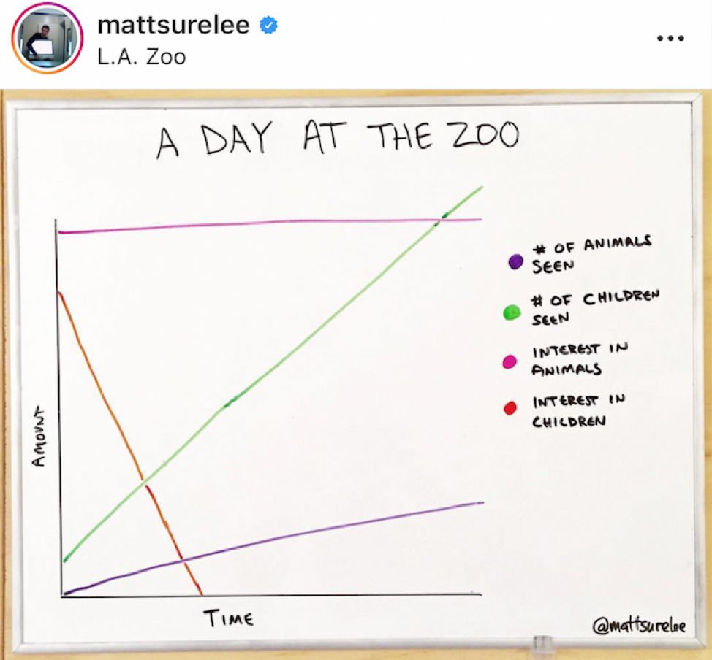
What is the graph telling you? Write down in your notebook EVERYTHING you think the graph is telling you.
What do the different straight lines mean compared to each other? Write down your thoughts in your notebook.

Slide 6
The Situations
Decide whether the information provided to you in each situation can be graphed as a straight line or not.

Slide 8
The ‘Answers’ - Situation 1
Straight or not?
Characteristics?
Your thought process?

Slide 9
The ‘Answers’ - Situation 2
Straight or not?
Characteristics?
Your thought process?

Slide 10
The ‘Answers’ - Situation 3
Straight or not?
Characteristics?

Slide 11
The ‘Answers’ - Situation 4
Straight or not?
Characteristics?

Slide 12
Notes
Rate - the mathematical amount of change in two variables
Linear association - when two variables with a rate graphs to make a straight line
Non-linear association - when the change in two numbers is not proportional, so it doesn’t graph as a straight line
Ratio - a relationship between two numbers, as one increases the other does at the same rate
Proportion - two equivalent ratios
Slope - the mathematical steepness of a line

Slide 13
Determining Rates
Look back to the first situation. Let’s figure out how to calculate the number of pages/minute rate.
Now try it with every situation that is a straight line.

Slide 14
Notes:
Brittany and Amber

Slide 15
Make your own Situation
Use the handout to make your own situation. Make sure it is proportional.
When you’re done, cut along the dotted lines.

Slide 17
Exchange!
Mix all of your pieces together with your tablemates. Exchange your pile with another table’s pile.
Try to piece together the story, graph, table, and rates that go together.

