Slide 1
Connecting Classmates:
How Social Media Can Build a Stronger Community

Slide 2
Essential Question
How does social media help build relationships and community?

Slide 3
Lesson Objectives
Understand how video technology can be used in and out of the classroom
Communicate clearly using Canva and Padlet
Listen and learn about peers through the use of Canva and Padlet

Slide 4
“All About Me” Name Tents
At your desk, you will find a folded piece of cardstock.
Please put your name on one side in bold letters and answer the following questions on the back:
How many years have you lived in this town?
What is your favorite activity or hobby?
What is your favorite genre, novel, short story, poem, or play?
What is your favorite part of ELA: reading, writing, listening, speaking, or viewing?
What is most important to you as a student in this class?
What is your favorite type of social media?

Slide 5
Partner Speaks
Choose a partner.
Share the information from your “All About Me” Name Tent while your partner listens.
Switch places.
Each person shares one detail about their partner’s name tent while using their partner’s name:
My partner is Joey, and Joey likes the novel Fahrenheit 451 by Ray Bradbury.
Notes:
K20 Center. (n.d.). Partner Speaks. Strategies. https://learn.k20center.ou.edu/strategy/62

Slide 6
Social Media: What/Who/Why?
WHAT social media platforms do you use?
WHOM do you communicate with regularly?
WHY do you use this platform?
Example:
Facebook is my favorite platform.
I communicate with my friends, family and a few groups I have joined.
I like that I can use gifs, emojis, videos, etc.
Notes:
https://k20center.padlet.org/pbase/p7eklmumt6rtj71q

Slide 7
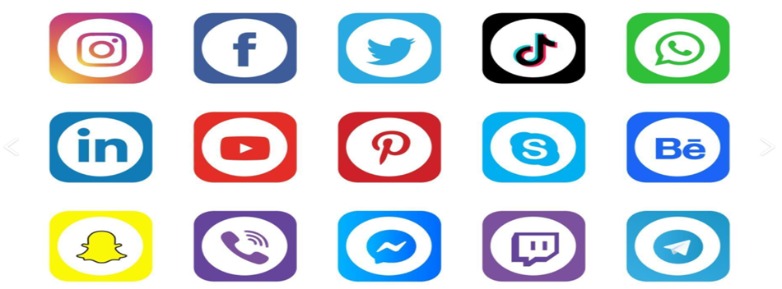
View Results
Use the Padlet link or QR code to post your answer.
https://k20center.padlet.org/pbase/p7eklmumt6rtj71q
Notes:
https://k20center.padlet.org/pbase/p7eklmumt6rtj71q

Slide 8
Record Yourself Canva Design Skills for Students video
Be prepared to share as many details from the video as possible.
Notes:
https://www.youtube.com/watch?v=52Dhed2QwAo

Slide 9
30-Second Expert
What did you learn from the Canva video?
Get together with your previous partner.
The first person will take 30 seconds to share everything they learned from the video.
Switch places.
The second person will repeat what they heard and add anything else they learned from the video.
Questions?
Notes:
K20 Center. (n.d.). 30-Second Expert. Strategies. https://learn.k20center.ou.edu/strategy/1048

Slide 10
Canva Time
Go to Canva.com
If you have Canva account, select “Log in”
If you do not have a Canva account, select “Sign up” and follow the prompts to set up a free account.
Follow this link to access your template: https://tinyurl.com/325csar4
Notes:
https://learn.k20center.ou.edu/tech-tool/612
https://tinyurl.com/325csar4

Slide 11
Record Your Video
On the left side of your screen, select “ Uploads.”
At the top of the menu, select “Record Yourself.”
A menu should appear in the top left corner of your screen. Select “Camera” and make sure your visual and audio selections are correct.
Select “Record” at the bottom of your screen when you are ready to record your video. Your video should be 60 seconds or less.
You may playback your video or rerecord until you are satisfied with your product.
Move you video to the best spot on your page when you are done.

Slide 12
Move Your Page to Padlet
When you are satisfied with your page and video, select the “Share” button in the top right corner of your screen.
Under “Collaboration link” make sure your settings are:
“Anyone with the link”
“Can view”
Select “Copy link”
Navigate to Padlet using this link:
Create a post on the Padlet board by selecting the “+” sign in the bottom right corner.
Title your post.
Add the link to your Canva page by selecting the link symbol and pasting your link where it says, “Paste or type link here”.
When you are done, add your post to the board.
Notes:
https://learn.k20center.ou.edu/tech-tool/612
https://learn.k20center.ou.edu/tech-tool/1077

Slide 13
Share, View and Post
Who will volunteer to share their video with the class?
Next steps:
View three classmates’ videos.
Post one video responding to a classmate.
Select the “+” next to “Add a comment”.
Select “Video recorder” to record your response.
Post one positive comment responding to a classmate.
Type in the “Add a comment” box.
Post one clarifying question responding to a classmate.
Clarify something you were curious about after viewing the video in the “Add a comment” box.

Slide 14
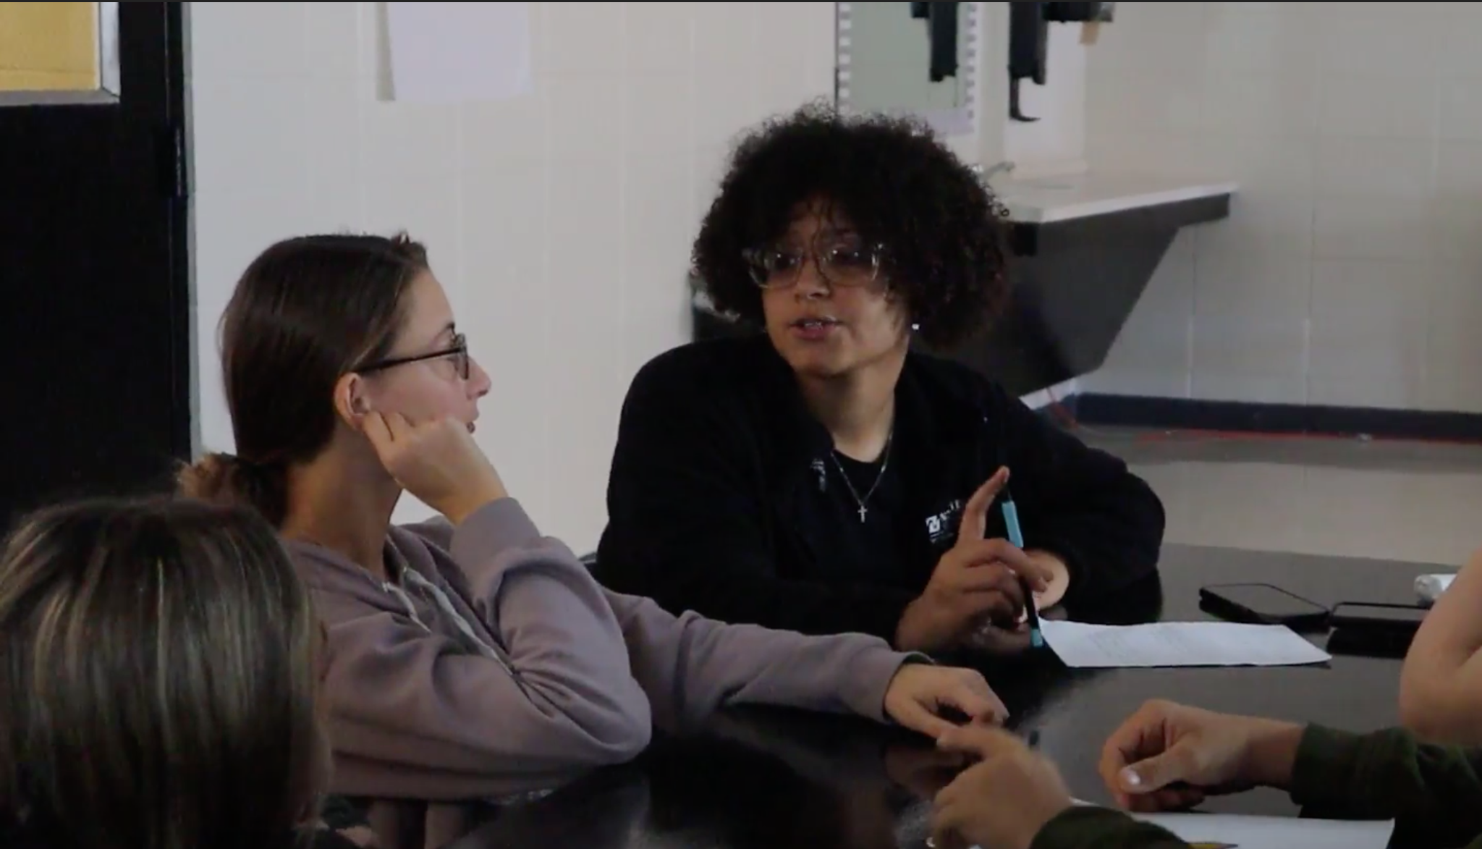
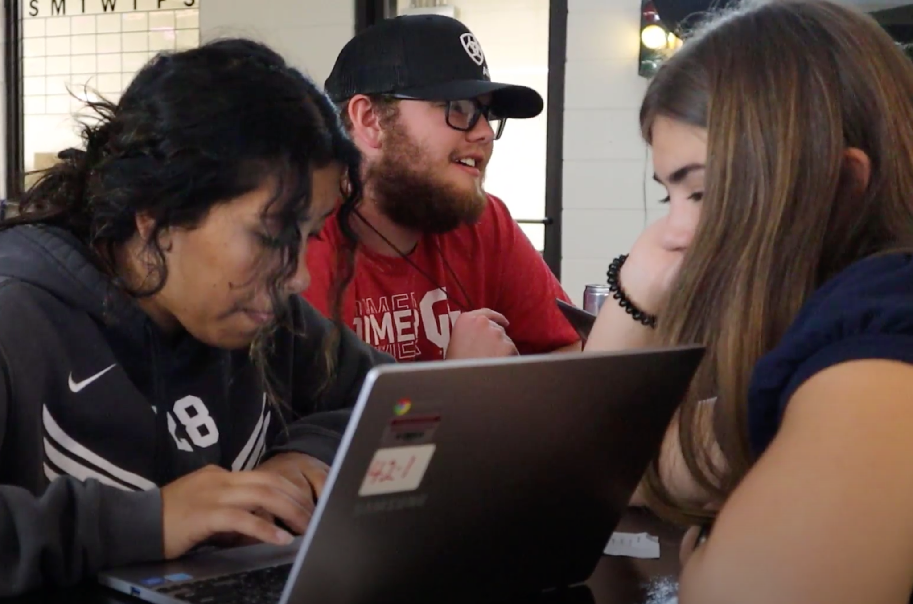
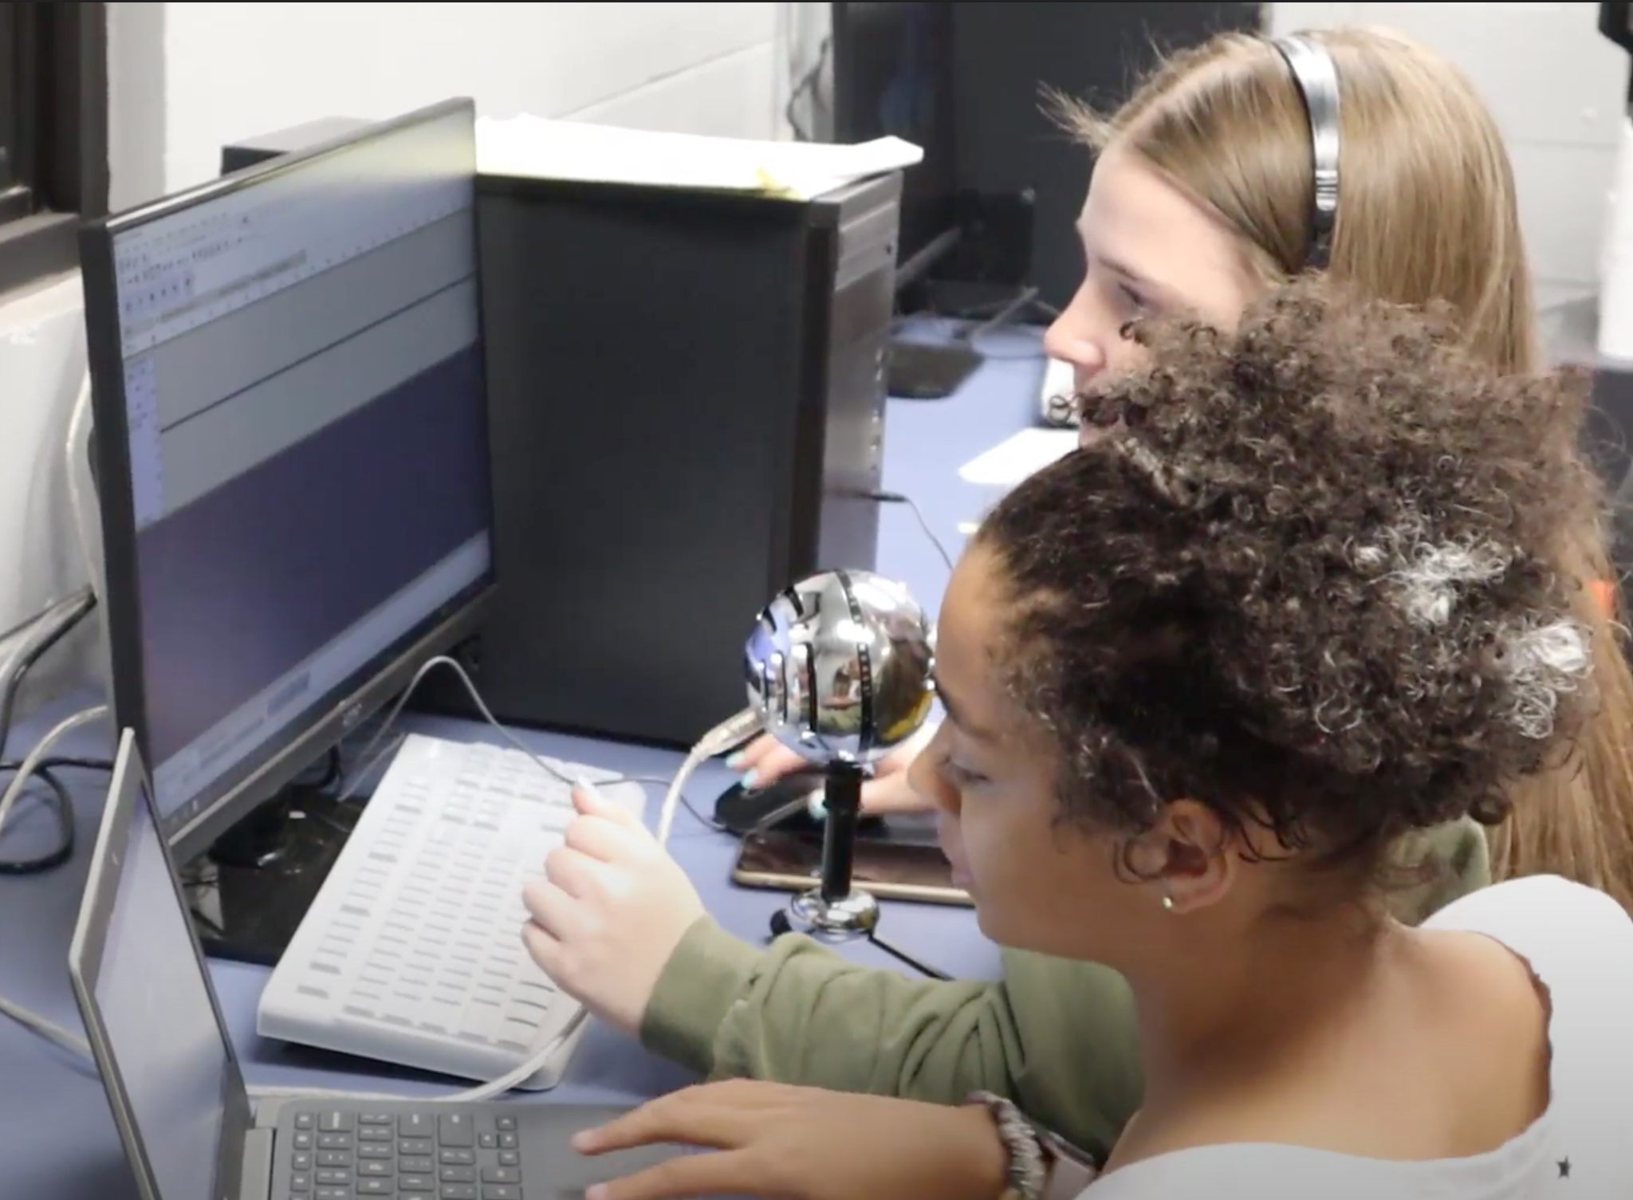
Exit Ticket
How does social media help build relationships and community?

