Slide 2
Function Operations, Part 2
Function Composition

Slide 3
Essential Question
What happens if the output of one function becomes the input of another?

Slide 4
Lesson Objectives
Combine functions by composition: algebraically, graphically, numerically, and verbally.
Algebraically prove that given functions are or are not inverses.

Slide 5

Spotlight Questioning
Everyone’s voice is valued.
You will be given a question and asked
to work with your partner to answer
the question.
Everyone needs to be able to answer
the question on the following slide
because some of you will be called upon.
Get ready to be in the “spotlight!”

Slide 6


Coupon Conundrum
You visit your favorite store, and you have two coupons:
20% off of your next purchase
$10 off of your next purchase
If you spend $100, which one do you think that they will apply first at the register? Explain your thinking.

Slide 7
Coupon Conundrum
Write two functions, one for each coupon.
f(x): 20% off of your next purchase
g(x): $10 off of your next purchase

Slide 8
Exploring Function Notation
Work with a partner and use f (x) = x² – 5 to answer each of the questions on your handout.
Answer each question in the order it was provided.

Slide 9
Exploring Function Notation (Solutions 1–5)

Slide 10


Exploring Function Notation (Solutions 6–10)

Slide 11
Revisit the Coupon Conundrum

Slide 12
Revisit the Coupon Conundrum

Slide 13
Guided Notes
Let’s complete the Guided Notes together.

Slide 14
Verifying Inverses
Using this information, work with a partner to determine if each pair of functions are inverses on your Applying Function Composition handout (questions 1–3).

Slide 15
Verifying Inverses (Solution 1)

Slide 16
Verifying Inverses (Solution 2)

Slide 17
Verifying Inverses (Solution 3)

Slide 18
Extending Your Knowledge
Work with your partner to complete the second portion of your Applying Function Composition handout.
Use the given information about
f (x), g(x), h(x), and k(x) to answer questions 4–7.
Be ready to be in the “spotlight!”

Slide 19
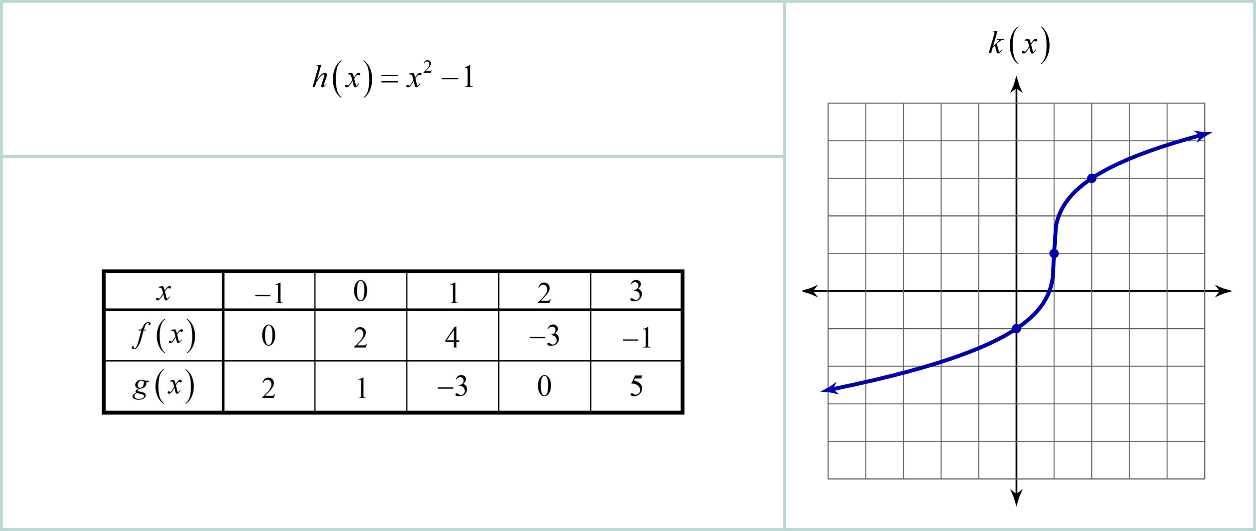
Extending Your Knowledge

Slide 20
Extending Your Knowledge (Solutions 4–7)

Slide 21

Exit Ticket
Work independently to perform the
indicated operations on your handout.
Indicate any domain restrictions of the new function.

Slide 22
Exit Ticket (Solution 1)

Slide 23
Exit Ticket (Solution 1)
…continued

Slide 24
Exit Ticket (Solution 2)

Slide 25
Exit Ticket (Solution 2)
…continued

