Slide 1
Driving Rationally
Antonia is driving from Oklahoma City to Dallas, a distance of 200 miles. After exactly 100 miles, she stops and determines that she has been averaging a speed of 60 miles per hour. She wants to average 50 miles per hour for her trip to Dallas. At what speed should she drive for the remainder of the trip? (Be sure to check your work and verify your answer is correct.)

Slide 2
Repeat the problem
In your groups, repeat the first problem about Antonia if she drove the first 100 miles at:
  50 miles per hour.
  40 miles per hour.
  30 miles per hour.
  X miles per hour. Express your answer as an equation solved for y and simplified where y is the speed Antonia must drive during the second part of the trip.

Slide 3
Examine the function
Examine the function you wrote for y. How is this function different than other functions we have examined in this class?
Graph the function on your graphing calculator. How is the graph different than other graphs we have examined?

Slide 4
Rational Functions
Definition:
  A rational function is a function in which one polynomial, P(x), is divided by a second polynomial, Q(x), of degree 1 or more.
  P(x) .
  Q(X)
  Note: P(x) can be a constant, like 200; but Q(x) must contain a variable.
  Rational functions may have asymptotes

Slide 5
Asymptotes
Definition:
A line for which a function gets “arbitrarily close” at certain values
“Arbitrarily close” means the graph of the function cozies up to the line, getting closer and closer.
In the problem about Antonia, what line was an asymptote for our equation?

Slide 6
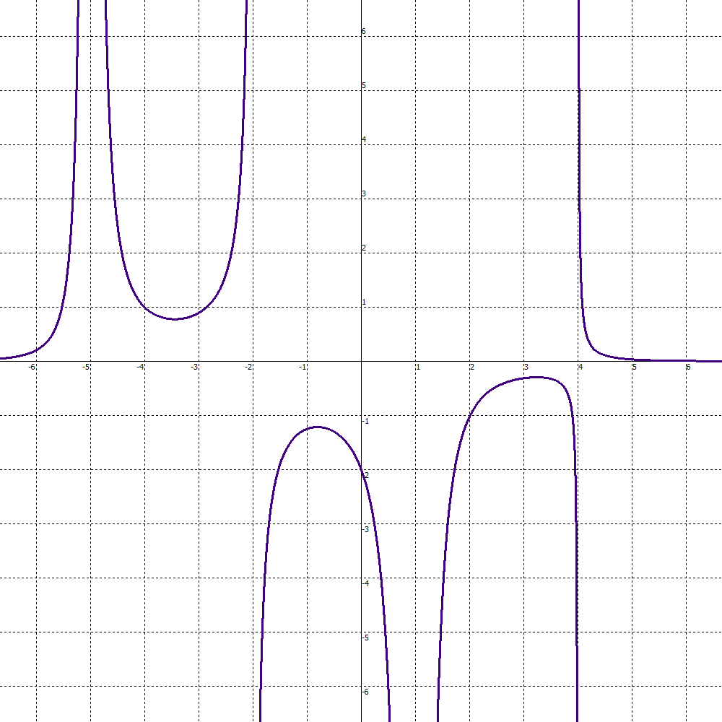
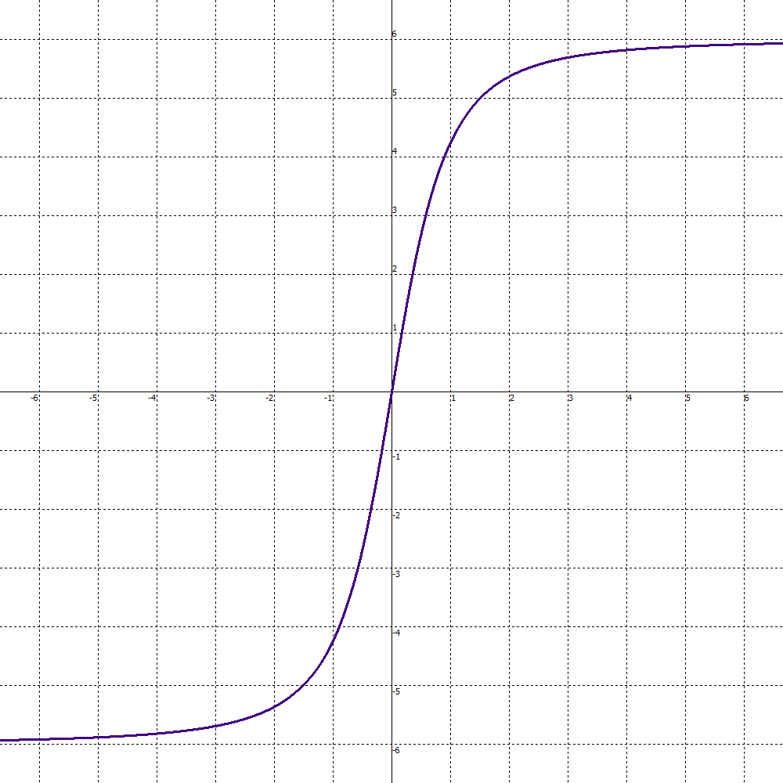
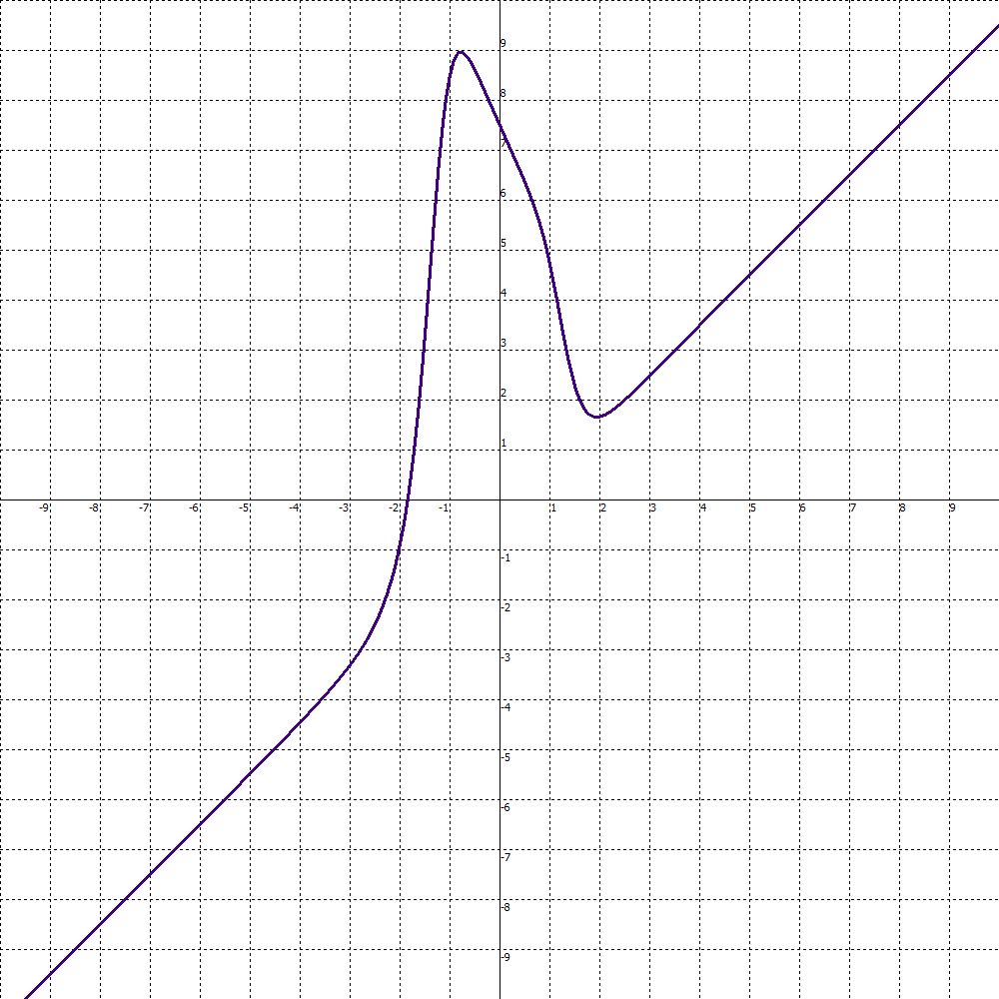
Three kinds of Asymptotes
Vertical Horizontal Slant

Slide 7
Thinking Rationally
Determine which of the phenomena below could be modeled by a rational function. For each rational phenomena, determine if the model would have vertical, horizontal, or slant asymptotes (or none of those). Sketch a possible graph of each phenonemon.
The time, T, a person can be in the sun before burning as a function of v, the intensity of UV index.
The cost, C, of cleaning up p percentage of the oil spilled in an oil spill.
The concentration, C, of salt in a water-based solution as a function of s, the number of grams of salt added to the solution.

Slide 8
Looking Ahead
Make a prediction to answer each question below:
When do rational functions have vertical, horizontal, or slant asymptotes?
What other phenomena can be modeled by rational functions?
How can we determine what the graph of a rational function looks like?

