Slide 2
The Power of Giving
A Lesson for Personal Financial Literacy
Standard 14: Charitable Giving

Slide 3
Essential Questions
How do charitable organizations benefit the community?
Do you have a responsibility to be charitable?

Slide 4
Lesson Objectives
By the end of this lesson, you will be able to:
  identify types of charitable giving.
  describe the impact of charitable giving.
  identify tools to research charitable organizations.

Slide 5
What Do These Organizations Have in Common?
The American Red Cross
The Salvation Army
The American Cancer Society
Wounded Warrior Project
St. Jude Children’s Hospital
Let’s discuss!

Slide 6
Which Organization Do You Know Best?
Pick the organization from our discussion that you know best.
  The American Red Cross
  The Salvation Army
  The American Cancer Society
  Wounded Warrior Project
  St. Jude’s Children Hospital
On a piece of paper, write down three things that you know about your selected organization.

Slide 7

Group Up
Stand up and find other classmates who selected the same organization as you.
Once you are in a group, compile a new list together by sharing ideas about what you know.
Add any new information that your group brainstorms.

Slide 8
Share Out
As a group, elect a spokesperson.
Listen carefully as each spokesperson reads their group’s list.

Slide 9
Charities
Based on what groups of shared, what are the characteristics of a charity?
How could we define a charity?
How can citizens like us help these charities?

Slide 10
What’s Your Opinion?
Read the question below and raise your hand to give your opinion.
Do we, as citizens, have a responsibility to help people who are in need?

Slide 11
How Do We Know?
Reflect on the list of charities we originally worked with and identified characteristics of.
What information about an organization do we need to know to determine if it is worthy of our charity, time, gifts, and money?

Slide 12

Let’s Investigate
As a group, select a charitable organization that you believe WOULD be worthy of your help or support.
Use the handout to record important information about your selected organization.
In your research, identify the following:
  When was your charitable organization founded or started?
  Where is it located?
  What is its mission or purpose?
  What is its budget or annual income?
  What does it do to help people?
  How many people has it helped?
  Where does it get its money?
  How do citizens get involved?

Slide 13
Are All Nonprofits Worthy of Our Time and Gifts?
Charity Watch rates charities according to the amount of and percentages of direct services provided to people in need.
Use the website to investigate your selected organization and review its rating.
  Feel free to check the ratings of other organizations to get a better idea of how the ratings work.
Be prepared to report your findings in a group presentation.

Slide 14
Evaluate
Your grade for this lesson will be based on:
  The presentation of your findings
  3-2-1 activity

Slide 15
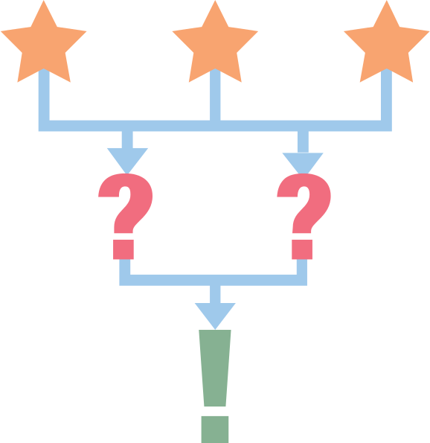
3-2-1
On notebook paper, write…
3 statements about charities, in general, that you did not know before this lesson.
2 names of charities you saw in presentations that you believe are worthy of support.
1 statement discussing why someone should or should not support charitable organizations.

