Slide 1
How does Fear impact a nation?
Essential Question

Slide 2
Game of Chicken
Notes:
Ask students if they are familiar with the game of chicken. Allow students to share the basic premise of the game. For students who might not have a clear knowledge of the concept, show students the visual for the game of chicken (this slide). Next, show them the chart for a visual of the several different possibilities within the game of chicken (next slide). Slide two will allow students to play a modified game of chicken so they can understand that it is a game of unpredictable risks. This game of chicken can be played with dice to demonstrate the basic premise of chicken:

Slide 3
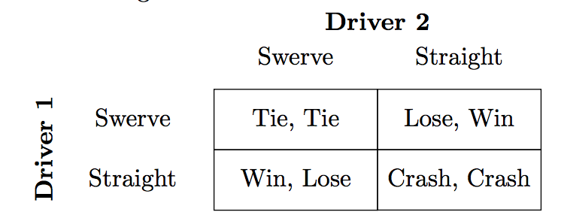
Die Roll 1, 3, 5 = Swerve
Die Roll 2, 4, 6 = Straight
Notes:
Give one of the students in class the die. If they roll a 1, 3, or 5, the class will swerve. If they roll a 2, 4, or 6, the class will go straight.
Give another student the die. If they roll a 1, 3, or 5, the "opponent" will swerve. If they roll a 2, 4, or 6, the "opponent" will go straight.
Help students understand the concepts on the game of chicken chart. If both the class and the opponent go straight, then they crash. The game is played with dice because the game of chicken is a game of risk. One never really truly knows whether or not their opponent will drive straight or swerve.

Slide 4
Brinkmanship
A shared risk of war in which each side pushes the other towards the brink of disaster or war ever closer in order to force the other side to surrender at the last second.
Notes:
Once students understand the idea of chicken, show them the definition for brinkmanship (above). There are additional visuals to remind them that this was a conflict between the United States and the Soviet Union on the next slide. Again, if possible, “play” the modified version of brinkmanship using the brinkmanship chart. Divide the class in half. One side of the room will be the United States. The other side of the room will be the Soviet Union.

Slide 5
Brinkmanship
Notes:
Cold war politics have been compared to the game of chicken. “Brinkmanship is a shared risk of war in which each side pushes the other toward the brink of disaster or war ever closer in an effort to force the other side to capitulate at the last second. Soviet-American interactions at several points during the Cold War manipulated this situation to extract favorable gains, though none so clearly as during the Cuban Missile Crisis. The chicken game also introduces an interesting point about uncontrollable risk and rationality. Here, even if both drivers are acting rationally, uncontrollable events can still trigger a crash between the drivers if both believe the other will swerve at the last second. This generates the possibility of ‘accidental nuclear wars’ or nuclear instability caused by misinformation or wrong beliefs about the other side.” (Malone, n.d.)
Malone, I. (n.d.). PS 114s. International security in a changing world nuclear weapons, brinkmanship, and deterrence: A cheat sheet. Stanford University. Retrieved from https://web.stanford.edu/~imalone/Teaching/pols114/AddendumNuclearDeterrenceGameTheory.pdf

Slide 6
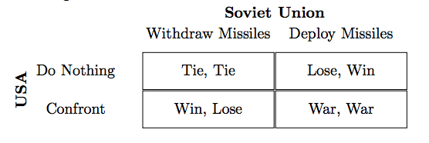
Die Roll 1, 3, 5 = Avoid Firing Weapons
Die Roll 2, 4, 6 = Fire Weapons
Notes:
Give one of the students from the United States side in class a die. If they roll a 1, 3, or 5, the class (United States) will avoid firing weapons. If they roll a 2, 4, or 6, the class (United States) will fire weapons.
Give another student from the Soviet Union side in class a die. If they roll a 1, 3, or 5, the Soviet Union will avoid firing weapons. If they roll a 2, 4, or 6, the Soviet Union will fire weapons.
Help students understand the concepts of the game of chicken are very similar to the concept of brinkmanship during the Cold War. The U.S.A could not read the minds of the Soviet Union. It was a game of risk.

Slide 7
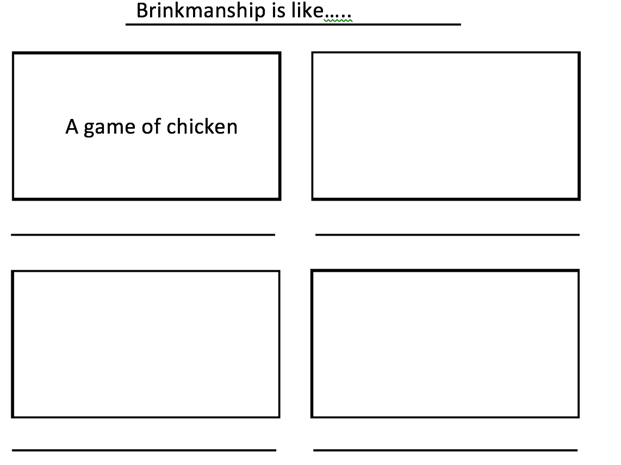
Synectics
Notes:
To check for understanding, use the formative assessment instructional strategy Synectics. Share that synectics is a way for students to make connections between an academic concept and real life. Distribute the synectics handout, or students could copy a template on the board. As a class, have students discuss how brinkmanship is similar to a game of chicken. With the class, ask students to come up with another concept that is similar to brinkmanship (e.g., the game of paper, rock, scissors). Discuss this option and have students fill in their answer under the “game of chicken” box. Once students have an understanding of how synectics work, allow them to work with a partner or small group to fill in the rest of the boxes remaining. Together, they should come up with two additional ideas.

