Slide 2
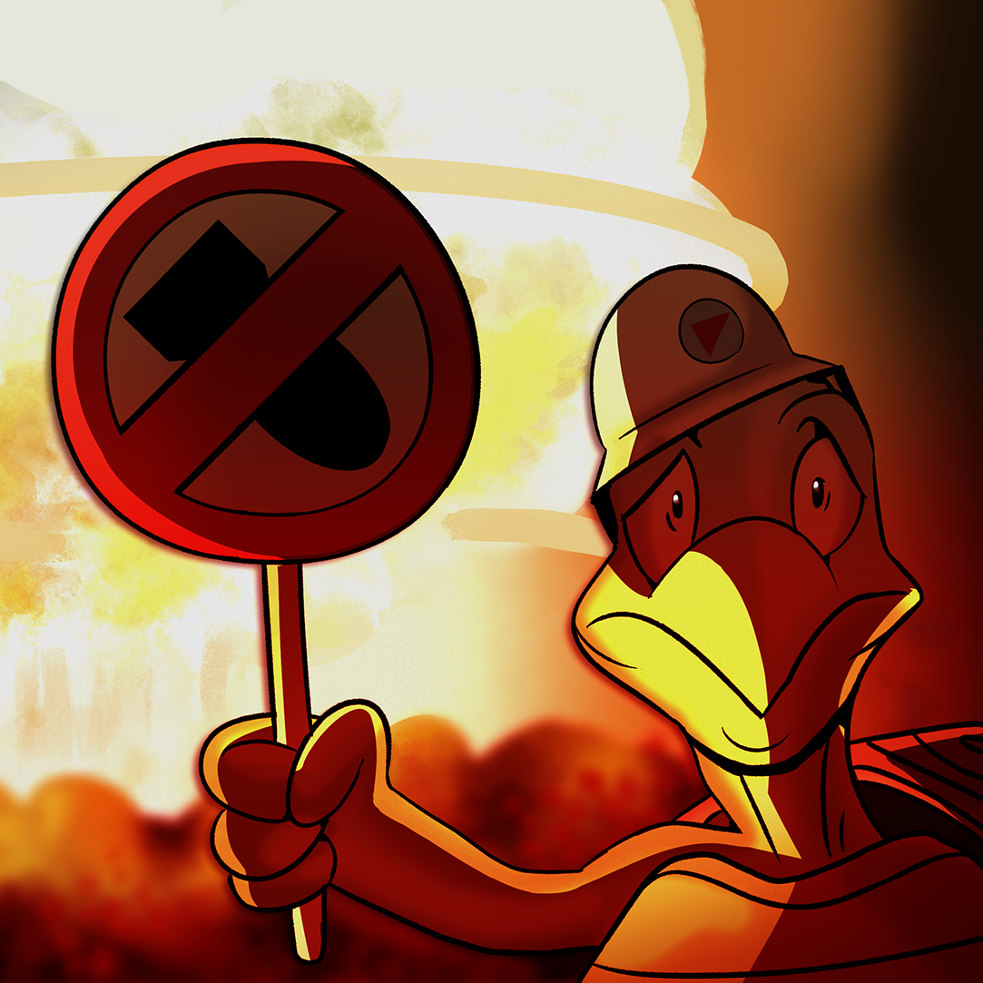
Are We MAD?
Impact of the Cold War

Slide 3
Fallout Survival
Imagine you have survived a nuclear attack inside of a fallout shelter.
Read the descriptions of your fellow survivors listed on the handout.
Decide which 7 of the 12 listed survivors will be allowed to stay in the fallout shelter.

Slide 4
Fallout Survival
Share which 7 people you allowed to stay in the shelter with your group members.
Work as a group to agree on which 7 people will be allowed to stay.

Slide 5
Essential Question
How can fear impact a nation?

Slide 6
Learning Objectives
Analyze how the Cold War impacted relations between countries.
Explain how the Cold War affected people’s lives.

Slide 7
Brinkmanship
Brinkmanship is a shared risk of war in which each side pushes the other closer toward the brink of disaster or to force the other side to surrender at the last second.

Slide 8
Brinkmanship Rolling
One student should assume the role of the U.S. and the other should assume the role of the U.S.S.R.
Each roll the die once.
  If you roll a 1, 3, or 5 you don’t fire nuclear weapons.
  If you roll a 2, 4, or 6 you fire nuclear weapons.
Note the outcome of the roll.
Repeat the process and keep track of each outcome.

Slide 9

Synectics
Brinkmanship is like a game of chicken because…
What is another Synectic that explains brinkmanship?
  Work with your partner to develop a Synectic.
  Be prepared to share it with the class.
Notes:
K20 Center. (n.d.). Synectics. Strategies. https://learn.k20center.ou.edu/strategy/120

Slide 10
Mutually Assured Destruction
Mutually assured destruction (MAD) is a military theory of nuclear deterrence that holds that neither side of a conflict will attack the other if both sides are guaranteed to be destroyed in the conflict.

Slide 11

Window Notes
Read the article about MAD and take notes on your Window Notes handout.
Access the article at: https://k20.ou.edu/r9
Notes:
K20 Center. (n.d.). Window notes. Strategies. https://learn.k20center.ou.edu/strategy/189

Slide 12

S-I-T
As you watch the video, identify…
  one thing you find surprising
  one thing you find interesting
  one thing you find troubling
Notes:
K20 Center. (n.d.). S-I-T (Surprising, interesting, troubling). Strategies. https://learn.k20center.ou.edu/strategy/926

Slide 13
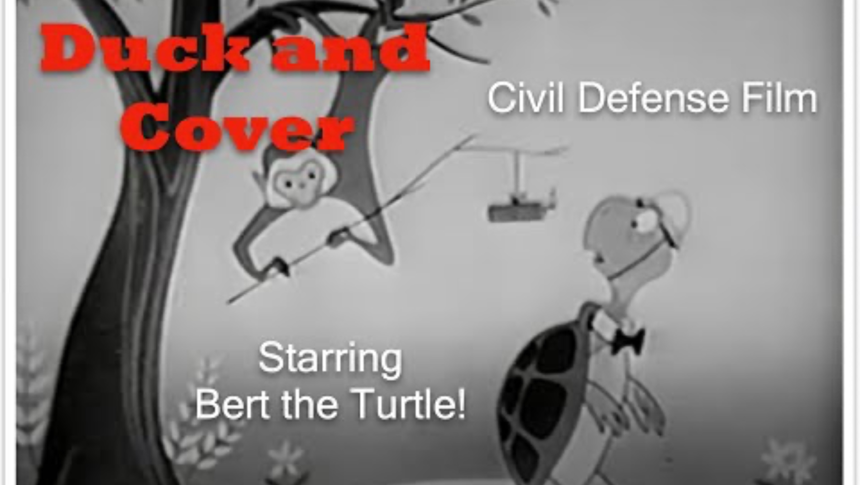
Duck and Cover
Notes:
Nuclear Vault. (2009, July 11). Duck and cover (1951) Bert the turtle [Video]. YouTube. https://www.youtube.com/watch?v=IKqXu-5jw60

Slide 14
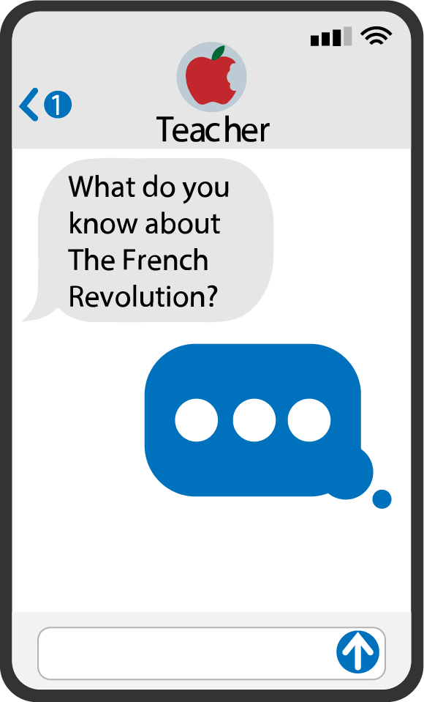
Quick Write
How can fear impact a nation?
Notes:
K20 Center. (n.d.). Quick write. Strategies. https://learn.k20center.ou.edu/strategy/1127

