Slide 2
In the Kingdom of Night, Part 1
Exploring the Role of Neutrality in the Holocaust

Slide 3
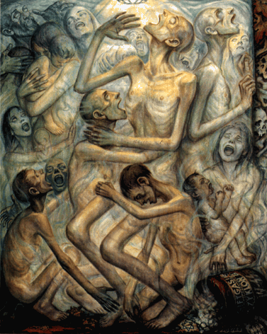
Bell Ringer
Write down everything you notice in this painting.
What is it depicting?
You have 4 minutes.
Notes:
Olère, D. (1943). Gassing by Zyklon B [Depiction of gas chambers]. Museum of Jewish Heritage, New York, NY/USA. David Olère Drawings & Paintings (2005). Retrieved from: https://fcit.usf.edu/holocaust/resource/gallery/olere.htm
K20 Center. (n.d.). Bell Ringers and Exit Tickets. Strategies. https://learn.k20center.ou.edu/strategy/125

Slide 4
Bell Ringer
This painting by David Olère is titled “Gassing by Zyklon B.”
He was imprisoned at Auschwitz from March 2, 1943, to January 19, 1945.
Now, draw a line underneath your previous response.
Write down everything you know about the Holocaust.
Notes:
Olère, D. (1943). Gassing by Zyklon B [Depiction of gas chambers]. Museum of Jewish Heritage, New York, NY/USA. David Olère Drawings & Paintings (2005). Retrieved from: https://fcit.usf.edu/holocaust/resource/gallery/olere.htm
K20 Center. (n.d.). Bell Ringers and Exit Tickets. Strategies. https://learn.k20center.ou.edu/strategy/125

Slide 5
Lesson Objective
Summarize and analyze information to inform an opinion on the role of neutrality during the Holocaust

Slide 6
Essential Question
Why is it important to learn history?

Slide 7
Exploring the US Holocaust Memorial Museum
Go to https://bit.ly/3K7vcHZ.
Choose one article from one of the following categories:
Nazi Rule (9 articles available)
Jews in Prewar Germany (9 articles available)
The “Final Solution” (8 articles available)
Nazi Camp System (8 articles available)
Rescue and Resistance (7 articles available)

Slide 8
Exploring the US Holocaust Memorial Museum
Using your handout, complete the following:
Write down the name of your chosen article;
Write a 10-sentence summary of the article; and
Write 3 things you learned from the article.
You have 20 minutes to complete this.

Slide 9
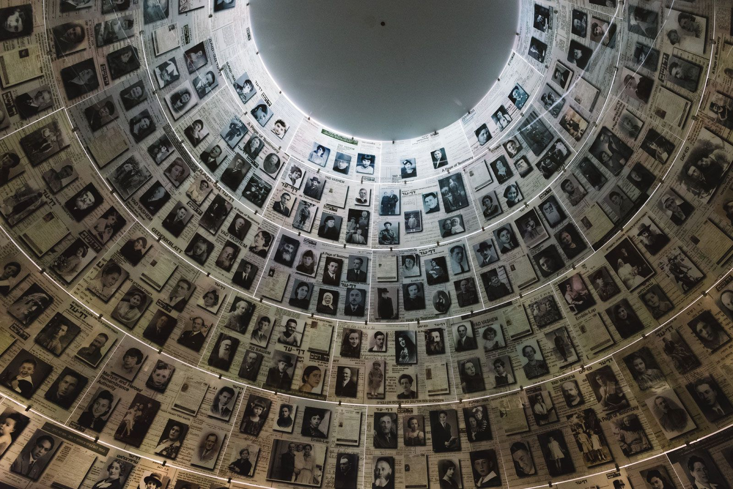
Exploring the US Holocaust Memorial Museum
What are some things you learned?
What do you have questions about?
Hall of Names at Yad Vashem in Jerusalem
Notes:
Parrott-Sheffer, C. (2019, March 20). Holocaust museum. Encyclopedia Britannica. https://www.britannica.com/topic/Holocaust-museum

Slide 10
Pre-Reading Thought Question
“
Do you agree or disagree with this quote?
Let’s discuss.
We must always take sides. Neutrality helps the oppressor, never the victim. Silence encourages the tormentor, never the tormented.
”
-Elie Wiesel
Notes:
Wiesel, E. (1986, December 10). Nobel Peace Prize Acceptance Speech. NobelPrize.org https://www.nobelprize.org/prizes/peace/1986/wiesel/26054-elie-wiesel-acceptance-speech-1986/

Slide 11
Who was Elie Wiesel?
Notes:
United States Holocaust Memorial Museum (2019, September 26). Elie Wiesel as Survivor and Founder. [Video] YouTube. https://www.youtube.com/watch?v=ABJzkHEEmdI&t=3s

Slide 12
Elie Wiesel: Survivor and Author
Based on his experience in the Nazi German concentration camps: Auschwitz and Buchenwald from 1944–1945
Night was published in 1958
Dawn was published in 1960
Day was published in 1961
Genres: Autobiography, Memoir, Holocaust Literature, Nonfiction
Notes:
Wiesel, E. (2006). Dawn. Hill and Wang.
Wiesel, E. (2006). Night. Hill & Wang.
Wiesel, E., & Borchardt, A. (2006). Day. Hill and Wang.

Slide 13
Excerpt from Elie Wiesel’s “Night”
On your handout, complete a Stop and Jot at the end of each page of the excerpt.
Write a recap statement summarizing what has happened in the story thus far.
Use this time to ask any clarifying questions.
Notes:
K20 Center. (n.d.). Stop and Jot. Strategies. https://learn.k20center.ou.edu/strategy/168

Slide 14
How Am I Feeling? What Am I Thinking?
Draw a line down the middle of your sticky note.
After you finish, place the sticky note on your Note Catcher handout. You will turn this in at the end of class.
Draw a small visual or write a short response of how you feel about what you learned today.
Write a question or comment explaining what you think or understand about what you learned today.
Notes:
K20 Center. (n.d.). How Am I Feeling? What Am I Thinking?. Strategies. https://learn.k20center.ou.edu/strategy/187

Slide 15
Why-Lighting
You are about to read Elie Wiesel’s Nobel Prize Acceptance Speech.
As you read, highlight any passages you find important or profound or that you have a question about it.
Write in the margins your notes: Why did you highlight those words or lines of text?
Notes:
K20 Center. (n.d.). Why-Lighting. Strategies. https://learn.k20center.ou.edu/strategy/128

Slide 16
Things to Know
Andrei Sakharov: Sakharov was a Russian nuclear physicist who fought for human rights and was against nuclear testing. For his protests, the Soviet government exiled him from his home in Moscow to the city of Gorky, where he lived in isolation and under police surveillance for six years.
Josef Biegun: Biegun lived in the Soviet Union and was put in prison by the government because he fought for the rights of Russian Jews. His behavior was said to be “anti-Soviet.”

Slide 17
Things to Know
Solidarity: Solidarity is the name of a trade union in Poland that was openly anti-communist and contributed to the collapse of the Soviet Union.
Lech Wałęsa: Wałęsa was a founding member of Solidarity. In support of workers’ rights, he organized multiple shipyard protests, which led to his being arrested for months without trial.
Nelson Mandela: Mandela was a South African lawyer and politician that protested racial segregation laws known as apartheid. The government imprisoned him for 27 years.

Slide 18
Why-Lighting: Share Out
With a partner, compare annotations.
What did you highlight that was the same? Different?
Discuss your “why” for highlights that differ.
Can you answer each other’s questions?
If not, research your questions to determine the answer.
You have 10 minutes to complete this.
Notes:
K20 Center. (n.d.). Why-Lighting. Strategies. https://learn.k20center.ou.edu/strategy/128

Slide 19
CER: Revisiting the Thought Question
“
Do you agree or disagree with this quote?
Write a CER paragraph explaining your answer.
You have 5 minutes.
We must always take sides. Neutrality helps the oppressor, never the victim. Silence encourages the tormentor, never the tormented.
”
-Elie Wiesel
Notes:
Wiesel, W. (1986, December 10). Nobel Peace Prize Acceptance Speech. NobelPrize.org https://www.nobelprize.org/prizes/peace/1986/wiesel/26054-elie-wiesel-acceptance-speech-1986/
K20 Center. (n.d.). Claim, Evidence, Reasoning (CER). Strategies. https://learn.k20center.ou.edu/strategy/156

Slide 20
CER: Sentence Starters
Claim: I agree/disagree with this quote because _____.
Evidence: For example, in the [speech or book] it says _____.
Reasoning: This shows _____. This is important because _____.
Notes:
K20 Center. (n.d.). Bell Ringers and Exit Tickets. Strategies. https://learn.k20center.ou.edu/strategy/125

Slide 21
Claim, Evidence, Reasoning
Notes:
K20 Center. (2021, August 19). Claim, Evidence, Reasoning [Video]. YouTube. https://www.youtube.com/watch?v=JGOxVIgmGWE

