Slide 2
Loop Me In
Creating Music with Loops

Slide 3
Essential Question
In music recording and production, what is a loop?
How are loops used in music creation?

Slide 4
Lesson Objectives
Create a song in BandLab using loops.
Demonstrate comfort and confidence working in a digital audio workstation.

Slide 5
Tip of the Iceberg
Using the Tip of the Iceberg, write words associated with the word “loop” on the tip of the Iceberg.
When you have completed your list, set your paper aside for future use.
Notes:
K20 Center. (n.d.). Tip of the Iceberg. Strategies. https://learn.k20center.ou.edu/strategy/67

Slide 6
Chrome Music Lab “Melody Maker”
Go to the following link: musiclab.chromeexperiments.com
Scroll down to the bottom left-hand corner and click “Melody Maker.”
Explore! Make something cool!
Notes:
Chrome Music Lab. (n.d.). Melody Maker. https://musiclab.chromeexperiments.com/

Slide 7
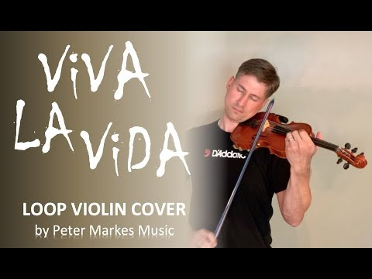
Peter Markes - Viva La Vida Loop Violin Cover
Reflect on the video using your Notecatcher.
Notes:
Markes, Peter. (July 11, 2019). Viva La Vida. Loop Violin Cover. [Video] YouTube. https://www.youtube.com/watch?v=Y8Wg4wz9tpc

Slide 8
Tip of the Iceberg
Return to the Tip of the Iceberg, record new knowledge you have about loops at the waterline of the Iceberg.
When you are finished, set your paper aside for future use.

Slide 9
Cus and Discuss
As you read the “What is a Loop” handout, circle new words, underline details, and star the main ideas.
Compare your notes with a partner.
Notes:
K20 Center. (n.d.). Cus and Discuss. Strategies. https://learn.k20center.ou.edu/strategy/162

Slide 10
BandLab
Go to edu.BandLab.com
Log in.
Follow the instructions on the BandLab Instructions handout.
Notes:
Bandlab for Education. (n.d.). BandLab app. https://edu.bandlab.com/

Slide 11
Tip of the Iceberg
Returning once again to your Tip of the Iceberg, complete the bottom portion of the Iceberg with all that you now know.
When you are finished, wait for your teacher to collect your work and give further instructions.

