Slide 2
In the Kingdom of Night, Part 2
A Call to Action

Slide 3
Essential Questions
Why is it important to learn history?
How can we inspire change?

Slide 4
Lesson Objectives
Annotate speeches to assess their impact and effectiveness
Write a Holocaust Remembrance speech that uses a call to action

Slide 5


What Makes a Great Speech?
On a sheet of notebook paper, list 3–5 things
that make a good or great speech.
You have 2 minutes.

Slide 6
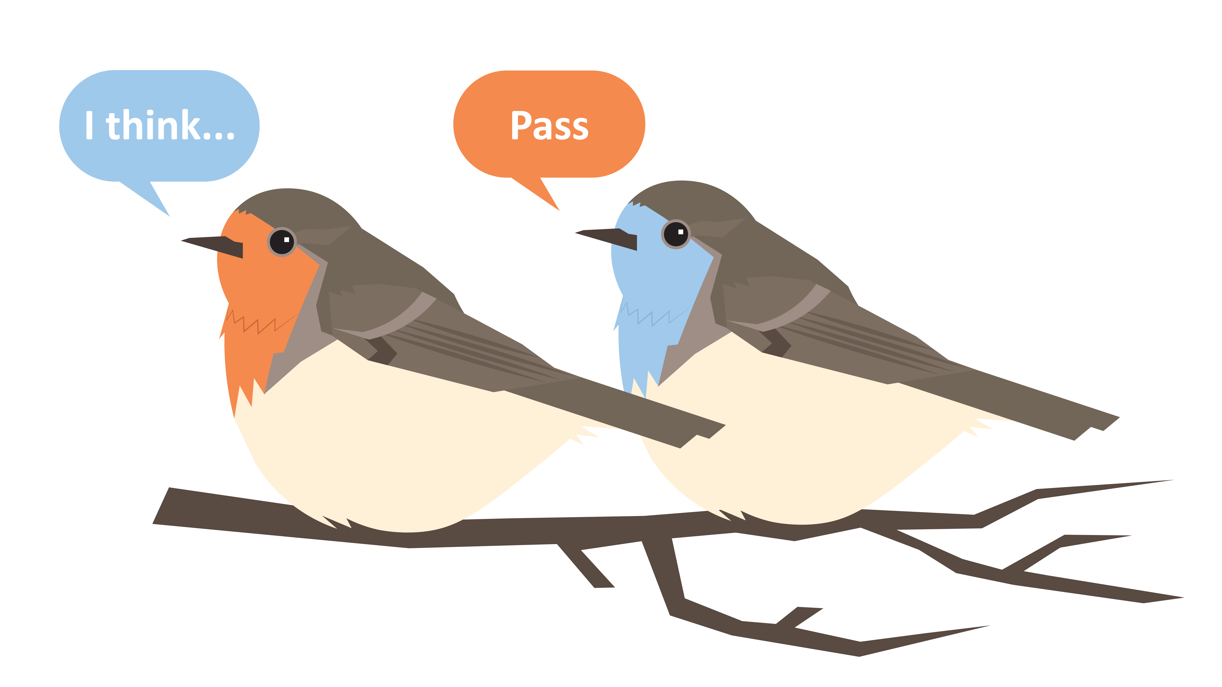
What Makes a Great Speech?
Share 1 thing from your list.
If your ideas have already been said, say, “Pass.”
Notes:
K20 Center. (n.d.). Round Robin. Strategies. https://learn.k20center.ou.edu/strategy/2183

Slide 7
Elie Wiesel’s Nobel Prize Acceptance Speech
Listen to Elie Wiesel’s 1986 Nobel Peace Prize Acceptance Speech.
As you listen, read along using your handout and write in the margins what he did to make this a good speech.
* The written speech and the presented speech vary slightly.

Slide 8
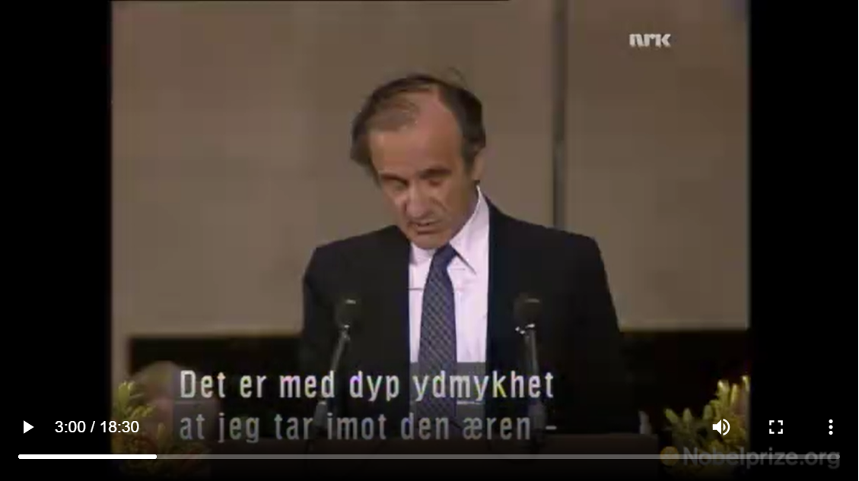
Elie Wiesel’s Nobel Prize Acceptance Speech
Notes:
Wiesel, W. (1986, December 10). Nobel Peace Prize Acceptance Speech. NobelPrize.org https://www.nobelprize.org/prizes/peace/1986/wiesel/26054-elie-wiesel-acceptance-speech-1986/

Slide 9
Acceptance Speech: Share Out
With a partner, compare notes.
What did you list that was the same in the two versions? Different?
What was the “why” for the things that differ?
Did you find anything we should add to our list from earlier? If so, what did you notice?
Is there anything you noticed today that you did not notice the first time we read this speech?
You have 10 minutes to complete this.

Slide 10
What Do These Quotes Have in Common?
“Ask not what your country can do you for you—ask what you can do for your country.” – John F. Kennedy
“I have a dream that one day….This will be the day when all of God’s children will be able to….” – Martin Luther King, Jr.
“With malice toward none with charity for all with firmness in the right as God gives us to see the right…. to do all which may achieve and cherish a just and lasting peace among
ourselves and with all nations.” – Abraham Lincoln
Notes:
Kennedy, J.F. (1691, January 20). Inaugural Address. JFKLibrary.org. https://www.jfklibrary.org/learn/about-jfk/historic-speeches/inaugural-address
King, M.L., Jr. (1963, August 28). I Have a Dream Speech. NPR.org. https://www.npr.org/2010/01/18/122701268/i-have-a-dream-speech-in-its-entirety
Lincoln, A. (1865, March 4). Lincoln’s Second Inaugural Address. NPS.gov. https://www.nps.gov/linc/learn/historyculture/lincoln-second-inaugural.htm

Slide 11
How Does Elie Wiesel’s Speech Inspire?
He uses a call to action.
In writing, a call to action is a message that inspires the audience to take action to support a particular cause.
Why is a call to action important?
  “An audience might be thoroughly gripped by your narrative and convinced to believe what you do—but if they leave not knowing what they are supposed to do with your ideas, your presentation will have been—essentially—fruitless.”
Notes:
Duarte, N. (2021, September 1). How to write a call to action in a persuasive speech. The Secret to Writing a Call to Action in A Persuasive Speech. Retrieved March 17, 2022, from https://www.duarte.com/presentation-skills-resources/how-to-write-a-call-to-action-in-a-persuasive-speech/

Slide 12

Why-Lighting: Speeches 1 and 2
Read the two Holocaust Remembrance
Speeches written by two former presidents.
Using a highlighter, highlight anything you think is important, profound, or that you have a question about.
Using a pen/pencil, write why you highlighted those things in the margins.
You have 15 minutes to complete this.
Notes:
K20 Center. (n.d.). Why-Lighting. Strategies. https://learn.k20center.ou.edu/strategy/128

Slide 13
Why-Lighting: Share Out
Compare annotations with a partner.
What did you highlight that was the same? Different?
Discuss your “why” for highlights that differ.
How do these speeches compare to Elie Wiesel’s speech?
Find the call to action in both speeches and underline it.
You have 10 minutes to complete this.
Notes:
K20 Center. (n.d.). Why-Lighting. Strategies. https://learn.k20center.ou.edu/strategy/128

Slide 14
Using a Call to Action
Write a Holocaust Remembrance Speech for Yom HaShoah that includes a call to action.
Use the speeches that we have annotated as an inspiration to write your own.
Yom HaShoah (/yam/ /həšoə/), also known as Holocaust Remembrance Day, is a day set aside to honor the Jewish lives lost during the Holocaust. It is observed on the 27th
of the Hebrew month of Nisan.
Notes:
The first vowel is /a/ pronounced like first sound in "aware". The /š/ makes the "sh" sound.

Slide 15
Write a Holocaust Remembrance Speech
Requirements:
Minimum of 25 Sentences, 3 Paragraphs
Must be Presented (in one of the following ways):
  In-person
    During class
    During lunch
    After school
  Filmed and submitted

Slide 16
Write a Holocaust Remembrance Speech
Suggested Format:
Paragraph 1: Explanation of purpose
Paragraph 2: Background and acknowledgement of topic and its impact (in both the past and present)
Paragraph 3: Call to action
  Persuade and inspire the audience to take action

Slide 17
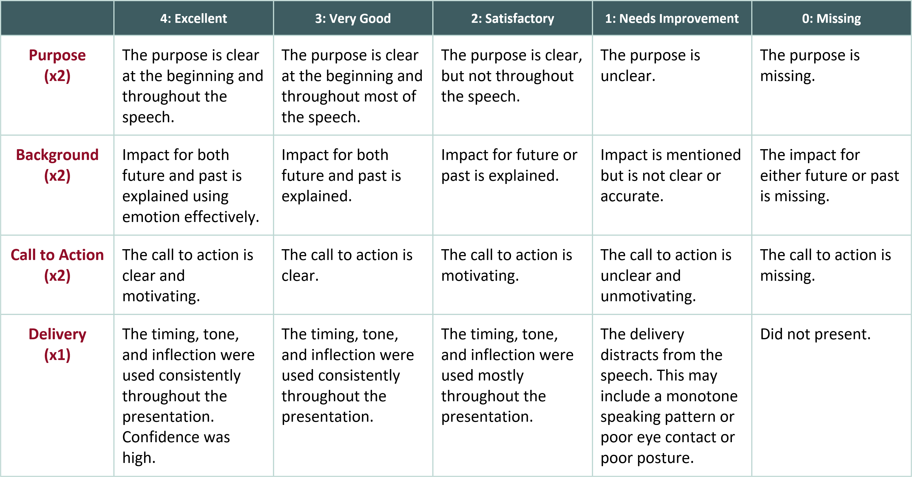
Holocaust Remembrance Speech Rubric

Slide 18

Peer Editing
Use the Speech Rubric to give peer feedback.
Is the purpose clear?
Is the impact for both past and future explained?
Is the call to action clear and motivating?
Notes:
K20 Center. (n.d.). Two Stars and a Wish. Strategies. https://learn.k20center.ou.edu/strategy/83

Slide 19
Let’s Present

