Slide 2

Say What You Mean
Gaining Mastery of Prepositional, Infinitive, and Gerund Idioms

Slide 3
Essential Questions:
How does grammar enhance your writing?
How will understanding the role of idioms help your ACT performance?

Slide 4
Lesson Objectives:
Identify and correctly use prepositional, infinitive, and gerund idioms.
Analyze how idiomatic usage impacts sentence correctness.
Apply idiomatic knowledge through ACT-style practice.

Slide 5

Sounds Right? Sounds Off?
Find a partner.
Decide who will read the odd/even numbered sentences.
As one person reads, the other person should decide whether it sounds right or sounds off.
  Mark each answer on the handout.
  Talk about your decision with your partner.
Switch roles for the next sentence.
Repeat until you have completed the handout.
Notes:
K20 Center. (n.d.). Sounds right? Sounds off?. Strategies. https://learn.k20center.ou.edu/strategy/4991

Slide 6
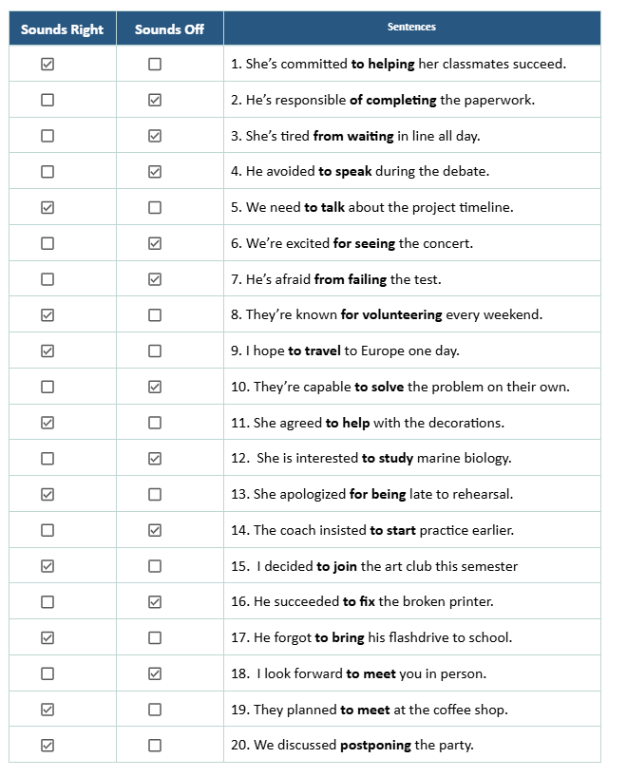
Answer Key
What do these sentences have in common?
How are they different?

Slide 7

Which ones go together? Why?
Get a card sort set from your teacher.
As a team, group the cards that are similar.
Talk about each group and what makes the cards go together.
How would you label each group of cards and why?
Use your sticky notes to create labels and group all the cards.
Notes:
After about 5 minutes, tell the students that there are only 3 categories.
K20 Center. (n.d.). Card sort. Strategies. https://learn.k20center.ou.edu/strategy/147

Slide 8
Card Sort | Answers
Prepositional
Agree with | Fond of | Opposed to | Worry about | Substitute for
Limited to | Outraged by | Difference between | Interested in | Afraid of
Responsible for | Depend on | Approve of | Object to | Apologized for

Slide 9
Card Sort | Answers
Infinitive
Pretend to understand | Want to win | Refuse to participate | Learn to drive | Hope to improve
Decides to leave | Failed to secure | Neglect to mention | Strive to evoke | Consent to participate
Hesitate to speak | Afford to take | Vow to address

Slide 10
Card Sort | Answers
Gerund
Refrain from going | Effective at winning | Insisted on staying | Postpone walking | Discouraged from talking
Tolerate lying | Succeed in graduating | Regarded as being | Committed to helping | Succeed in finishing
Accused of cheating | Admit to lying

Slide 11
What Does it Mean?
Discuss the vocabulary handout.
  What do you notice about the definitions?
  How do the examples support the definitions?
Individually, write your personal version of each definition.
  How do you make sense of the given definitions and examples?
  What do they remind you of?

Slide 12
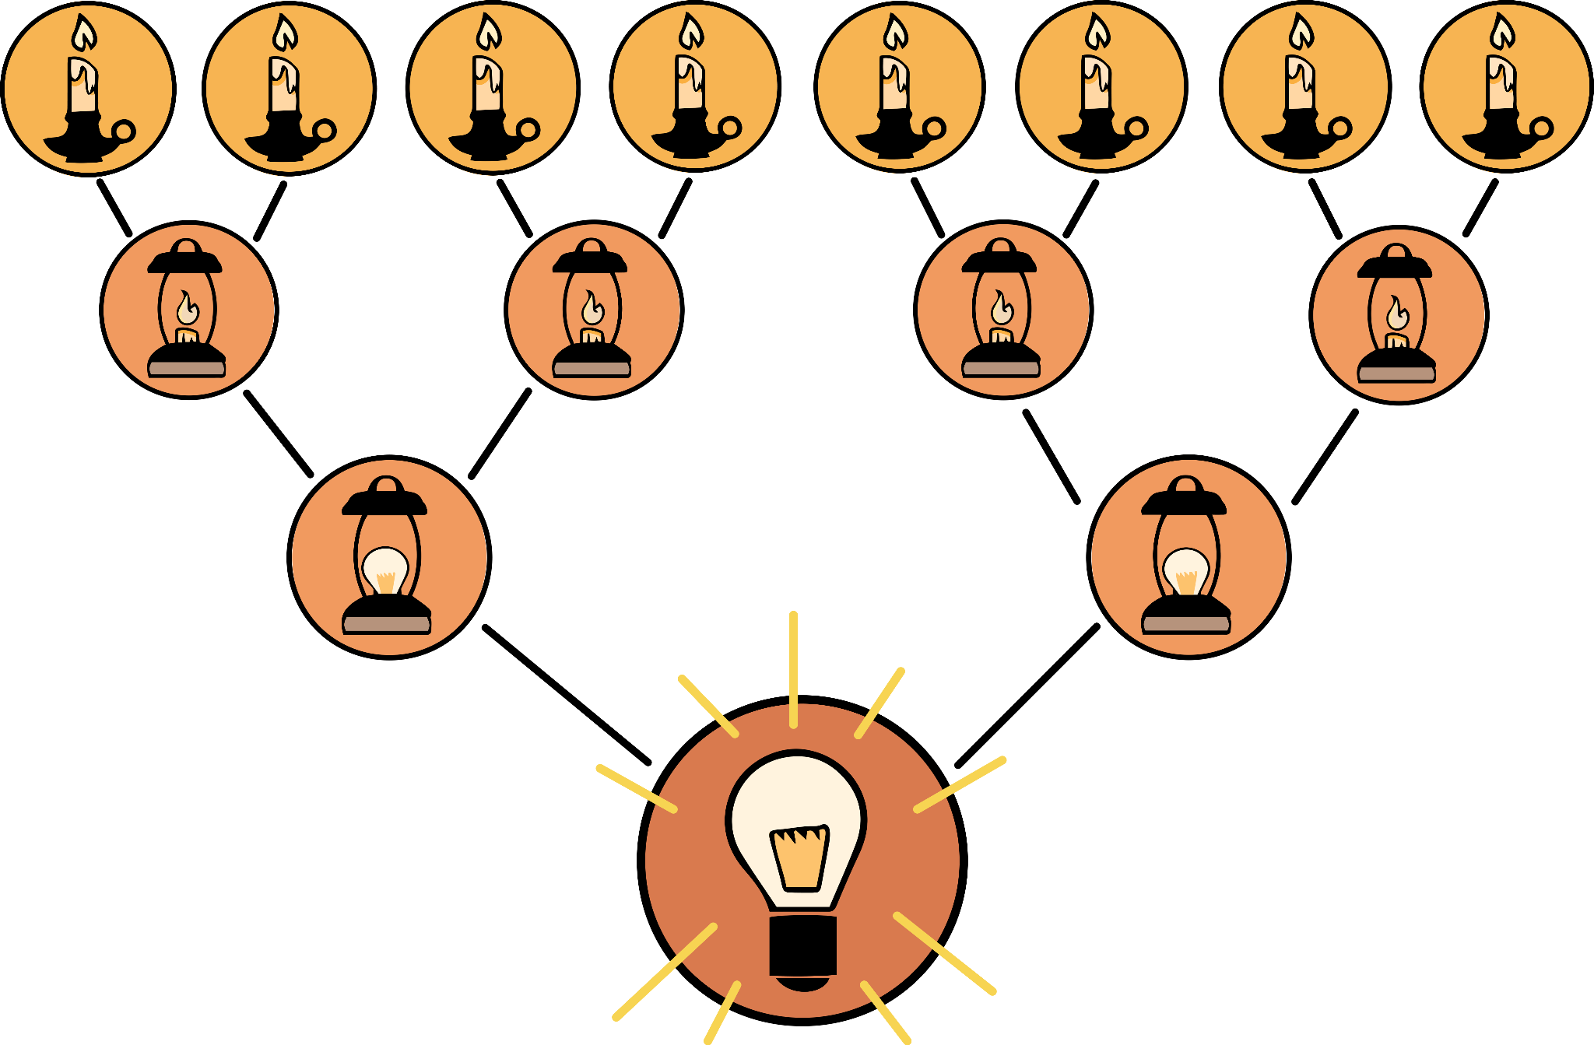

8-UP
We are going to create a class set of definitions for idioms, but first…
With your partner:
Share your individual definitions from before.
Combine or synthesize your ideas into a new set of definitions.
K20 4 Minute Timer
Notes:
K20 Center. (n.d.). 8-up. Strategies. https://learn.k20center.ou.edu/strategy/2494
K20 Center. (2021, September 21). 4 Minute Timer [Video]. YouTube. https://youtu.be/kpCsfuvzQeY?feature=shared

Slide 13
8-UP
We are going to create a class set of definitions for idioms, but first…
With your group:
Share your individual definitions from before.
Combine or synthesize your ideas into a new set of definitions.
K20 4 Minute Timer
Notes:
K20 Center. (n.d.). 8-up. Strategies. https://learn.k20center.ou.edu/strategy/2494
K20 Center. (2021, September 21). 4 Minute Timer [Video]. YouTube. https://youtu.be/kpCsfuvzQeY?feature=shared

Slide 14
8-UP
We are going to create a class set of definitions for idioms, but first…
With your new group:
Share your individual definitions from before.
Combine or synthesize your ideas into a new set of definitions.
K20 4 Minute Timer
Notes:
K20 Center. (n.d.). 8-up. Strategies. https://learn.k20center.ou.edu/strategy/2494
K20 Center. (2021, September 21). 4 Minute Timer [Video]. YouTube. https://youtu.be/kpCsfuvzQeY?feature=shared

Slide 15
8-UP
What’s our class set of definitions?
Notes:
K20 Center. (n.d.). 8-up. Strategies. https://learn.k20center.ou.edu/strategy/2494

Slide 16
“Shooting an Elephant” ACT Practice
The passage you are about to read is modeled after the ACT English subtest.
A true English passage would have 10 questions that test a variety of grammar and writing skills.
This passage has only 5 questions and focuses solely on idioms.
With 5 passages and 50 questions total, aim to answer each in 42 seconds!
4 Minute K20 Timer
Notes:
K20 Center. (2021, September 21). 4 Minute Timer. YouTube. https://www.youtube.com/watch?v=kpCsfuvzQeY&list=PL-aUhEQeaZXLMF3fItNDxiuSkEr0pq0c2&index=6
ACT. (n.d.). ACT Education Corp. https://www.act.org/

Slide 17
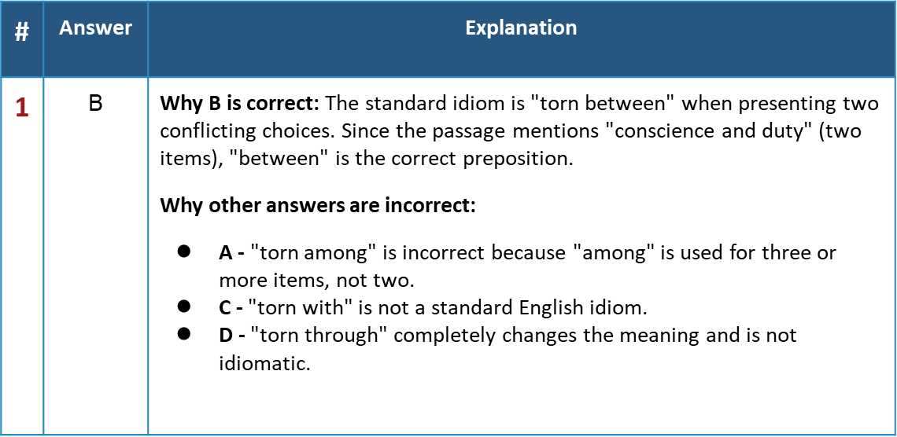
Shooting an Elephant | Answers

Slide 18
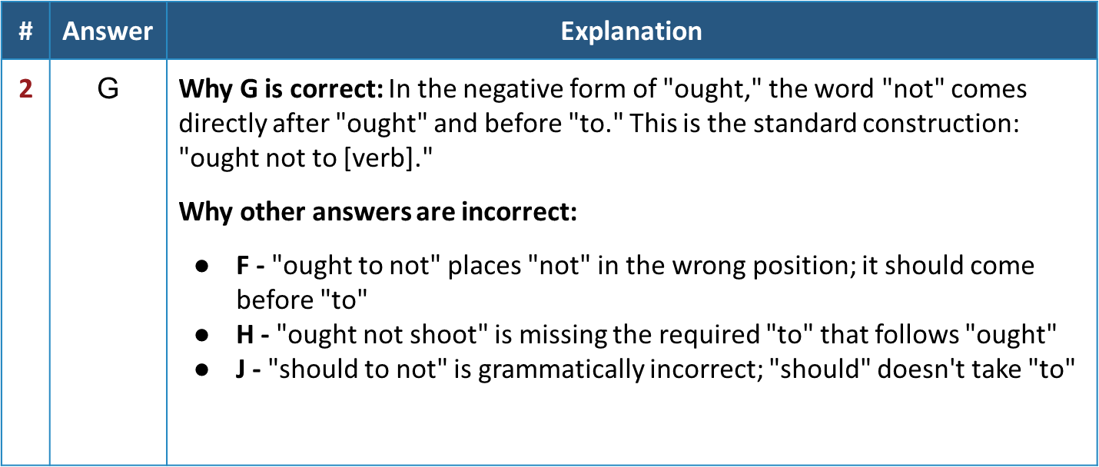
Shooting an Elephant | Answers

Slide 19
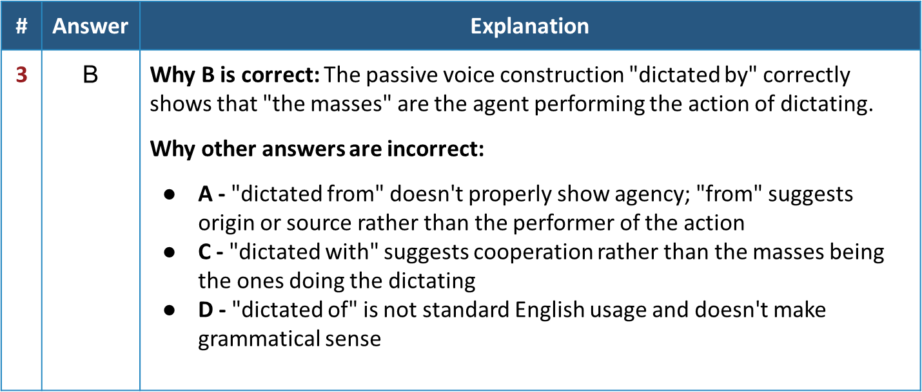
Shooting an Elephant | Answers

Slide 20
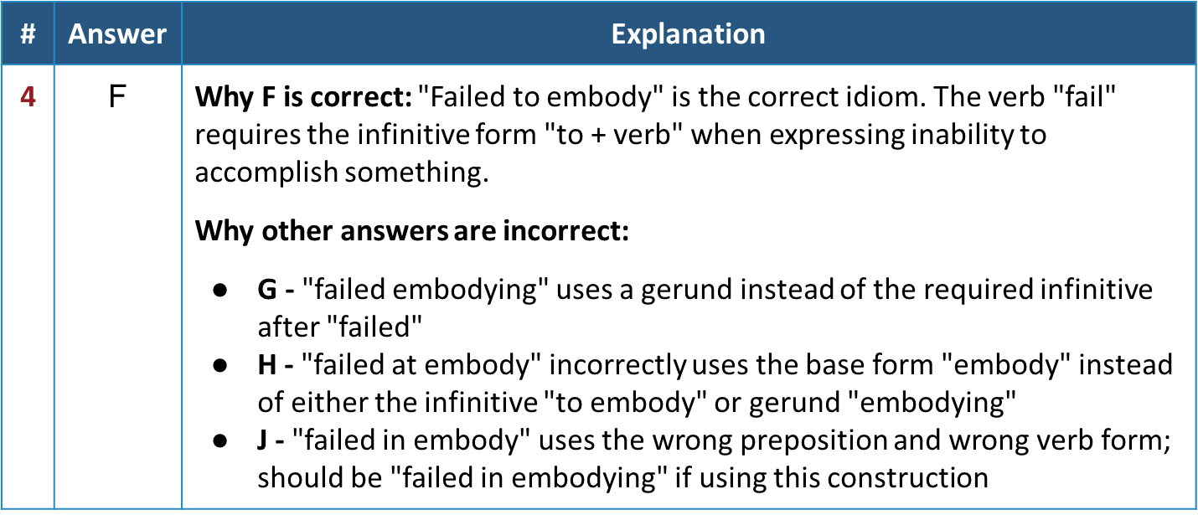
Shooting an Elephant | Answers

Slide 21
Shooting an Elephant | Answers
Answer | Explanation
A | Why A is correct: "Felt impossible" is grammatically correct. The verb "felt" can be followed by an adjective, and "impossible" properly describes the feeling or state. Why other answers are incorrect: B - "felt impossibly" uses an adverb instead of an adjective; "impossibly" would modify how something felt rather than describing the state C - "felt like impossible" is incomplete; it would need "felt like an impossible situation" or similar D - "felt as impossible" requires a comparison (felt as impossible as something else) to be grammatically complete.

Slide 22

Categorical Highlighting
Read the passage, “Shooting an Elephant,” again. This time identify ALL the idioms!
Highlight each type of idiom a different color:
  Prepositional
  Gerund
  Infinitive
Notes:
K20 Center. (n.d.). Categorical highlighting. Strategies. https://learn.k20center.ou.edu/strategy/192

Slide 23
Practice Time!
Write a short narrative with at least two examples of each type of idiom.
Prompt: Write about a time where you were in conflict between your conscience and what others might think of you.

Slide 24

Margin Mates | Peer Review
Digitally switch papers with your partner.
Using your preferred program, use the “comments” or “suggestions” features to give your partner feedback on the following:
  Identify 2 examples of each type of idiom (prepositional, gerund, and infinitive).
  If you can’t find any examples, suggest they rephrase parts of their writing to include a missing example.
Notes:
K20 Center. (n.d.). Margin Mates. Strategies. https://learn.k20center.ou.edu/strategy/5116

Slide 25

Exit Ticket
On a sticky note or scratch paper, write about the following:
How can I train my ear for idioms?
How will this help me on the ACT?
Notes:
K20 Center. (n.d.). Bell ringers and exit tickets. Strategies. https://learn.k20center.ou.edu/strategy/125

