Slide 2
Barbie: Blessing or Curse?
Style, Format, and Genre

Slide 3
Essential Questions
How do style, format, and genre affect a text?
Are there particular styles or formats that are more effective for a particular genre?

Slide 4
Lesson Objectives
Consider how the style, format, and genre of a text affect its meaning and effectiveness.
Create an argument in a particular genre and present it to classmates.

Slide 5
Barbie’s First Commercial
As you watch, consider these questions:
What stylistic choices do you see in the commercial (graphics, sounds, word choice, syntax)?
Is the commercial effective? Why or why not?
What influences do you think Barbie has had on society?
Notes:
Show the commercial on the next slide.

Slide 6
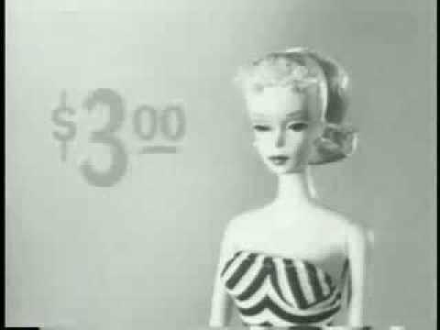
Barbie’s First Commercial
Notes:
Source: BarbieCollectors. (2008, October 29). 1959 First EVER Barbie Commercial High Quality HQ! [Video]. YouTube. https://www.youtube.com/watch?v=9hhjjhYGQtY

Slide 7

Quick Write
What stylistic choices do you see in the commercial (graphics, sounds, word choice, syntax)?
Is the commercial effective? Why or why not?
What influences do you think Barbie has had on society?
Notes:
Source: K20 Center. (n.d.). K20 5-minute timer [Video]. https://www.youtube.com/watch?v=EVS_yYQoLJg

Slide 8

Think-Pair-Share
Think about the questions you answered.
Discuss your answers with a partner.
Share what you discussed with the class.

Slide 9
Poem Paraphrase
Read the poem “Barbie Doll” by Marge Piercy.
In your group, break down the poem line by line, stanza by stanza, paraphrasing the poem in your own words (how you would tell it to a friend).
Write your paraphrased poem on the poster paper.

Slide 10
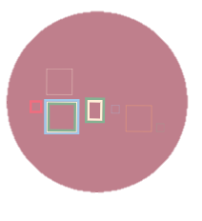
Gallery Walk
Take your sticky notes and visit each group's poem.
Leave a note with a comment or question about the language they chose to paraphrase.
Remember to be respectful with your comments.

Slide 11
Article Annotation
Retrieve a copy of “Barbie Is Past Saving,” an opinion article by Alexandra Petri.
As you read, use the Stop and Jot annotation strategy:
  Stop at the end of each paragraph.
  Write the main ideas of that paragraph in the margin.
Choose a partner. Compare and contrast the notes you each wrote in the margin.
Notes:
Source: K20 Center. (n.d.). Stop and Jot. Strategies. https://learn.k20center.ou.edu/strategy/168

Slide 12
Class Discussion
How do the genre and format of a text influence its message or meaning?
How would the message of Marge Piercy’s poem be different if it were a short story, an essay, a nonfiction article, etc.?
How would the message of Alexandra Petri’s opinion article change if it were a documentary, a poem, or a commercial?

Slide 13
Challenge
Make a connection between the author’s purpose and the format of the poem “Barbie Doll.”
Make a connection between the author’s purpose and the format of the opinion article “Barbie Is Past Saving.”

Slide 14
A Definition of Literary Style
How a writer decides to express whatever they want to say: choice of words, sentence structure, syntax, and language (figurative or metaphorical).
Source: Jan-Louis Nagel, The Rough Guide to Literary Style
Notes:
Source: Nagel, J. L. (2018, May 24). The rough guide to literary style. Norwegian Digital Learning Arena. https://ndla.no/en/subject:17/topic:1:184557/resource:1:110262?filters=urn:filter:41cb93c0-abc7-4212-b69f-df81106ae3c0

Slide 15
Genre Table
Find a partner, if you want one.
Fill out the chart on the Genre Table handout.
  Identify style/literary choices in each of the three types of media
  you reviewed about Barbie.
  Cite evidence proving each style choice.
  Describe the effectiveness (or lack of effectiveness)
  of the author’s style choice.

Slide 16
Brainstorming Class List
Genres | Social Issues

Slide 17
Create Your Own
Choose your favorite genre.
In that genre, write an argument related to a social issue of your choice.
  Consider the literary/style choices you would like to include.
  Consider how the genre you’ve chosen will convey your argument most effectively.

Slide 18
Share and Provide Feedback
Present your argument to your classmates.
As your classmates share, fill out a feedback form to assess their argument.

