Slide 2
You’ve Got a Friend in Me
Collaboration in the Visual Arts

Slide 3
“Old Town Road”: Listen and List
“Old Town Road” was a commercial and critical success. It was number one in musical charts around the world in places like the United States, Canada, Australia, and Germany.
Listen to the song and create a list of reasons why you think the song was so successful. You have until the end of the song to make a list.
Notes:
Link to audio of Old Town Road: https://www.youtube.com/watch?v=75PpxGzR7s0

Slide 4
Observe and List
Observe the following three pieces of art for one minute each.
List everything you think is important about each piece of art.

Slide 5
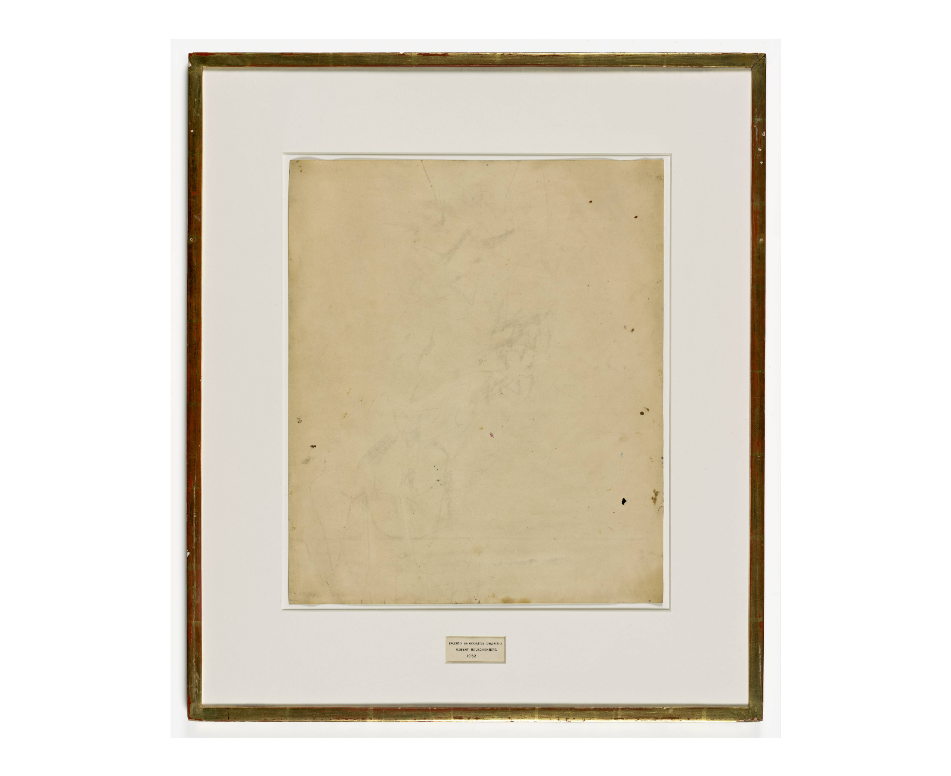
Notes:
Read inscription to students:
“Erased de Kooning Drawing
Robert Rauschenberg
1953”
Rauschenberg, R. (1953). Erased de Kooning drawing [Traces of drawing media on paper with label and gilded frame]. SFMOMA, San Francisco, CA. www.sfmoma.org/artwork/98.298/essay/erased-de-kooning-drawing/

Slide 6
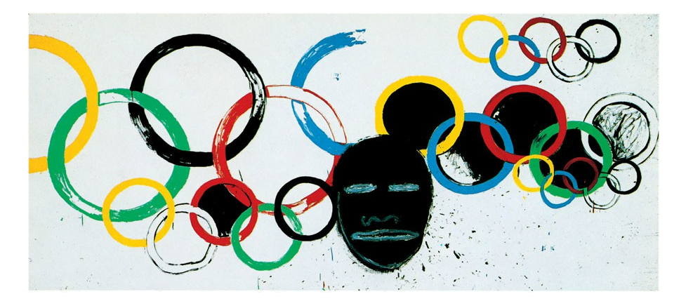
Notes:
Basquiat, J. & Warhol, A. (1985). Olympic Rings [Painting]. Gagosian Gallery, Davies Street, London. gagosian.com/exhibitions/2012/jean-michel-basquiat-and-andy-warhol-olympic-rings/

Slide 7
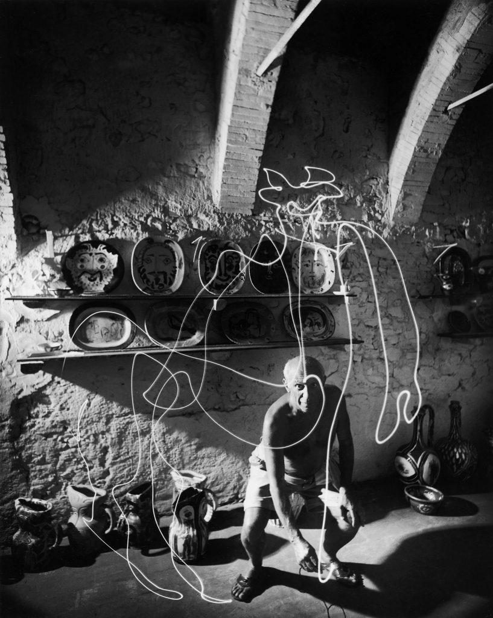
Notes:
Mili, G. (1949). Pablo Picasso "draws" A centaur in the air with light [Silver gelatin photograph]. Holden Luntz Gallery, Palm Beach, Florida. www.holdenluntz.com/magazine/photo-spotlight/gjon-mili-pablo-picasso-draws-a-centaur-in-the-air-with-light/

Slide 8
Commit and Toss
On a sticky note, explain what might be the common element between the three pieces of art you have observed.
When you are finished, crumple up the note into a ball and toss it into the basket.

Slide 9
Essential Question
How does collaboration affect the creative process?

Slide 10
Lesson Objectives
Analyze the process of creating art collaboratively.
Create a work of art within a group.

Slide 11
Jigsaw
In groups, pick out one article each about the three art pieces.
Become an “expert” on the piece of art you have read about.
Share with your group what you have learned about the piece of art.

Slide 12
Choose a Card
Choose one card at random from the deck.

Slide 13
Collaborative Art Project
Choose one card from your group to be the subject of your collaborative art piece.
Choose one medium (marker, paint, etc.) per group member to create your art.
Without talking, recreate the object from the card on your blank poster paper.
Take turns drawing only one line at a time.
Continue until the art piece is complete.

Slide 14
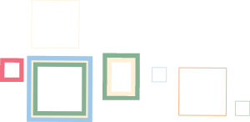
Gallery Walk
Rotate and view each work of art with your group.
Leave a sticky note near the art with one positive critique and one guess as to what object the artists recreated.

Slide 15
Reflection
Return to your original seat and respond to the reflection questions.
What challenges came from collaborating with your classmates?
What benefits did you discover while collaborating?
Now that you have completed the lesson, why do you think the song at the beginning of the lesson was selected?

