Slide 2
Budgeting Basics: Needs vs. Wants
A Financial Literacy Lesson
How do I prepare for the future I want?

Slide 3
Careers | Education
CEO | College Degree
Accountant | College Degree
Veterinarian | College Degree + Vet School
Teacher | College Degree
Welder | Career Tech Training
Construction Worker | HS Diploma
McDonald’s Cashier | HS Diploma
Wal-Mart Cashier | HS Diploma
Registered Nurse | College Degree
Military Service 1st year- Army | HS Diploma
Plumber | Career Tech Training
Airline Pilot | College Degree + Aviation training
Computer Programmer | College Degree
Social Worker | College Degree

Slide 4
1. What are your plans for the future? What will you be doing at age “25”?
Personal | Financial | Educational | Career
2. What can you be doing now to achieve your goals? By the end of the school year? By next year?

Slide 5
Careers | Salaries
CEO | $102,690
Accountant | $ 67,190
Veterinarian | $ 88,490
Teacher | $ 57,200
Welder | $ 38,150
Construction Worker | $ 39,640
McDonald’s Cashier | $ 19,790
Wal-Mart Cashier | $ 18,000
Registered Nurse | $ 67,490
Military Service 1st year- Army | $ 18,802
Plumber | $ 50,620
Airline Pilot | $102,520
Computer Programmer | $ 79,530
Social Worker | $ 45,900

Slide 6
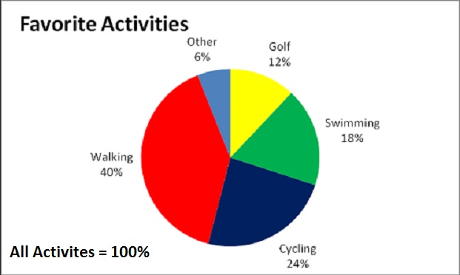
An Example of a Pie Chart

Slide 7
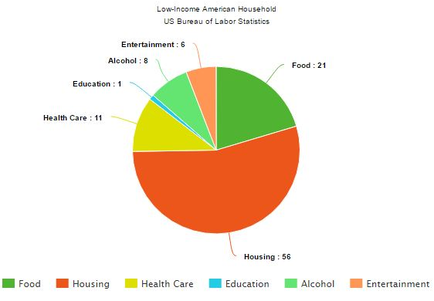

Slide 8
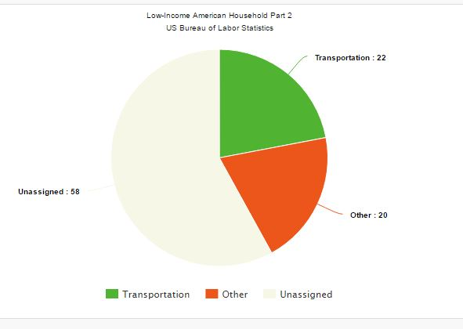

Slide 9
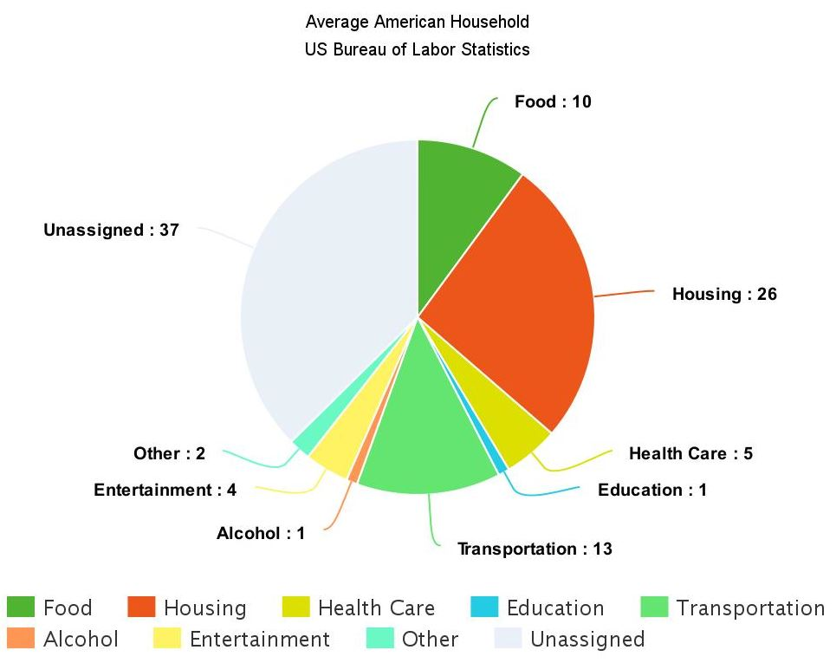

Slide 10
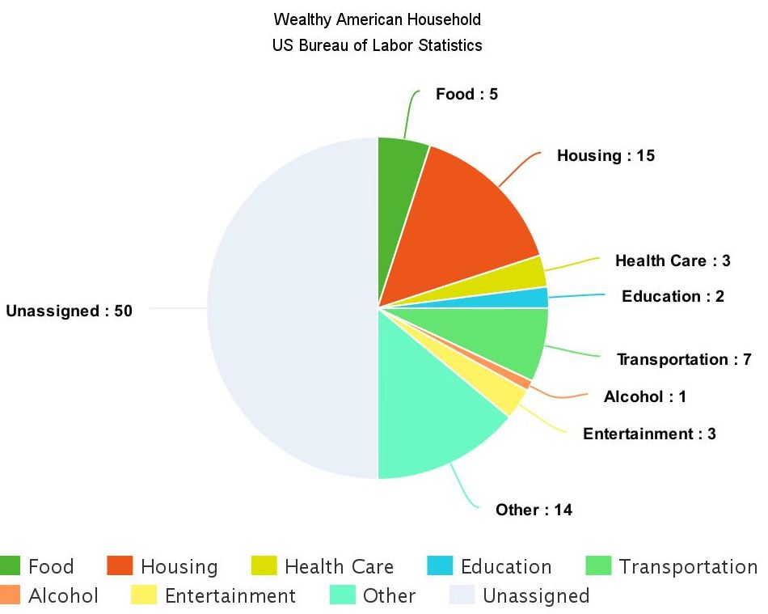

Slide 11
Questions about the Pie Charts
Which American household is over their budget?
For the low income American household, where is the largest percentage of their money spent?
Which household is spending the least amount on expenses for what they earn? Why do you think they have so much extra money?
What might be the reason for the larger amount of food costs for the wealthy American household as compared to the others?
For the average American household, where is the largest percentage of their money spent?
The low-income household is spending more than they earn. In your opinion, in what areas (other than housing, which usually is a set amount) could they reduce their expenses?
What other conclusions can you determine from the three household charts?
In your opinion, what should be most important in a budget? Least important?

Slide 12
What is Essential (needed) and Non-Essential (wanted)?
With your group, decide upon a recorder.
Determine as a group, the top 4 things in life that are needed (essential) for daily living.
Determine as a group, the top 4 things in life that may be something you may want but NOT essential for daily living.
Be prepared to discuss your choices.

Slide 13
Individual assignment
1. What are your plans for the future? What will you be doing at age “25”? 2. What can you be doing now to achieve your goals? By the end of the school year? Next year?
3. What “wants” are you willing to wait for to achieve your goals?
Personal | Financial | Educational | Career

