Slide 2
Tribal Sovereignty and the Indian Reorganization Act
Tribal Governments

Slide 3
Essential Questions
What is sovereignty?
What was the impact of the Indian Reorganization Act?
How do the tribal governments reflect the culture and values of the tribal people?

Slide 4
Lesson Objective
Identify and describe how tribes exert their authority.

Slide 5
What do tribal governments do?
Notes:
Video: https://www.youtube.com/watch?v=b37DnbUwK1I

Slide 6
I Notice, I Wonder
What did you notice when watching the video?
What questions did you have?
Jot these down and be ready to discuss.
Notes:
Instructional Strategy Source: https://learn.k20center.ou.edu/strategy/180

Slide 7
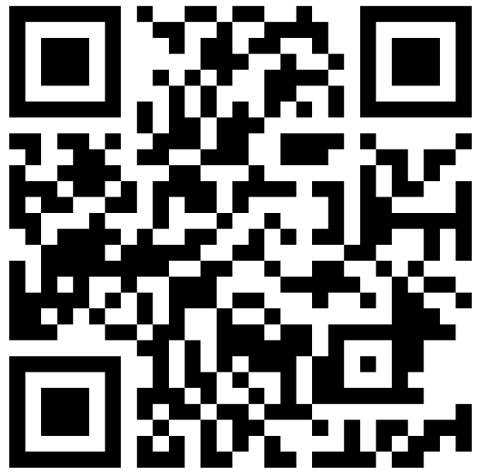
Research a Tribal Government
Navigate to the Wakelet “Oklahoma Tribes and Their Constitutions.”
Peruse the various tribes and where they reside in Oklahoma.
Choose one and click on the link to their constitution.
wakelet.com/wake/wg-MYU5_ZZqL8M2cOfhit
Notes:
Tech Tool Source: https://learn.k20center.ou.edu/tech-tool/2180

Slide 8
Research a Tribal Government
Once you have agreed on a tribe to research, begin filling out the Note Catcher.
You have 30 minutes to research and fill out the Note Catcher.

Slide 9
Present your research
Using information from your Note Catcher and the tribe’s constitution, create a poster or a Google Slides presentation to present your research to the class.
Be sure to include a picture of the tribe’s leader.
Each group will have five minutes to present.

Slide 10
CUS and Discuss
Read the History of the Indian Reorganization Act.
As you read, note important information to use in the CUS and Discuss.
Circle any important vocabulary.
Underline any information that supported tribal sovereignty.
Star any information that wounded tribal sovereignty.
Notes:
Instructional Strategy Source: https://learn.k20center.ou.edu/strategy/162

Slide 11
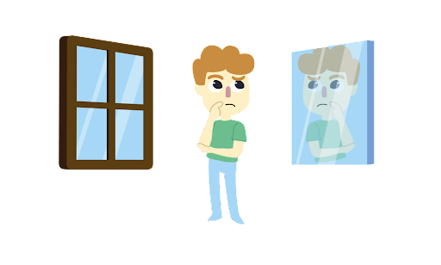
Windows and Mirrors
After discussing the reading, answer the following questions.
Windows: What differences do tribal governments have compared to the US government?
Mirrors: How are tribal governments similar to the US government?
Notes:
Instructional Strategy Source: https://learn.k20center.ou.edu/strategy/948

Slide 12
Jigsaw
Organize into groups of 4.
Each person in your group will be given a task with information to capture on the handout.
Complete the final review as a group.
Be ready to discuss what you learned with the class.
Notes:
Instructional Strategy Source: https://learn.k20center.ou.edu/strategy/179

Slide 13
I Think, We Think
I Think: Answer the question, “How do tribes assert their authority?” using as many details from the lesson as possible.
We Think: Get into groups of four and answer the same question together.
Be ready to discuss your answer(s) with the whole class.
Notes:
Instructional Strategy Source: https://learn.k20center.ou.edu/strategy/141

