Slide 2
Finding Factors, Part 1
Factoring Quadratics

Slide 3
Essential Question
How can we solve quadratic equations by factoring?

Slide 4
Lesson Objectives
Factor quadratic expressions.
Solve quadratic equations.

Slide 5
TRI Game
TRI sets: sets of three cards that have a greatest common factor containing x or y and a coefficient greater than 1.
“TRI”
The GCF of these three cards is 8x².
NOT a
TRI set.
The GCF
of these three cards is 5.

Slide 6
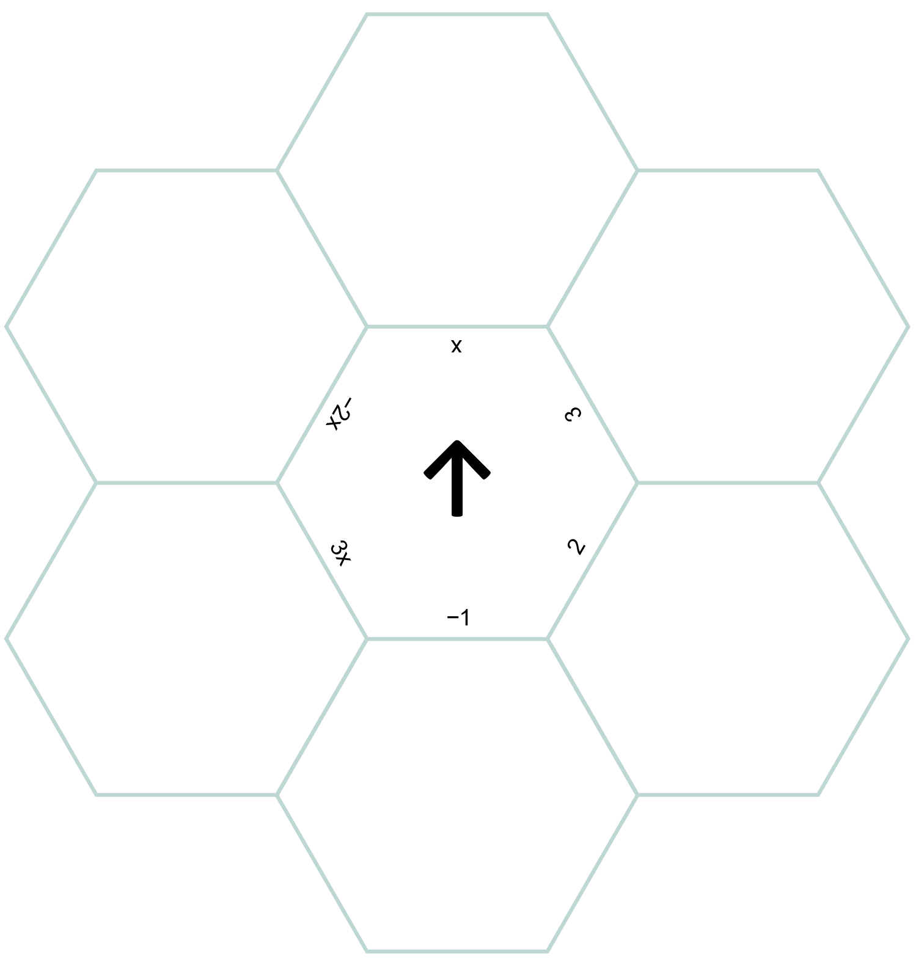
Hexagon Puzzle
Work with your partner to arrange the hexagons such that sides with equivalent expressions OR sides with an expression and its GCF are touching.
The center hexagon contains the GCFs.

Slide 7
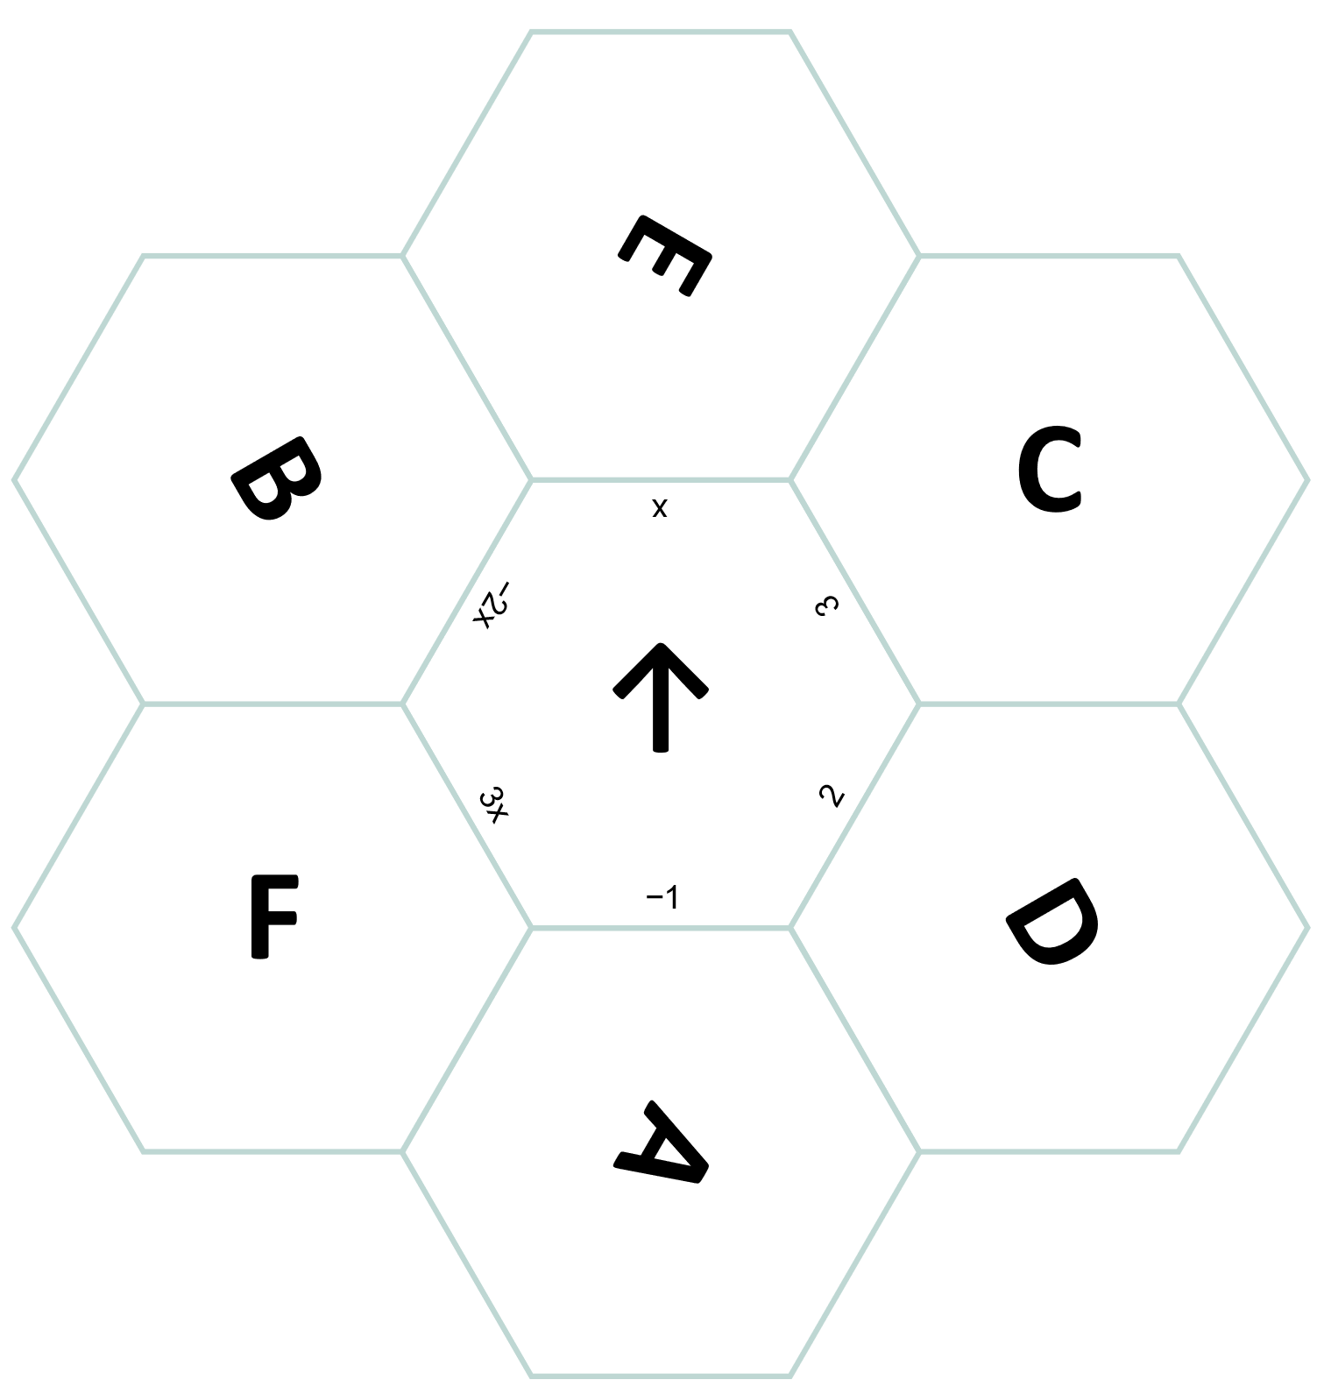
Hexagon Puzzle
(Solution)

Slide 8
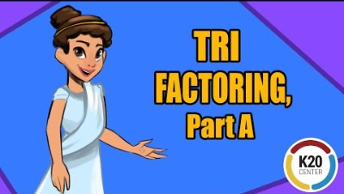
Guided Notes (a = 1)
TRI Factoring, Part A
Notes:
K20 Center. TRI Factoring, Part A. YouTube. https://youtu.be/2FGYijGLa2c

Slide 9
Factoring Quadratics When a = 1
Work with a partner to factor questions 1–4 on your
TRI Factoring handout. Then, discuss these questions:
How are questions 3 and 4 similar?
How are they different?

Slide 10
Factoring Quadratics When a = 1 (Solutions)

Slide 11
Factoring Quadratics When a = 1 (Solutions)

Slide 12
Solving Quadratics When a = 1
To solve a quadratic equation by factoring, you would:
Algebraically rearrange the equation so that one side equals zero:
Factor the quadratic expression.
Set each factor equal to zero.
Solve for x.
Why must one side of the equation equal zero
before you start factoring?

Slide 13
Solving Quadratics When a = 1
Work with your partner and use factoring to solve the quadratic equations on questions 5–8.

Slide 14
Solving Quadratics When a = 1 (Solutions)

Slide 15
Solving Quadratics When a = 1 (Solutions)
The ball is on the ground at 2 and 8 seconds.

Slide 16
Solving Quadratics When a = 1 (Solutions)
The truck should park
20 feet away from the burning building.

Slide 17
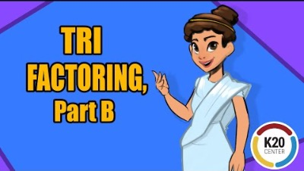
Guided Notes (a ≠ 1)
TRI Factoring, Part B
Notes:
K20 Center. TRI Factoring, Part B. YouTube. https://www.youtube.com/watch?v=DGc0VQiDsz4

Slide 18
Factoring Quadratics When a ≠ 1
Work with a partner to factor questions 1–4 on your
TRI Factoring Again handout and discuss these questions.
How are questions 2 and 4 similar?
How are they different?

Slide 19
Factoring Quadratics When a ≠ 1 (Solutions)

Slide 20
Solving Quadratics When a ≠ 1 (Solutions)

Slide 21
Solving Quadratics When a ≠ 1 (Solutions)
The rocket lands approximately
2.2 seconds after
it launched.

Slide 22
Solving Quadratics When a ≠ 1 (Solutions)
It will take 20 seconds for the skydiver to be only 3,600 feet above the ground.

Slide 23

Why-Lighting Factors
Highlight the critical details that
help you make decisions when factoring.
Explain your reason for your highlighting in the margins.
Be prepared to share your thinking.

