Slide 2
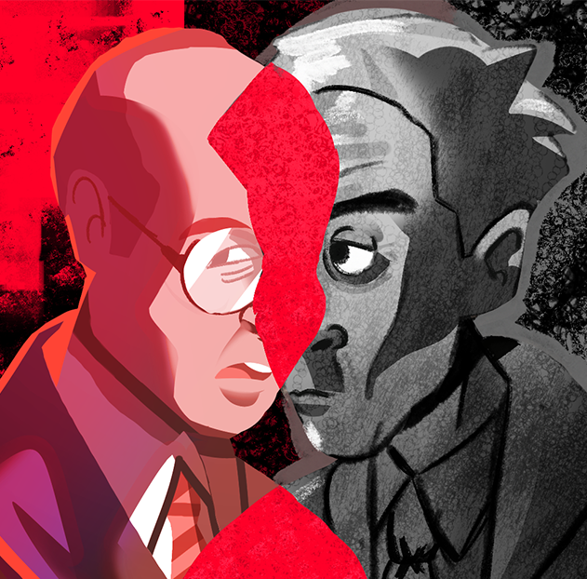
Comparing/Contrasting Characters Through Two-Voice Poems
Characterization

Slide 3
Mr. Sousa or Mr. Knechtman?
Randomly choose a slip of paper and then take a seat at a table that reflects the name you chose.

Slide 4
Essential Question
How do authors develop characters over the course of a text?

Slide 5
Learning Objective
Compare and contrast characters by creating a two-voice poem.

Slide 6


Quick Write
Under the question you wrote on your paper, take 3 minutes to respond to it with any of the following:
Additional questions or thoughts that the prompt brings up for you
Any other texts and stories that relate to the prompt
Notes:
K20 Center. (n.d.). Quick write. Strategies. https://learn.k20center.ou.edu/strategy/1127
K20 Center. (2021, September 21). K20 Center 3 minute timer [Video]. YouTube. https://www.youtube.com/watch?v=iISP02KPau0

Slide 7
Exploring Images
Based on the name you chose, look at your assigned page of images.
Review each image on the page, then write down predictions about the who, what, when, where, and why of the story you will read later.

Slide 8
Analyzing Poems
Once you have read through your assigned poems, record the following on your notebook paper:
The overall main idea in one-two sentences.
Four imagery words that stand out to you.

Slide 9

Comparing and Contrasting Poems
Step 1: Draw a T-Chart on your notebook paper.
Step 2: Label the left column “Post-WWII American Culture” and the right column “Post-WWII Holocaust Survivors.”
Step 3: Share out any words, main ideas, or questions associated with your column. Jot them down on your paper.
Notes:
K20 Center. (n.d.). T-chart. Strategies. https://learn.k20center.ou.edu/strategy/86

Slide 10
Comparing and Contrasting Characters
As the poem is read, follow along and record details in your Venn diagram during the breaks.
Make sure to record textual evidence about your character. Include the following information:
Physical appearance
Thoughts and feelings
Dialogue
Narrator’s comments

Slide 11
Comparing and Contrasting Characters
Decide which partner will focus on Mr. Sousa and which partner will focus on Mr. Knechtmann.
Share the notes you have from your venn diagram and then work together to fill in the center with similarities between Mr. Sousa and Mr. Knechtmann.

Slide 12
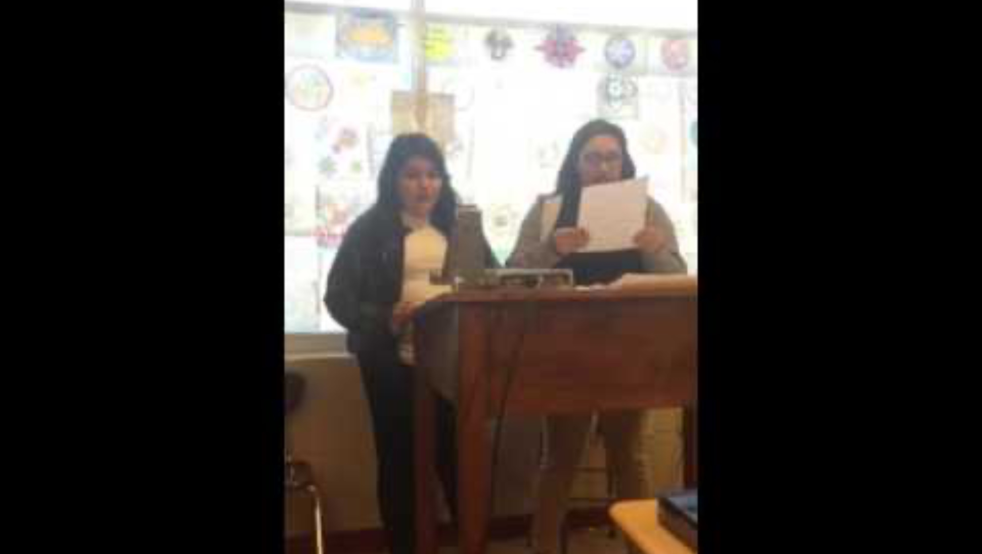
Two-Voice Poem
Notes:
Donaghue, S. (2016, June 8). twovoicepoem [Video]. YouTube. https://www.youtube.com/watch?v=Hsab375fGcc

Slide 13
Reflect
How do authors develop characters over the course of a text?

