Slide 2
Who was Henrietta Lacks?
Ethics in Scientific Research

Slide 3
Essential Question
Should scientists be able to use the tissues or cells of a person for research without their consent?

Slide 4
Inside Out
In the innermost circle, answer the following question:
Should scientists be able to use the tissues or cells of a person for research without their consent?

Slide 5
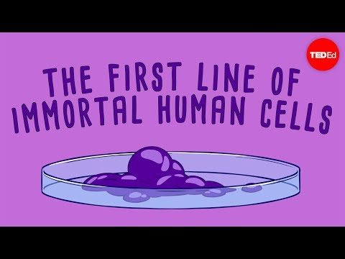
Notes:
TEDEducation (Director). (2016, February 08). The immortal cells of Henrietta lacks - robin bulleri [Video file]. Retrieved March 26, 2021, from https://www.youtube.com/watch?v=22lGbAVWhro&list=RDCMUCsooa4yRKGN_zEE8iknghZA&start_radio=1

Slide 6
Lesson Objective
Use evidence to defend your position on the use of a person’s tissues or cells for research without their consent.

Slide 7
Jigsaw
In your group of four (4), you will split up the articles.
There are four (4) articles to choose from:
Legal
Familial
Societal
Medical

Slide 8
Why-Lighting
While reading you should
Highlight information in the passage that you believe to be important.
Annotate in the margins why you highlighted the information.

Slide 9
Inside Out
While you are reading, write at least three (3) questions in the middle circle.

Slide 10
Jigsaw
Connect with those who read the same article as you and discuss the following:
Takeaways from the article
Questions you still have

Slide 11
Jigsaw
In your original group of four (4), each person should share the following:
What you learned from your reading
What you included in the middle circle of your Inside Out handout

Slide 12
Inside Out
In the outermost circle answer, include the following:
Most important information you learned from your group
This should come from the articles you DID NOT read

Slide 13
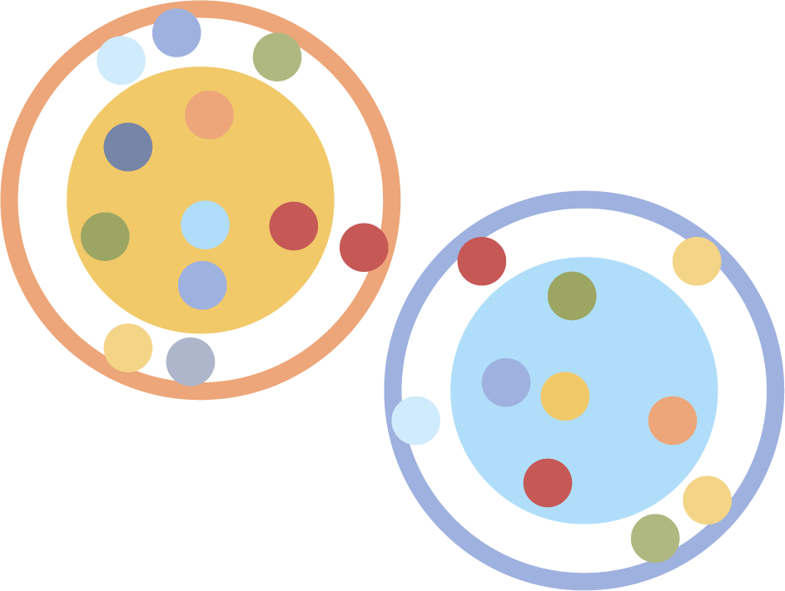
Socratic Seminar
With your small group, decide on one question you believe to be the most important that you still want to discuss.

Slide 14
Socratic Seminar
Divide into two groups:
Inner Circle: answer the questions and have a group discussion over one of them
Outer Circle: quietly record observations of the speakers

Slide 15
Notes:
Crashcourse (Director). (2018, April 18). Henrietta lacks, the Tuskegee experiment, and ethical data collection: Crash course STATISTICS #12 [Video file]. Retrieved March 26, 2021, from https://www.youtube.com/watch?v=CzNANZnoiRs

Slide 16
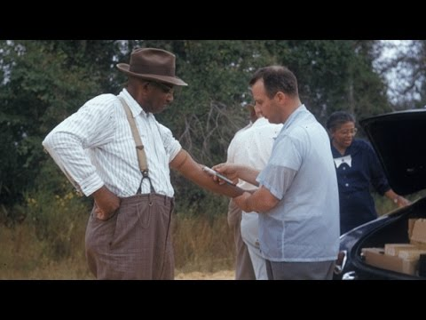
Notes:
NewsyHub (Director). (2016, August 25). The unknowns about the Tuskegee syphilis study [Video file]. Retrieved March 26, 2021, from https://www.youtube.com/watch?v=J3tQ93fQf8U

Slide 17
Inverted Pyramid
With your partner discuss the following:
The implications of the Tuskegee Institute and the damage it has done to Black Americans
Your feelings about scientific research on human subjects

Slide 18
Inverted Pyramid
Did your perspective change after watching the videos?

Slide 19
I Used to Think...But Now I Know
Write a personal reflection based on the essential question:
Should scientists be able to use the tissues or cells of a person for research without their consent?
Use what you wrote in the innermost circle of your Inside Out handout to get you started.

