Slide 2
Lesson Title
Lesson Subtitle

Slide 3
Essential Question
The essential question should not be in a bulleted list if there is only one question.

Slide 4
Lesson Objectives
Explore LEARN style and formatting conventions.
Practice editing attachments using APA style and LEARN style and formatting conventions.

Slide 5
Basic Slide Format
This is the most common slide type found in Lesson Slides.

Slide 6
Best Practices
When editing Lesson Slides, it may not be easiest or most efficient to start from scratch by using a template, as you would with most Word docs. In this case:
Edit the existing Lesson Slides while doing your best to follow the style and formatting conventions laid out in this template.
Just as you would with Word docs, remember to go to File > Info and add the lesson title in the Title field (under Properties). Be sure K20 Center is in the Author field (under Related People).

Slide 7
Bullet Levels
Primary bullet is dark red; font size is 26 when possible.
Secondary bullet is mustard yellow; font size is 20.
Tertiary bullet is dark blue; font size is 17.

Slide 8
Layout Examples
The slides that follow are meant to illustrate the use of various slide layouts available in the LEARN template. The following types of slides are not common.

Slide 9
Table
Column Header | Column Header | Column Header
Row Header | Text
Row Header | Delete column 1 or row 1 if row headers or column headers are not needed.
Row Header

Slide 10
Strategy Option 1

Slide 11
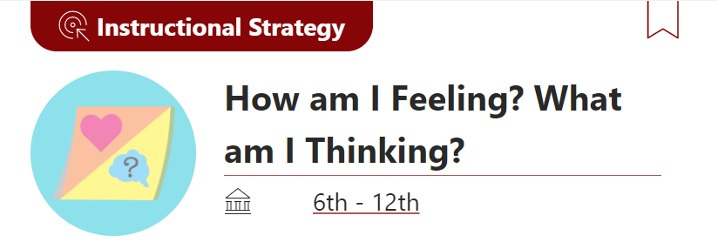
Strategy Option 2

Slide 12
Quote
Tell me and I forget. Teach me and I remember. Involve me and I learn.
-Benjamin Franklin

