Slide 2
Should I Stay or Should I Go?
The Great Migration

Slide 3
Identify the mystery word
Notes:
Knorck. (2009). Nordpfeil [Photograph]. Wikimedia Commons. https://commons.wikimedia.org/wiki/File:Nordpfeil.png
Patrick87. (2013). Compass Rose en small N [Photograph]. Wikimedia Commons. https://commons.wikimedia.org/wiki/File:Compass_Rose_en_small_N.svg

Slide 4
Think-Pair-Share
What is the mystery word?
Notes:
https://www.youtube.com/watch?v=AMW_5yR32mM&list=PL-aUhEQeaZXLMF3fItNDxiuSkEr0pq0c2&index=3

Slide 5
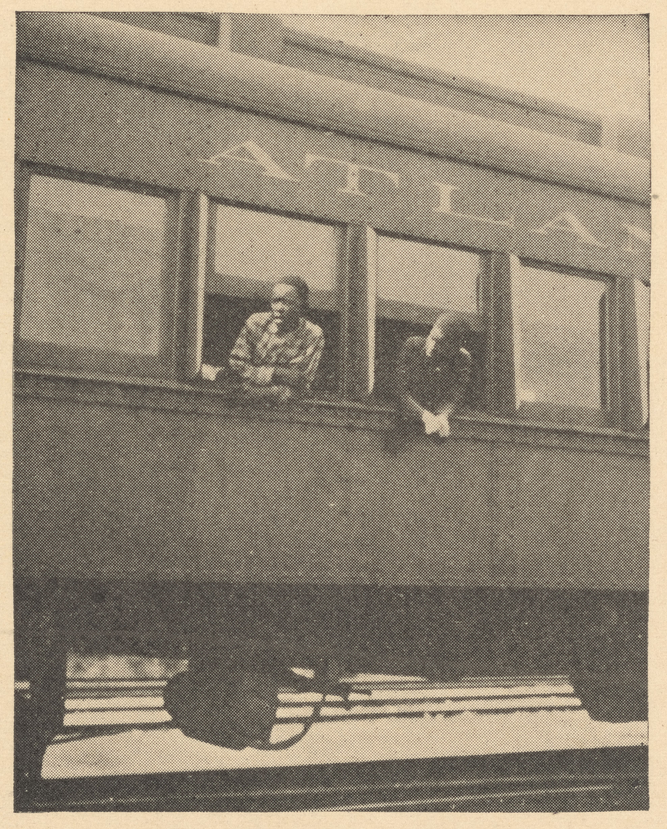
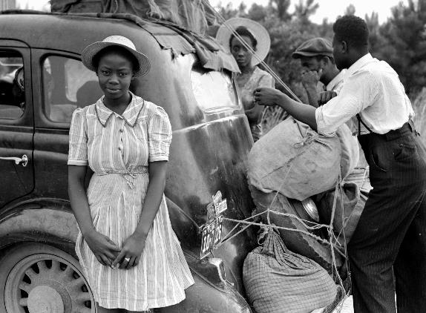
Identify the mystery word
Notes:
Delano, J. (1940). A girl from Shawboro [Photograph]. Wikimedia Commons. https://commons.wikimedia.org/wiki/File:A_girl_from_Shawboro.jpg#globalusage
A Jim-Crow car for Negroes only, Fayetteville, N.C. [Photograph]. The New York Public Library Digital Collections. https://digitalcollections.nypl.org/items/510d47de-1a3b-a3d9-e040-e00a18064a99

Slide 6
Think-Pair-Share
What is the mystery word?
Notes:
https://www.youtube.com/watch?v=AMW_5yR32mM&list=PL-aUhEQeaZXLMF3fItNDxiuSkEr0pq0c2&index=3

Slide 7
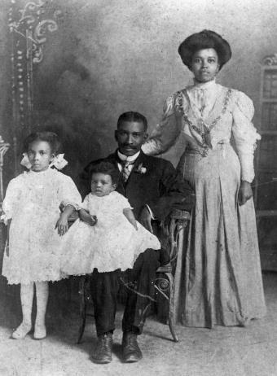
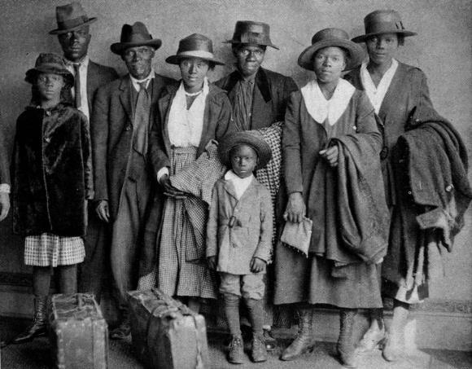
Identify the mystery word
Notes:
Vansickel. (1900). Portrait of an African American family: Gainesville, Florida [Photograph]. Wikimedia Commons. https://commons.wikimedia.org/wiki/File:Portrait_of_an_African_American_family-_Gainesville,_Florida_(6909517529).jpg
The Chicago Defender. (1920). Great Migration [Photograph]. Wikimedia Commons. https://commons.wikimedia.org/wiki/File:Great_migration.jpg

Slide 8
Think-Pair-Share
What is the mystery word?
Notes:
https://www.youtube.com/watch?v=AMW_5yR32mM&list=PL-aUhEQeaZXLMF3fItNDxiuSkEr0pq0c2&index=3

Slide 9
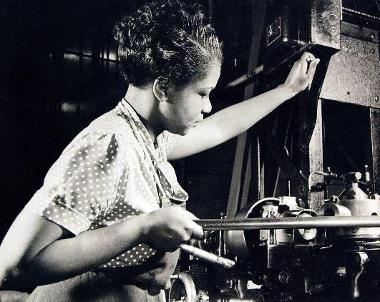
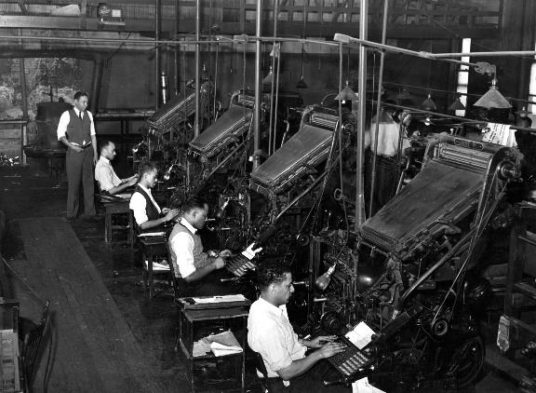
Identify the mystery word
Notes:
National Museum of the US Navy. (2016). Lot 2073-14: Manpower: African-American Philadelphia Navy Yard Workers [Photograph]. Wikimedia Commons. https://commons.wikimedia.org/wiki/File:Lot_2073-14_(26992151845).jpg
Lee, R. (1941). Linotype operators of the Chicago Defender, 1941 [Photograph]. Wikimedia Commons. https://commons.wikimedia.org/wiki/File:Russell_Lee,_Linotype_operators_of_the_Chicago_Defender,_1941.jpg

Slide 10
Think-Pair-Share
What is the mystery word?
Notes:
https://www.youtube.com/watch?v=AMW_5yR32mM&list=PL-aUhEQeaZXLMF3fItNDxiuSkEr0pq0c2&index=3

Slide 11
Essential Question
Why do people move?

Slide 12
Lesson Objective
Evaluate the factors that led to the Great Migration.

Slide 13
Why immigrate?
What were some push factors that would lead to African American people leaving the south during the early 20th century?
What were some pull factors that contributed to African American people migrating to the north during the early 20th century?
Notes:
Donovan, R. (2008). Door with both push and pull signs [Photograph]. Wikimedia Commons. https://commons.wikimedia.org/wiki/File:Door_with_both_push_and_pull_signs.jpg

Slide 14
The Great Migration
Using a device, go to http://k20.ou.edu/migration.
View the painting series by Jacob Lawrence that depicts the Great Migration.
Use the Great Migration Note Catcher to take notes about each painting.

Slide 15
The Great Migration
Listen to author and journalist Isabel Wilkerson discuss her book about the Great Migration.
Which part of the Great Migration do you identify as a window into other people’s lives?
Which part of the Great Migration do you identify as a mirror that reflects your own experience?
Notes:
https://www.npr.org/templates/story/story.php?storyId=130291351

Slide 16
Reflecting on the Great Migration
Why do people move?
Think about the Great Migration and other migration experiences you are familiar with.
Use your new knowledge and your prior knowledge to write a response.

