Slide 2
Keep Your Eye on the Ball...or Jump Rope, or Traffic Cone
Inventing a Sport
Notes:
Photo by Wan San Yip on Unsplash

Slide 3
Essential Question
How are sports made?

Slide 4
Lesson Objectives
Identify functional elements of a game.
Design a new game that integrates available resources and game elements.

Slide 5

Let’s Play Ultimate Frisbee®!
Play begins with a “pull” (disc is launched toward the opposing team).
1 point is scored for each completed pass within the end zone.
After each point, play is turned over to the other team. Play begins again with a “pull.”
The first team to earn 15 points wins the game.
The player in possession of the disc may not move and cannot hold the frisbee for longer than 10 seconds.
If the disc is dropped, goes out of bounds, or is intercepted, play is turned over to the other team.
10 simple rules. USA Ultimate. (2020, December 16). https://usaultimate.org/rules/10-simple-rules/

Slide 6

What makes Ultimate Frisbee® a sport?
Individually, brainstorm a list of words to describe what makes ultimate a sport?
In groups of no more than 4, share your lists with each other.
Each group will share with the whole class.

Slide 7
Collect ‘em all!
Goal: Collect all four Rules of Play.
Decide the order team members will retrieve rules 1-4.
When the whistle blows, run to one cone and collect one of the four rules of play.
Return to your team and tap the next runner in the relay.
The first team to collect all four rules wins!
Note: If you run to a cone and have already collected the available rules, return to your team and tap the next runner.

Slide 8

Rules of Play
Read the “Rules of Play” section of the Design a Sport handout.
What is the Point of Most Significance to keep in mind when you design your sport?

Slide 9
Design a Sport
Work in groups of no more than four.
Read the “Additional Guidelines” section of the Design a Sport handout.
Design a sport following the guidelines in the handout.
Document the sport (players, conflict, rules) in the “Your Design” section. Don’t forget to name your sport!

Slide 10
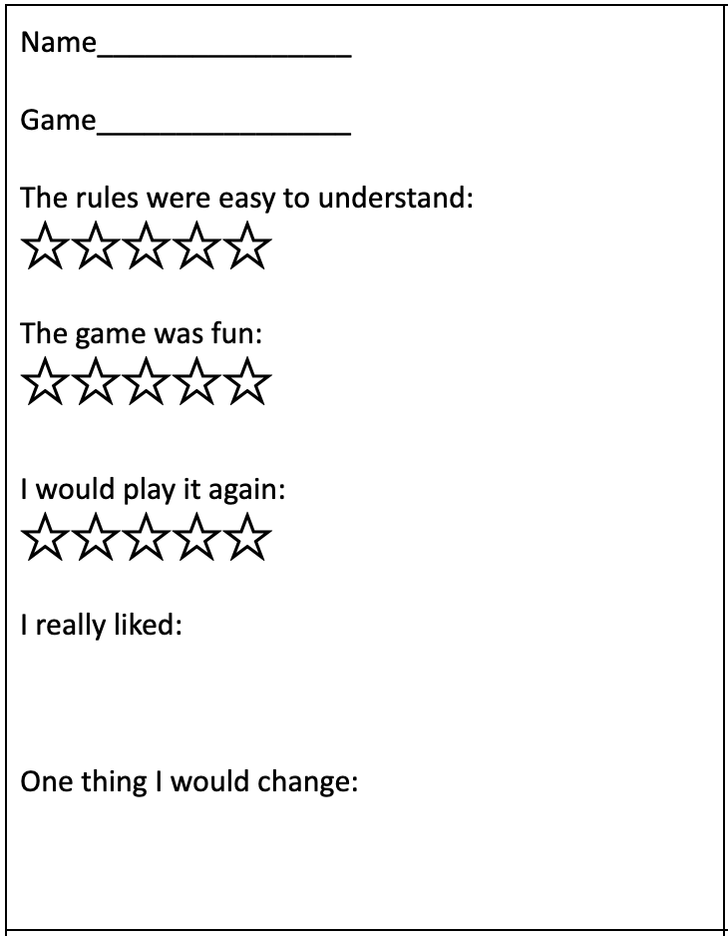
Time to play!
Each group find a partner group.
Playtest each other’s new sport.
Complete a feedback form on the other group’s game.

Slide 11
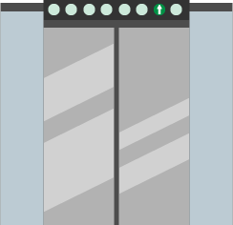
Elevator Speech
Refine the rules of your new sport.
Create a 60-second Elevator Speech to tell others about your sport.
Present your group’s 60-second speech to the whole class.

Slide 12
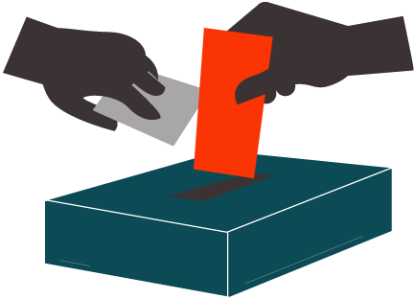
What’s Your Favorite?
Based on the Elevator Speeches, vote for your favorite sport.
We will play the newly created sport during the next class period.

