Slide 2
Finding Factors, Part 2
Factoring Polynomials

Slide 3
Essential Question
How can we solve polynomial equations?

Slide 4
Lesson Objectives
Factor polynomial expressions.
Solve polynomial equations.

Slide 5

Perfect Pairings: Matching
Independently match each of the given graphs with its corresponding equation.
Notes:
K20 Center. (n.d.). Inverted Pyramid. Strategies. https://learn.k20center.ou.edu/strategy/173

Slide 6
Perfect Pairings
With a partner, share your thinking for how you matched your graphs and equations together.
Work together to write the equation for the last graph.
Notes:
K20 Center. (n.d.). Inverted Pyramid. Strategies. https://learn.k20center.ou.edu/strategy/173

Slide 7
Perfect Pairings: Making Predictions
With another pair, share your reasoning for the equation you wrote.
Come to an agreement about the equation.
  Be ready to share with the class.
Notes:
K20 Center. (n.d.). Inverted Pyramid. Strategies. https://learn.k20center.ou.edu/strategy/173

Slide 8

Diamond Puzzle
Work with your partner to arrange the tiles so that the sides with equivalent factored forms and expanded forms are touching.

Slide 9
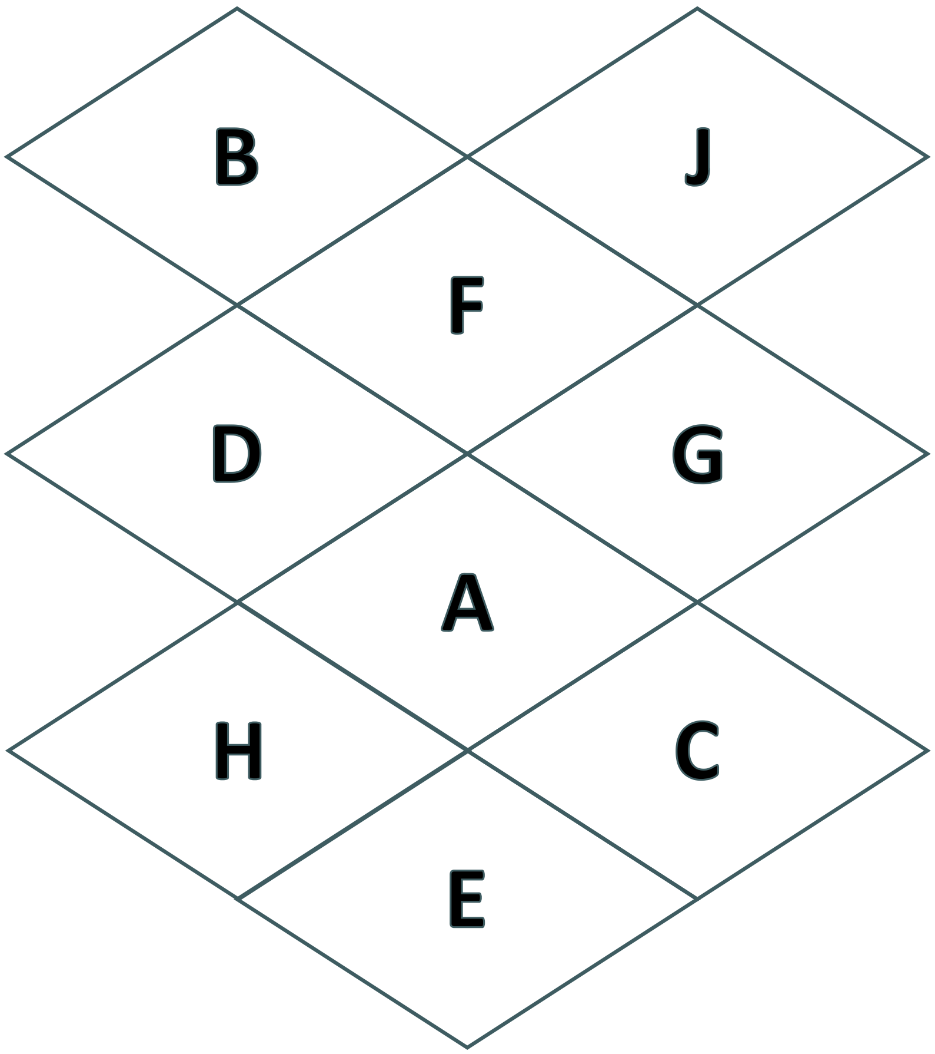
Diamond Puzzle
(Solution)

Slide 10
Guided Notes: Two Terms
Let’s complete the Guided Notes together.

Slide 11
Factor Finder: Factoring Polynomials
Work with a partner to complete questions 1-2 on your handout.

Slide 12
Factor Finder (Solution 1)

Slide 13
Factor Finder (Solution 2)

Slide 14
Factor Finder
What was similar about questions 1-2?
What was different?
How did this impact how you approached factoring?

Slide 15
Factor Finder: Solving Polynomials
Work with a partner to complete questions 3-6 on your handout.

Slide 16
Factor Finder (Solution 3)

Slide 17
Factor Finder (Solution 4)

Slide 18
Factor Finder (Solution 5)

Slide 19
Factor Finder (Solution 6)

Slide 20
Factor Finder (Solution 6 continued)

Slide 21
Factor Finder: Reflection
Is there a relationship between the number of solutions and the type of polynomial?
If so, what do you think it is?

Slide 22
How Many Solutions?
When we started to solve 4a⁵–100a³=0,
we factored to get 4a³(a+5)(a–5)=0.
Then we set each factor equal to zero to solve.
Notice that we could have written: 4a·a·a(a+5)(a–5)=0.
That means that the solutions to this polynomial are
a = 0, a = 0, a = 0, a = –5, and a = 5.
There are five solutions, and the
degree of the polynomial is five.

Slide 23
Multiplicity
If a = 0, a = 0, a = 0, a = –5, and a = 5 are the solutions,
we do not need to write repeated solutions.
So, we would say that a = 0 has a multiplicity of 3.

Slide 24
Guided Notes: 3-4 Terms
Let’s complete the Guided Notes together.

Slide 25

Get Your Factors Straight
Select and complete three of the tasks.
Only complete 1 task per row.
Only complete 1 task per column.
For example:
  Complete 1B – 2C – 3A
  Complete 1C – 2A – 3B
Notes:
K20 Center. (n.d.). Choice Boards. Strategies. https://learn.k20center.ou.edu/strategy/73

Slide 26
How To Factor: Flowchart
Start
Indicates where the user begins.
Create a flowchart that a peer could use to factor a polynomial.
Decision
This is where the user needs to make a decision.
Process
What action does the user need to take?
End
Indicates that the user is finished.

Slide 27
How to Factor a Polynomial
How many terms are there?
2 terms
3 terms
4 terms

