Slide 1
Between the lines
Understanding the Big Picture Using the Inferencing Skill

Slide 2
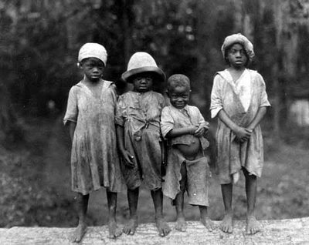
In the picture, I notice that…
I also wonder…

Slide 3
C.E.R. Paragraph
C = Claim
The claim is an opinion or what you believe written as a fact.
E = Evidence
Evidence sentences are facts, observations, and back ground knowledge that prove/back up/explain the claim to be true.
R = Reasoning
Reasoning sentences are explanation sentences that explain how the evidence makes the claim true.

Slide 4
2 Minute Quick Write
How did you know the political cartoon’s meaning without a written explanation?

Slide 5
Inference - noun in·fer·ence \ˈin-f(ə-)rən(t)s, -fərn(t)s\
1: the act or process of reaching a conclusion about something from known facts or evidence
2: a conclusion or opinion that is formed because of known facts or evidence

Slide 6
Excerpt 1
I was born in Tuckahoe, near Hillsborough, and about twelve miles from Easton, in Talbot County, Maryland. I have no accurate knowledge of my age, never having seen any authentic record containing it. By far the larger part of the slaves know as little of their ages as horses know of theirs, and it is the wish of most masters within my knowledge to keep their slaves thus ignorant. I do not remember to have ever met a slave who could tell of his birthday. They seldom come nearer to it than planting-time, harvest-time, cherry-time, spring-time, or fall-time. A want of information concerning my own was a source of unhappiness to me even during childhood. The white children could tell their ages. I could not tell why I ought to be deprived of the same privilege.

Slide 7
Excerpt 2
I never saw my mother, to know her as such, more than four or five times in my life; and each of these times was very short in duration, and at night. She was hired by a Mr. Stewart, who lived about twelve miles from my home. She made her journeys to see me in the night, travelling the whole distance on foot, after the performance of her day's work. She was a field hand, and a whipping is the penalty of not being in the field at sunrise, unless a slave has special permission from his or her master to the contrary—a permission which they seldom get, and one that gives to him that gives it the proud name of being a kind master. I do not recollect of ever seeing my mother by the light of day. She was with me in the night. She would lie down with me, and get me to sleep, but long before I waked she was gone.

