Slide 1
Mapping My Little Piece of the World
Creating and Using a Physical Map

Slide 2
Essential Questions
Why are maps important to our everyday life?
Why is it important to be able to create a map of your neighborhood?
How could the parts of a physical map be useful when creating a map of your neighborhood?

Slide 3
Lesson Objectives
Describe the parts of a physical map.
Make a map of my home and neighborhood.

Slide 4
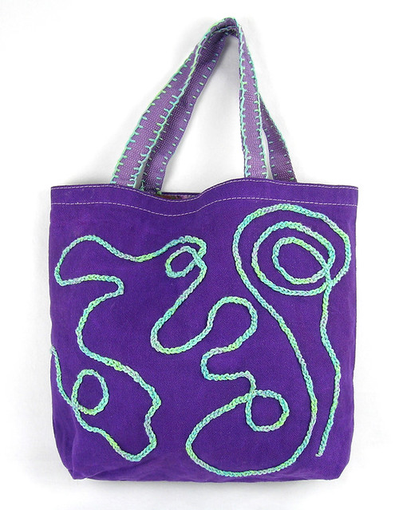
What’s in my Jackdaw Bag?
This Photo by Unknown Author is licensed under CC BY-SA
Notes:
BenjaminMiller2651. A cute young girl holding a blank sign [Photograph]. Freerange. Retrieved [May 6, 2022] from https://freerangestock.com/photos/32174/a-cute-young-girl-holding-a-blank-sign.html
Haskins. P. purple cat tote back [Image]. flickr. Retrieved May 6, 2022, from https://www.flickr.com/photos/23085888@N00/4385607968

Slide 5
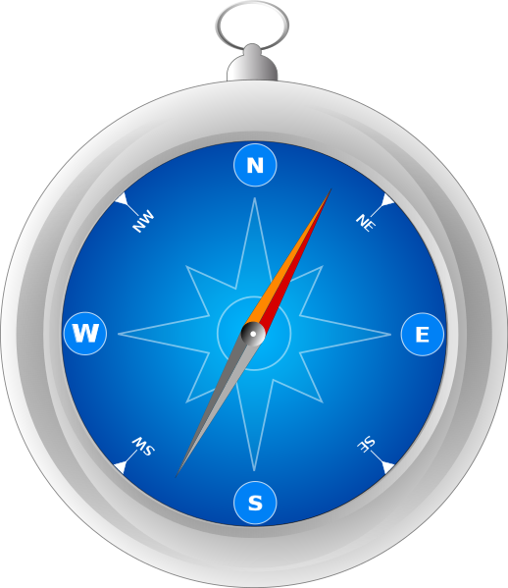
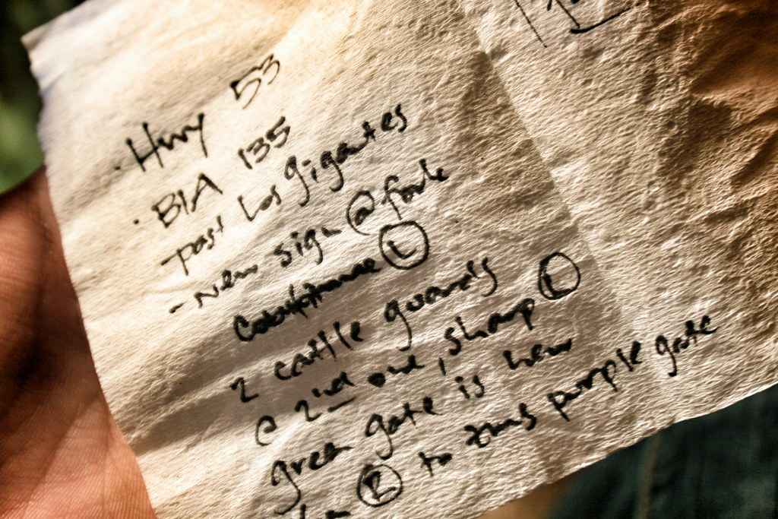
What do these items have in common?
Notes:
Haikubeeyatch. How does Ghostwriting Work? [Image]. Ghost Words Inc. Retrieved May 6, 2022, fromhttps://ghostwordsinc.com/2015/08/19/how-does-ghostwriting-work/
Jwslubbock. Using the Commons Uploader app 2.jpg [Cropped Image]. Wikimedia Commons. Retrieved May 6, 2022, from https://commons.wikimedia.org/wiki/File:Using_the_Commons_Uploader_app_2.jpg
Olivo, M. Compass.svg [Image]. Wikimedia Commons. Retrieved May 6, 2022, from https://commons.wikimedia.org/wiki/File:Compass.svg
Sazonova, E. Person Holding Map Inside Vehiclehttps://www.pexels.com/photo/person-holding-map-inside-vehicle-2705756/ [Image]. Unsplash. Retrieved May 6, 2022, from

Slide 6
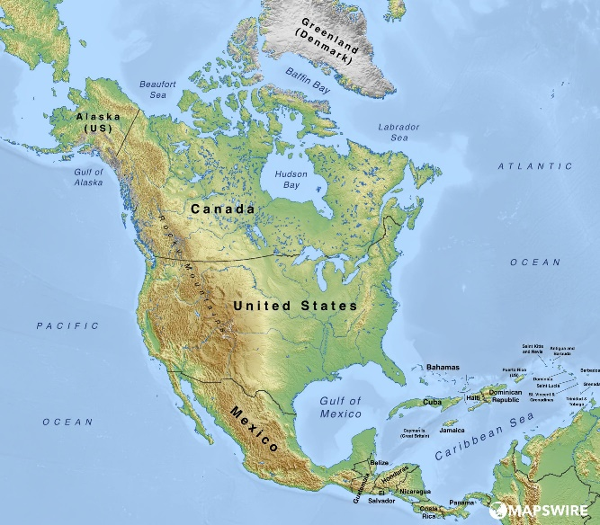
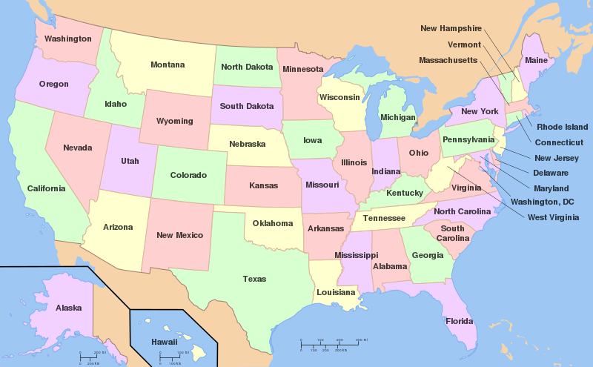
How are these two maps the same and how are they different?
Physical Map
Political Map
Notes:
Physical Map: a map that focuses on land features such as mountains and bodies of water.
Political Map: a map that focuses on borders between cities, states, or countries.
Mapswire (2019). Free Physical Maps of North America [Image]. Mapswire. https://mapswire.com/north-america/physical-maps/
Wapcaplet. Map of USA with state names.svg [Image]. Wikimedia Commons. Retrieved May 6, 2022, from https://commons.wikimedia.org/wiki/File:Map_of_USA_with_state_names.svg

Slide 7
If you wanted to make a map of your neighborhood, which type of map would be the most suitable?
How could the parts of a physical map be useful if you wanted to create a map of your neighborhood?
What would you need to know in order to make a physical map of your neighborhood?
Notes:
Use the World Atlas website to show examples and to answer student questions. Copy and paste the following link into your browser: https://www.worldatlas.com/geography/political-and-physical-map.html
Misachi, J. (2021). Political And Physical Map. World Atlas. https://www.worldatlas.com/geography/political-and-physical-map.html

Slide 8
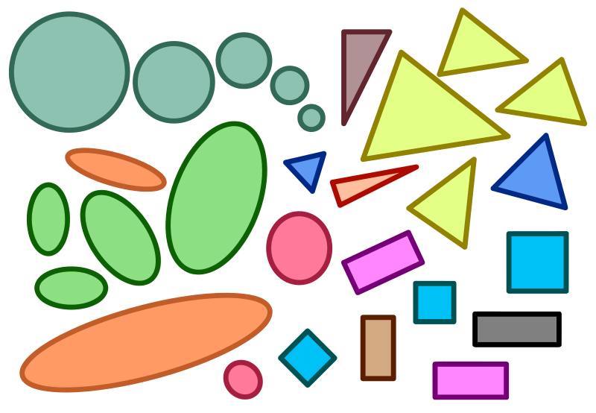
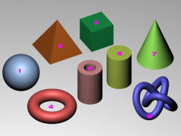
Which one is 2-Dimensional? Which one is 3-Dimensional?
Notes:
Caduser2003. SolidShapes.png [Image]. Wikimedia Commons. Retrieved May 6, 2022, from https://commons.wikimedia.org/wiki/File:SolidShapes.png
Amada44. Similar-geometric-shapes.svg [Image]. Wikimedia Commons. Retrieved May 6, 2022, from https://commons.wikimedia.org/wiki/File:Similar-geometric-shapes.svg

Slide 9
Which one is 2-Dimensional? Which one is 3-Dimensional?
Notes:
Redrobsche. (2018). Tree swing cartoon cololred1.svg [Illustration]. Wikimedia Commons. Retrieved May 6, 2022, from https://commons.wikimedia.org/wiki/File:Tree_swing_cartoon_colored1.svg
Horner, C. (2018). green leaf tree on gray stone during daytime [Photograph]. Unsplash. Retrieved May 6, 2022, from https://unsplash.com/photos/czuYtHCuKBQ

Slide 10
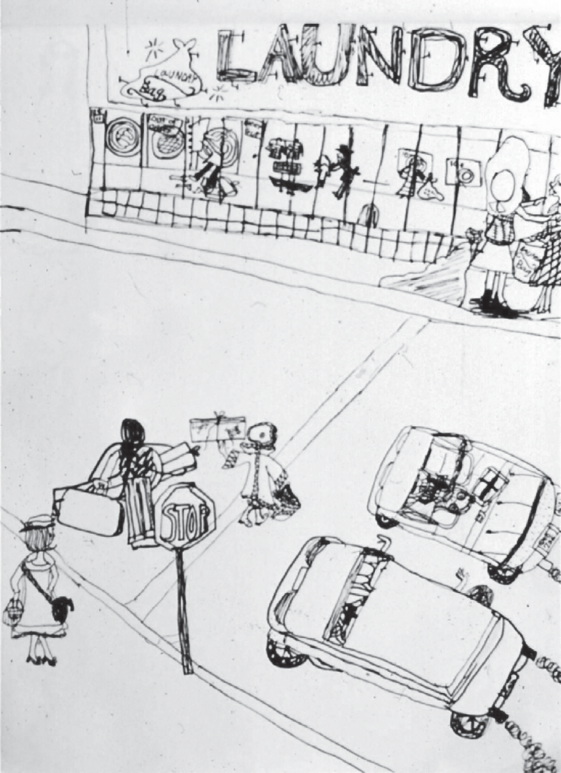
Sketch your home and neighborhood.
What should you include in your sketch?
Notes:
Milbrath, C. (1998). 5 Talented girl, Age 8. Mixed viewpoint drawing. [Image]. ResearchGate. Retrieved May 6, 2022, from https://www.researchgate.net/figure/Talented-girl-Age-8-Mixed-viewpoint-drawing-Source-Constance-Milbraths-collection_fig4_264311070

Slide 11
Let’s look at the rubric!
3D Physical Map Rubric | Needs Improvement | Good | Fantastic
My project is neat and complete.
My project has land features that are realistic.
I can talk about the land features in my project in an understandable way.

