Slide 2
Making Ten With The Circus
Composing and Decomposing Numbers From One to Ten

Slide 3
Essential Questions
What are the different ways to make a number?

Slide 4
What might you see at a circus?

Slide 5
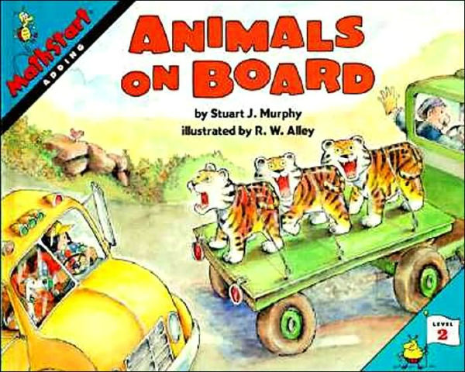
What do you Notice?
Notes:
Do they notice any of the things they suggested that they could see at a circus?

Slide 7
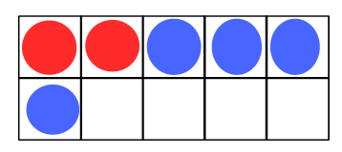
Compose: Put together 2+ 4

Slide 8
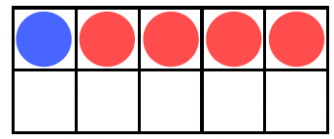
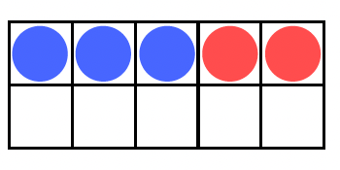
Decompose: Take apart 5
5 can be 1 + 4
or
5 can be 3 +2

Slide 9
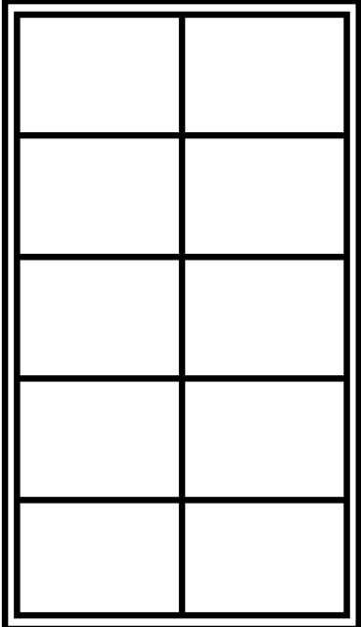
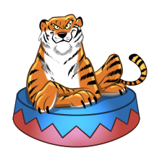
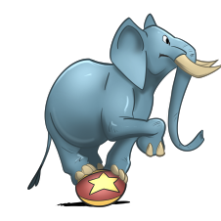
Center 1

Slide 10
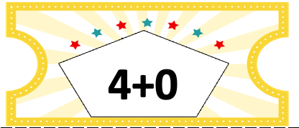
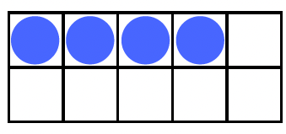
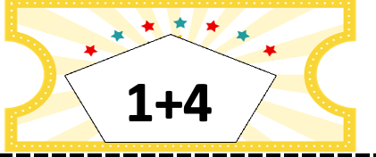
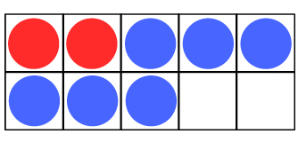
Center 2

Slide 11
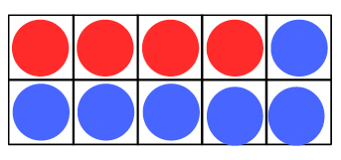
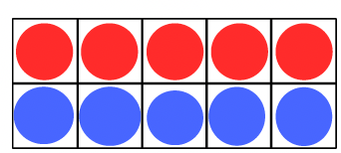
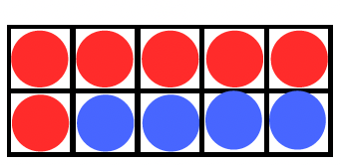
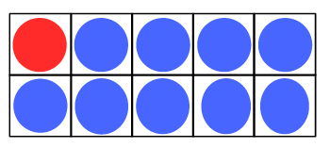
Show What You Know
I saw 10 zebras sleeping at the circus. How could they have arrived?
4+6=10
5+5= 10
6+4= 10
1+9= 10
Are there any more combinations?

Slide 12
More stories
I saw seven tigers eating meat.
I saw 10 elephants balancing balls with their trunks.
I saw one acrobat swinging on a rope.
I saw four clowns trip over their shoes.
I saw eight seals dancing in a circle.
I saw six horses prancing onto the stage.
I saw five giraffes wearing fancy blankets.

