Slide 2
From Apples to Oranges
Examining Literary Devices

Slide 3
Essential Questions
How does understanding literary devices help our understanding of a text?
How do we use literary devices in our everyday lives?

Slide 4
Lesson Objectives
Using an acrostic poem, summarize and reconstruct the meaning of a literary device.

Slide 5
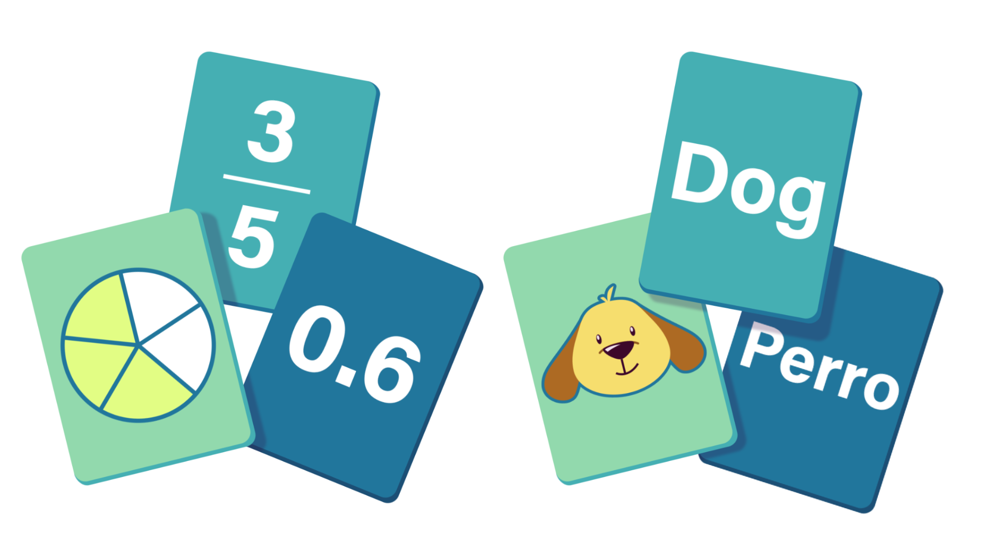
Card Matching
In your small groups, match the literary device with its definition.
You have 5 minutes.
Notes:
K20 Center. (n.d.). Card Matching. Strategies. https://learn.k20center.ou.edu/search?text=Card%20Match&type=strategies&limit=12

Slide 6
Highlighting Unfamiliar Terms
On your handout, highlight each literary device you are not familiar with.
You have 4 minutes to do this.

Slide 7
Vocabulary Acrostics
At each of your groups, there are four large sticky notes with the name of a literary device written at the top and one chart marker.
In your groups, you will create acrostic poems for each of your assigned literary devices that explain what it is and provide examples of it in use.
Let’s look at the example for the word analogy.

Slide 8
Analogy - A parallel between different ideas, people, things, or events that is more elaborate than a metaphor or simile
Always comparing
Night is to day as short is to long
An easy way to explain
Looking for connections
Often called analogous thinking or analogical reasoning
Grass is to green as sky is to blue
You’re more likely to see on the SAT than the ACT.

Slide 9
Vocabulary Acrostics Directions
In your groups, create acrostic poems that explain what each of your assigned literary devices is and provide examples of it. Your acrostic poem must:
  Simplify the explanation
  Provide examples
The purpose of this assignment is to help you memorize and get a better understanding of each of these literary devices.

Slide 10


Slide 11
Gallery Walk
Place your posters around the room, so they can easily be viewed.
Using your Literary Devices Definition handout, visit the posters with the terms that you previously highlighted.
Write down one of the examples and one of the simplified explanations from the acrostic poem.

Slide 12
Assess Your Understanding
Using the Literary Devices Definitions handout, use the following key to label each term.
Triangle: I don’t understand this at all. It’s still pretty new to me.
Square: I somewhat understand this. But I still need more practice.
Circle: I understand this completely. I feel confident about it.

