Slide 1
Argument is Everywhere.
Do you agree or disagree? Why?
ARGUMENT IS EVERYWHERE
Notes:
*For More Examples: Google Search- “Argument is Everywhere” https://www.google.com/search?q=argument+is+everywhere&espv=2&biw=1920&bih=955&source=lnms&tbm=isch&sa=X&ved=0ahUKEwjg2uvwg6PNAhUSW1IKHXjEBnEQ_AUIBigB

Slide 2
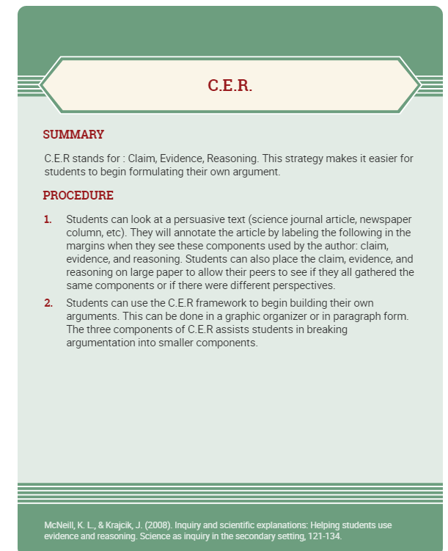
For every “argument” Claim Card presented, identify the C.E.R.
Annotate the graphic by marking the Claim, Evidence, and Reasoning used. You may also draw arrows or circles, make notes, or jot counterclaims.
2) Consider the Rhetorical Situation:
Who is the Audience?
What is the Purpose?
What is the Context?

Slide 3
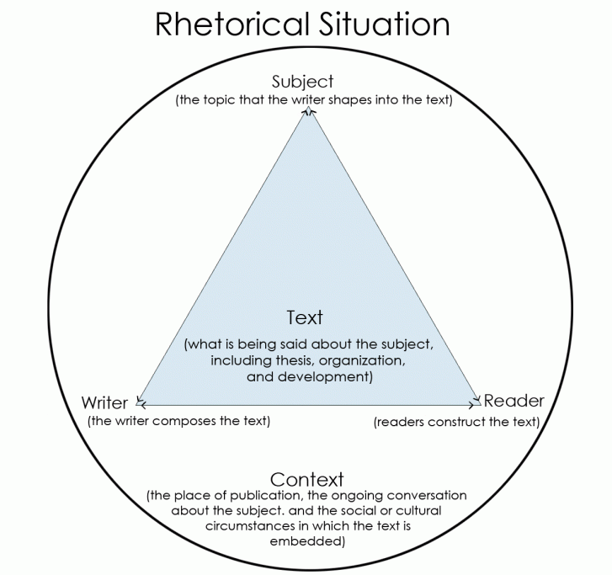
https://www.youtube.com/watch?v=f61SPxeIEgU
Rhetorical Situation [Digital image]. (n.d.). Retrieved from https://jacobsdialectic.files.wordpress.com/2015/01/rhetoricalsituationoverhead.gif?w=727&h=683
Notes:
https://www.youtube.com/watch?v=f61SPxeIEgU

Slide 4
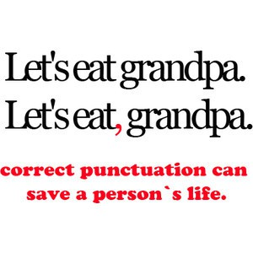
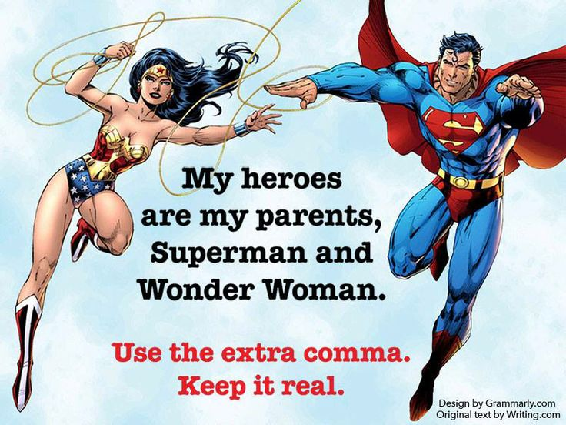
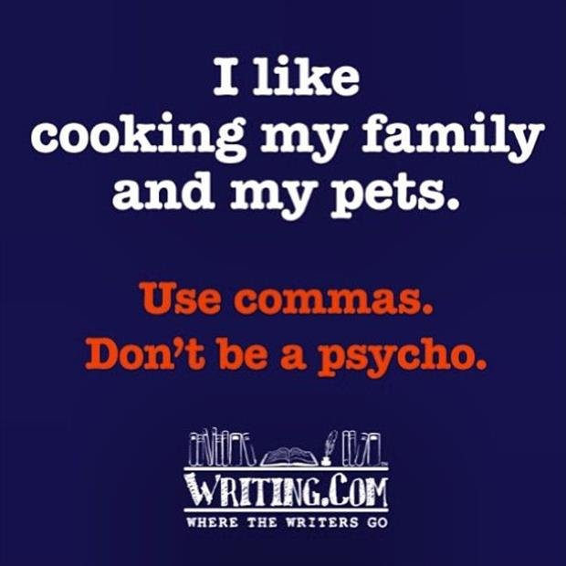
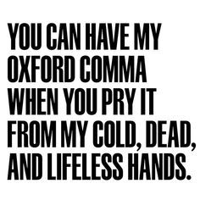
[Digital image]. (n.d.). Retrieved from http://cdn.thewritepractice.com/wp-content/uploads/2011/08/the-oxford-comma.jpg
[Digital image]. (n.d.). Retrieved from https://andrewpegodadotcom.files.wordpress.com/2014/06/a2809c9bbd4a97907836c6919994b7c7.jpg
[Digital image]. (n.d.). Retrieved from http://www.writeher.com/uploads/2/5/5/2/2552696/163222_orig.jpg
[Digital image]. (n.d.). Retrieved from http://bigwords101.com/wp-content/uploads/2015/09/04ad3ca166114082897f4ee129c9a960.jpg

Slide 5
C.laim: The Oxford Comma is necessary to understanding sentence meanings.
E.vidence: The sample memes provide examples of sentences that include or do not include the comma.
R.easoning: Sentences that do not include the Oxford Comma are often prone to misunderstandings.
Rhetorical Situation:
Audience: People who do not use the Oxford Comma.
Purpose: To stress the importance of using the Oxford Comma to clarify meaning.
Context: The Oxford (or serial) comma is the final comma in a list of things. Use of the Oxford comma is stylistic, meaning that some style guides demand its use while others don’t. Unless you’re writing for a particular publication or drafting an essay for school, whether or not you use the Oxford comma is generally up to you.
Notes:
https://www.grammarly.com/blog/what-is-the-oxford-comma-and-why-do-people-care-so-much-about-it/

Slide 6
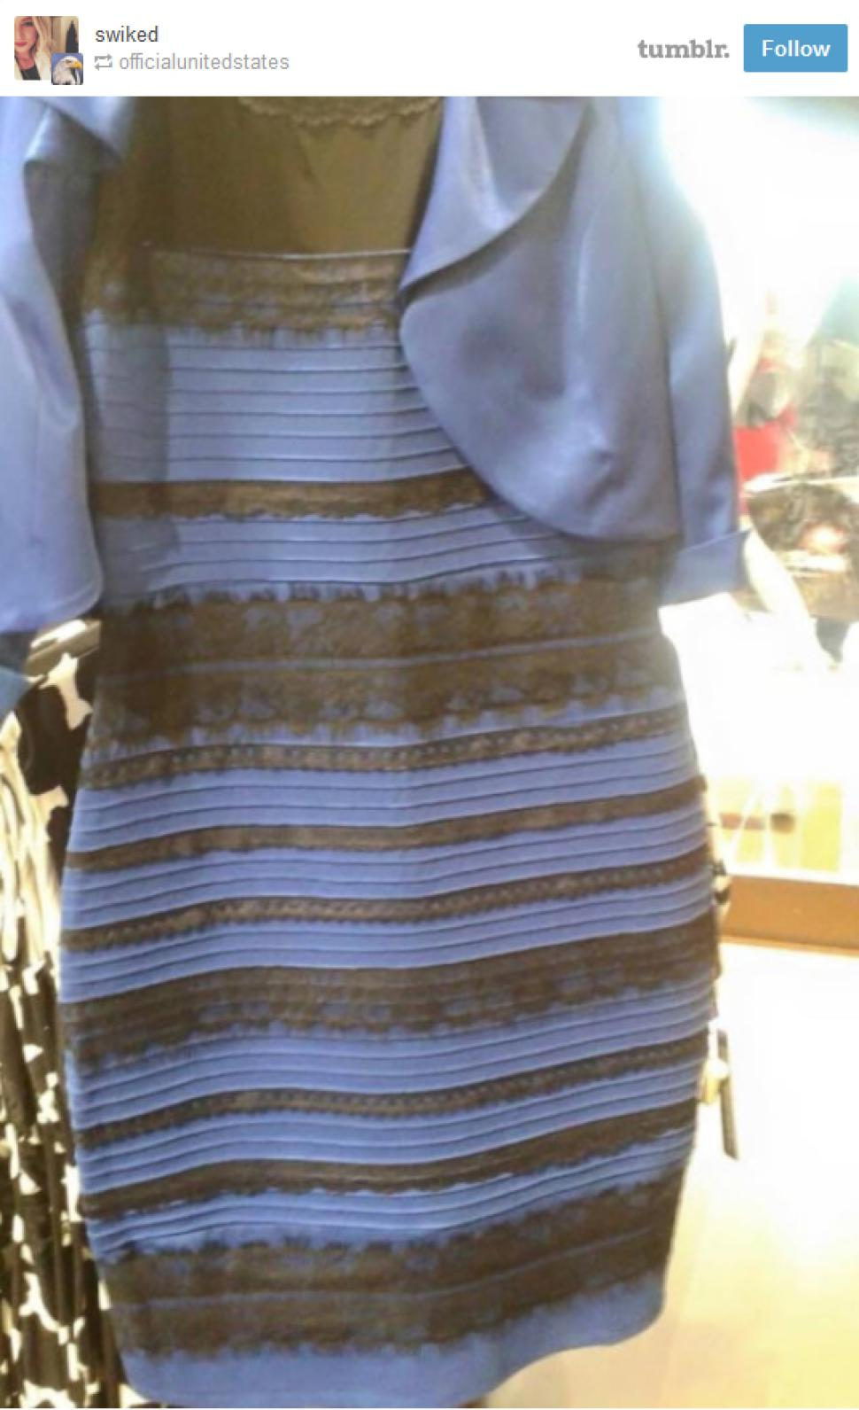
C.laim:
E.vidence:
R.easoning:
Rhetorical Situation:
Audience:
Purpose:
Context:
[Digital image]. (n.d.). Retrieved from http://i.huffpost.com/gen/2662272/thumbs/o-BLACK-AND-BLUE-GOLD-AND-WHITE-DRESS-570.jpg

Slide 7
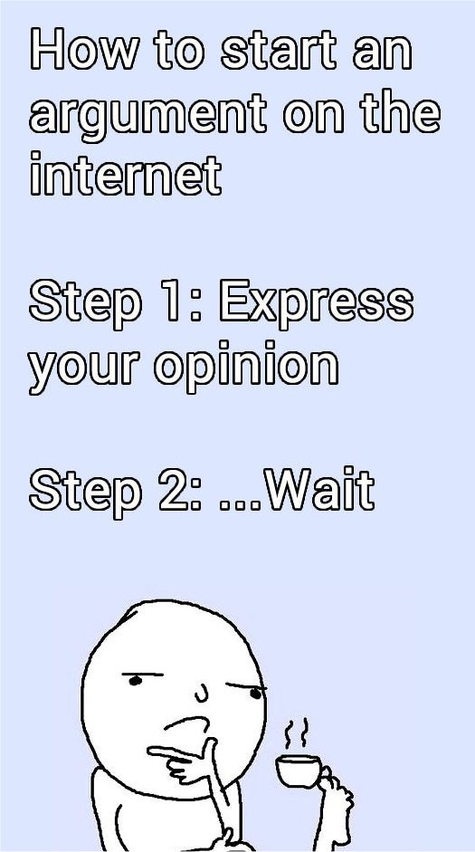
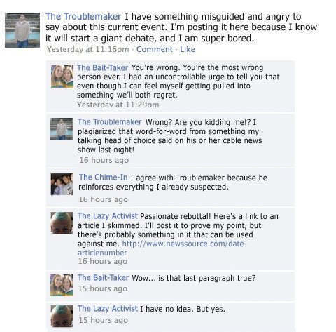
C.laim:
E.vidence:
R.easoning:
Rhetorical Situation:
Audience:
Purpose:
Context:
[Digital image]. (n.d.). Retrieved from http://www.maniacworld.com/images/how-to-start-an-argument-on-the-internet.jpg
[Digital image]. (n.d.). Retrieved from http://3.bp.blogspot.com/_P5v43v9HACc/TUBXG2yqcKI/AAAAAAAAB2w/TzyvG7S-EvM/s1600/FacebookArgument1.jpg

Slide 8
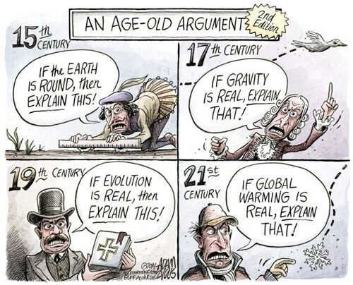
C.laim:
E.vidence:
R.easoning:
Rhetorical Situation:
Audience:
Purpose:
Context:
[Digital image]. (n.d.). Retrieved from http://www.nocaptionneeded.com/wp-content/uploads/2014/04/funny-old-argument-century-comic.jpg

Slide 9
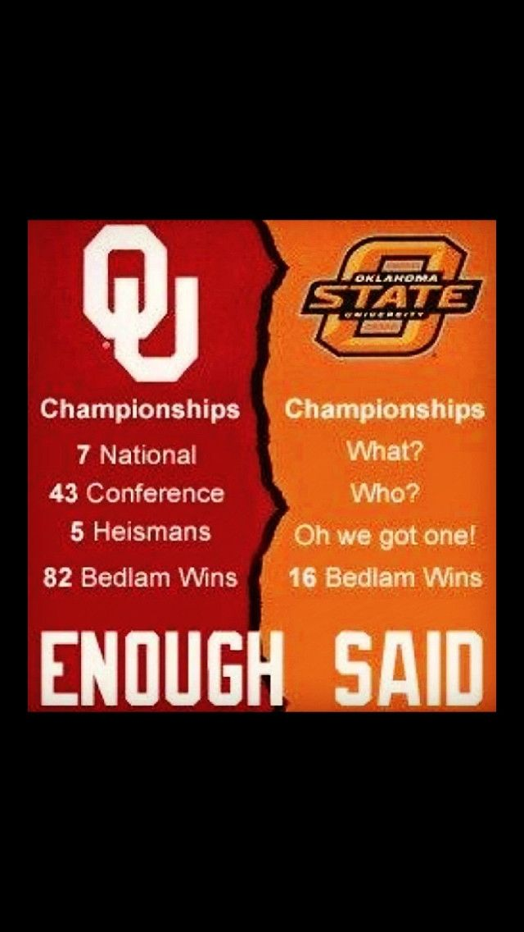
C.laim:
E.vidence:
R.easoning:
Rhetorical Situation:
Audience:
Purpose:
Context:
[Digital image]. (n.d.). Retrieved from https://s-media-cache-ak0.pinimg.com/736x/df/0e/d0/df0ed0790429fa54027053182304c53f.jpg

Slide 10
C.laim:
E.vidence:
R.easoning:
Rhetorical Situation:
Audience:
Purpose:
Context:
[Digital image]. (n.d.). Retrieved from http://images-cdn.moviepilot.com/images/c_fill,h_274,w_430/t_mp_quality/c19yayhhyansoow0pc1p/my-7-reasons-why-harry-potter-
is-better-than-twilight-620611.jpg

Slide 11
1. Go to the following Website and select a topic/question/prompt that interests you:
http://learning.blogs.nytimes.com/2014/02/04/200-prompts-for-argumentative-writing/
http://nyti.ms/1YwZKas
1. Education
2. Technology and Social Media
3. Arts and Media: TV, Music, Video Games and Literature
4. Gender Issues
5. Sports and Athletics
6. Politics and the Legal System
7. Parenting and Childhood
8. Health and Nutrition
9. Personal Character and Morality Questions
10. Science
11. Other Questions
C.laim:
E.vidence:
R.easoning:
Rhetorical Situation:
Audience:
Purpose:
Context:
2. Read the article that connects to your selected topic and identify the C.E.R. and Rhetorical Situation.
ARGUMENT IS EVERYWHERE

Slide 12
*Topic Category: ________________________________________________________________________________ *Argumentative Question: ________________________________________________________________________ Author Last: ___________________, Author First: ____________________. Article Title: “________________________________________________________________________________?” Publisher: The Learning Network. The New York Times, Electronically Published: ___ (Day) _____________ (Month) _____ (Year). Date Accessed (today): Web. ___ (Day) _____________ (Month) _____ (Year). URL: <_______________________________________________________________________________________>. MLA Citation:
*Name: ______________________________________________ Hr: ____
C.laim:
E.vidence:
R.easoning:
Rhetorical Situation:
Audience:
Purpose:
Context:

Slide 13
Find your own example of “Argument is Everywhere.” It can be a meme/ advertisement or personal experience (the clothes you wear, the music you listen to, etc).
Google Image Search: “Argument is Everywhere Examples”
Print Out (or Send Electronically?) and include the C.E.R. and Rhetorical Situation.
Be prepared to share with class!
C.laim:
E.vidence:
R.easoning:
Rhetorical Situation:
Audience:
Purpose:
Context:
ARGUMENT IS EVERYWHERE

Slide 14
Works Cited
[Digital image]. (n.d.). Retrieved from http://3.bp.blogspot.com/_P5v43v9HACc/TUBXG2yqcKI/AAAAAAAAB2w/TzyvG7S-EvM/s1600/FacebookArgument1.jpg
[Digital image]. (n.d.). Retrieved from http://bigwords101.com/wp-content/uploads/2015/09/04ad3ca166114082897f4ee129c9a960.jpg
[Digital image]. (n.d.). Retrieved from http://cdn.thewritepractice.com/wp-content/uploads/2011/08/the-oxford-comma.jpg
[Digital image]. (n.d.). Retrieved from http://i.huffpost.com/gen/2662272/thumbs/o-BLACK-AND-BLUE-GOLD-AND-WHITE-DRESS-570.jpg
[Digital image]. (n.d.). Retrieved from http://images-cdn.moviepilot.com/images/c_fill,h_274,w_430/t_mp_quality/c19yayhhyansoow0pc1p/my-7-reasons-why-harry-potter-
is-better-than-twilight-620611.jpg
[Digital image]. (n.d.). Retrieved from https://andrewpegodadotcom.files.wordpress.com/2014/06/a2809c9bbd4a97907836c6919994b7c7.jpg
[Digital image]. (n.d.). Retrieved from https://s-media-cache-ak0.pinimg.com/736x/df/0e/d0/df0ed0790429fa54027053182304c53f.jpg
[Digital image]. (n.d.). Retrieved from http://www.maniacworld.com/images/how-to-start-an-argument-on-the-internet.jpg
[Digital image]. (n.d.). Retrieved from http://www.nocaptionneeded.com/wp-content/uploads/2014/04/funny-old-argument-century-comic.jpg
[Digital image]. (n.d.). Retrieved from http://www.writeher.com/uploads/2/5/5/2/2552696/163222_orig.jpg
G. (2012, May 22). The Comic Sans Song | gunnarolla ft. Andrew Huang. Retrieved June 12, 2016, from https://www.youtube.com/watch?v=OBibXwwLBts
Gonchar, M. (2014, February 4). 200 Prompts for Argumentative Writing. Retrieved June 12, 2016, from http://learning.blogs.nytimes.com/2014/02/04/200-prompts-for-
argumentative-writing/?_r=0
K20 LEARN. (n.d.). Instructional Strategies. Retrieved June 12, 2016, from https://learn.k20center.ou.edu/strategy/find.html
K-20 Strategy: Bellringer Question: https://learn.k20center.ou.edu/strategy/d9908066f654727934df7bf4f505d6f2
K-20 Strategy: Line of Agreement: https://learn.k20center.ou.edu/strategy/d9908066f654727934df7bf4f507570a
K-20 Strategy: Claim Cards: https://learn.k20center.ou.edu/strategy/d9908066f654727934df7bf4f5072736
K-20 Strategy: Gallery Walk: https://learn.k20center.ou.edu/strategy/d9908066f654727934df7bf4f505a54d
@kadavy. (2011, January 25). Why You Hate Comic Sans. Retrieved June 12, 2016, from http://designforhackers.com/blog/comic-sans-hate/
M. (2013, August 03). A Smart Move: Responding to the Rhetorical Situation. Retrieved June 12, 2016, from https://www.youtube.com/watch?v=f61SPxeIEgU
Rhetorical Situation [Digital image]. (n.d.). Retrieved from https://jacobsdialectic.files.wordpress.com/2015/01/rhetoricalsituationoverhead.gif?w=727&h=683

