Slide 1
A Pictographic Story
Exploring Cultural Forms of Written Communication

Slide 2
What does this mean?
What does this mean?
Notes:
I’ll Be Right Back
Hear no evil. Speak no evil. See no evil

Slide 3
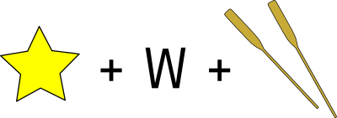
What does this mean?
What does this mean?
Notes:
3.Star Wars. https://openclipart.org/image/800px/60325
4. Love at first sight.

Slide 4
What does this mean?
BAD
WOLF
What does this mean?
D Movie
D Movie
D Movie
Notes:
Big Bad Wolf
3D Movie

Slide 5
What does this mean?
What does this mean?
Notes:
Cotton Candy
Thumbs Up to You

Slide 6
Think about:
What visual cues did you use to decipher the puzzle?
Did you rely more on the images, letters, or symbols?
How did context or prior knowledge help you solve the puzzles?
Were there any strategies that proved particularly helpful for solving the rebus puzzles?

Slide 7
Essential Question
What is a pictograph and how does it compare to written words?
How does your own culture influence your experiences with new information?
How does a visual dictionary help make story translations more accurate?

Slide 8
Lesson Objectives
Define a pictograph and compare its characteristics and functions to written words.
Explore how personal cultural backgrounds influence experiences with new information.
Assess the visual dictionary's role in improving story translation accuracy and its benefits for cross-cultural communication.

Slide 10
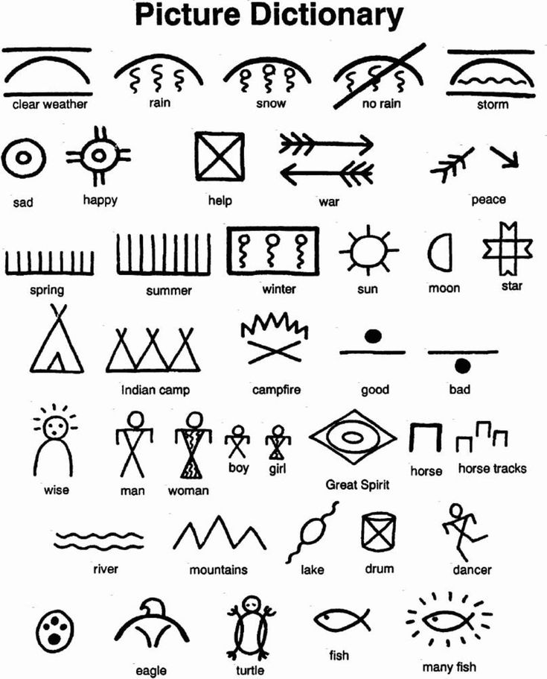
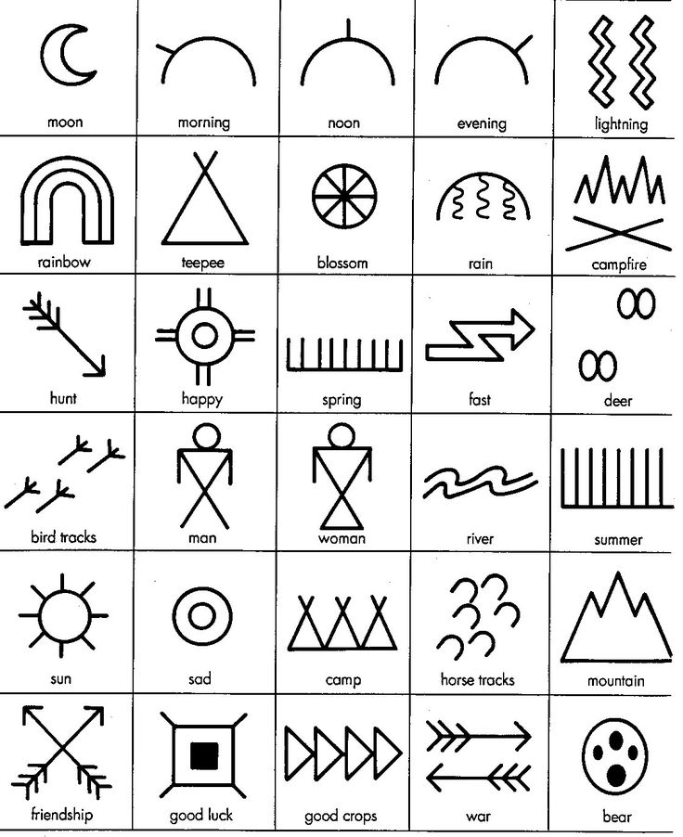

Slide 11
Why would Bear ask Eagle for help?

Slide 12
I Think, We Think
Look at pictures about Native American Culture.
Think about what you see and why it’s important to Native American culture.
Write your thoughts in the “I Think” column.
Talk with a partner or your team about what you think and look for ideas you both agree on.
Write what you all think in the “We Think” column.

Slide 14
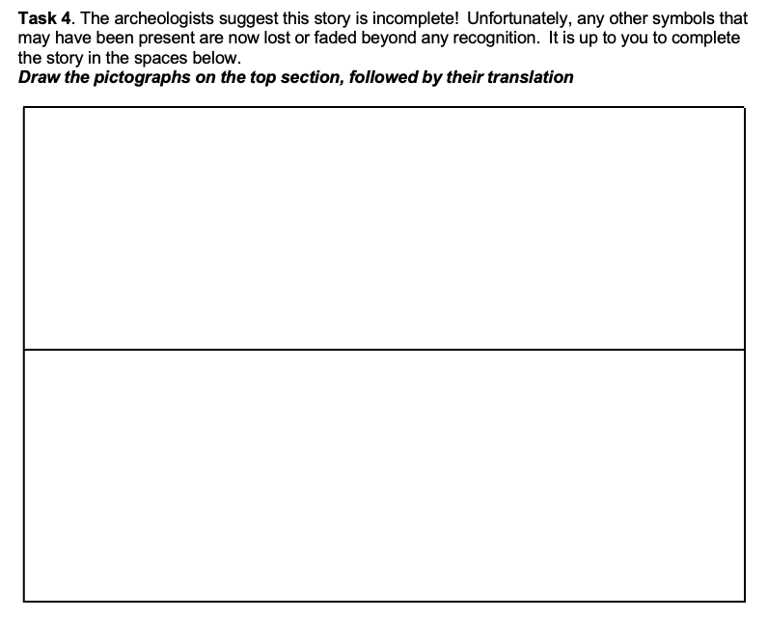

Slide 15
If you feel stuck, think about these ideas:
What knowledge could the wise man have that would make the fish return to the lake?
Does the wise man tell Bear and Eagle to do something specific or does he take action himself?

