Slide 2
The Tasty Shape of Contours
Exploring Basic Principles of Shape and Contour in Art

Slide 3
Surprise Quiz!!!
Number your paper 1-5.
Write down what you think the image is on the following slides.
Notes:
K20 Center. (n.d.). Card Sort. Strategies. https://learn.k20center.ou.edu/strategy/147

Slide 4
Notes:
Designed by Freepik.” www.freepik.com

Slide 5
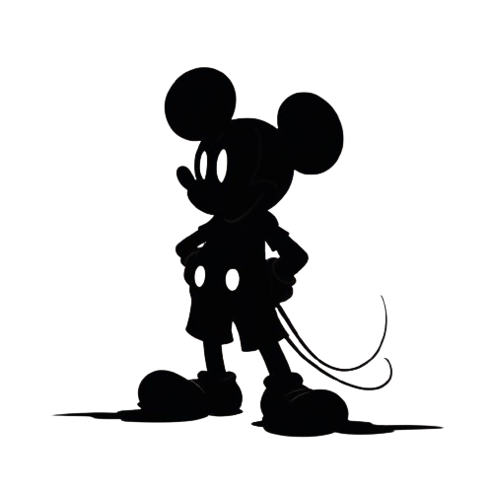
Notes:
Designed by Freepik.” www.freepik.com

Slide 6
Notes:
<a href="https://www.freepik.com/free-vector/statue-liberty-background_715990.htm#fromView=search&page=1&position=0&uuid=3d54ed20-3855-4463-8baa-de7a7bb3731d">Image by freepik</a>

Slide 7
Notes:
Designed by Freepik.” www.freepik.com

Slide 8
Notes:
Designed by Freepik.” www.freepik.com

Slide 9
Essential Question
Why is good contour important in visual art?

Slide 10
Lesson Objectives
Students will apply their creativity and design skills to develop unique contour designs.
Students will be able to understand why good contour is important in visual art.

Slide 11
Guidelines for Your Outline Drawing
Draw only the outline of your character.
Use your Chromebook or laptop to look up any required visual reference.
Draw the character outline 7-8" tall, taking up most of a standard sheet of paper.
Pose the character dramatically.
Simplify the outline as much as possible.

Slide 12
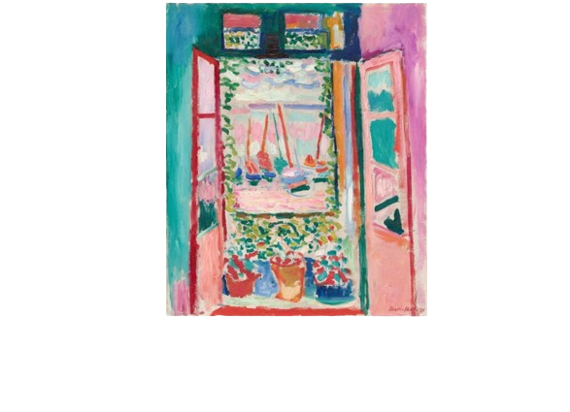
Contour
A contour line defines the outline of a form and hints at structure without using internal details. It is a fundamental basis of drawing.
Notes:
Images fly in when you click the return key or the arrow key
https://www.nga.gov/open-access-images.html
https://c1.staticflickr.com/7/6054/6868591240_491dc8f653_b.jpg
https://www.publicdomainpictures.net/pictures/40000/velka/sitting-children-silhouette.jpg

Slide 13
Making Your Cookie
Remove the cookie dough from the bag and press it on the wax paper in the cookie sheet.
Next, take some of the flour and rub the dowel rod with it. Then sprinkle a little flour on the dough and roll it out using the dowel.
After rolling out your dough into a large even sheet, retrieve the metal strap contour you created.
Use the strap contour as a cutter for the cookie dough, creating a large cookie shape.

Slide 14
Consider the Following:
What are some important shapes to include in the decoration? Think about character symbols or specific details that help with identification (Superman’s "S", LeBron James’ jersey number, etc.).
What colors do you want to use based on the shapes of the different details?
Do you want to trace a few copies of your original designs from (Day 1) to try out different ideas?
Use colored pencils to try different color combinations.

Slide 15
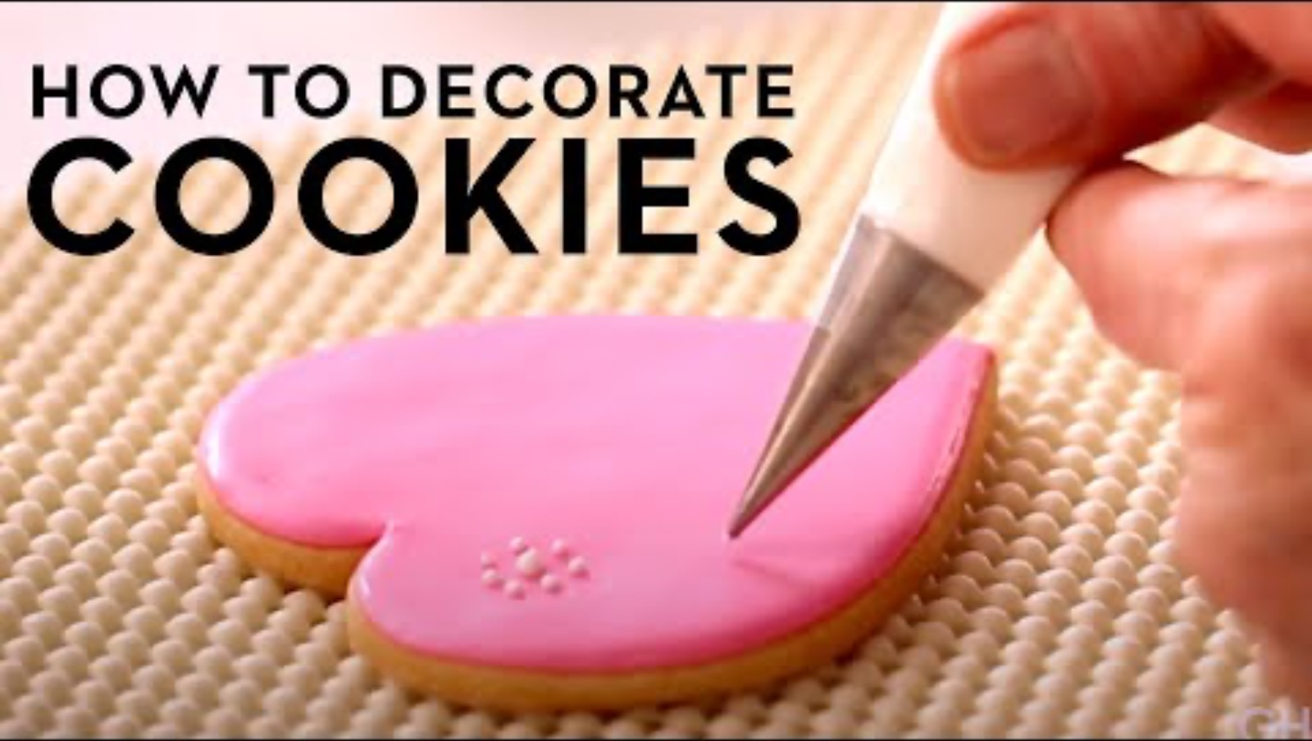
How to Decorate with Icing
Notes:
The video should help students understand how to color the icing, how to use the piping bags, and techniques to thin the icing for flood filling. It also shows why the color choices need to be limited to 3 and helps them strategize how to approach their decoration procedure. Should they use piping lines to color their cookies, or is flood filling preferable?

Slide 16
Gallery Walk
Take five sticky notes and a pencil with you.
View your classmates ‘Character Contour Cookies.’
Leave positive and constructive comments for 5 different Character Contour Cookies.
Be sure not to touch or taste the cookies.

Slide 17
3-2-1 Reflection
3 - What are three ways good contour is important in visual art?
2 - What are two things you learned about how the term “contour” relates to the element of shape? How did you apply this knowledge of art in designing and decorating to your character cookies?
1 - What is one thing you found interesting or surprised you?

